Slide 1
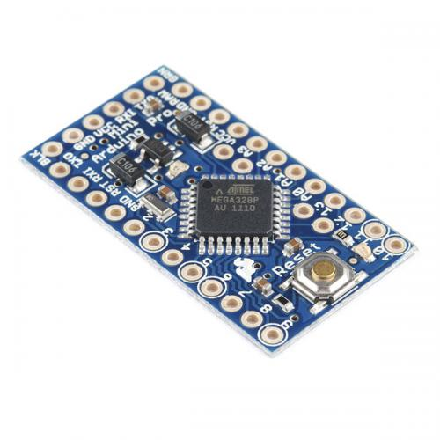
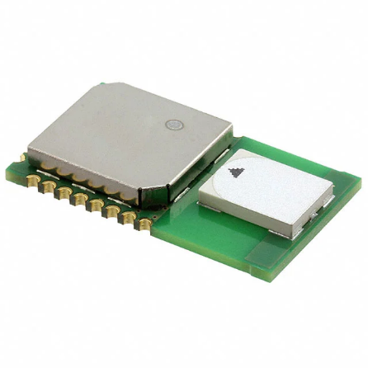
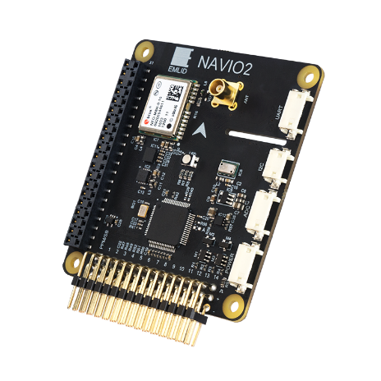
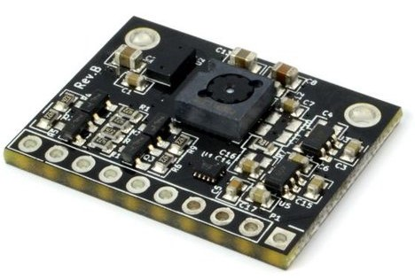
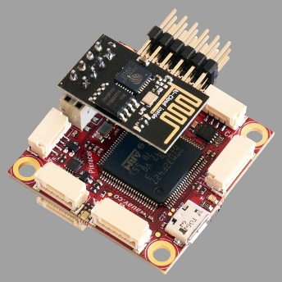

SPI
Arduino Pro Mini
DWM1000
Micro controller
I2C
UWB antenna
SPI
UART
I2C
NAVIO2
Arduino Pro Mini
PMW3901/VL53L0x
Optical flow
Distance sensor
Sensor board
USB
Raspberry Pi
Pixracer
Main computer
Fright controller

Slide 2


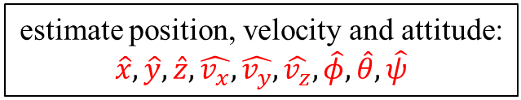
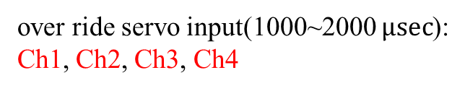

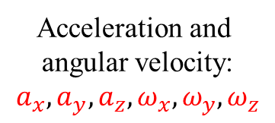
UWB Modules
distance between Anchors and Tag:
$$d_{1},d_{2},d_{3},d_{4}$$
Raspberry Pi
estimate position, velocity and attitude:
$$\hat{x},\hat{y},\hat{z},\hat{v_{x}},\hat{v_{y}},\hat{v_{z}},\hat{φ},\hat{θ},\hat{ψ}$$
NAVIO2
Distance Sensor
Acceleration and
angular velocity:
$$a_{x},a_{y},a_{z},ω_{x},ω_{y},ω_{z}$$
altitude: h
position PID controller
set position: $x_{d},y_{d},z_{d}$
calculate desired angle
$$φ_{d},θ_{d},ψ_{d}$$
change angle to servo signal
over ride servo input(1000~2000 $μsec$):
Ch1, Ch2, Ch3, Ch4
Pixracer
Attitude controller

Slide 3


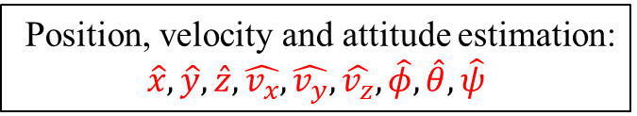

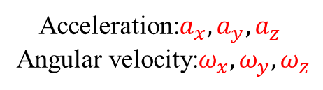
Distance Sensor
UWB Modules
Altitude: h
Distances between Anchors and Tag:
$$d_{1},d_{2},d_{3},d_{4}$$
Position, velocity and attitude estimation:
$$\hat{x},\hat{y},\hat{z},\hat{v_{x}},\hat{v_{y}},\hat{v_{z}},\hat{φ},\hat{θ},\hat{ψ}$$
NAVIO2
Acceleration:$a_{x},a_{y},a_{z}$
Angular velocity:$ω_{x},ω_{y},ω_{z}$
Position PID controller
Set position: $x_{d},y_{d},z_{d}$
Desired angle calcuration
$$φ_{d},θ_{d},ψ_{d}$$
Change angles to servo signal
Raspberry Pi
over ride servo input(1000~2000 $μsec$):
Ch1, Ch2, Ch3, Ch4
Pixracer
Attitude controller

