Slide 1
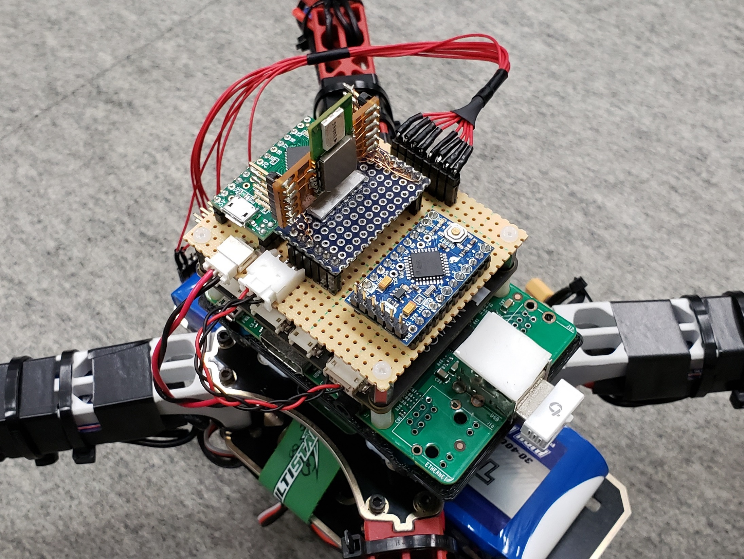
UWB antenna
Arduino Pro Mini
for UWB
Power from battery
UART connector

Slide 2
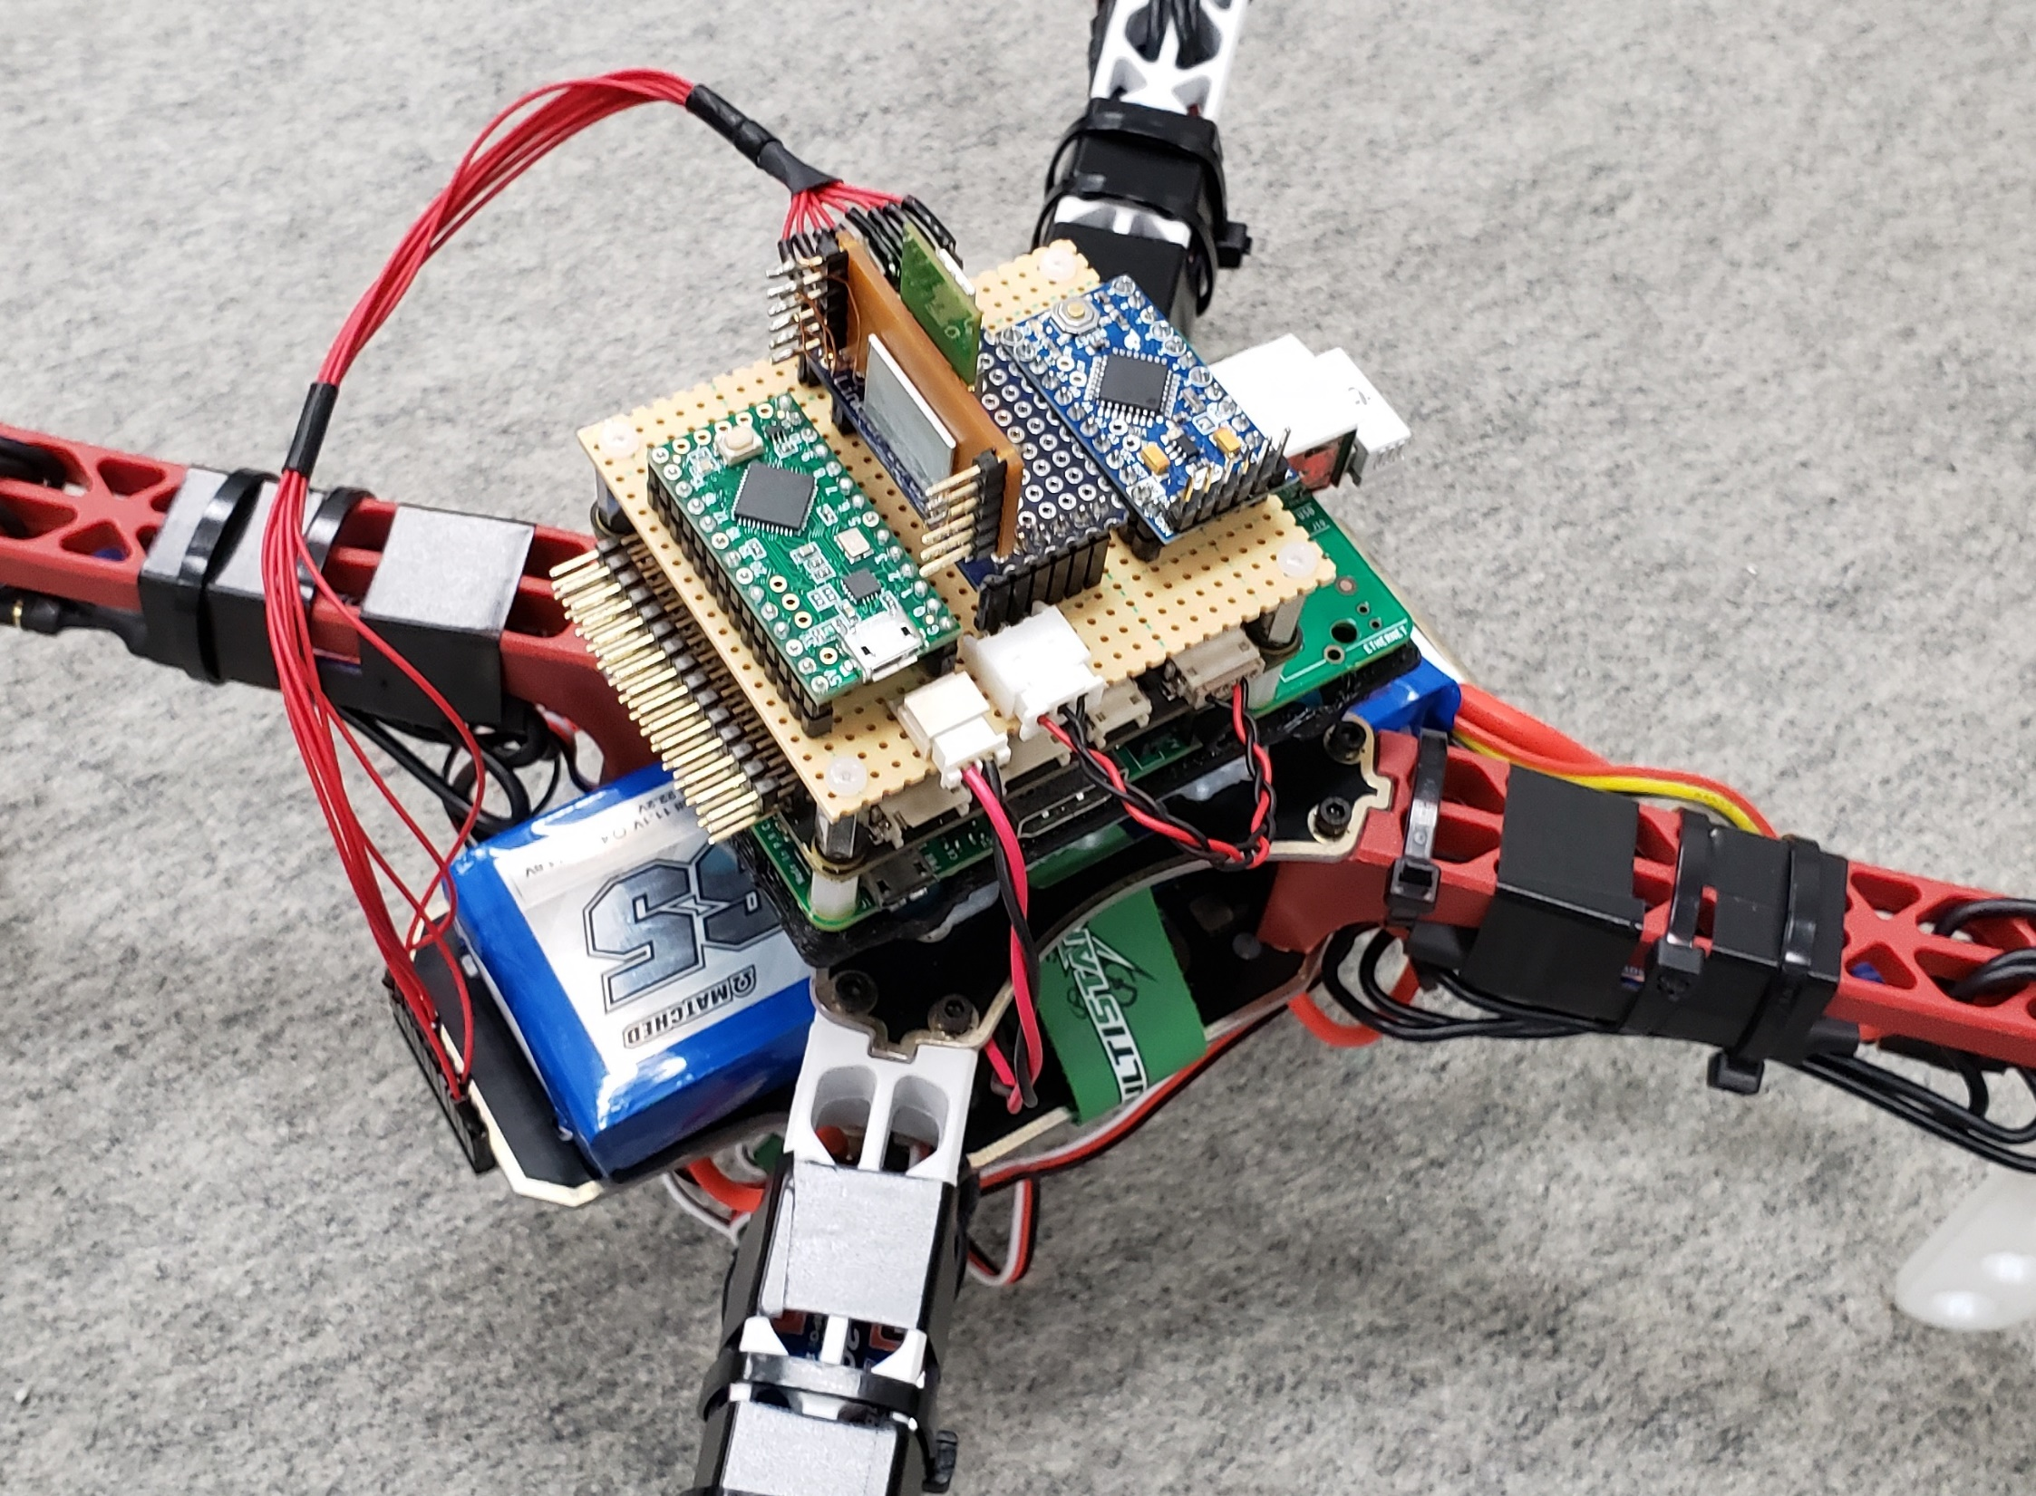
Teensy LC
for Optical flow sensor
Optical flow sensor

Slide 3
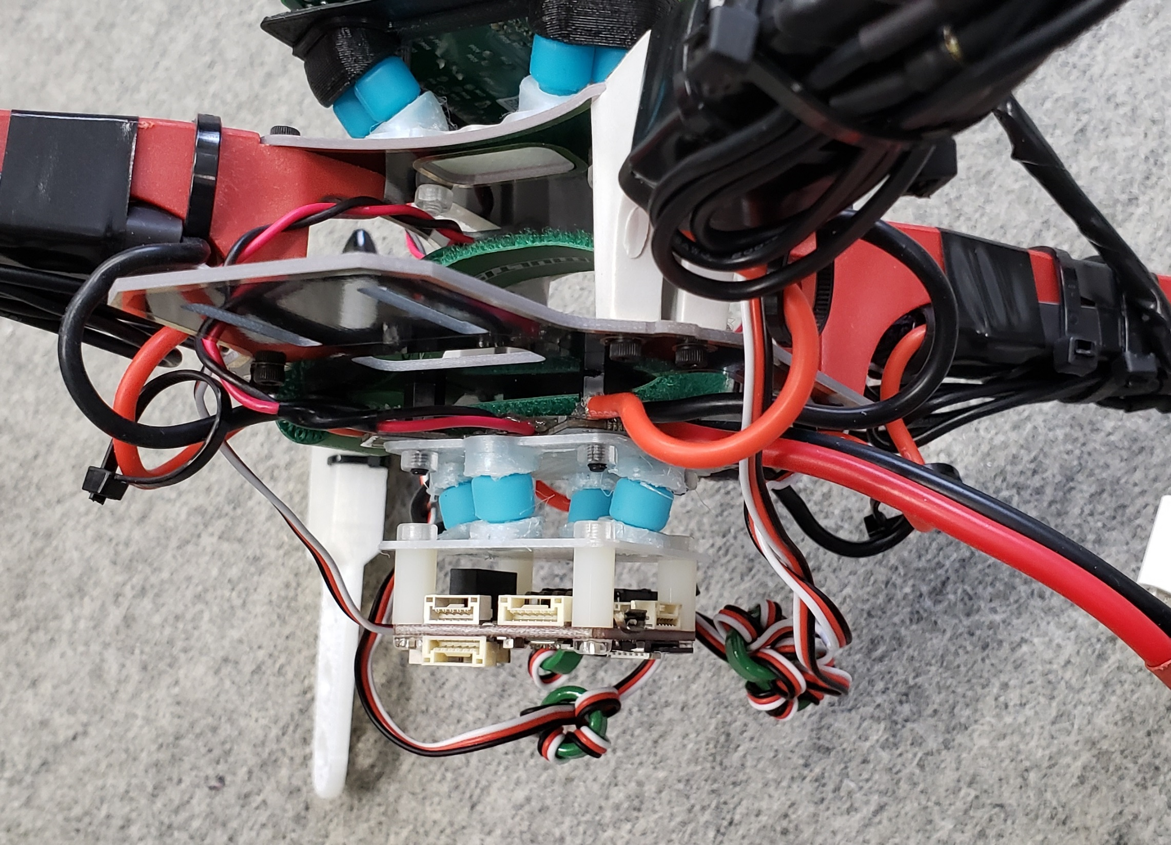
Damper
Pixracer

