Slide 1
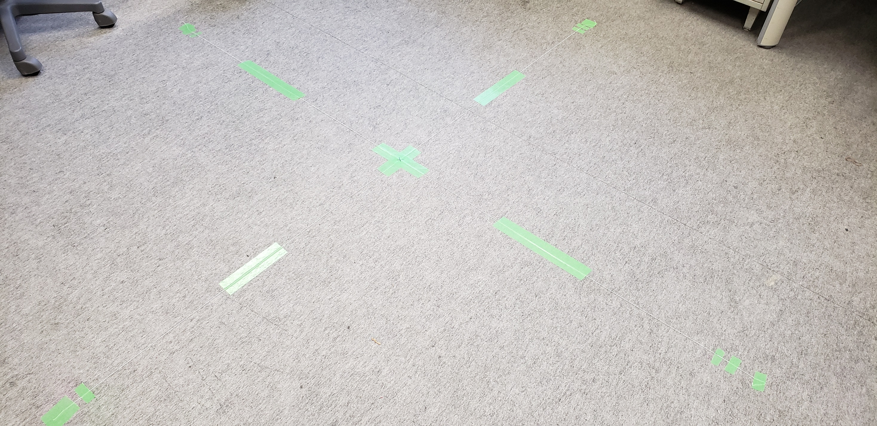
Origin
1m
1m
Reference point

