Slide 1

Machine Learning and Artificial Intelligence (ML/AI)
A Gentle Introduction
Sanjay Dorairaj
CIS Faculty, San Jose City College
Picture source: https://www.nature.com/collections/zbkpvddmhm

Slide 2
Agenda
Fundamentals
DEMO
A historical perspective on pattern recognition.
Linear Regression
to Neural Nets
Career
Pathways
Journey through advancing levels of Machine Learning
Why talk about AI and ML?
Mathematical models
Machine Learning
Applications
Introduction
Mathematical solutions to prediction - OLS & Gradient Descent
Some powerful AI/ML examples

Slide 3
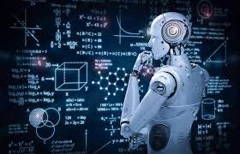
Why talk about AI and Machine Learning?

Slide 4
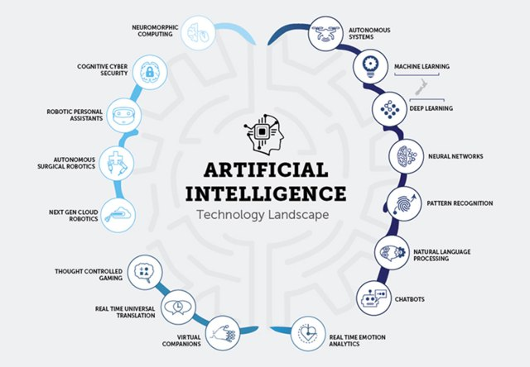
Source: https://dzone.com/articles/ai-and-machine-learning-trends-for-2018-what-to-ex

Slide 5
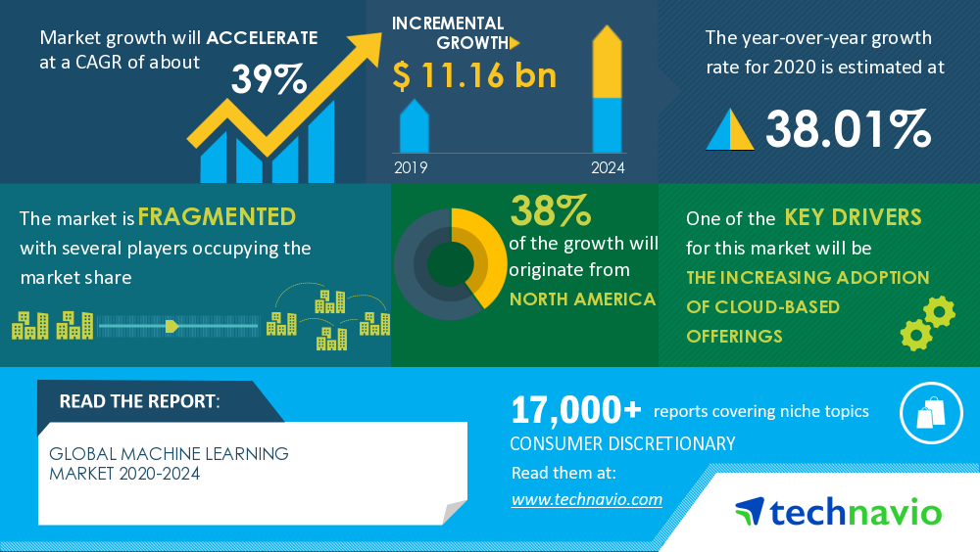
Source: https://www.businesswire.com/news/home/20200327005177/en/Global-Machine-Learning-Market-2020-2024-Increasing-Adoption-of-Cloud-Based-Offerings-to-Boost-the-Market-Growth-Technavio

Slide 6
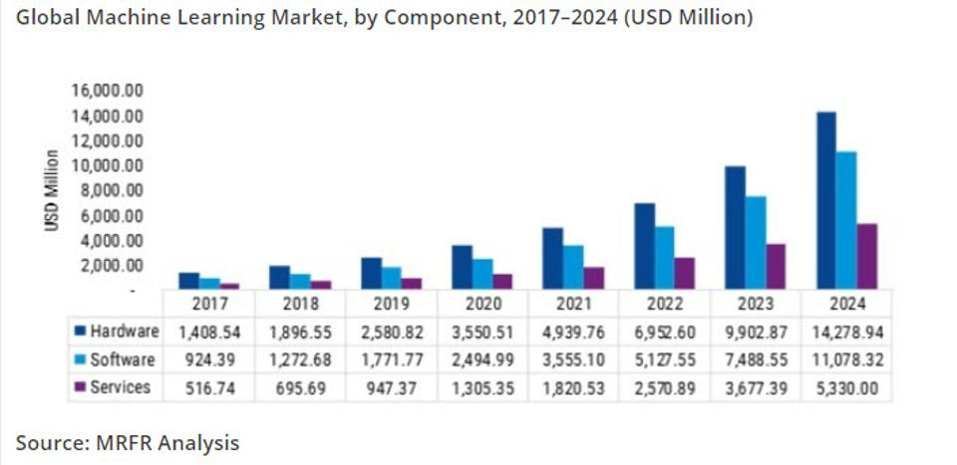
Source: https://www.forbes.com/sites/louiscolumbus/2020/01/19/roundup-of-machine-learning-forecasts-and-market-estimates-2020/?sh=77930c355c02

Slide 7
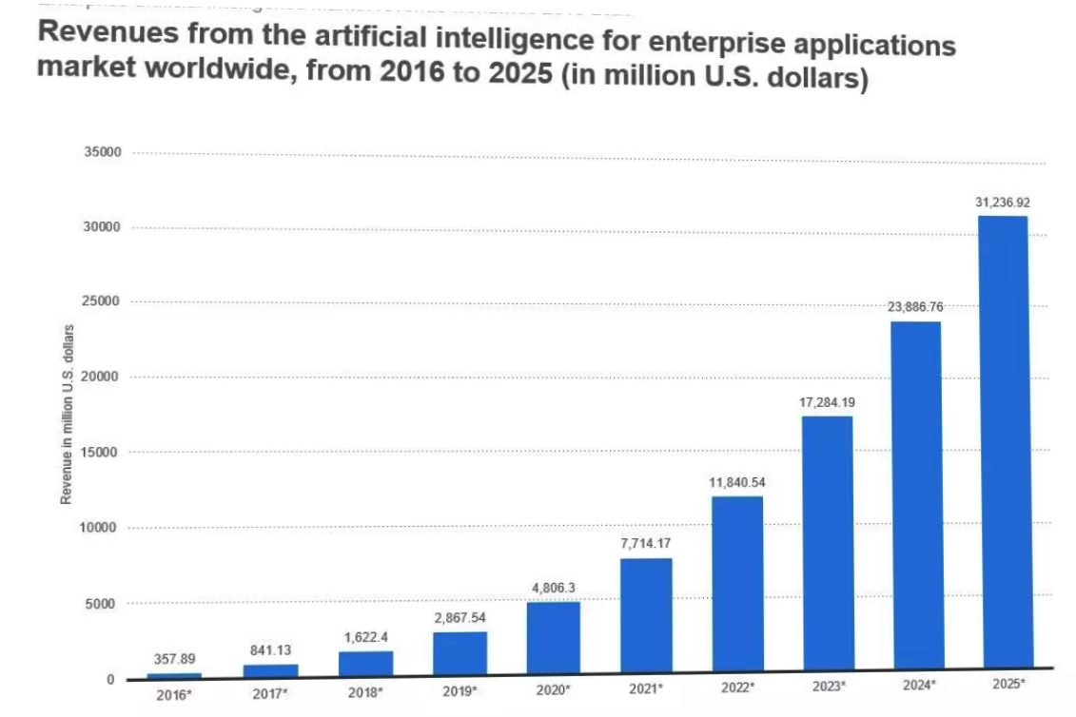
Source: https://laptrinhx.com/top-7-machine-learning-app-development-companies-supporting-sme-enterprises-ml-adoption-in-2020-584702710/

Slide 8
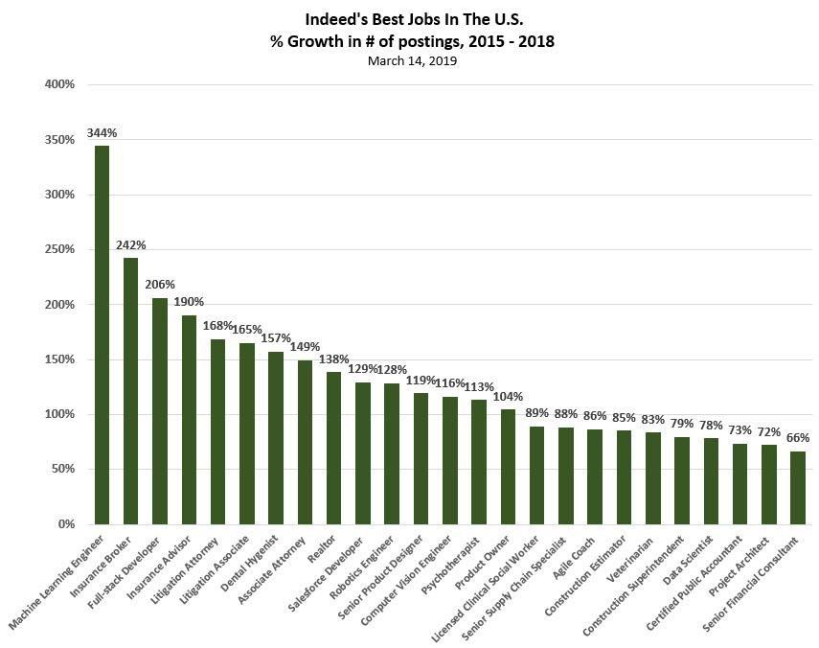
Source: https://www.forbes.com/sites/louiscolumbus/2019/03/17/machine-learning-engineer-is-the-best-job-in-the-u-s-according-to-indeed/?sh=1ddab5d87bb0

Slide 9

The Fundamentals

Slide 10
Predictions
As humans, we make numerous predictions on a daily basis
Our ability to make these predictions allow us to be functional and productive
Historical learnings and experiences allow us to identify and recognize patterns, which in turn allow us to make predictions

Slide 11
Traditional approaches to Prediction
For a long time, Linear Regression (OLS) has been the primary tool for prediction.
It typically involves finding a line of best fit using the method of least squares
This method suffers from several problems
It breaks down when multiple independent variables exist
It is computationally intractable as the number of independent variables increase or as the data points increase resulting in sampling smaller sets of data and parameters.
Valid solutions do not always exist in all cases.
Source: https://en.wikipedia.org/wiki/Linear_regression

Slide 12

Mathematical Models

Slide 13
The Machine Learning Approach
The machine learning approach to prediction is based on incremental problem solving
Rather than attempt to solve for the all the unknown coefficients with all known data, we strive to close in on the most optimal solution in an incremental manner
Optimal solution reached
Updated
Coefficients
Update coefficients on next data-batch
(training)
Validate coefficients on independent data-set
(testing)
Coefficients for prediction
(model and weights)
Optimal solution NOT reached

Slide 14
Visualizing Convergence and Validation
Cost Functions and Gradients
Training and Validation
Source:
https://towardsdatascience.com/machine-learning-fundamentals-via-linear-regression-41a5d11f5220
Source: https://stats.stackexchange.com/questions/292283/general-question-regarding-over-fitting-vs-complexity-of-models

Slide 15

Linear Regression to Neural Nets

Slide 16
Linear Regression Algorithm
Linear Regression algorithms generate a model that makes predictions for continuous output values
This is similar to the types of predictions made by traditional mathematical models based on Ordinary Least Squares (OLS), although the algorithm uses the machine learning approach.
Uses of Linear Regression
House Prices
Stock Prices
Product Prices

Slide 17
Logistic Regression
Logistic Regression is a modification to the Linear Regression algorithm that allows for the prediction of categorical values
Example:
Single Class Classification: True or False
Multiple Class Classification: Dog, Cat, Lion etc
Source: https://www.saedsayad.com/logistic_regression.htm

Slide 18
On to simple neural networks
Neural Networks attempt to model the behavior of the human nervous system
The Human Brain
A Neural Network
Source: https://www.123rf.com/photo_90941320_stock-illustration-human-brain-and-neuron-cells-on-abstract-blue-background-3d-illustration.html
Source: https://towardsdatascience.com/applied-deep-learning-part-1-artificial-neural-networks-d7834f67a4f6

Slide 19
Neural Network as an aggregation of Logistic Regression blocks
Each block is Logistic Regression block
Intermediate blocks are called hidden units
Multiple layers make this a deep net
Fewer layers form a shallow net
Together, the blocks can learn complex patterns
https://en.wikipedia.org/wiki/Universal_approximation_theorem

Slide 20
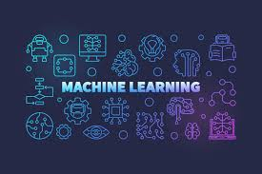
ML/AI Applications

Slide 21
Document Intelligence
Word2Vec/
BERT
Language Model
Training
Optical Character Recognition
Entity Extraction
Vectorization
Model
Algorithms
Language Model: BERT/Glove/Word2Vec
Prediction: Multilayer Perceptron, Recurrent Neural Nets, Sequence to Sequence networks
Prediction

Slide 22
Fault Prediction
Batched Data
(Big Data)
Data Transform
Data Transform
Training
Queue (Kafka)
Model
Streaming
Micro-
Batching
Data Transform
Prediction
Algorithms
Prediction: Distributed Random Forest, Logistic Regression, SVM, Neural Nets

Slide 23
Recommendations Systems
Movie Recommendations
Source: https://data-flair.training/blogs/data-science-r-movie-recommendation/

Slide 24
Recommendations
- Item-Item & User-User Similarity
Source: https://buildingrecommenders.wordpress.com/2015/11/18/overview-of-recommender-algorithms-part-2/

Slide 25
Recommendation Systems Pipeline
User viewing data
Queue (Kafka)
Streaming
Update Similarity
Matrix
Recommend
Algorithms
Collaborative Filtering, Cosine Similarity

Slide 26
Machine Translation Algorithm
Source: https://towardsdatascience.com/seq2seq-model-in-tensorflow-ec0c557e560f

Slide 27
Typical Machine Learning Pipeline
Conceptual Flow
Data Preprocessing
Split into train and test sets
Select & Configure Algorithm Params
Train
(train data)
Validate
(test data)
Equivalent methods in sklearn/pandas
Load Data
read_csv
Split into train and test sets
train_test_split
Select & Configure Algorithm Params
(typically in model constructor)
Train
fit
Validate
predict or score
If the training does not yield an optimal solution
Get additional data
Use a different machine learning algorithm
Fine tune machine learning algorithm parameters

Slide 28
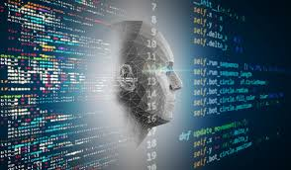
Machine Learning Demo

Slide 29
CIS-107 – Foundations of Data Science Demo
Predicting Fraudulent Bank Notes
Predicting Breast Cancer
Predict Chronic Kidney Disease

Slide 30
Income Prediction Demo
Source Code: https://bit.ly/2vPi9Kw
Data obtained from US census bureau based on the 1994 census
Prediction task is to determine whether a person makes over 50k USD/year
https://archive.ics.uci.edu/ml/machine-learning-databases/adult/adult.data
Total data points - 32,561
Predictors
Age, workclass, education, education-num, Marital-status, occupation, relationship, race, sex, capital-gain,capital-loss: hours-per-week, native-country
Predicted value, also known as the response value
<50k
>=50k

Slide 31

AI and Machine Learning Career Pathways

Slide 32
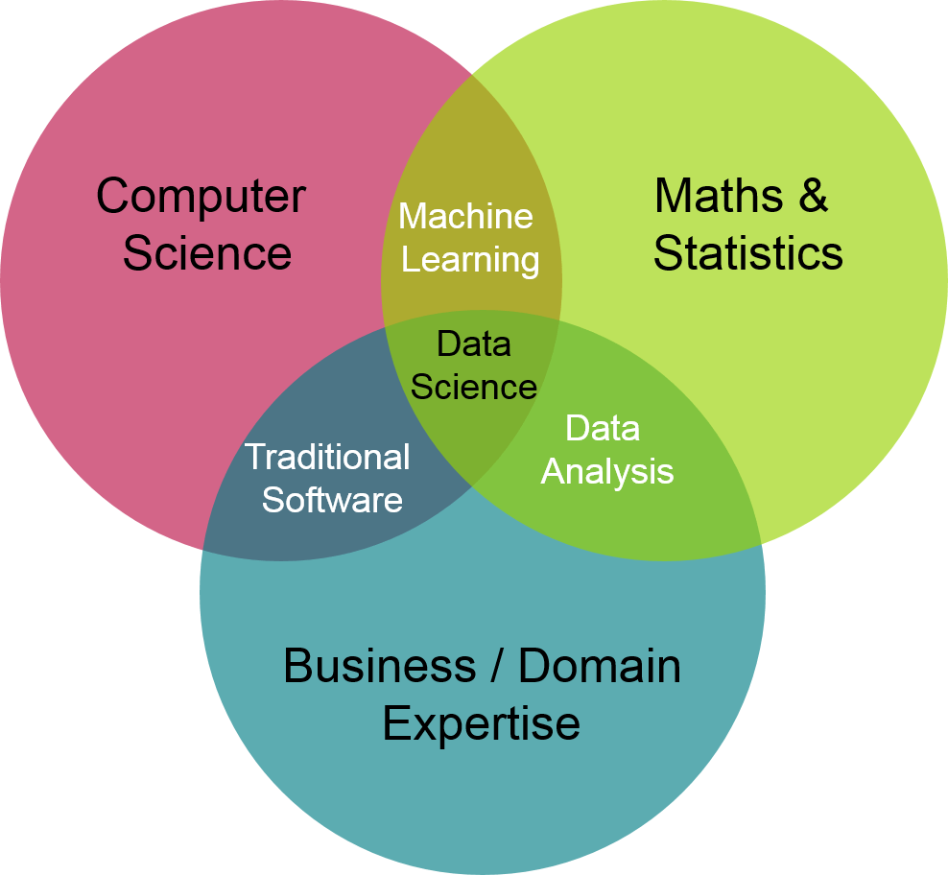
Source: https://www.mygreatlearning.com/blog/data-science-tutorial/

Slide 33
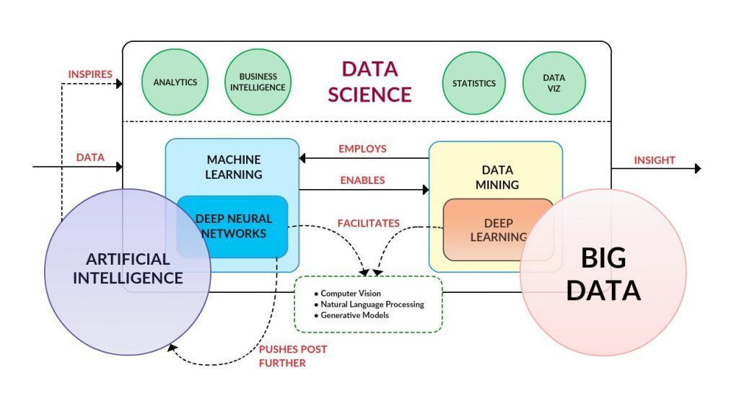
Source: https://www.takethiscourse.net/big-data-applications-machine-learning-at-scale/

Slide 34
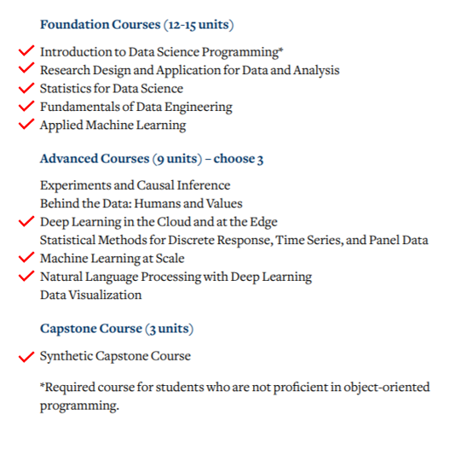
Source: https://towardsdatascience.com/review-on-uc-berkeley-master-of-information-and-data-science-mids-program-fc4ae2ef7f9c

Slide 35
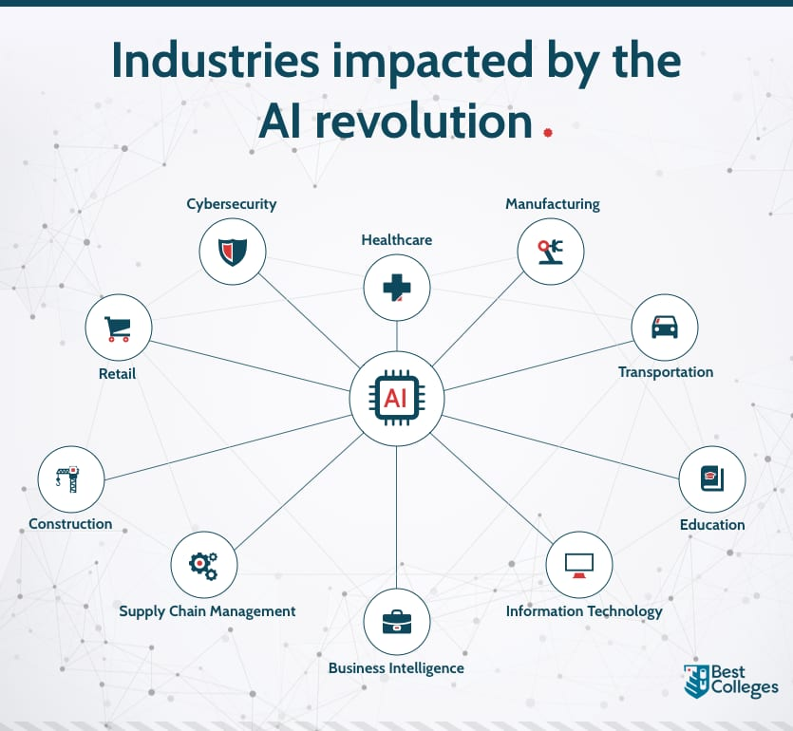
Source: https://www.bestcolleges.com/blog/future-proof-industries-artificial-intelligence/

Slide 36
Questions?

Slide 37

Thanks!
Feel free to reach out to me for any questions at sanjay.dorairaj@sjcc.edu

