Slide 1

California Voting Trends
Adam Reilly, Carlee Price, Sanjay Dorairaj

Slide 2
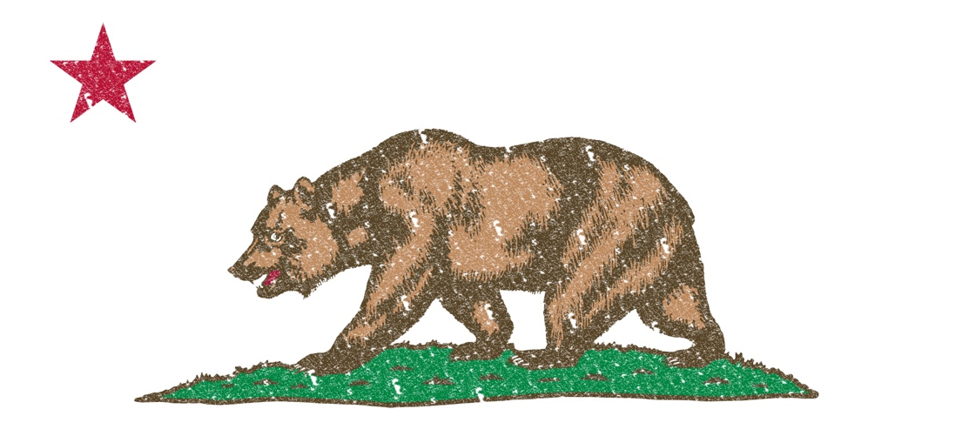
Goals
Analyze California’s election history
Key Questions
How do “Consistent Voters” different demographically from the overall population?
How do “New Voters” differ?
What was the effect of crossover voters on the most recent elections?
Other Questions of Interest
What are the most/least politically engaged counties and what sets them apart
Do any counties stand out as predominantly male/female, old/young, foreign/native-born?

Slide 3
Data Source
Election data made available by the State of California Public Voter Registration Data Request (PVRDR)
Consists of
PVRDR VRD - Voter Registration Data
PVRDR VPH - Voter Participation History
PVRDR PD - Political District
[root@ip-172-31-50-19 election_results]# ls -latrh 109* | grep ".txt" -rw-rw-r-- 1 w205 w205 4.0G Mar 6 06:23 109-6704-59-pvrdr-vrd-20170228-0952_NH.txt -rw-rw-r-- 1 w205 w205 14G Mar 6 06:34 109-6704-59-pvrdr-vph-20170228-0952_NH.txt -rw-rw-r-- 1 w205 w205 22G Mar 6 06:49 109-6704-59-pvrdr-pd-20170228-0952_NH.txt

Slide 4
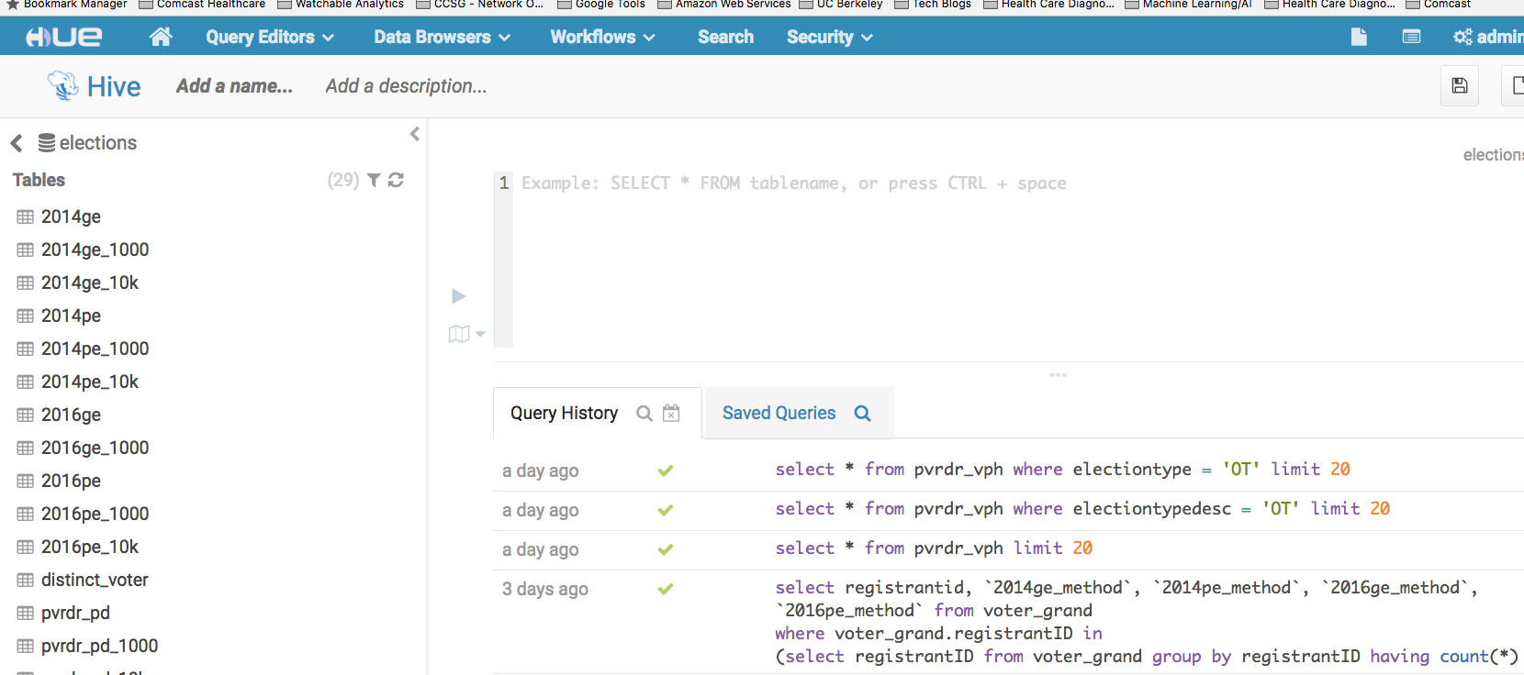
Data access for analysis - HUE/HIVE

Slide 5
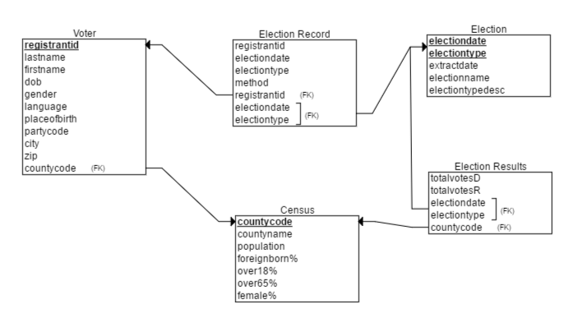
Entity Relationship diagram (DRAFT)

Slide 6
PROJECT STATUS - EDA & TRANSFORMATIONS
Extracted 20GB plus voter registration data into individual components
Data Hosted on HDFS on AWS EC2 instance
Platform leverages Hue/Hive for shared access to data and SQL query support.
Primary focus has been extracting, cleaning, organizing, EDA and formulating research questions

Slide 7
challenges
Incompatible file format of original data extract
Installed evaluation of Winzip to extract zipx file
Large table sizes
Created several downsampled versions of files for analyzes
Sparsely populated data
Looked to use gender and race but noticed that columns were sparsely populated. Investigating use of genderize.io to auto-populate Duplicated Data
Duplicated data
Method of voting initially considered for analysis but likely to be dropped due to cases where the same individual shows up for both “voting my mail” and “voting in person”.
Miscellaneous
OpenRefine inability to handle large files sizes.
Issues with Hadoop when restoring AMI on a larger EC2 instance

Slide 8
NEXT STEPS
Proceed with crystallizing/answering research questions

