Slide 1
Mockups

Slide 2
Mockup - 1
Product Search and Recommendations

Slide 3
Mockup-1
Provide 2 views – Product Explorer and Recommendation
Both views default to a product with the highest nutrient score
Product Explorer
Allows user to look for a product and search for related products
3-d Product Box view defaults to image of the product
Selecting a product changes to the product box view to selected product
Selecting a nutrient changes similar products based on selected nutrient
Recommendation View
User selects a food category, nutrient and threshold
Recommendations are displayed based on selections
User can select a product and look for other similar products based on selection

Slide 4
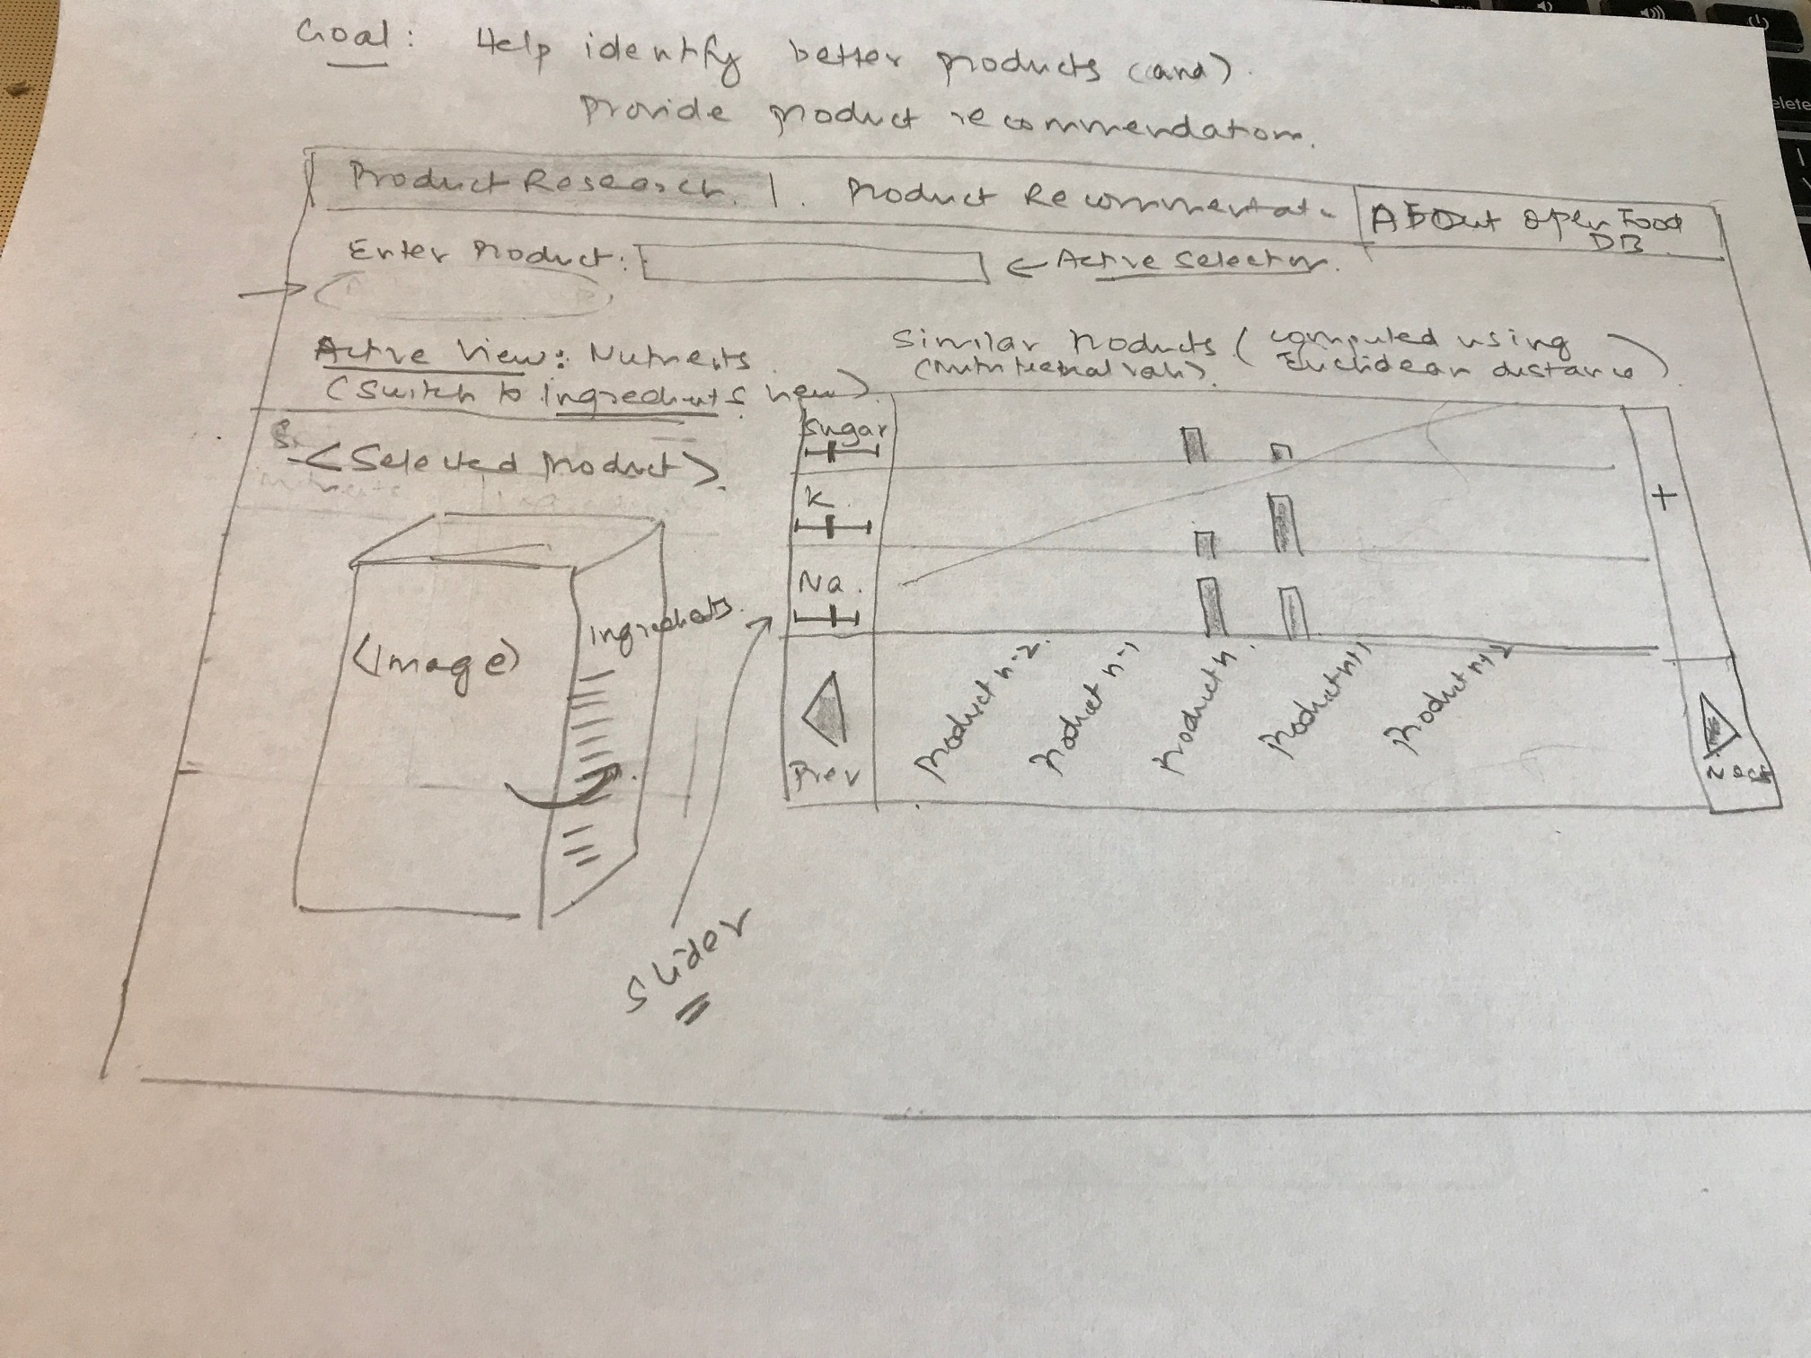
Iteration 1

Slide 5
Iteration 2

Slide 6
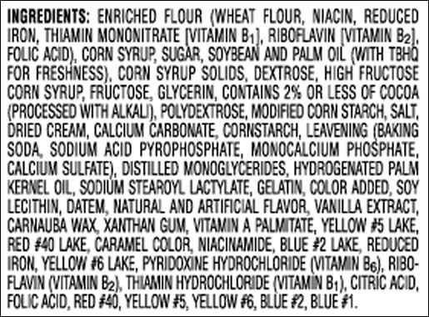
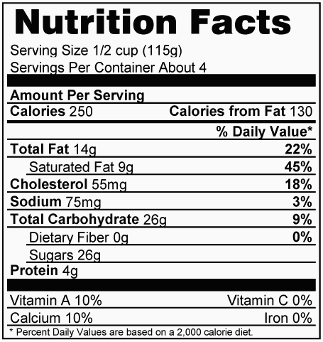
Food Explorer
`
Search
Recommendations
Fat selected
Enter Product…
More products
FAT
SUGARS
PROTEINS
Watermark
PRODUCT
PRODUCT
PRODUCT
This product selected
More Nutrients

Slide 7
`
Search
Recommendations
Select Product Category…
Select Criteria
Select Range
FAT
SUGARS
PROTEINS
PRODUCT
PRODUCT
PRODUCT

Slide 8
Mockup - 2
Similar Products

Slide 9
Mockup-2
Shows winners and losers to encourage/discourage positive and negative players respectively
Default product is the best product of the day
Products at the bottom are healthier options
User can select products on the left/right or bottom and change focus to that product
Changing a product causes healthy recommendations to change

Slide 10
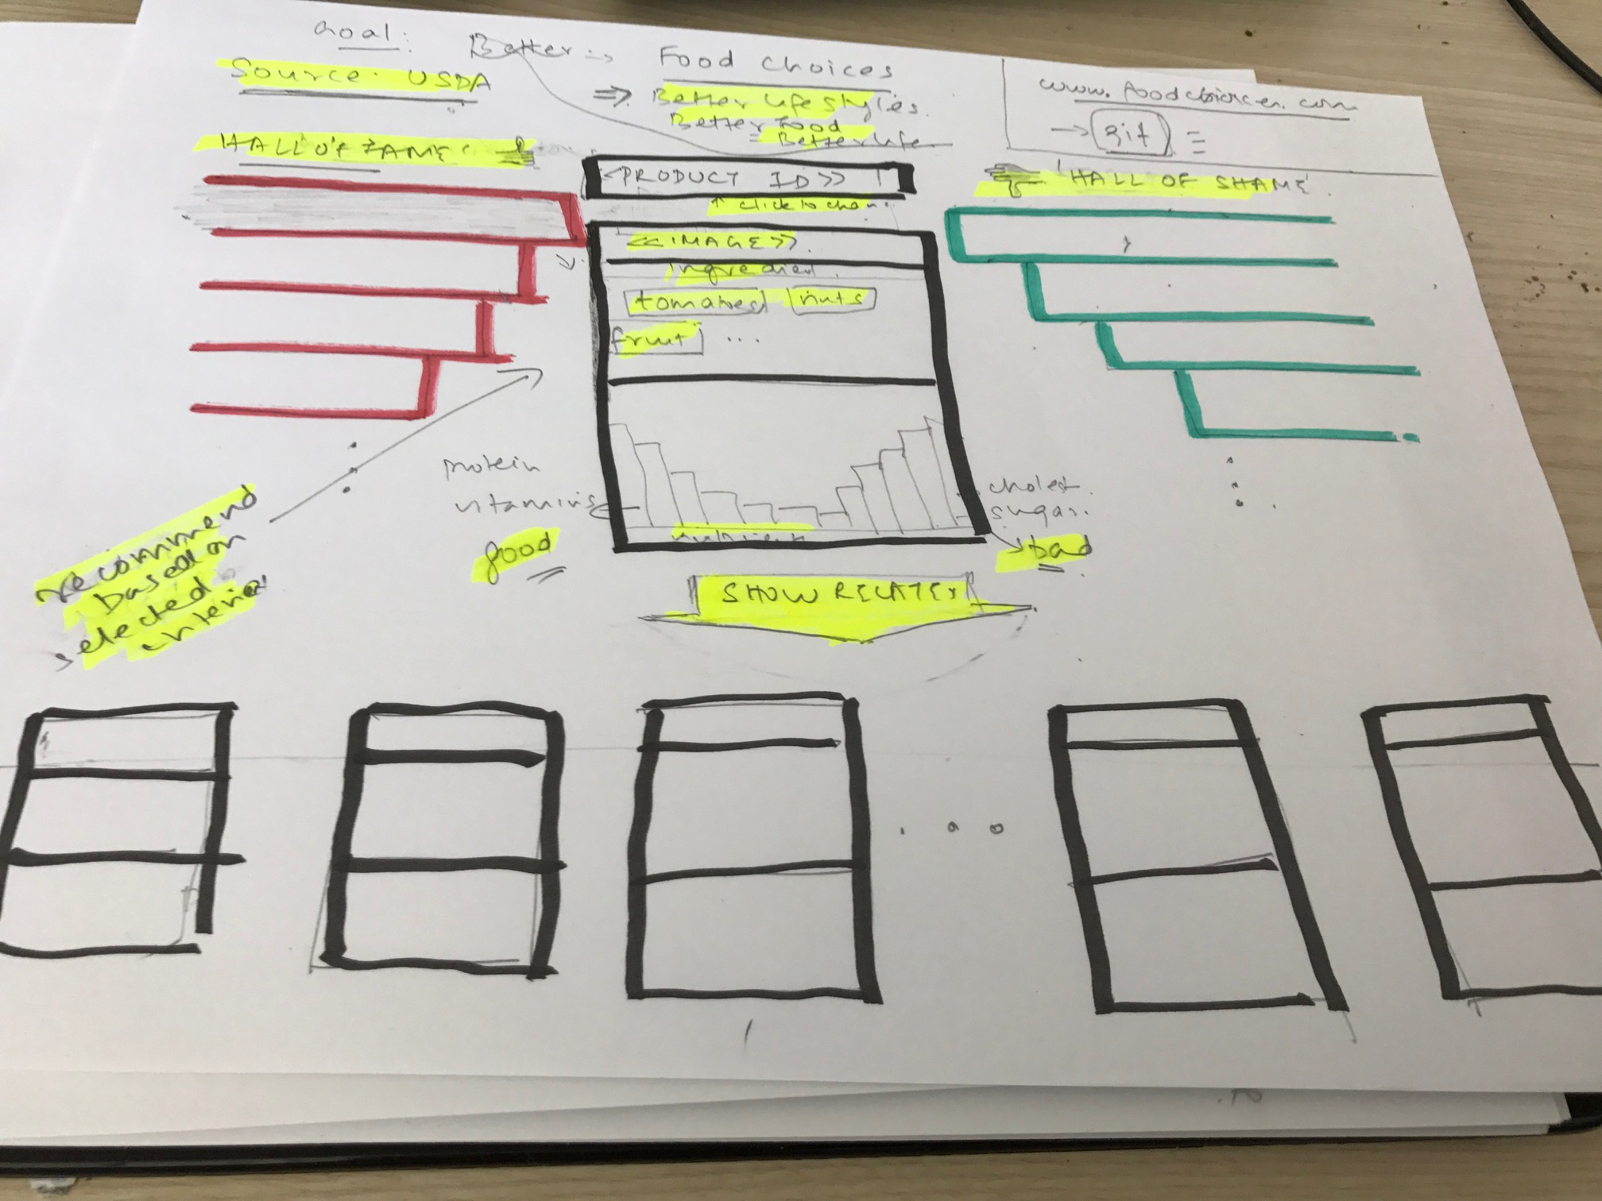
Iteration 1

Slide 11
Iteration 2

Slide 12

Better Foods for a Better Life
Winners
<<Active Product>>
Click here to change…
Losers
Product 1
Product 1
Product 2
Product 2
Product 3
Product 3
Product 4
Product 4
Better Choices
<<Product>>
<<Product>>
<<Your Product>>
<<Product>>
<<Product>>

Slide 13
Insights from the discussions
Focus on healthier options rather than showing a spectrum of good to bad options
Finding similar products based on similar ingredients
Preparing several similarity matrices with ordered sets of similar products for each product by food category to allow for faster navigation
Limiting the number of products that are displayed to few rather than many to avoid confusing the user
Displaying a default product rather than allowing the user to select a product the first time. This allows users to play with the tool without having any knowledge of specific products

