Slide 1
Amazon Reviews Analysis Big Data and Cloud Computing
Dora Jiayue Li

Slide 2

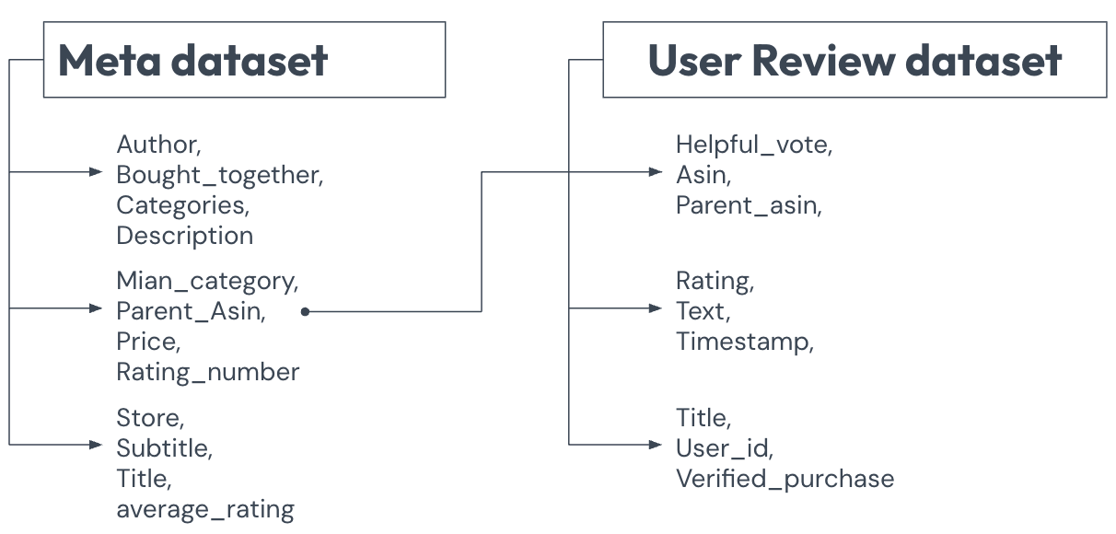
Executive Summary
As AI is getting better at writing coherently like a human, it’s easier to AI-generate a bunch of fake reviews on Amazon to promote products.
So this project aims to provide detailed analysis on two Amazon datasets from 2000 to 2023, total 285 months, for the purpose of investigating whether AI technologies contribute to redundant product reviews, and if these be detected using big data scalable similarity-based analysis.

Slide 3
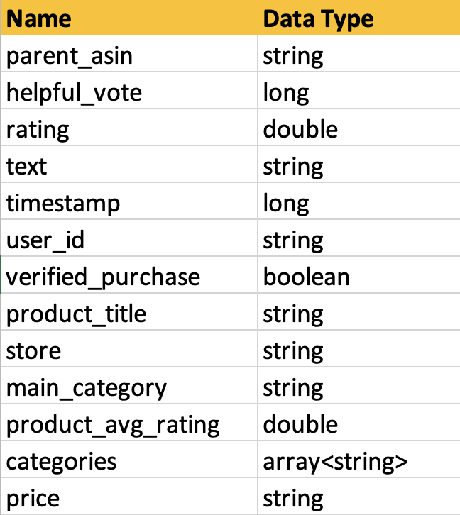
Methodology
I kept these columns because they are essential for analyzing user purchases, reviews, ratings, and prices, enabling comprehensive exploratory analysis of review patterns across the combined datasets.
Data cleaning & filtering
Detected 1% duplicate data
Found the duplication filtered through timestamp and user_id and only kept one.
Removed columns with large number of null values
Removed records with missing categories, ratings, product title, timestamps, or join keys
Joining 2 datasets
Selected only the most essential columns

Slide 4
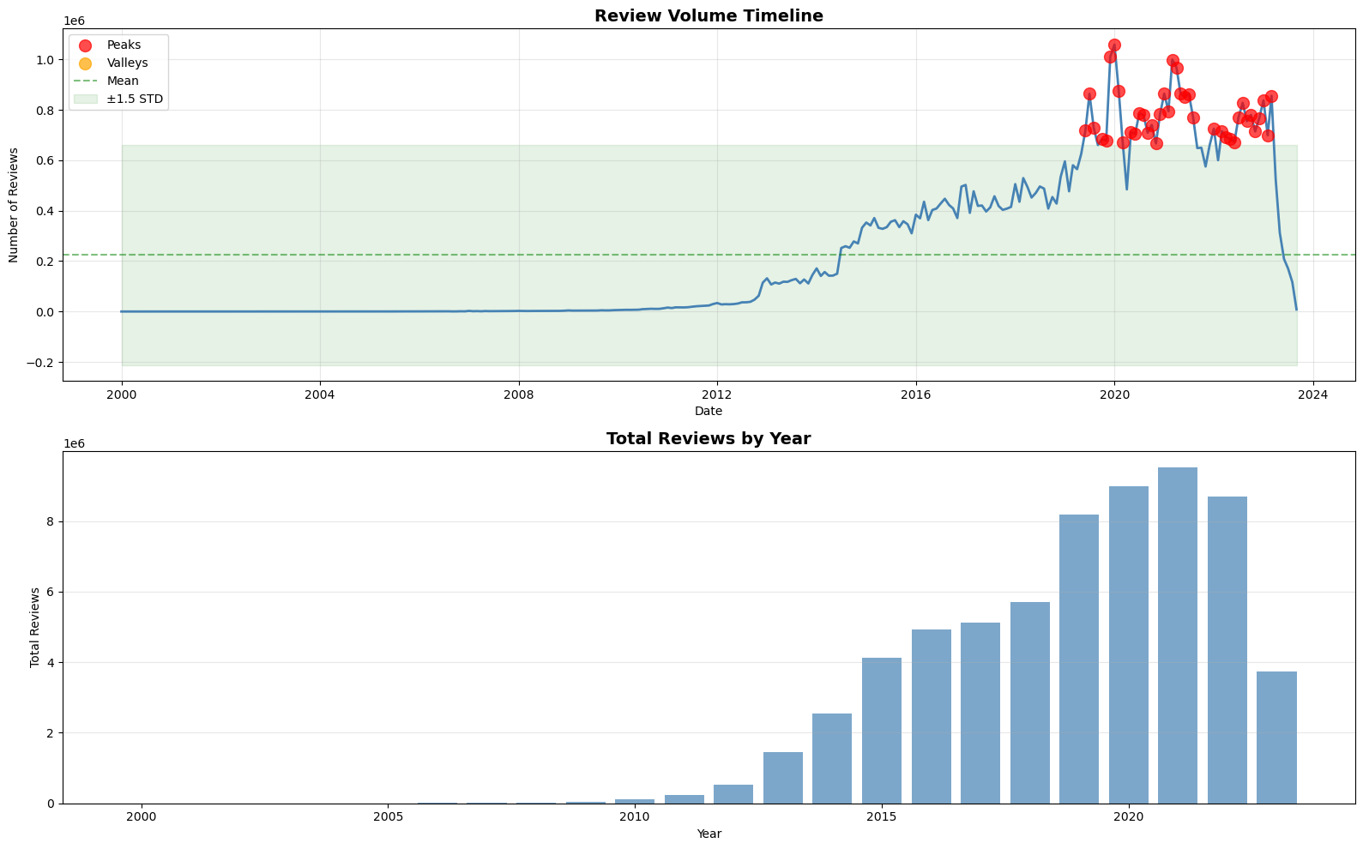
Time Series Analysis
No significant gaps and outliers noticed in the timeline analysis.
My analysis focus on reviews from 2000 to 2023. There are very few reviews from 2000 to 2012, and number of reviews rise from 2012 likely due to increasing use of online shopping.
The amount of reviews peaked in 2019-12 and 2020-01 corresponding to starting of COVID during which people’s lifestyle dependent on delivery from Amazon. Similarly there are spikes in 2021-03 and 2021-04 overlapping the COVID lockdown.

Slide 5
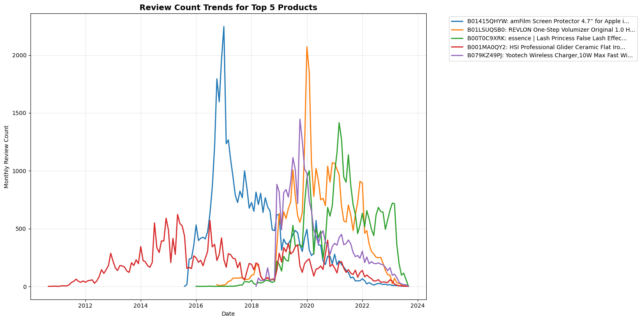
Top 1-5 products with most reviews
Popular items include Phone protector, beauty products.
amFilm Screen Protector for Apple iPhone 8/7 (4.7”)
REVLON One-Step Volumizer Original 1.0 Hair Dryer and Hot Air Brush
essence Lash Princess False Lash Effect Mascara
HSI Professional Glider Ceramic Flat Iron Hair Straightener
Yootech Wireless Charger 10W Max Fast Charging Pad

Slide 6
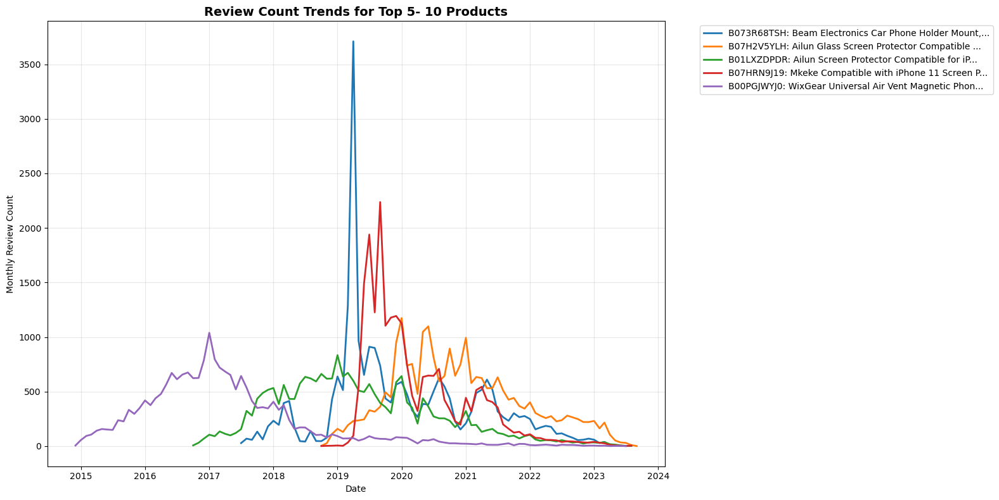
Top 6-10 products with most reviews
Mostly electronics related products
6. Beam Electronics Car Phone Holder Mount, Phone Car Air Vent
7. Ailun Glass Screen Protector Compatible for iPhone 11/XR, 6.1
8. Ailun Screen Protector Compatible for iPhone 8 Plus, 7 Plus, 6
9. Mkeke Compatible with iPhone 11 Screen Protector
10. WixGear Universal Air Vent Magnetic Phone Car Mount Holder

Slide 7
Categories that have most reviews
1. All Beauty
3. Automotive
Peaked in Winter
(Dec - March) sales season
2. Cell Phones & accessories
Spread Out throughout the year
Peaked in Jan & Dec due to holiday gifts
Other highly reviewed categories:
Health & personal care
All electronics
Amazon home

Slide 8
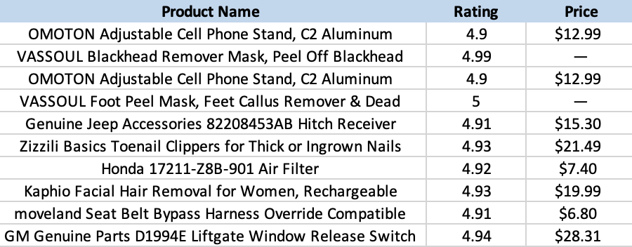
Ten highly rated products with most reviews
These are some products with high ratings (>4.9) and still have lots of reviews (mostly 500-2000 review counts).
Most of these products are under $25.

Slide 9
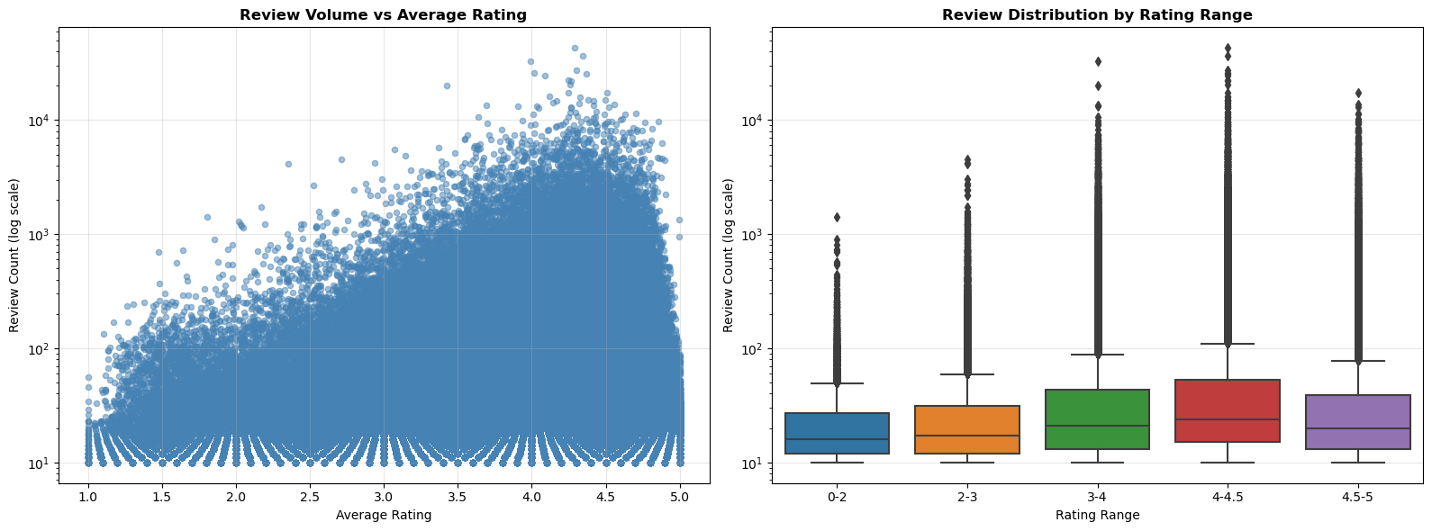
Review volumes and ratings
Highest number of reviews clustered around 4.0 to 4.5 bin.
The second highest number of reviews are 3.0 to 4.0 bin and 4.5 to 5 bin.
The lowest number of reviews in 0-2 bin.

Slide 10
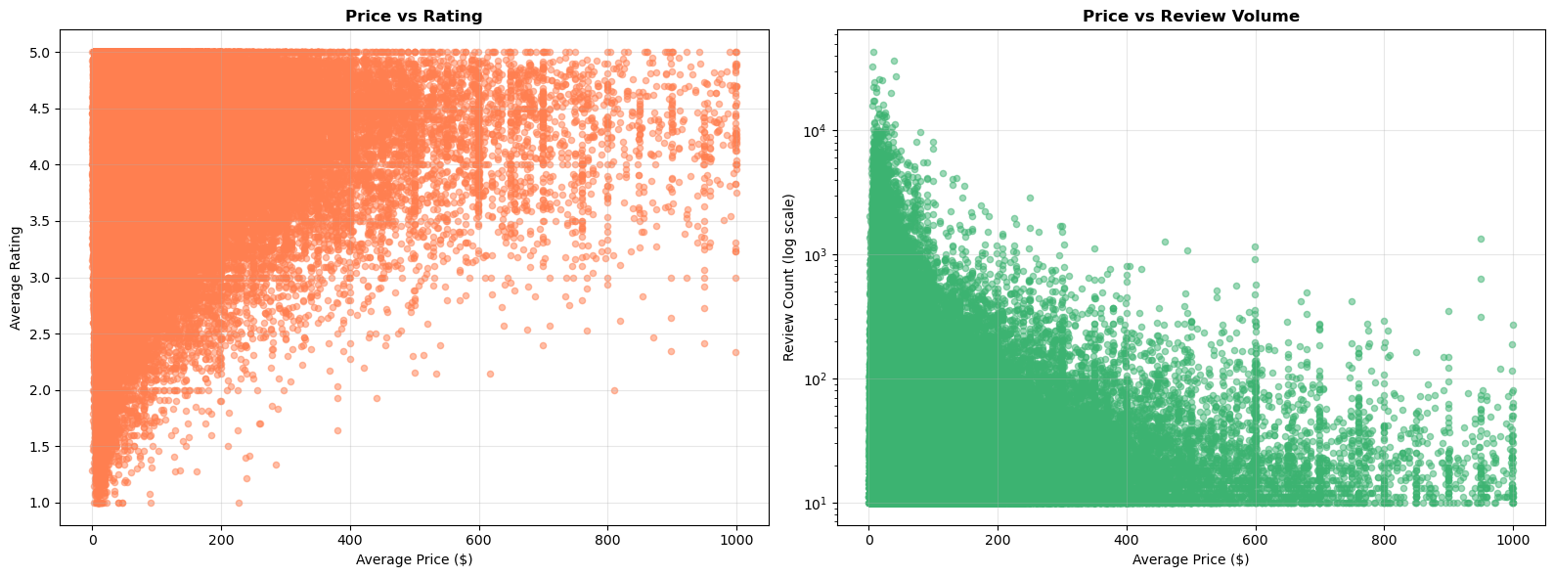
Price and Rating relationship
As product prices increased, the number of reviews tended to decrease (right), suggesting that higher-priced items attract fewer buyers or generate less user feedback. Additionally, the average rating is higher at higher prices (left), indicating that more expensive products generally receive more consistently positive reviews.

Slide 11
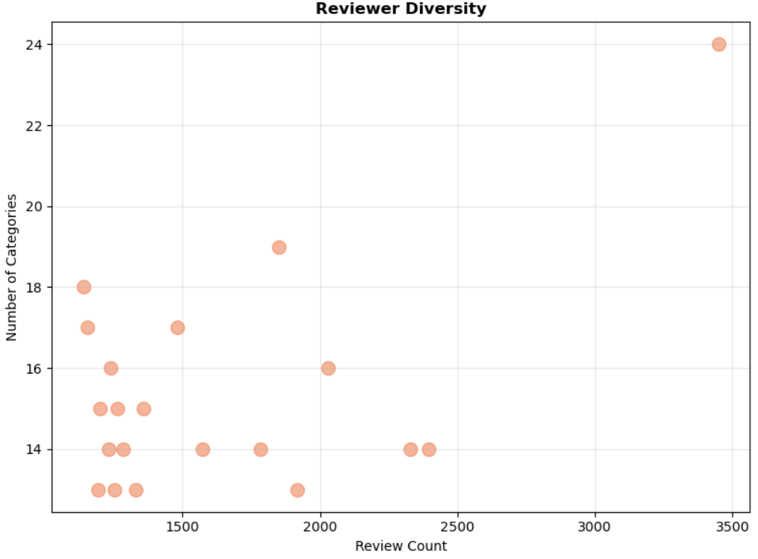
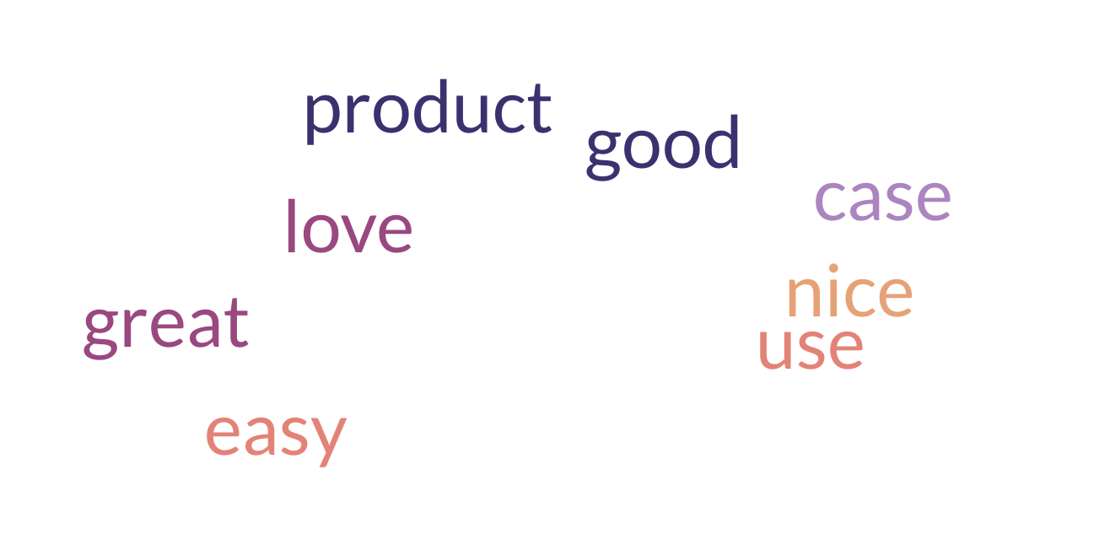
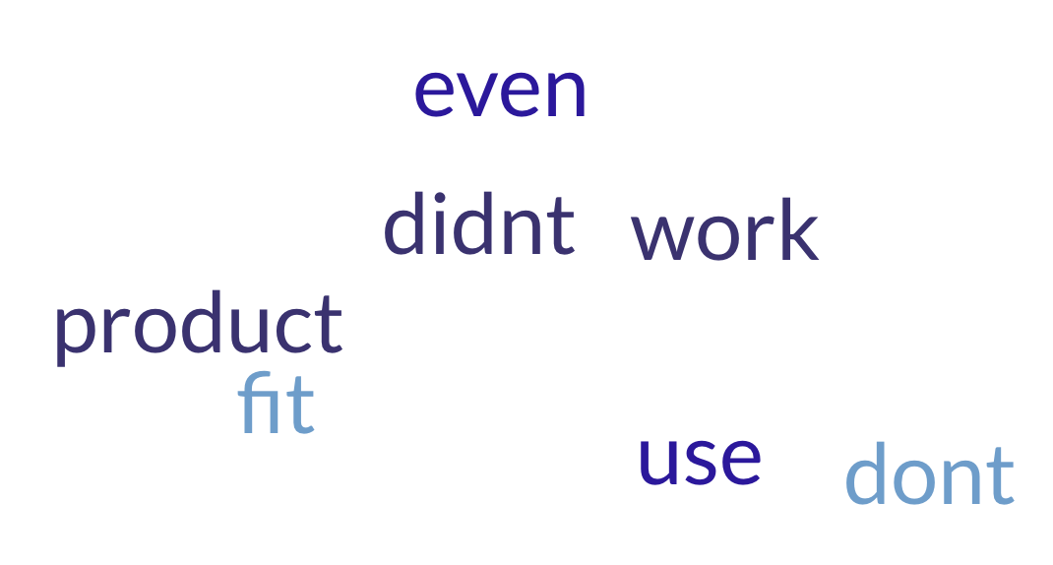
Top reviewers and common words
Common Words in 5 star reviews
More positive (well, nice, easy)
Common words in 1 star reviews
More negative words; product and use are overlapping
Top reviewers frequently wrote reviews across different categories. I wonder if there are any incentives or discounts for writing reviews by Amazon.

Slide 12
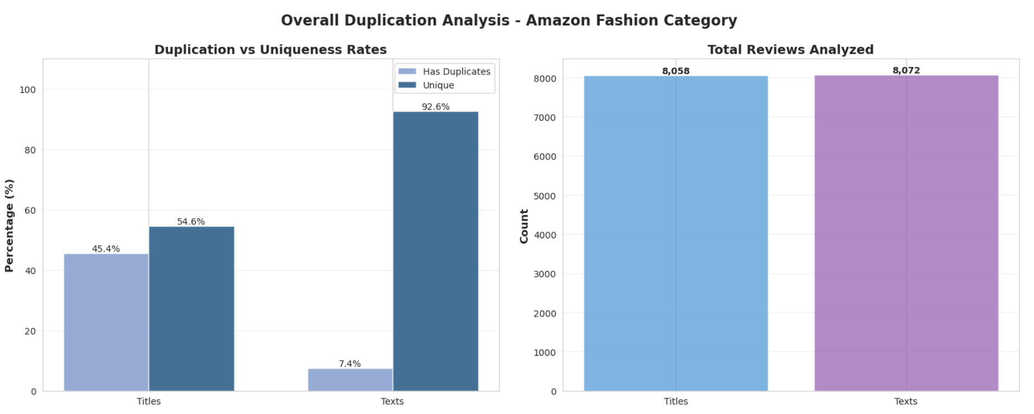
Review Similarity Analysis
Text can be a lot more unique than titles. In 8,058 titles, 45.45% of reviews have similar titles
While only 7.40% of reviews have similar content in main texts.

Slide 13
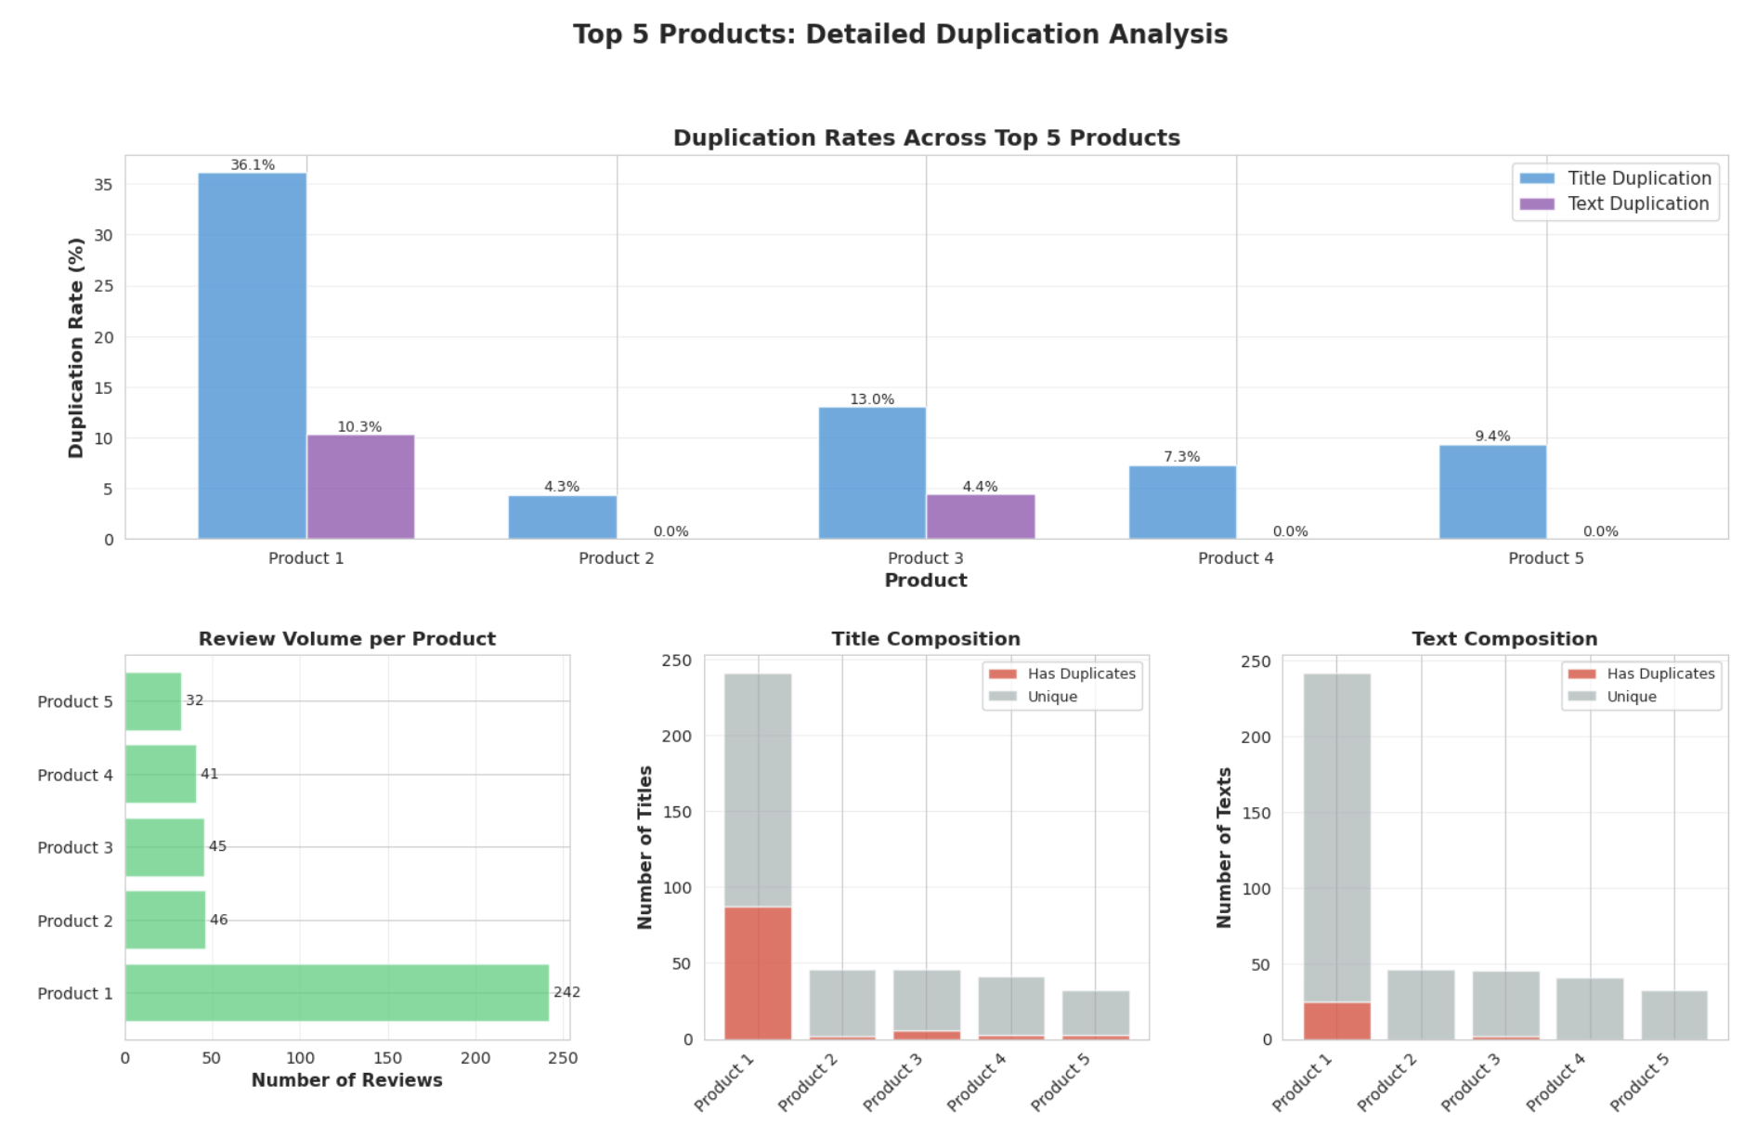
Top 5 products in Amazon fashion

Slide 14
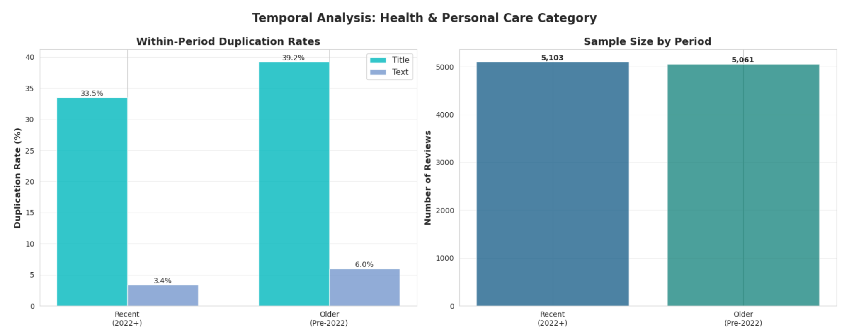
Comparing Older v.s. Recent reviews
Using LSH, I compared 5103 recent reviews (2022-2023) and 5061 older reviews (before 2022). It’s surprising that there are lower duplication rates among recent reviews, and older reviews show higher similarity. With the use of AI, the reviewers have more customized and personalized experience written in different expressions (semantics similarity) which LSH might not be able to detect.

Slide 15
Conclusions
Summary of my findings:
Higher duplication rates for titles than texts, because the limit amounts of words and highly repetitive topics.
It’s harder to use LSH to detect duplications in recent reviews compared to older ones. LSH is not great at detect semantic similarity, only lexical duplication, and AI-generated review is lexically unique which makes duplication rate dropped in recent reviews.
Active Reviewers review across different categories, and high review rates can co-exist with high ratings but most of them are affordable products under $25.
Some products’ main category is mislabeled, for example, I detected “screen protector” in AMAZON Fashion category.
Recommendations:
Implement differentiated detection strategies for Titles vs. Texts to ensure authentic reviews scoring rather than AI generated reviews.
Have multi-dimensional review structure with scoring on different aspects of products to encourage reviews to highlight detailed, realistic product experiences.
Provide benefits / points to frequent reviewers to encourage more people to share their product experience.

