Slide 1


Forecasting Chicago 311 Service Demand for Operational Planning
Group 4: Elaine Wang, Dora(Jiayue) Li, Yuwei Tang, Tallulah Cook, Xiaoyan Chen

Slide 2
Business Case & Problem Statement
The Problem: Chicago's 311 system routes hundreds of thousands of service requests monthly across city departments. Without reliable demand forecasts, agencies cannot efficiently allocate staffing or resources. Which can lead to delayed response times, resident dissatisfaction, and budget inefficiencies.
Why It Matters:
Predictable seasonal surges and event-driven spikes
Reactive staffing
Cross-department coordination
Accurate forecasting
Success Looks Like: A model recommendation that balances forecast accuracy (MAE/RMSE) with interpretability — one the city could realistically adopt for day-to-day resource planning and seasonal preparedness.
Notes:
The Problem: Chicago's 311 system routes hundreds of thousands of service requests monthly across city departments. Without reliable demand forecasts, agencies cannot efficiently allocate staffing or resources — leading to delayed response times, resident dissatisfaction, and budget inefficiencies.
Why It Matters:
Predictable seasonal surges (winter snow removal, spring pothole repair) and event-driven spikes (severe weather, festivals) strain city resources when unplanned
Reactive staffing leads to both costly overstaffing in slow periods and dangerous understaffing during peaks
Cross-department coordination breaks down without a shared demand signal
Better forecasts = pre-staged resources, faster response times, and improved public safety
Success Looks Like: A model recommendation that balances forecast accuracy (MAE/RMSE) with interpretability — one the city could realistically adopt for day-to-day resource planning and seasonal preparedness.

Slide 3
Modeling Hypothesis & Assumptions
Hypotheses:
(H1) Seasonal Patterns Drive Demand
(H2) Calendar Effects Create Systematic Deviations
(H3) Weather Conditions Affect Demand with Lag
Key Modeling Assumptions:
Demand patterns
COVID-19 (2020–2021)
Train/Test protocols
Forecast evaluation
Notes:
H1 — Seasonal Patterns Drive Demand 311 request volume exhibits strong weekly seasonality (weekday vs. weekend effects) and annual variation (winter surges, spring peaks) that can be captured through seasonal time series models.
H2 — Calendar Effects Create Systematic Deviations Holidays and weekends produce predictable dips and spikes beyond baseline seasonality. These structural calendar effects can be modeled explicitly as exogenous regressors to improve accuracy.
H3 — Weather Conditions Affect Demand with Lag Temperature, precipitation, and extreme weather events influence 311 volume, particularly for departments like Streets & Sanitation and DWM. These effects may not appear immediately but lagged weather variables are expected to improve forecast accuracy during extreme weather periods.
Key Modeling Assumptions:
Demand patterns are sufficiently stable over the sample period to support out-of-sample forecasting
COVID-19 (2020–2021) represents a structural break — models should account for or be robust to this anomaly
All 5 models will use identical train/test protocols to ensure fair comparison
Forecast evaluation will prioritize MAE and RMSE

Slide 4
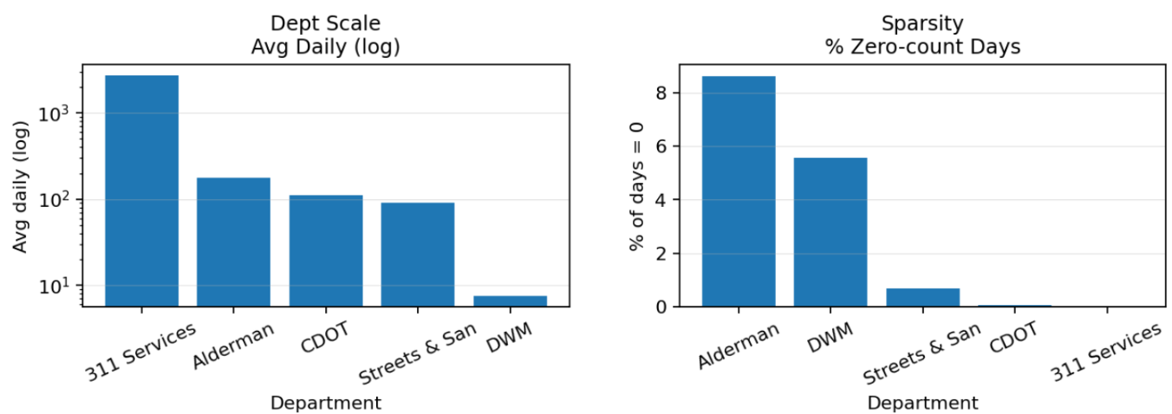
Data Description and Properties
Datasets
Chicago 311 demand (counts): daily request volume, 2020–2026
Views: Total + Top 5 departments
Departments: 311 City Services, Alderman, CDOT, Streets & Sanitation, DWM
Weather (monthly): 2020–2026, from NOAA NCEI Climate at a Glance
Fields: Date (YYYYMM), Value (avg temp), Anomaly (temp anomaly)
Notes:
First, Chicago 311 demand as daily request counts from 2020 to 2026, in two views: a citywide total and the top five departments.
Second, we include monthly weather from the same period as an external context dataset.
The department scale plot shows big differences in magnitude across departments, so RMSE is not directly comparable across departments. The zero-rate plot also shows some departments have zero-count days.

Slide 5
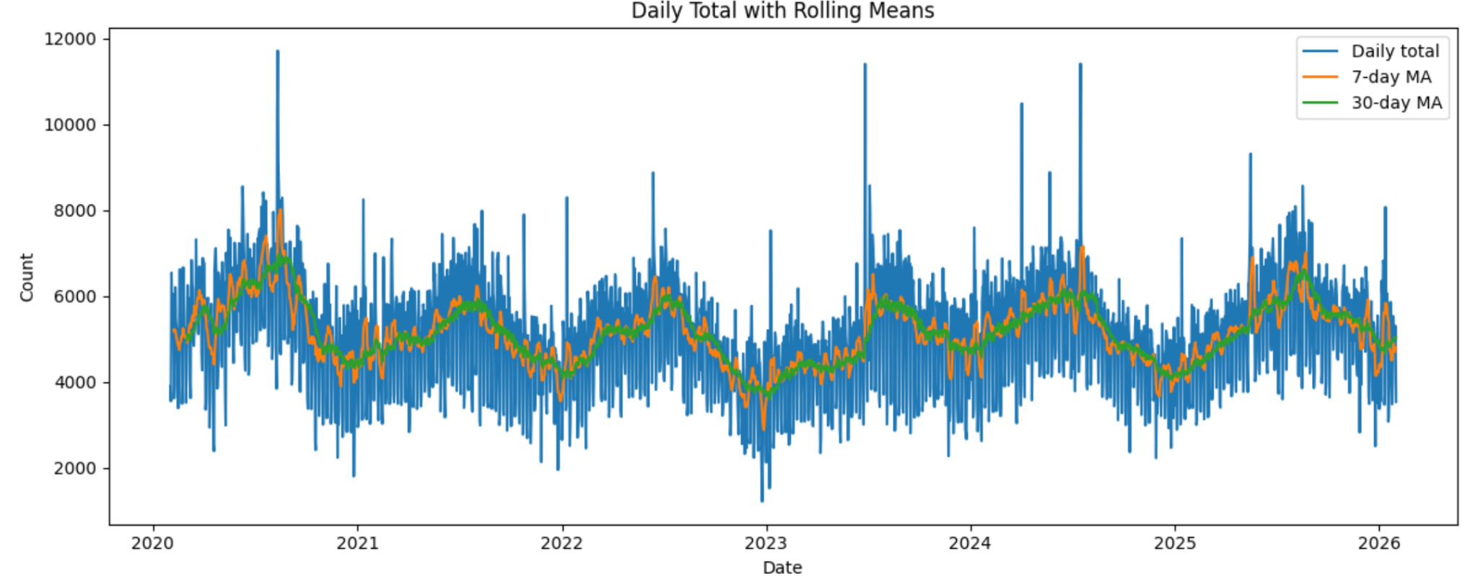
Data Processing and EDA
Processing:
Make a complete daily timeline and fill missing days
Aggregate to monthly (sum/mean) to compare trends and match weather frequency
Join monthly 311 with NOAA weather
Notes:
built a complete daily timeline and handled missing dates in a count-safe way. Then we aggregated 311 to monthly sum and mean to match the weather frequency, and joined monthly 311 with monthly temperature by year-month.
The rolling mean is clearly not flat, so the level changes over time. That’s a sign the series isn’t stationary and there are level shifts across years.

Slide 6
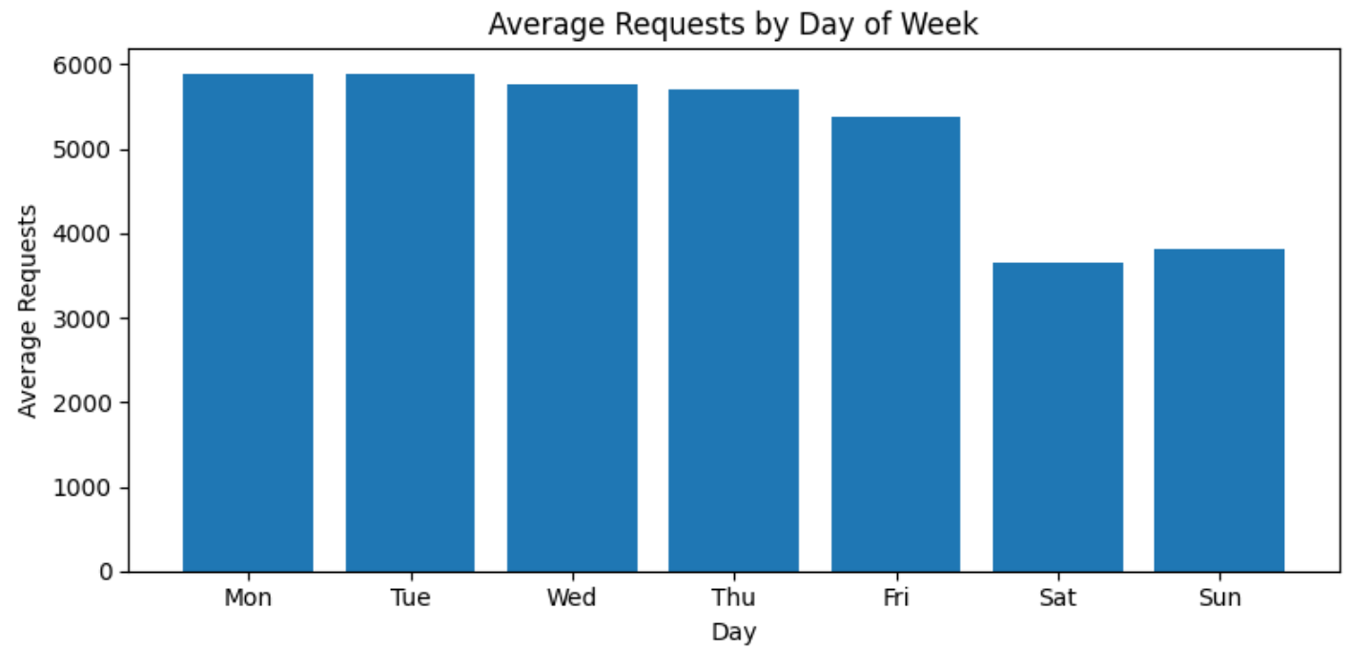
Data Processing and EDA
Processing:
Parse dates, sort, set a continuous time index
Reindex to daily counts; handle missing days/NA (count-safe)
Build monthly aggregates (sum/mean) for robustness and weather alignment
Join monthly 311 with NOAA weather
Indicates strong weekly seasonality in 311 demand
Supports using a 7-day seasonal period (sp = 7) for daily models
Notes:
weekdays are higher than weekends, so there’s a strong weekly seasonal pattern.

Slide 7
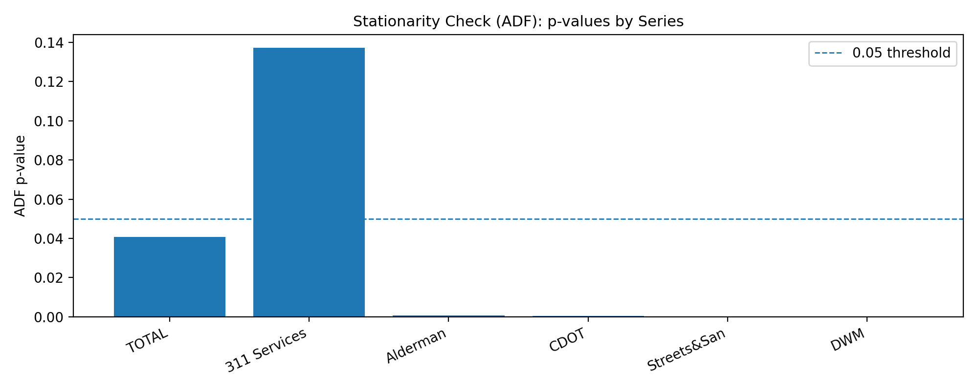
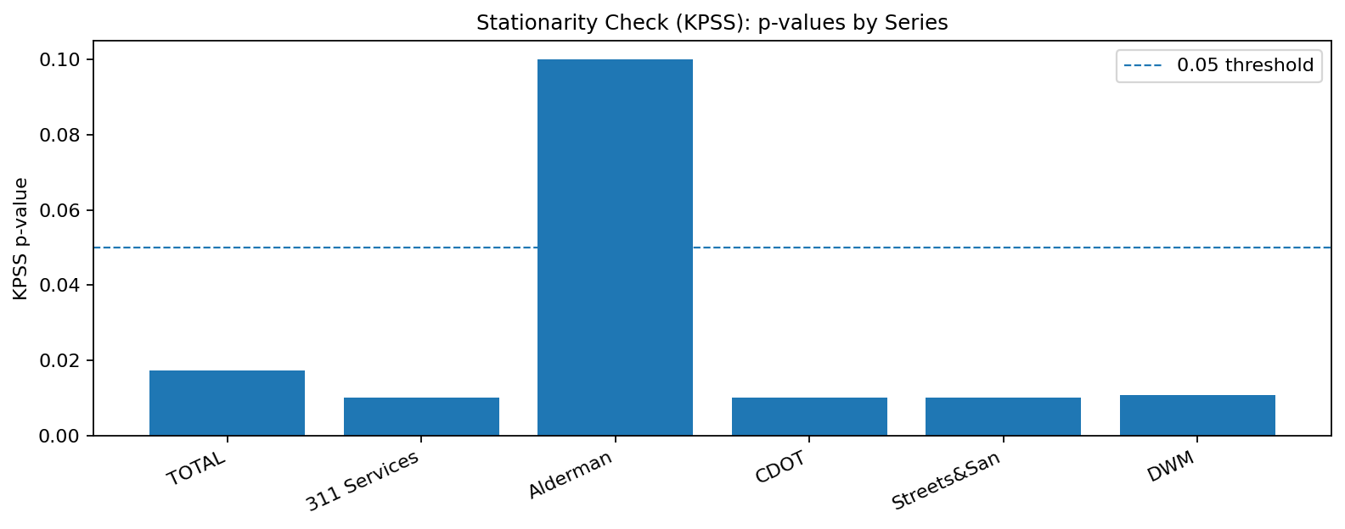
Data Processing and EDA
Ran ADF and KPSS tests as a quick stationarity check
ADF: p-values above 0.05 suggest we cannot reject a unit root → non-stationary
311 Services is non-stationary
KPSS: Most series are below 0.05, while Alderman is above 0.05.
The stationarity tests give mixed results, so some series may need differencing for ARIMA/VAR-type model.
After 1st differencing, the other series look more stationary.
Notes:
the ADF and KPSS plots check stationarity. Based on what we see here, Alderman looks stationary, but the other series are not consistently stationary. So for SARIMA or VAR-type models, we applied first differencing, and after 1st differencing the other series look more stationary.

Slide 8
Feature Engineering
Weather as External Regressor
To capture environmental effects on service demand, we incorporated weather variables into the modeling framework.
Weather data was merged with the 311 request dataset.
Average temperature was used as an external regressor in models that support exogenous variables.
Weather features aim to capture environment-driven fluctuations in service requests.
Motivation
Certain types of 311 requests are sensitive to environmental conditions:
High temperatures may increase water-related service requests
Extreme weather can increase infrastructure maintenance demand
Seasonal weather patterns may affect sanitation and transportation services
Notes:
In the feature engineering stage, weather data was merged with the 311 request dataset, and weather variables were incorporated as external regressors to capture environmental effects.
The motivation is that many types of service requests are sensitive to environmental conditions. For example, higher temperatures may increase water-related requests, extreme weather can raise infrastructure maintenance demand, and seasonal weather patterns can influence sanitation and transportation services.
So by including weather variables, the model can better capture environment-driven fluctuations in service demand.

Slide 9
Proposed Modeling Approaches
To forecast 311 service demand, we evaluated several time series models with different modeling assumptions:
Model | Purpose
Baseline | Simple benchmark using historical patterns (Forecast tomorrow using last week’s same weekday)
SARIMA | Captures trend and seasonal structure
SARIMAX | SARIMA with external regressors (weather)
Prophet | Flexible model for trend, holiday, and seasonality
Holt-Winters | Exponential smoothing with seasonal components
VAR | Multivariate model capturing interactions between departments and weather
Evaluation Framework
· The same train/test split was used for all models (80/20)
· Performance was evaluated using:
· MAE
· RMSE
· AIC
This framework allows us to compare forecasting performance across different modeling approaches.
Notes:
In our project, several time series models were evaluated to forecast 311 service demand, each with slightly different modeling assumptions.
A simple baseline model was first used as a benchmark, mainly based on historical patterns. SARIMA was applied to capture weekly trend and seasonal structures in the data. SARIMAX extends this approach by incorporating weather variables as external regressors. Prophet provides a flexible framework for modeling trend and seasonality, while Holt-Winters uses exponential smoothing to capture seasonal patterns. Finally, a VAR model was used to capture interactions between different departments and weather variables.
All models were evaluated using the same train–test split, and forecasting performance was compared using MAE, RMSE, and AIC.

Slide 10

Selected Model Results with Justifications
 | Model | MAE | RMSE | AIC
Total 311 Demand | Baseline (Daily) | 613.21 | 911.86 | N/A
 | SARIMA (Monthly) | 14124.07 | 16509.91 | 1398.72
 | SARIMAX (Monthly) | 13800.62 | 16797.89 | 1418.90
 | Prophet (Daily) | 518.01 | 680.43 | N/A
 | Holt-Winters (Daily) | 896.64 | 1145.67 | N/A
 | VAR (Monthly) | 14494.74 | 18145.15 | 21.64
Prophet demonstrates highest accuracy in forecasting due to several advantages:
Handling Weekday vs. Weekend variance in Chicago 311 data
Using monthly data made SARIMAX / VAR struggle to differentiate between noise and signals
Prophet incorporated seasonality, specific holiday effects into the model.
Hypertuning the changepoint_prior_scale,
Fourier_order improved the MAE / RMSE
Notes:
Prophet is the Superior Model: It achieved the highest accuracy with the lowest error metrics (MAE: 518, RMSE: 680.43), significantly outperforming both the baseline and complex statistical models.
Handling Weekday vs. Weekend Variance: A key advantage for Prophet is its ability to model the distinct, varied patterns between weekday and weekend requests; while it slightly under-forecasts weekends, its flexible weekly seasonality captures these shifts better than other approaches.
Resilience to Volatility: The 311 dataset is highly volatile, causing traditional models like SARIMA and VAR to fail with extremely high error rates (MAE > 13,000), whereas Prophet’s design remains robust against such fluctuations.
Comprehensive Pattern Recognition: Beyond daily volatility, Prophet successfully incorporates broader trends, annual seasonality, and specific holiday effects, making it the most reliable tool for city-wide operational planning.

Slide 11
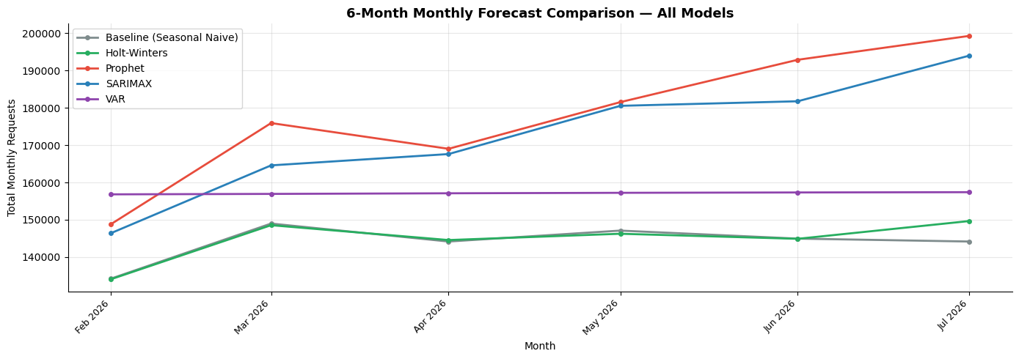
6-month Forecasts
Notes:
Prophet and SARIMAX both predicted upwards trend, VAR is very flat very minor changes forecasted, and baseline and holt-winters are kind of fluctuating.

Slide 12
Model Tradeoffs
Holt-Winters
SARIMA/ SARIMAX
VAR
Prophet
Baseline
Stable patterns
Best at 311 Department-level forecasting with more stable, recurring patterns
Complexity
Situations where simple seasonal models are insufficient
Weather Related Strength
Strength in weather related forecasts in department, such as, streets and sanitation
Capture overall seasonality
slightly under-forecast weekend activity
Strong Consistency
Lacks sophistication in the model to capture seasonality,
limited predictions for long term trends
Simplicity vs. Complexity: Simple seasonal models (like Holt-Winters) generally outperformed more complex ones at the department level.
Exogenous Variables (Weather): Incorporating weather (SARIMAX/VAR) added instability and did not provide consistent accuracy gains for total 311 forecast, though it may improve performance for specific department-level requests.

Slide 13

Key Insights & Next Steps
Key Insights:
Best model varies by aggregation level (Total vs. Department) and time granularity (daily vs. monthly)
Daily (operational): Prophet best for Total 311; Holt-Winters/Prophet best for departments
Limitations:
Inconsistent feature sets across models (some include weather as external regressors, others didn’t)
Single train/test split, not enough cross validation
Different time granularity (daily vs. monthly) limits direct MAE/RMSE comparison
Future Work:
Add richer weather features
Further tune models for different department demand patterns
Test rolling retraining for practical deployment

Slide 14
From Model Results to Business Impact
How the Forecast Solves the Business Problem
Input: daily 311 demand forecasts (citywide + by department)
Output: next-day outlook for operations (and longer-horizon forecasts for planning)
Operational Use Cases
Pre-stage resources ahead of predicted surges
Adjust staffing schedules by department ahead of peak days
Trigger cross-department coordination when multiple departments spike
Hypotheses → Modeling Choices
H1 Seasonality: seasonal models (baseline / Holt-Winters / Prophet) capture weekly & annual patterns
H2 Calendar effects: weekday & holiday effects captured in Prophet (calendar features)
H3 Weather lag: tested lagged weather regressors (SARIMAX / regressor setup)
Recommended Deployment Setup
Two-level daily setup (recommended): citywide forecast for planning + department forecasts for staffing
Monthly models (SARIMA/SARIMAX/VAR): reference only (not comparable to daily MAE/RMSE)
Trade-off: External regressors showed limited and inconsistent accuracy gains

Slide 15
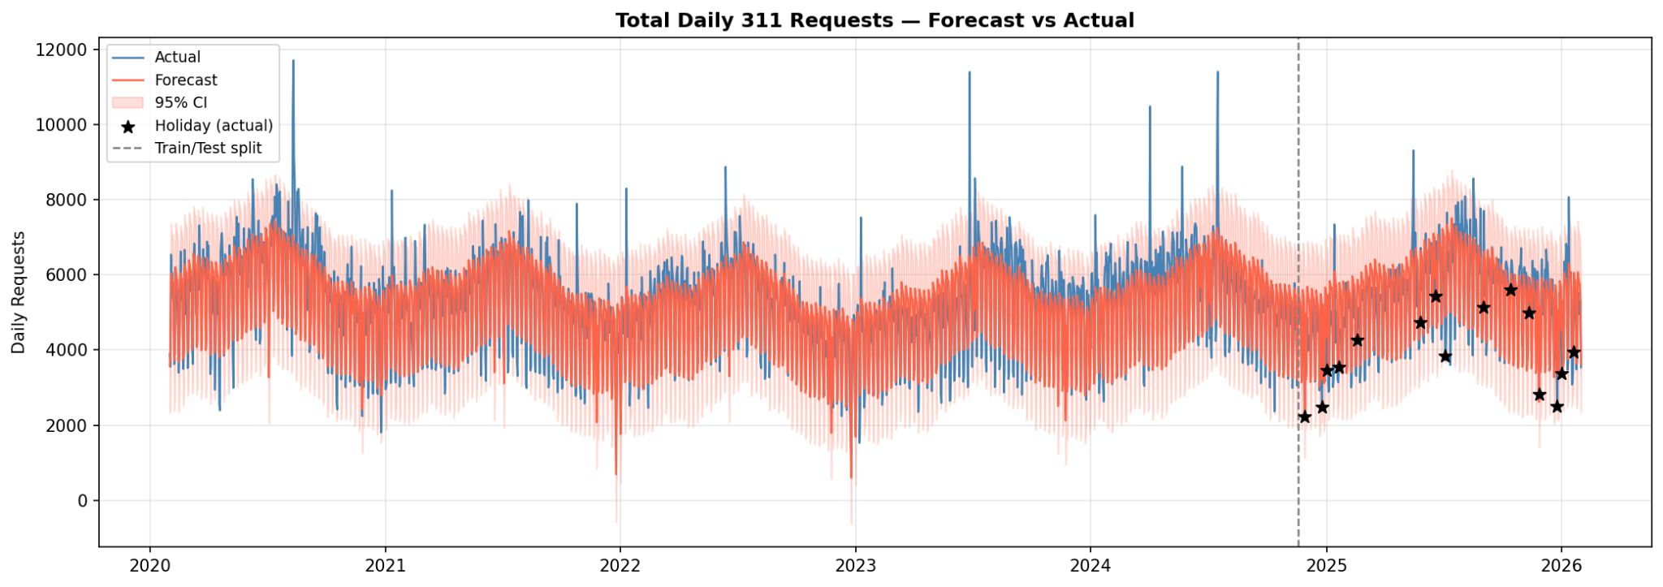
Appendix (Prophet Testing / Forecasting Result)
Prophet is our best model with validated forecasting result

