Slide 1
GEN AI PRINCIPLES · UCHICAGO MSADS
TEAM INTRODUCTION
Generative AI Projects Presentation
Matteo
Dora
Rita
Diana
Xiaoyang
Matteo Mirgone
Jiayue Li
Zehui Luo
Danqing Chen
Xiaoyang Zhang
ARCHITECTURE & RETRIEVAL
FRONTEND & DEMO
EVALUATION & PROMPTING
MULTIMODAL & DATA
TESTING MULTIMODAL ENGINE
Owned the RAG pipeline design and ChromaDB integration across both projects.
Streamlit UI, chat interaction testing & debugging, and live-demo flow.
Harness-agent evaluator, web-scraping for midterm project, grounded-output rules.
CLIP integration, hybrid retrieval, Amazon catalog preparation.
Testing for vision & language model; evaluate the multimodal engine
Notes:
Good morning. We're presenting two RAG projects we built this quarter. We're Matteo, Dora, Zehui and Daqi — we'll each introduce ourselves and our roles in a moment. Then Project 1: the MSADS website chatbot, three slides plus a live demo. Then Project 2: a multimodal e-commerce assistant, same structure. Two minutes for the team intro, four minutes per project, and we'll save questions for the end.

Slide 2











PROJECT 1 · MIDTERM
RAG system for the MSADS website
Applicants usually navigate 14 separate MSADS pages to answer simple questions about admissions, tuition, curriculum, and capstone requirements.
DESIGN PRINCIPLE
Ground every answer in retrieved evidence.
FAILURE POLICY
If retrieval fails → respond with “I don’t know”.
We built a grounded RAG chatbot that retrieves the correct passage, cites the source, and declines unsupported answers.
GROUNDING CONSTRAINT
The chatbot must not invent program details.
Data Ingestion Pipeline
01
02
03
04
05
Scrape
Clean & Structure
Chunk
Embed
Index & Store
Collect 14 MSADS sub-pages using requests & beautifulsoup
Strip footer & scripts;
Extract main body text + title;
Normalize white space
Sliding windows of 1500 character size; 100 character overlap
Sentence-transformers (all-mpnet-base-v2, 768-dim)
Chroma DB HNSW for index similarity search later
Notes:
Project 1 in one sentence: the MSADS website has fourteen sub-pages covering curriculum, admissions, tuition, OPT, the FAQ — and applicants have to hop between them to assemble simple answers. Our solution is a grounded RAG chatbot that retrieves the right passage and answers in plain English, with citations. The hard constraint is grounding — the model must not invent program details, and if retrieval misses, it has to say 'I don't know.' On the right is the full five-stage pipeline: scrape, chunk, embed, retrieve, generate.
chunk size: 300-400 tokens per chunk ; 1500 character size;

Slide 3
PROJECT 1 · MIDTERM
system architecture (Query Pipeline)
User Query
Filter Keywords
Off Topic
Polite Redirect
Query Encoder
Retrieve
Generate
Clean Up
Chroma DB Cosine Search
GPT-4o/LLama 3.2
all-Mpnet-base-v2
PII Redact
Strong general-purpose sentence encoder that runs locally, produces 768-dim query Vector
top-k = 4 [adjustable]
returns text, title, URL
Assemble Context, ≤ 3,000 chars
Temp = 0.2
Max 900 tokens
Context grounded
Regex Strips all email addresses & phone numbers from LLm output before display.
TOOLS & STACK
Streamlit · BeautifulSoup ·SentenceTransformer · ChromaDB · OpenAI API · regex PII redaction
Display Answer + Citation
Notes:
The four design decisions that drove this system. Encoder: MPNet — strongest general-purpose sentence encoder that runs locally, 768 dimensions, cosine similarity. LLM: GPT-4o at temperature 0.2 — picked specifically because it had the best grounding compliance in our prompt tests; strict cite-or-decline. Chunk size: we converged on roughly 700 characters, topic-aligned rather than URL-aligned, after sweeping bigger and smaller. Retrieval: ChromaDB, persistent HNSW, top-4 per query. Stack is Streamlit, BeautifulSoup, LangChain, regex PII redaction. Most of these will be visible in the demo.

Slide 4
PROJECT 1 · MIDTERM
Challenges and our approaches.
DATA
LLM BEHAVIOR
Evaluation
Broaden knowledge base
Prompts allow limited questions
Evaluating behavior, not recall
we encountered a problem that the chatbot frequently responded with 'I don't have enough information' when users posed questions
There would be an error when the user asked two questions in one prompt, because of the way our retriever embeds the entire multi-question prompt as one vector
Retrieval recall alone doesn't catch hallucinations or bad refusals. We used the harness agent that probes the bot and scores faithfulness, relevance, refusal quality, and citation accuracy.
FIX
FIX
Custom cleaner + re-chunk by topic, expanding our data corpus (from webscraping only 9 —> 14 pages)
Multi-query retrieval + Query decomposition
SIGNAL
Our model passed all the tests by Harness!
Notes:
Three challenges. Data: the scraped HTML was full of navigation chrome and breadcrumbs that polluted chunks; we had to write a custom cleaner and re-chunk by topic. LLM behavior: early prompts let GPT-4o extrapolate plausibly past context, which is exactly the hallucination failure mode we needed to prevent — we closed it with five explicit grounding rules and a strict refusal clause. Solution design: how do you evaluate behavior, not just retrieval? We built a harness agent — an LLM-driven evaluator that probes the bot with follow-up questions and scores four dimensions: faithfulness, answer relevance, refusal quality, and citation accuracy. Low scores in some categories are useful signal — they tell us where to focus next.

Slide 5
PROJECT 1
05 / 10
Live Demo.
MSADS chatbot in Streamlit · quick walkthrough.
01
02
03
Ask a real program question
Try an off-topic query
Inspect the citations
Watch the retrieved passages render alongside the answer.
Scope filter politely refuses before any API call.
Every claim ties back to a specific MSADS page.
Quick demo
Notes:
Switching to the browser. Two minutes. I'll ask a real program question and point out the retrieved passages and citations on the right. Then I'll try an off-topic query so you can see the scope filter refuse politely before any API call. If retrieval misses on something, I'll show how the bot says 'I don't know' rather than invent. Coming back to slides for project two.

Slide 6
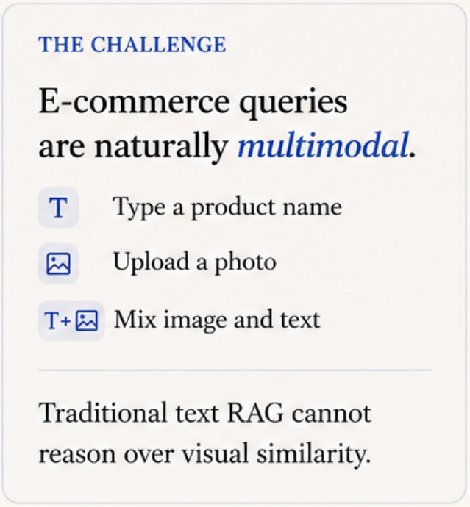
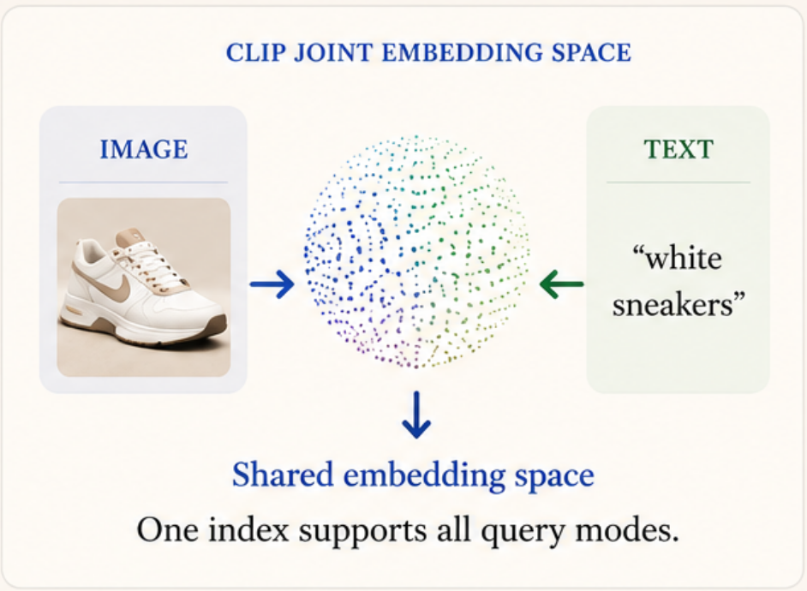
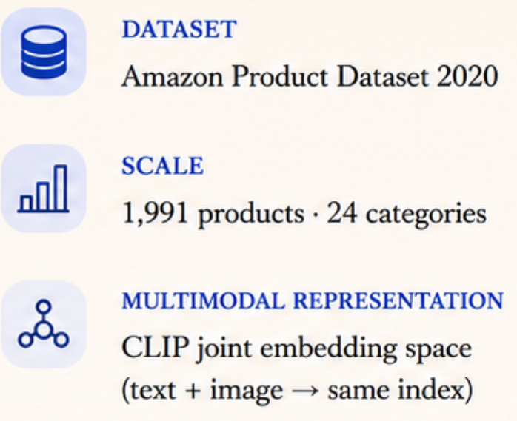
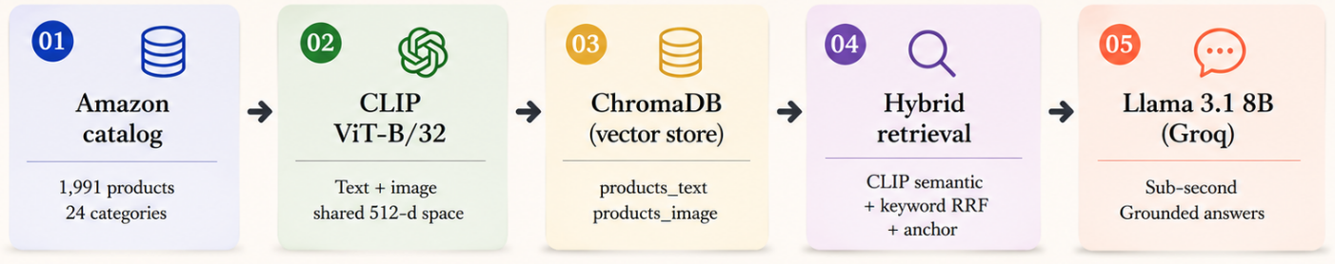
PROJECT 2 · GOAL & OVERVIEW
PROJECT 2 · FINAL
Grounded multimodal retrieval
One assistant for image, text, and hybrid queries.
Notes:
Project 2 in one sentence: e-commerce queries are naturally multimodal — type a product name, upload a photo to identify it, or do both — and pure text RAG can't handle the image side. The solution is a multimodal RAG assistant over the Amazon Product Dataset 2020 — 1,991 products across 24 categories. Same five-stage RAG spine on the right, but the encoder is now CLIP, which embeds images and text into the same 512-d vector space, so an uploaded photo and a typed query land in the same index.

Slide 7
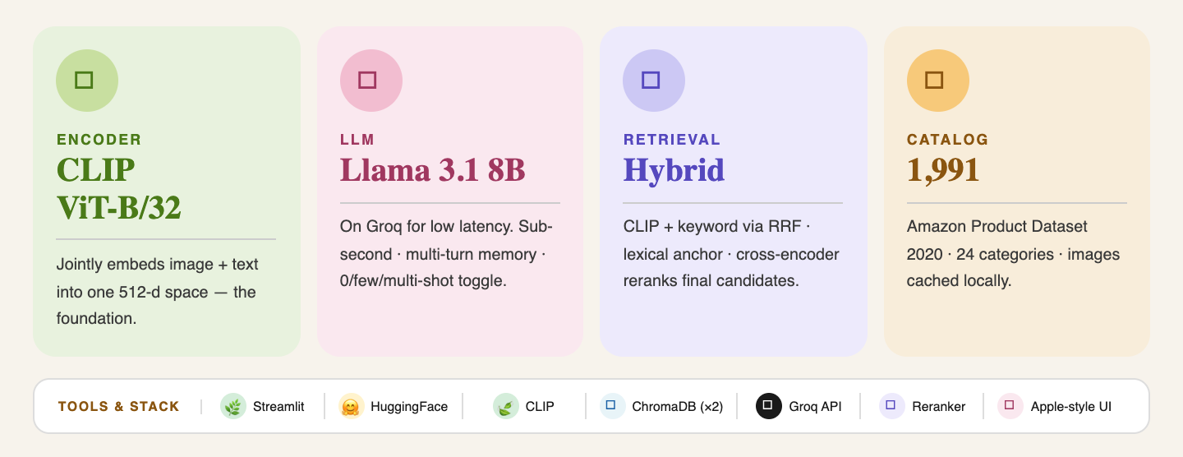
PROJECT 2 · FINAL
Four decisions, multimodal edition
Notes:
Four design decisions. Encoder: CLIP ViT-B/32 — the joint image-text embedding is the whole foundation. LLM: Llama 3.1 8B on Groq — open-source, sub-second inference, free-tier friendly, no vendor lock-in. Retrieval is a hybrid layer: CLIP cosine merged with keyword search via Reciprocal Rank Fusion, plus a lexical anchor that promotes exact name matches — this was the unlock for short queries. Storage: two ChromaDB collections, one for text and one for image, so we can route queries by modality. UI is Streamlit with a chat input that accepts text or images and a zero/few/multi-shot prompting toggle.

Slide 8
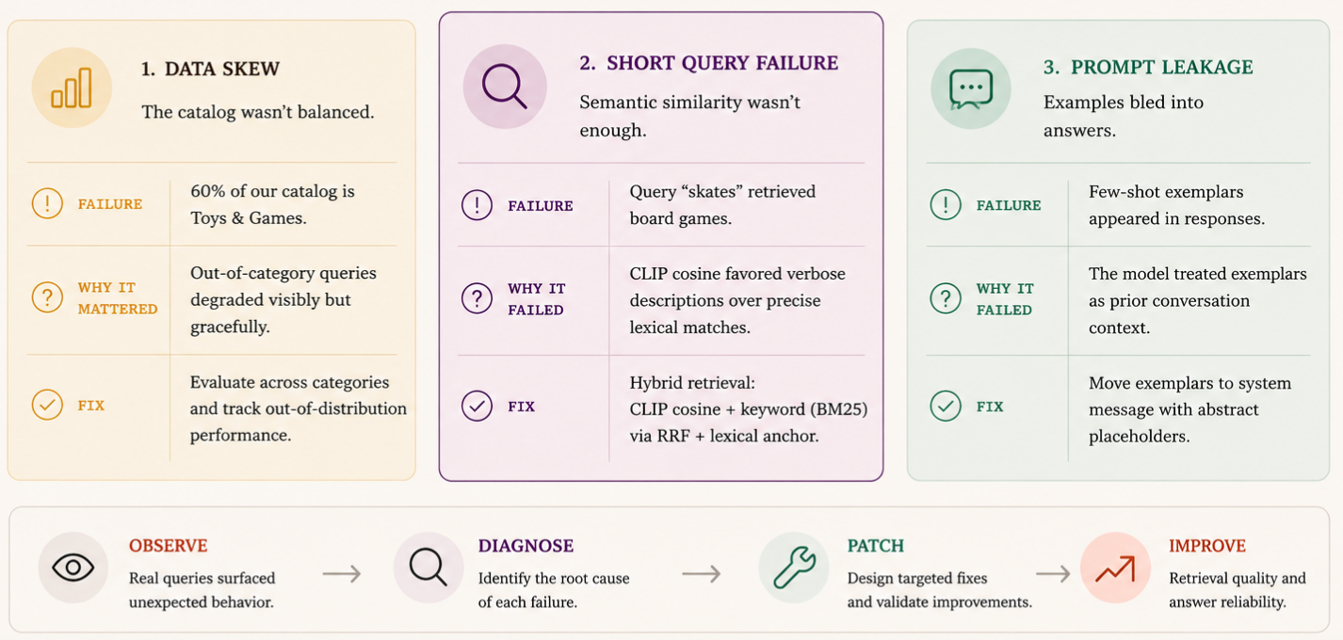
PROJECT 2 · FINAL
Failure modes & fixes
Notes:
Three challenges. Data: 60% of our catalog is Toys & Games — a real dataset skew we discovered late; out-of-category queries degrade gracefully but visibly. Solution design: pure CLIP retrieval was failing on short queries like 'skates' — semantic similarity favored verbose descriptions over precise lexical matches; we layered keyword retrieval and RRF on top, which fixed it. LLM behavior: few-shot examples bled into real answers — the model was treating exemplars as prior conversation. Fix was moving exemplars into the system message with abstract placeholders.

Slide 9
PROJECT 2
Live Demo Two.
Multimodal assistant — text, image, both.
01
02
03
Upload an image · ask about it
"Five products for a 5-year-old"
Ask a follow-up
CLIP retrieves matching products. Llama identifies and describes.
Open-ended query — retriever surfaces five, Llama explains why.
'How much does it cost?' — memory resolves 'it' to the previous product.
Quick demo
Notes:
Second demo, two minutes. I'll upload an image of a product and ask the assistant to identify it and describe its use. Then I'll run an open-ended natural-language query — 'give me five products appropriate for a five-year-old' — and you'll see the retriever surface five real items and Llama explain why each fits. Finally — your turn. Throw any question at it. Including the cases where it doesn't do well; those are honest data points.

Slide 10
PROJECT 1
PROJECT 2
Q&A
Thank you. Questions?
THE TEAM
CODE ON GITHUB:
https://github.com/dorajy8/RAG_interactiveAI_MSADS
https://github.com/MatteoMirgone/multimodal-rag-ecommerce
Matteo Mirgone · Dora Jiayue Li · Zehui Luo · Danqing Chen · Xiaoyang Zhang
Notes:
That's both projects. Same RAG spine in both — embed, retrieve, ground, generate — two scopes. The quality wins came from the boring engineering: chunking, prompting, hybrid retrieval. The model swap rarely moved the needle. Both repos run from a fresh clone with the prebuilt indexes checked in. Thank you — happy to take questions.

