Slide 1

Yelp Restaurant Recommendation System
Charlotte Zhang, Dora Li, Emily Xue, Mia Mac

Slide 2




OUR TEAM
Charlotte
Emily
Dora
Mia

Slide 3
01
02
03
04
Problem Statement
Assumptions/Hypotheses
Exploratory Data Analysis
Feature Engineering
05
06
07
08
Proposed Approaches
Proposed Solution
Results and Learnings
Future Work
TABLE OF CONTENTS

Slide 4

01.
PROBLEM STATEMENT

Slide 5

Restaurants Recommendations
Restaurant discovery is a high-frequency decision problem: people choose where to eat multiple times per week, yet most platforms surface options primarily by location proximity or average rating, leaving individual taste patterns largely unexploited.
This creates a persistent gap between what platforms recommend and what a given user would actually enjoy.
The goal of this project is to close that gap. Given a user's historical interactions on the Yelp Open Dataset (reviews, ratings, and profile features) alongside restaurant attributes including cuisine type, price range, ambience, and amenities, our objective is to produce a personalized ranked list of restaurants the user is most likely to rate positively.
Notes:
We approach this through four modeling paradigms of increasing complexity: item-based collaborative filtering, user-based collaborative filtering, a hybrid factorization machine, and a graph neural network, allowing us to directly compare how different representations of user preference and restaurant characteristics affect recommendation quality.

Slide 6

02.
ASSUMPTIONS/HYPOTHESES

Slide 7
Data Assumptions
1
2
3
Star ratings as preference signal
A user's star rating (1–5) is treated as an explicit measure of preference. Higher ratings indicate stronger positive affinity and serve as important signal across all four models.
User-Interaction as implicit confirmation.
The act of writing a review signals meaningful engagement with a restaurant. Only reviewed restaurants are treated as observed interactions.
Price range as core identity.
Restaurants without a reported price range are dropped rather than imputed.

Slide 8
Hypothesis
H1
H2
Recommendation quality improves as models incorporate richer representations of user preference and restaurant identity.
Our advanced models will outperform baseline models as they have full content features from the dataset
User activity level predicts collaborative signal quality
Users with higher review counts will receive more accurate top-10 recommendations than low-activity users

Slide 9

03.
EXPLORATORY DATA ANALYSIS

Slide 10
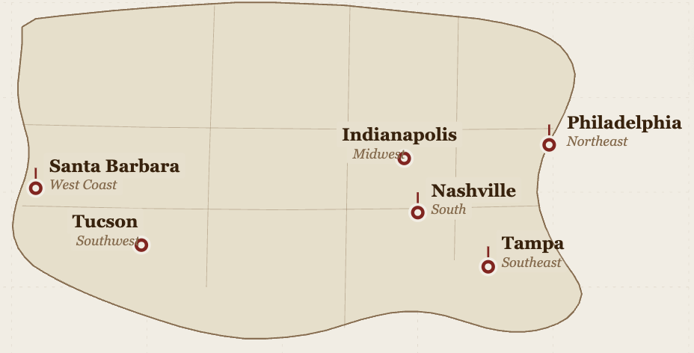
Scope of Data
We filtered and cleaned the dataset to cover restaurants in six U.S. cities, selected to provide broad geographic coverage across five regions while maintaining interaction density sufficient for ML model training.
Dataset Coverage (6 cities)

Slide 11
DATASET OVERVIEW
DATASET SCALE
RATINGS DISTRIBUTION
 | RAW | 5-CORE
Reviews | 1.9M | 1.0M
Restaurants | 14.8K | 13.1K
Users | 662K | 50K
5 star
43.6%
4 star
25.5%
3 star
12.0%
2 star
8.2%
1 star
10.6%
5-core: every user and item has at least 5 interactions, converged after 6 passes
11% of users and 45% of reviews retained after filtering
Interaction density: 0.09% (sparse matrix)
69% of reviews are 4-5 stars → strong positivity bias
Threshold for “relevant” set to 4+ stars in evaluation

Slide 12
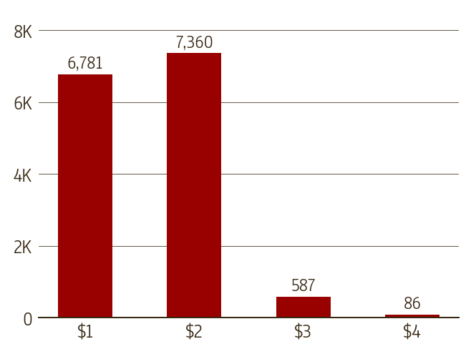
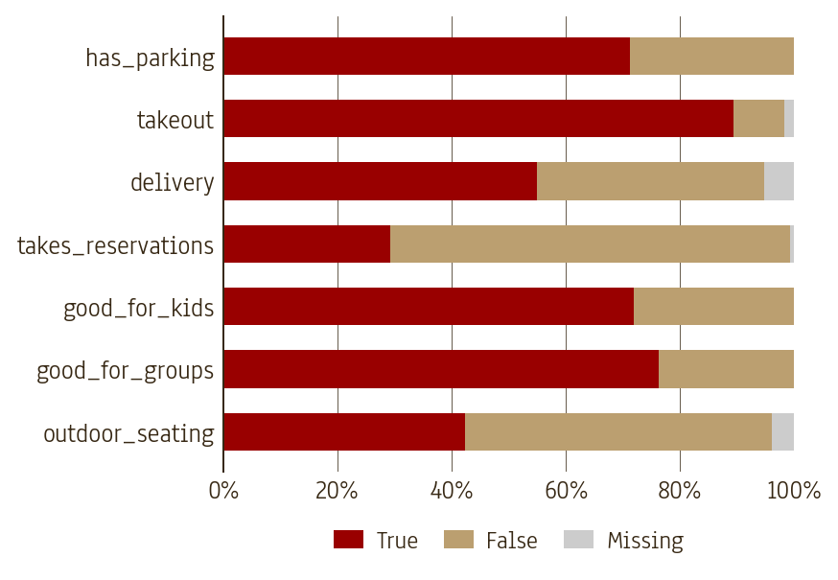
RESTAURANT CHARACTERISTICS
PRICE RANGES
FEATURE AVAILABILITY

Slide 13
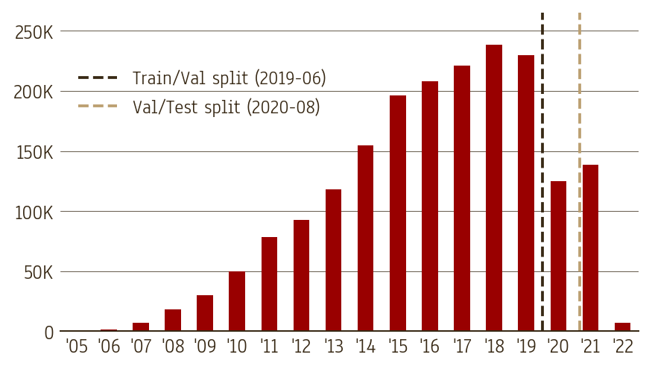
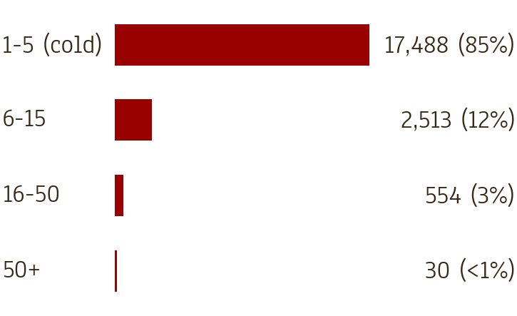
DATA CHALLENGES
REVIEW VOLUME BY YEAR
USER ACTIVITY (VAL)
85% of val users have only 1-5 training interactions (cold-start)

Slide 14

04.
FEATURE ENGINEERING

Slide 15
PIPELINE AND SPLITS
STEP 1
STEP 2
STEP 3
STEP 4
Raw CSVs (reviews, restaurants, users)
5-core filter (iterative, 6 passes)
Temporal split by timestamp
Encode per split (fit on train only)
SPLIT SIZES AFTER COLD-START
Split by timestamp (not random) to prevent future-data leakage
Cold-start: interactions removed where user or item unseen in train
Higher test removal reflects COVID period - many new users / inactive restaurants
 | Rows | % of 5-Core | Cold-Start
Train | 837K | 80% | N/A (reference)
Validation | 73K | 10% | 30% removed
Test | 55K | 10% | 47% removed

Slide 16
ENCODING BY FEATURE TYPE
 | Count | Method | Examples
IDs | 2 | Not encoded | user_id, business_id
Numeric | 8 | Log1p + MinMaxScaler | review_count, avg_stars, price_range
Boolean | 7 | True=1, False=0, NaN=-1 | is_open, delivery, outdoor_seating
Categorical | 317 | OneHotEncoder | city, wifi, alcohol, noise_level, primary_cuisine
332 total model features (IDs excluded, used only as join keys not model inputs)
Data Transformation: Log1p on right-skewed numeric: review_count, fans, useful
Missing Data: NaN encoded as -1 to distinguishes from false
Scaler: MinMaxScaler fit on train; val/test transformed with same parameters
account_age_years: derived from yelping_since (years since user joined Yelp)
Notes:
Optional? account_age_years: derived from yelping_since (years since user joined Yelp)

Slide 17

05.
PROPOSED APPROACHES
Notes:
5. Proposed Approaches (Model) with checks for overfitting/underfitting

Slide 18
Baseline Models
Item-Item CF
User-User CF
Interaction between users and restaurants
Recommends restaurants similar to ones a user has already rated highly by computing cosine similarities of each unrated restaurant to all rated ones.
Similarities among users’ ratings
finds users with similar rating histories and recommends what those neighbors enjoyed using K Nearest Neighbor
Interaction matrix is 0.016% dense - CF alone cannot generalize to cold-start users
Challenging when most user pairs share zero or one restaurant in common

Slide 19
Advanced Models
Hybrid Factorization Machine
Light Graph Convolution Network
user–item interaction matrix combined with content features (cuisine, price, parking, etc.)
Treats the entire dataset as a bipartite graph.
Users and restaurants are nodes, reviews are edges, and propagates preference signals across the network.
Both includes Content Features, evaluated based on Bayesian Personalized ranking
FM/Light GCN use item and user features to bridge the sparsity gap using full 308 item + user features

Slide 20

06.
MODEL SELECTION
Notes:
6. Proposed Solution (Model Selection) with regularization, if needed

Slide 21
Evaluation Metrics
Model | Precision@10 | Recall@10 | NDCG@10
Item-Item CF | 0.0118 | 0.0384 | 0.0259
User-User CF | 0.0138 | 0.0437 | 0.0299
Measures top 10 ranked restaurants relevancy
Hybrid FM | 0.0130 | 0.0430 | 0.0282
Light GCN | 0.0155 | 0.0516 | 0.0357
* All models evaluated on test set (15,744 users and 55,349 interactions) spanning COVID period. Metrics likely understate performance relative to a normal deployment window.
Notes:
NDCG@10 measures the quality of our model's top-10 ranked recommendations — specifically, not just whether relevant restaurants appear in the list, but whether they appear near the top

Slide 22
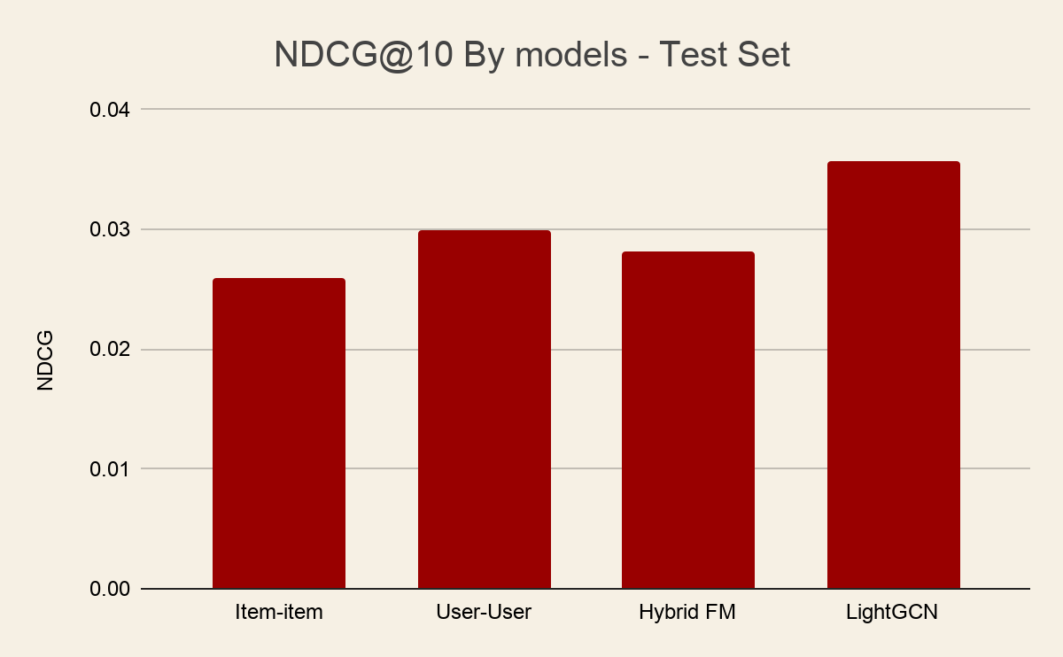
Light GCN > FM: graph propagation allowed a sparse user’s embedding to be shaped by users they have not interacted with which captures structural similarities from full network
User-user CF > FM: Not all 332 content features carry signal; FM not enough capacity to separate signal from noise
Models | Regularization
All Models | Early Stopping
Baseline Models | Shrinkage Bias
Advanced Models | BPR L2 Regularization
No Overfitting/underfitting observed across the models
Notes:
graph propagation allows a sparse user's embedding to be shaped by users they've never directly interacted with — capturing structural similarity across the full network — whereas FM can only model interactions within a single user's own observed history.
Hybrid FM trained with BPR underperformed User-User CF on NDCG@10, suggesting that at this matrix density and with high attribute missingness, the ranking objective did not compensate for the noise introduced by 332 partially-observed content features. This motivates LightGCN, which captures content-like structural similarity without relying on explicit attribute completeness

Slide 23

07.
RESULTS AND LEARNING
Notes:
7. Results (Accuracy) and Learnings from the methodology

Slide 24
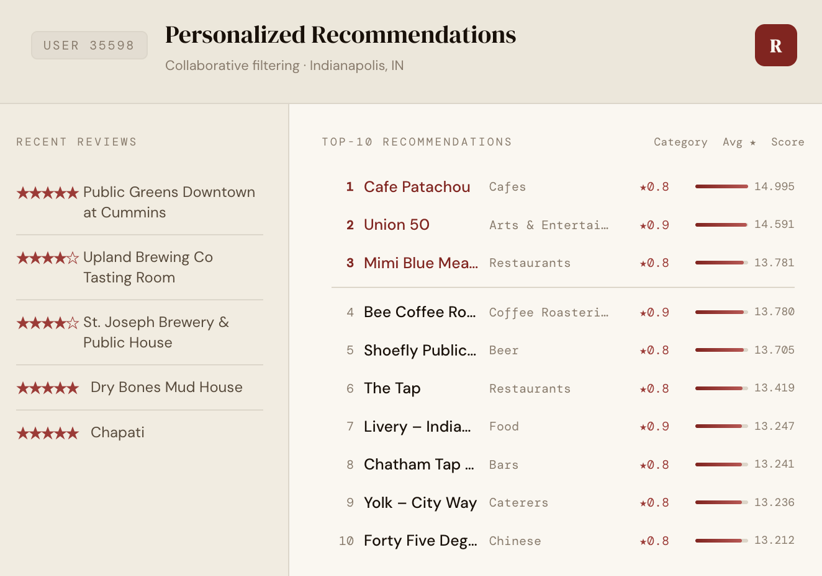
Best Model Results
Light GCN
RMSE of 1.156 is the lowest across all four models, confirming that graph-based embedding propagation produces the most accurate preference score predictions
No overfitting nor underfitting observed
NDCG@10 of 0.0357 remains low in absolute terms, suggesting the model's ranked recommendations are only marginally better than random ordering.

Slide 25
Hypotheses & Key Learnings
HYPOTHESE
KEY LEARNINGS
H1: Richer presentation improve ranking
Each architectural step addressed the previous model's bottleneck — content features broke the sparsity ceiling, graph propagation added multi-hop signal.
+38% NDCG@10 from Item-Item CF to LightGCN (0.026 → 0.036)
Graph beats features
LightGCN's 3-hop propagation surfaces restaurants that share no direct reviewers with the user, something 332 content features can't replicate
Confirm
Sparsity is the core bottleneck
At 0.09% density, memory-based models can't find reliable neighbors; graph propagation is the only way around it
H2: User activity predicts CF quality
True for Item-Item CF and LightGCN. But User-User CF showed a non-monotonic pattern
NDCG@10 dipped for 6–20 review users vs 1–5 review users
Partially Confirm
Ranking metric over RMSE
NDCG@10 reflects what users actually see; RMSE alone would have obscured FM's strong ranking despite uncalibrated scores

Slide 26

08.
FUTURE WORK

Slide 27
Future Work
Cold-start fallback
New users have no interaction history. A content-based fallback using categories, location, and price range fills the gap until collaborative signal accumulates.
FAISS for real-time serving
Pre-computing user and item embeddings and indexing with FAISS enables sub-millisecond retrieval — making LightGCN viable at production scale.
Re-evaluate on post-COVID data
Our test set's 47% cold-start removal rate was driven by pandemic closures. Re-running on 2023–2024 data would give a cleaner baseline for true model performance.
Notes:
This is too much wordssss cutttt!!!!!

Slide 28

THANKS!
Do you have any questions?

