Slide 1
How much search budget a target fidelity actually needs
Answering last checkpoint's action item: two boundary runs, decided on validation only.
Known before: physics-informed proposals beat random and greedy circuit search in all seven tested conditions; the closed-loop bonus was not general.
Measured now: on the Ising chain the open loop meets the rule at budget 6 (12/12) while the closed loop does not (8/12); raising the XXZ budget from 8 to 10 moved the closed loop from 9/12 to 5/12.
Not claimed: no single minimum budget, no interval, and nothing about the held-out test set, which was never evaluated in this work.
Tomoya Hatanaka
Project: llm-vqc · Previous checkpoint: one-factor robustness stress test · New model calls: 138 · candidate circuits trained: 408 · Measured cost at list price: USD 0.29 (hard cap USD 2.00, authorised in advance)
llm-vqc
Notes:
The previous checkpoint ended on an action item rather than a result. This run executes it and reports two outcomes that are not flattering to the closed loop.

Slide 2
1 · QUESTION AND CLAIM
What budget reaches a required accuracy, not which method wins
Every earlier comparison ranked methods at one fixed budget; that is not the operational question.
For a target validation trash fidelity, what is the smallest candidate budget that reaches it in at least 10 of the same 12 paired seeds?
• Claim under test (EXPERIMENT_CHECK_REQUIRED before this run): a budget below 8 suffices on the Ising chain, and the XXZ cell that fell one seed short at budget 8 is rescued by more budget.
• Alternative that fits the same evidence (MODEL_INFERENCE): attainment counts near a threshold are dominated by run-to-run variation, so a budget change moves the count without moving the underlying fidelity distribution much.
• Both were separable in advance, because each budget is run as its own independent policy rather than as a prefix of a larger run.
• A result could exist under a false claim only if the counts were monotone in budget by construction. They are not: the runs are independent, so this was a genuine test.
The endpoint is a count of seeds over a fixed threshold, not a mean fidelity.
Next: What was already settled, and what this adds.
llm-vqc · Checkpoint: minimum budget to a target validation fidelity · 2026-09-08
2 / 10
Notes:
Stating the alternative first matters here, because the measured result turned out to favour it.

Slide 3
2 · PRIOR WORK AND GAP
Settled: semantics helps. Unsettled: how much search it needs
Position relative to the immediately preceding checkpoint of this project.
Settled (CONFIRMED, measured)
Already shown fragile (measured)
The gap this run addresses
Novelty: recombined
• Physics-informed proposals beat non-semantic search in all seven previously tested conditions.
• The result survives changes of budget, width, Hamiltonian and model.
• The extra gain from a closed feedback loop is not general; it changes with every factor tested.
• Invalid proposals become random draws, entangling validity with architecture quality.
• No budget between 4 and 8 had ever been run.
• One cell sat exactly one seed short of the rule and had never been retried at a larger budget.
• The methods, prompts, trainer and seeds are unchanged; only the budget moves.
• Closest prior work is this project's own previous checkpoint, reused here as controls.
Next: Every term the rest of the deck uses.
llm-vqc · Checkpoint: minimum budget to a target validation fidelity · 2026-09-08
3 / 10
Notes:
Nothing here is new physics; the contribution is a decision procedure and two executed boundary cells.

Slide 4
3 · DEFINITIONS
From a ground state to a single pass-or-fail count
Each arrow is a fixed rule, written down before the runs; nothing below was chosen after seeing a result.
Budget B candidate circuits trained and evaluated per seed - not tokens, not model calls, not wall-clock time
Input state
→
Encoder circuit
→
Validation fidelity
→
Best so far
→
Pass or fail
ground state of a 4-qubit chain
Ising or XXZ, parameter in [0.2, 2.0]
16 gates: 12 rotations + 4 CNOTs
structure searched, angles trained
F = P(trash qubits end in |00>)
on 12 held-out validation states
highest F among the first k candidates
of a run configured at budget B
count seeds with F >= target
pass iff at least 10 of 12
A mean above the target is not a pass, and equality with the target counts as a hit.
Next: The judging rules, and the one that was deliberately changed.
llm-vqc · Checkpoint: minimum budget to a target validation fidelity · 2026-09-08
4 / 10
Notes:
The metric is validation fidelity throughout — not reconstruction fidelity, and not test fidelity.

Slide 5
4 · APPROACH
The judging rules were frozen and committed before any run
Fixed in the repository before the first new candidate circuit was generated.
Rule | Fixed as
Endpoint | Validation trash fidelity; never test
Targets | 0.95 and 0.99, both reported, neither revisable
Seeds | The same 12 paired seeds, 0-11, all reported
Pass rule | At least 10 of 12; equality counts
Admissible budgets | Even budgets 4, 6, 8, 10, 16 only
Budget split | Half exploration, half refinement, always
Inherited unchanged | Model, prompts, schema, repair policy, gates, trainer, splits, selection
Cost | Refuses to call without an explicit cap; USD 2.00
Reported as | Verified pass / verified fail / unverified
• One deliberate change from the action item: no interval for the minimum is reported.
• An interval would assume attainment never disappears as the budget grows. That assumption is testable, and slide 7 shows it failing, so the three-way report replaces it.
Does not show: The table does not show effect sizes or significance tests; the endpoint here is a count, and no paired statistic is claimed from it.
Next: What was actually executed, and what was reused.
llm-vqc · Checkpoint: minimum budget to a target validation fidelity · 2026-09-08
5 / 10
Notes:
The rules matter more than usual here because the measured result is close to the threshold.

Slide 6
5 · EXECUTION AND REPRODUCIBILITY
Two new runs, seven reused conditions, no test evaluation
Existing logs were re-analysed first; new calls were made only at the two unresolved boundaries.
Reused (no model calls)
Run now
Checks that passed
Not verified
• Seven earlier conditions, 2,880 candidate records.
• Re-analysis reproduces the earlier audit byte for byte (CONFIRMED by directory comparison).
• Ising chain at budget 6, all four methods, same seeds.
• XXZ chain at budget 10, closed loop only, same seeds.
• 408 candidate circuits trained and evaluated.
• Seed completeness, candidate order, finite fidelity, selection equals validation max.
• A machine check refuses any cell that moves more than the budget away from its declared anchor.
• 603 automated tests pass, 46 of them new.
• No confirmatory evaluation on any held-out set exists, by design.
• One run was interrupted by a network failure; the resume paid nothing for stored seeds.
Next: The main evidence.
Runner, analysis, figures, report and this deck are generated by checked-in scripts; the reproduction commands are in the report.
llm-vqc · Checkpoint: minimum budget to a target validation fidelity · 2026-09-08
6 / 10
Notes:
Reuse-only regeneration was demonstrated with no API key and no cost cap configured, and reproduced the tables byte for byte.

Slide 7
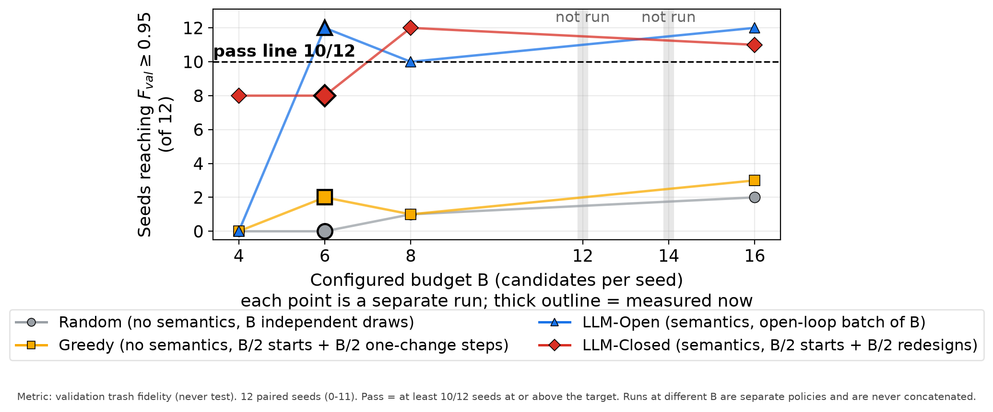
6 · MAIN RESULT
The open loop clears the bar at a budget the closed loop cannot
Ising chain, target 0.95, four independently executed budgets, the same 12 paired seeds.
Measured
• Budget 6: open 12/12 passes, closed 8/12 fails.
• Same budget and seeds: random 0/12, greedy 2/12.
Counts are not monotone
• Open over budgets 4, 6, 8, 16: 0, 12, 10, 12.
• Closed over the same budgets: 8, 8, 12, 11.
x: configured budget B, candidate circuits per seed. y: how many of the 12 paired seeds finished at or above validation fidelity 0.95. Dashed line: the 10-of-12 rule. Thick outline: measured here. Grey bands: budgets not run. Grey random, amber greedy, blue open loop, red closed loop.
Null result
• Target 0.99: 0 of 12 in both new runs.
• Not evidence that it is unreachable.
Does not show: No error bars - the quantity is a count over a fixed seed set, not an average. Nothing about budgets 12 or 14, the second target, other widths, or held-out test performance.
Next: What this does and does not mean.
Generated from the committed validation-only result tables by the checked-in figure script.
llm-vqc · Checkpoint: minimum budget to a target validation fidelity · 2026-09-08
7 / 10
Notes:
The non-monotone counts are the reason the interval was dropped from the reporting format.

Slide 8
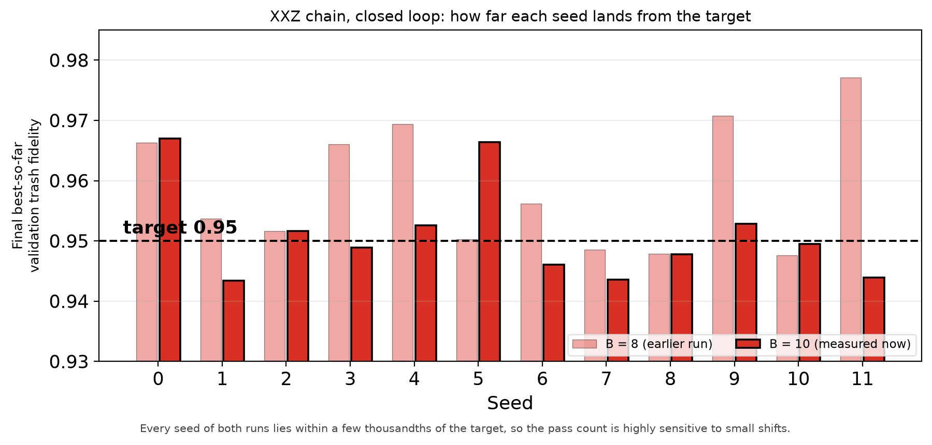
7 · INTERPRETATION
The XXZ count halved while the fidelities barely moved
Closed loop at the XXZ anchor, budget 8 against budget 10, per seed, same 12 paired seeds.
Observed (measured)
• Seeds at the target: 9 to 5 of 12.
• Mean fidelity moved only -0.0076; 17 of 24 results sit within 0.01 of it.
Interpretation (inferred)
• Near a threshold inside the distribution, the count is a knife-edge statistic.
• Only the budget was varied, so no cause is isolated.
x: seed. y: the final best-so-far validation trash fidelity that seed reached - pale for the earlier budget-8 run, solid for the budget-10 run measured here. Dashed line: the 0.95 target. Bars are single measured values, not averages.
Not supported
• That more budget harms the closed loop.
• That the closed loop is generally worse.
Does not show: Not the trajectory within a run, not the rejected candidates, and not whether a third run would land the same way.
Supports: the budget boundary is real and the count is threshold-sensitive. Does not support: any causal story about feedback.
Next: What would have to be true for this to be wrong.
llm-vqc · Checkpoint: minimum budget to a target validation fidelity · 2026-09-08
8 / 10
Notes:
Reporting the count faithfully matters more than explaining it; the mean shift is given so the reader can see the count is not a fidelity collapse.

Slide 9
8 · LIMITS AND OPEN QUESTIONS
What bounds this result, and what is recorded but unresolved
Stated before any of it is used to argue for a next step.
What would overturn it
Validity range
Negative and null results kept
Left unresolved on purpose
• A repeat landing on the other side of the threshold; margins are thousandths wide.
• A different target, which would reshuffle every count.
• 4 qubits, noiseless simulation, one circuit-capacity rule, one model snapshot, one XXZ anchor.
• 12 paired seeds; one open-loop pool shared across them, so 12 successes are not 12 generations.
• The closed loop fails the rule at budget 6.
• The XXZ boundary probe did not rescue the cell.
• Target 0.99: 0 of 12 everywhere, unresolved.
• 6 and 8 qubits and the alternative model were not probed; every method sits at 0-3 of 12 there.
• A blind sweep cannot separate invalid generation from too little search or capacity.
• Random fallbacks stay in the score: 12 of 408 evaluated candidates.
Open question: Attainment counts are not monotone in budget, so no statement of the form 'the minimum lies between X and Y' is supported by these runs.
Next: What needs deciding.
llm-vqc · Checkpoint: minimum budget to a target validation fidelity · 2026-09-08
9 / 10
Notes:
The limits are deliberately stated before the recommendation.

Slide 10
9 · DECISIONS AND NEXT STEP
Spend more on resolution, or diagnose why 0.99 is out of reach
Both new cells are complete; the next move needs a decision, not more of the same.
What the evidence supports
Decisions needed from you
Proposed next step
• Ising chain, target 0.95: smallest verified passing budget is 6 for the open loop, 8 for the closed loop; budget 4 fails for both.
• XXZ chain, closed loop: no verified passing budget; 8 and 10 are both verified failures (measured).
• Target 0.99 unresolved everywhere, both new cells included (null result).
• New work: 138 model calls, USD 0.29 at list prices, under a USD 2.00 cap.
• D1 Is the budget boundary worth more spend?
– (a) repeat both cells with fresh generation seeds - turns a knife-edge count into a distribution
– (b) stop refining; treat budget 6 open-loop as the working answer - free, but rests on one run
– Recommended (a), Ising cell only; moderate confidence.
• D2 What to do about the 0.99 target
– (a) diagnose circuit capacity and training length instead of search
– (b) record 0.99 as out of scope
– Recommended (a), moderate confidence; a budget sweep cannot separate the causes.
• D3 Any confirmatory read of held-out data
– Recommended: not yet, high confidence.
• On D1(a): repeat the Ising budget-6 cell with fresh generation seeds; report both runs together.
• On D2(a): write the capacity-versus-search protocol and its cost cap, then stop for review.
• A yes to either commits to a new protocol document and a new cost cap before anything runs.
• Already committed: report, raw logs with hashes, and the reproduction commands.
Recommendation and decision are recorded separately in the research log; nothing above is approved.
llm-vqc · Checkpoint: minimum budget to a target validation fidelity · 2026-09-08
10 / 10
Notes:
The recommendation and the decision are recorded separately in the research log; nothing above is treated as approved.

