Slide 1
Does an LLM design better quantum circuits,
or just bigger ones?
A five-gate, fixed-length comparison of LLM-guided and classical circuit search
Headline: last week's LLM advantage was mostly a circuit-size decision. Remove that one degree of freedom and it disappears on three of four tasks.
Tomoya Hatanaka
ML4SCI / Google Summer of Code 2026
July 31, 2026 · commit 0c7dff9 · experiment/bench-v2-real-llm-cost-minimal
Notes:
The question is deliberately narrow. Last week I reported that LLM-proposed circuits beat random search. This week I removed one degree of freedom from the search space and the advantage largely went away, which changes what that earlier result means.

Slide 2
WHAT CHANGED
Last week's search let the LLM choose the circuit size
Last week (2026-07-24 pilot)
This week - three conditions, 10 seeds each
Circuit body: 1 to 5 gates - length was itself a choice
Budget B = 4 candidates, 2 seeds
Reported: LLM open-loop 0.155 vs Random 0.189 (test RMSE; with 2 seeds mean = median)
Task generator amplitude_n3_smoke_v1 - not the one used this week
Its config: "integration/smoke demonstration only; not a statistically powered result"
PRIMARY: exactly 5 gates, B = 8. Length is fixed for every method, so it cannot be a source of advantage. Slides 6, 7 and 9 report this.
CONTROL A: 1 to 5 gates, B = 8 - length freed again, budget unchanged
CONTROL B: 1 to 5 gates, B = 4 - the pilot's own setting, rebuilt
Five arms in all three, up from three arms
Why this matters: if circuit length is a free variable and longer circuits are usually better, then any proposer that simply always asks for the maximum length wins - without designing anything.
The two data generators differ, so the pilot's numbers and this week's are NOT directly comparable. Slide 8 compares the three conditions above against each other - one codebase, one task, one model - so it does not depend on the pilot's numbers at all.
Verified against outputs/free_amplitude_fixed_readout_v1/EXPERIMENT_CONFIG.json: max_gates 5 (candidates ranged 1-5), budget_per_arm 4, seeds 2, 3 arms
Notes:
The pilot allowed one to five gates. That sounds harmless, but it hands the proposer a free decision that correlates with performance. This week I pinned the length so that decision cannot be made at all.

Slide 3
SEARCH SPACE
Applies to all three conditions only gate count and B differ between them
Every rule, stated so you can check any circuit by eye
Constraint | Value
Tasks | T1 Gaussian peak position · T2 sinusoid frequency · T3 change-point location · T4 one peak vs two (binary)
Qubits | 3 for T1, T2 (2^3 = 8 amplitudes); 5 for T3, T4 (2^5 = 32) - T3 and T4 are only frozen at n=5
Gate count | PRIMARY exactly 5 (not a max, not a range); Controls A and B relax it to 1-5. Every arm faces the same setting.
Gate set (7 types) | one wire: H, RX, RY, RZ two wires: CRX, CRY, CRZ
Angles | one continuous theta per gate in [-pi, pi]; H carries none
Budget | PRIMARY and Control A: B = 8 unique candidates. Control B: B = 4, the pilot's setting. 10 seeds throughout.
Training | NONE. The proposed angles are evaluated verbatim - no optimizer exists on this path.
Encoding / readout | amplitude encoding; Pauli-Z on qubit 0; prediction = (1 - <Z0>)/2
Classical params | zero - no dense layer can rescue a weak circuit
One operation = one physical gate here. There are no layer macros: a 5-gate circuit compiles to 5 gates, so "5" means the same thing to every arm and to the reader.
llm_vqc/mini5/space.py - the same grammar check is applied to classical samplers and LLM replies alike
Notes:
Everything is on this slide on purpose. Three or five qubits, seven gate types, exactly five gates, one angle per gate, no optimizer, no classical parameters. A reader can verify any proposed circuit against these seven rows.

Slide 4
WHAT IS MEASURED
One number, defined once: RMSE
Validation RMSE drives the search. Each arm evaluates its candidates and keeps the best one by validation RMSE.
Test RMSE is reported. The held-out split is touched once per cell, after the choice is frozen, so the reported number was never used to make that choice.
T1-T3 regress a continuous quantity, so RMSE is the natural metric.
T4 is binary classification. RMSE against a 0/1 label equals the square root of the Brier score - a proper scoring rule - so all four panels share one axis. AUROC is reported alongside it, and slide 7 shows why that matters.
RMSE is comparable between arms within one task, never between tasks. T1, T2, T3 and T4 predict different quantities on different scales, so the panels each carry their own y-axis and a T1 value must not be read against a T3 value.
256 train / 256 validation / 2048 test per replicate, regenerated per seed
Notes:
I dropped the phrase protected-test RMSE from last week because it was confusing. The discipline behind it is unchanged: the test split is evaluated once, after selection. What changed is only the label.

Slide 5
DESIGN
Applies to all three conditions arms are identical throughout
Five arms, one shared budget of unique candidates
Arm | How it proposes | API calls
Random | draws 5 gates, wires and angles uniformly | none
Evolutionary | (mu+lambda), mu=4: seed 4 at random, then mutate a survivor | none
Greedy | hill climbing: mutate the incumbent, keep it only if validation improves | none
LLM open-loop | one request per candidate; sees only the model contract and n | 1 per candidate
LLM closed-loop | same, plus validation-only results for what it already tried | 1 per candidate
B = 8 unique evaluated candidates per arm, 10 seeds. A duplicate or an ungrammatical proposal is recorded but consumes no budget, so no method can buy extra evaluations by proposing badly - and no method gets fewer because it proposes well. One candidate per request, so the closed loop is genuinely sequential: propose, see the result, propose again, eight times.
Greedy growth cannot apply at fixed length, so Greedy here is fixed-length hill climbing
Notes:
The budget is unique evaluated candidates because that is the quantity every method spends and the one that dominates cost. Duplicates and invalid proposals are the proposer's own problem; they do not earn extra tries.

Slide 6
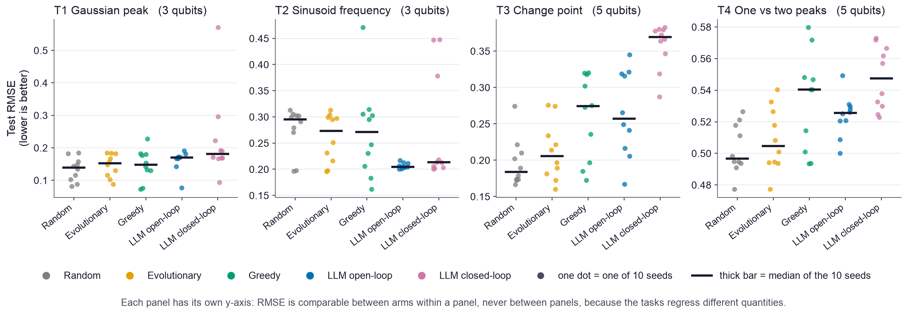
RESULT
PRIMARY: exactly 5 gates, B = 8, 10 seeds all four tasks, T1-T4
Random search wins on three of four tasks
The LLM wins on T2 alone, and there it wins clearly (0.204 vs 0.295). Closed-loop never beats open-loop on any task: eight rounds of feedback did not help this model at this budget.
10 seeds per arm, B = 8, exactly 5 gates · data/per_cell.csv
Notes:
Read the medians, not the individual dots. Random is best on T1, T3 and T4. The LLM arms win on T2 and only there. I am reporting this as measured; it is a negative result for the LLM hypothesis at this scale.

Slide 7
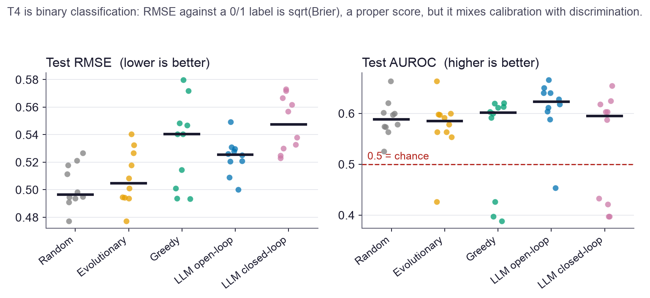
METRIC CHECK
PRIMARY: exactly 5 gates, B = 8, 10 seeds T4 only (peak count, 5 qubits)
On T4 the metric, not the method, picks the winner
By RMSE, Random leads. By AUROC, LLM open-loop leads. Same predictions, opposite ranking.
RMSE punishes a circuit that ranks the two classes correctly but outputs 0.45 and 0.55 instead of 0 and 1. AUROC does not.
With five gates and no optimizer the outputs sit near 0.5, so this failure mode is live here, not hypothetical.
Both numbers are shown because either one alone asserts a different answer.
Neither reading is strong. AUROC spans roughly 0.59 to 0.62 against 0.5 for chance. The honest summary of T4 is that five gates without training barely solve it at all, and that no arm separates convincingly.
AUROC computed from the identical predictions used for the RMSE, on the same single test evaluation
Notes:
This is why I kept AUROC even though the request was to use plain RMSE everywhere. On T4 the two metrics disagree about who wins, so reporting only one would have asserted something the data does not settle.

Slide 8
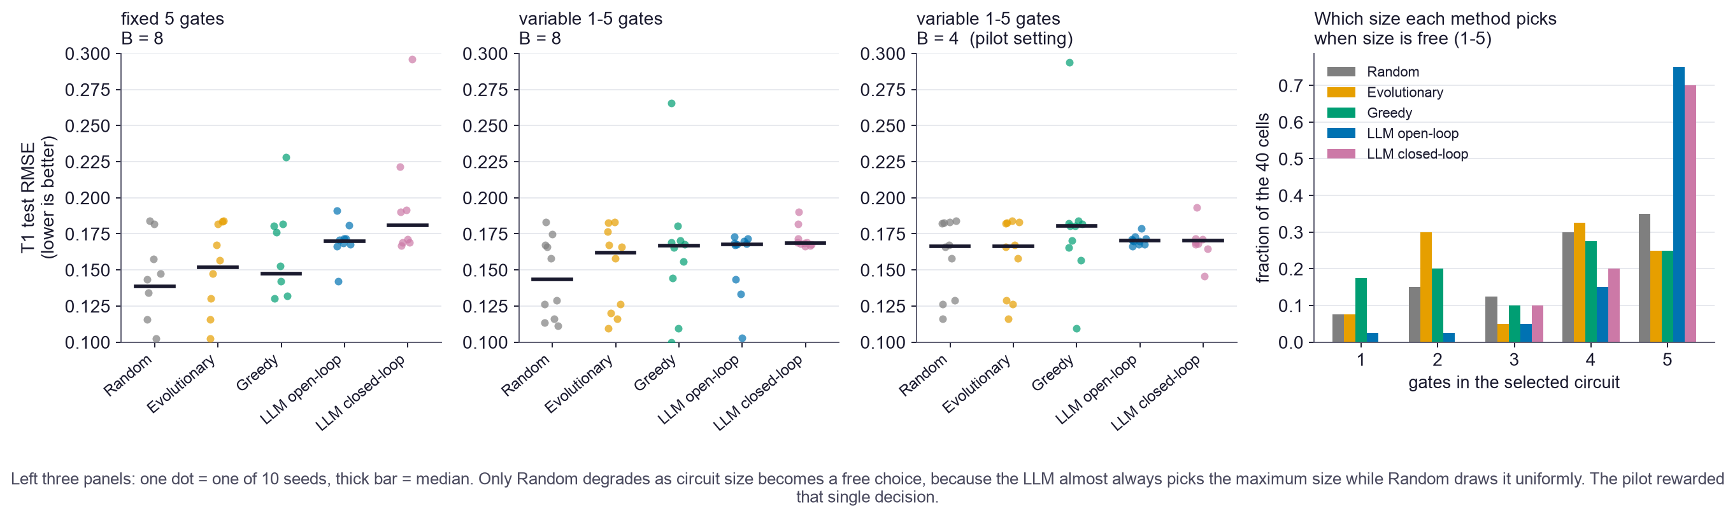
ATTRIBUTION
ALL THREE CONDITIONS side by side T1 only (Gaussian peak, 3 qubits)
Last week's advantage was a size decision, not a design one
Right panel: when length is free the LLM picks the maximum in about 7 of 10 cells while the classical arms spread over 1 to 5. Left three: only Random degrades as length is freed and the budget shrinks (T1 median 0.139 → 0.167), while the LLM barely moves (0.170 → 0.170). At the pilot's setting they meet.
All three conditions ran all four tasks with 10 seeds; T1 is shown here because it is the family the pilot used · data/condition_comparison.json
Notes:
This is the slide I would defend hardest. The pilot rewarded a single decision - ask for the maximum number of gates - and the LLM makes that decision almost every time while a uniform sampler does not. Pin the length and the advantage goes; restore the length and shrink the budget to the pilot's and the two meet again.

Slide 9
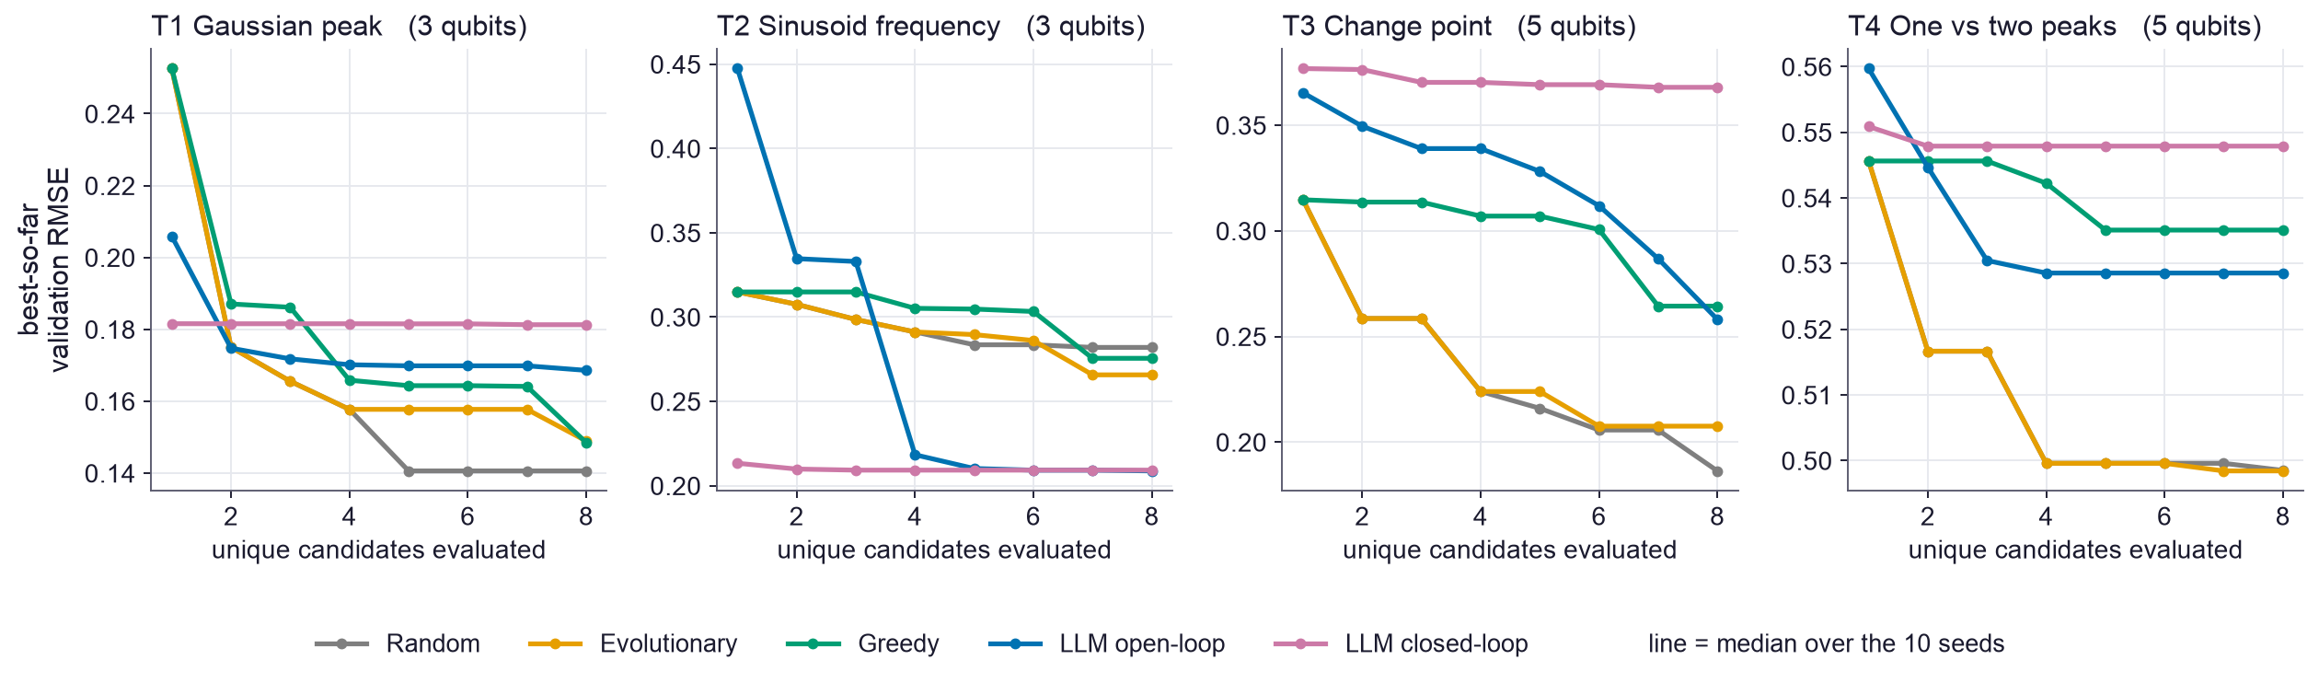
SEARCH DYNAMICS
PRIMARY: exactly 5 gates, B = 8, 10 seeds all four tasks, T1-T4
More feedback did not translate into better circuits
Closed-loop received eight rounds of validation-only feedback on its own candidates and still did not beat open-loop on any task.
A first attempt measured a 74% duplicate rate for closed-loop, with 11 of 40 cells starved of budget. The prompt now lists every circuit already tried; duplicates fell to 16% and every cell reached its full budget. The numbers here are from the corrected run.
Curves are the median best-so-far validation RMSE over 10 seeds; the x-axis is unique candidates, not API calls
Notes:
Worth being explicit: the first version of this experiment handicapped closed-loop through a prompt defect. I fixed it and re-ran rather than reporting the handicapped numbers. Even after the fix, feedback did not help.

Slide 10
What I can and cannot claim
Supported by this run
NOT supported
With circuit length fixed, gpt-5-nano does not beat random search on 3 of 4 tasks
It does beat every classical arm on T2, clearly and across all 10 seeds
When length is free it picks the maximum ~70% of the time; uniform sampling does not
That single decision explains most of last week's reported advantage
"LLMs cannot design quantum circuits" - one small model, one budget, four tiny tasks
"Closed-loop feedback does not work" - it failed here at 8 rounds on 5-gate circuits
Any claim about hardware: this is noiseless statevector simulation throughout
Any cross-task comparison of RMSE values
Next: give the LLM a decision that is actually hard. Fixed length removed the easy win; the open question is whether a larger budget, a stronger model, or a task where structure matters more can produce an advantage that survives this kind of attribution check.
600 cells across 3 conditions · 2.9 min for the main run · gpt-5-nano-2025-08-07 · $0.23 total
Notes:
The honest summary is that I removed a confound and a positive result mostly went away. That is a useful outcome: it tells us the earlier benchmark was rewarding the wrong thing, and it tells us what a fair test has to control for.

