Slide 1
Does the quantum-autoencoder search result
hold up when one thing changes?
A controlled robustness study of the previous result: change exactly one factor at a time — evaluation budget, qubit count, Hamiltonian, language model — and see which findings survive.
The question: last time, physics-informed language-model proposals beat random and greedy circuit search by a wide margin, and a closed feedback loop added a small extra gain — at 4 qubits, one Hamiltonian, one budget, one model. Which of those two findings is a property of the method, and which was a property of that one setting? We answer by moving exactly one declared factor per condition.
Tomoya Hatanaka
ML4SCI / Google Summer of Code 2026
September 4, 2026

Slide 2
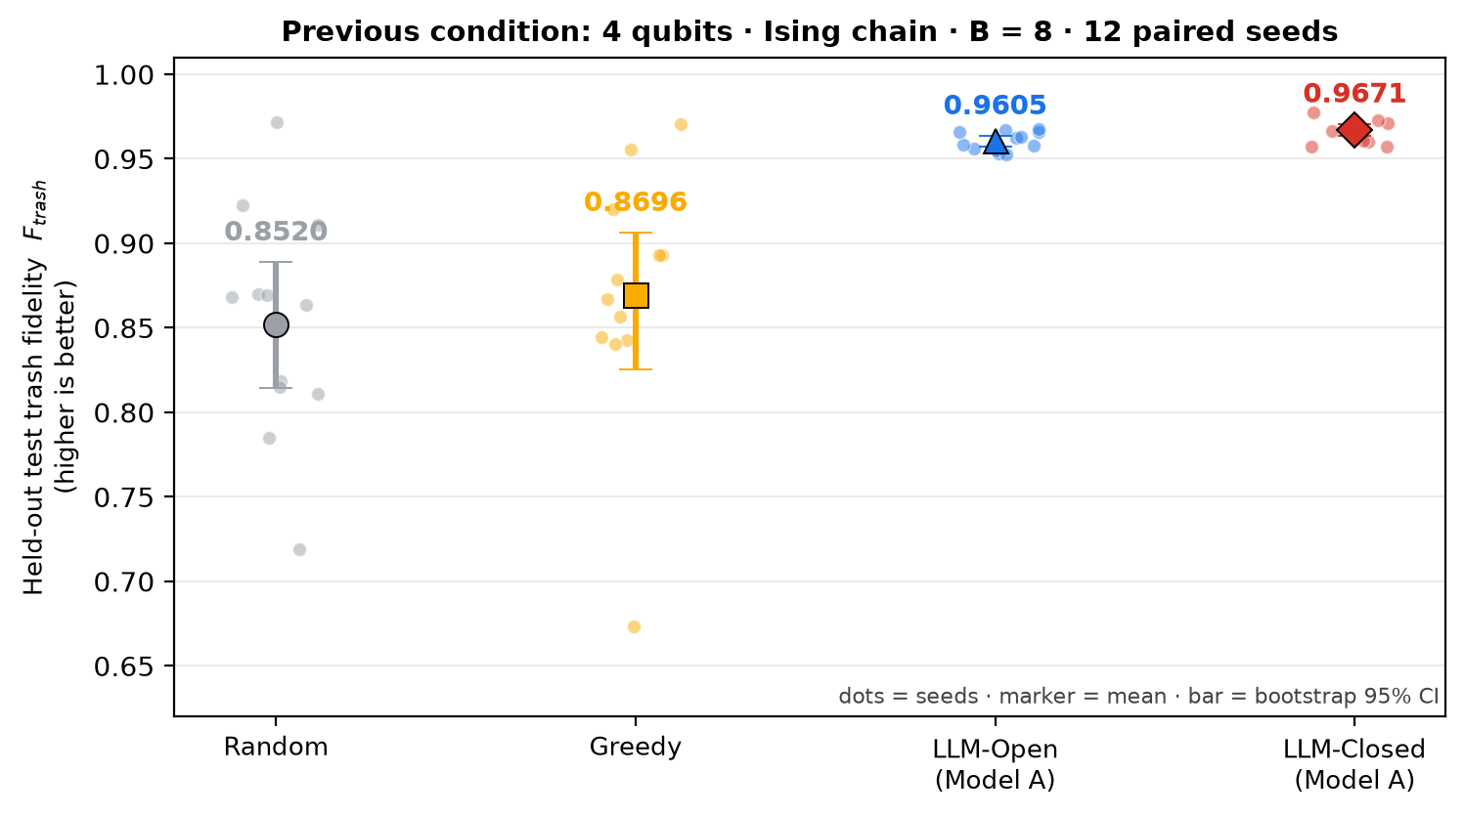
1 · PREVIOUS BASELINE
Where we left off: the previous baseline result
Quantum autoencoder (QAE): compress ground states into fewer qubits — 4 qubits · transverse-field Ising chain · budget B = 8 · 12 paired seeds
Input |ψ(h)⟩
ground state of the 4-qubit Ising chain
H = −Σ Zᵢ Zᵢ₊₁ − h Σ Xᵢ, h ∈ [0.2, 2.0]
→
Encoder Uθ
the circuit we search:
16 gates, angles trained
→
Latent q0, q1
the 2 qubits we KEEP
(the compressed code)
→
Trash q2, q3
should end in the SAME state |00⟩
for every input
Metric — trash fidelity: F_trash = ⟨00| ρ_trash |00⟩ = P(q2 q3 = 00), the probability that the trash qubits end in |00⟩. Higher is better. Reported on a held-out test set (64 unseen h values never used for training, selection or feedback), read once after selection.
The four methods — each may train and score exactly B candidate circuits per seed (B = the evaluation budget)
Random B independent uniform circuit draws; no physics, no feedback.
Greedy B/2 random starts (exploration, no feedback), then B/2 single-gate refinements of the best one (refinement, uses validation feedback); a change is kept only if validation improves.
LLM-Open open-loop: the language model writes all B physics-informed proposals BEFORE any score is seen.
LLM-Closed closed-loop: B/2 proposals, then B/2 free redesigns of the current best circuit, each given its validation score.
What the baseline found
1 Semantics is decisive. LLM-Open − Random +0.1084 [+0.0726, +0.1471] · 11/12 seeds · p < 0.001
2 The closed loop adds a little more. LLM-Closed − LLM-Open +0.0066 [+0.0023, +0.0112] · 11/12 seeds · p = 0.012
3 Non-semantic refinement is flat. Greedy − Random +0.0175 [-0.0249, +0.0625] · 6/12 seeds · p = 0.519
Reading: dots = the 12 paired seeds (12 independent draws of training/validation data, shared by all methods); marker = mean; bar = bootstrap 95% confidence interval (CI). Differences are per-seed paired; p = exact paired Wilcoxon test. Model A = the reference model of the baseline (gpt-5.4-mini).

Slide 3
2 · CONTROLLED PROTOCOL
One factor at a time; everything else frozen
Every condition differs from the baseline in exactly one declared factor, and an automated check refuses any condition that does not
FROZEN for every condition
• the task: quantum autoencoder, trash fidelity metric, 12 paired seeds
• the four methods, exactly as defined on the previous slide
• the language-model workflow: prompt wording, output format, sampling temperature, retry policy (only stated Hamiltonian facts are substituted)
• the circuit trainer: same optimizer, epochs, initialisation, data splits
• the selection rule: lowest validation loss; test set read once afterwards
• the gate set: RX, RY, RZ rotations and CNOT (controlled-NOT) gates
• random-number streams and all statistical conventions
VARIED — one factor per condition
Factor | Levels tested | All other settings
Evaluation budget B | 4 · 8 · 16 | 4 qubits, Ising, Model A
Qubit count | 4 · 6 · 8 | B = 8, Ising, Model A
Hamiltonian | Ising · XXZ | 4 qubits, B = 8, Model A
Language model | Model A · Model B | 4 qubits, Ising, B = 8
Model A = the reference model of the baseline (gpt-5.4-mini, March 2026 snapshot). Model B = the alternative model (gpt-4.1-mini, April 2025 snapshot): same prompt bytes, temperature, retries and token limit; only the model name changes.
XXZ = the second Hamiltonian family, an XXZ Heisenberg chain H = Σ (Xᵢ Xᵢ₊₁ + Yᵢ Yᵢ₊₁ + Δ Zᵢ Zᵢ₊₁), Δ ∈ [0.2, 2.0], declared before the run. The prompt changes only in the stated physics facts.
Scaling rules, fixed before the run: (1) circuit width = 3 trainable rotations + 1 CNOT per qubit for every method — so 4 qubits reproduces the baseline's 16-gate contract exactly; (2) half the qubits are latent, half are trash; (3) the two adaptive methods (Greedy, LLM-Closed) always split B evenly: B/2 exploration (proposals made without feedback) + B/2 refinement (proposals that use validation feedback).
Fairness check: each condition stores a fingerprint of every frozen component above; the run refuses to start if the fingerprint differs from the baseline's or if more than one factor moves. The baseline cell is reused rather than re-run; tests prove the study code reproduces its data, prompts and trainer exactly.
Reused baseline cell: 4 qubits · Ising · B = 8 · Model A. Not part of this study, by design: any change to the prompt's physical content.

Slide 4
3 · HOW TO READ THE RESULT GRIDS
How to read the two result grids
One grid per Hamiltonian · one cell per (qubit count, budget) · six categories per cell — the next two slides use exactly this layout
Ising grid (next slide)
XXZ grid (slide after)
The six categories in every cell, left to right
 | B = 4 | B = 8 | B = 16
4 qubits | 4 categories (Model A only) | 6 categories | 4 categories (Model A only)
6 qubits | not run | 4 categories (Model A only) | not run
8 qubits | not run | 4 categories (Model A only) | not run
 | B = 4 | B = 8 | B = 16
4 qubits | not run | 4 categories (Model A only) | not run
6 qubits | not run | not run | not run
8 qubits | not run | not run | not run
1 Random — no physics, no feedback
2 Greedy — no physics; single-gate refinement of the best start
3 LLM-Open · Model A — open-loop proposals, gpt-5.4-mini
4 LLM-Closed · Model A — closed-loop redesigns, gpt-5.4-mini
Rows = qubit count (4, 6, 8; half latent, half trash). Columns = evaluation budget B (4, 8, 16).
Why cells are missing: the study was designed one factor at a time from the baseline cell, so the off-axis cells were not run. They are shown grey, never estimated. Model B was run only in the baseline cell.
5 LLM-Open · Model B — open-loop proposals, gpt-4.1-mini
6 LLM-Closed · Model B — closed-loop redesigns, gpt-4.1-mini
Encoding in every cell: small dots = the 12 paired seeds; large marker = mean; vertical bar = bootstrap 95% CI; the number above = mean. Model A = filled markers, Model B = hollow markers of the same colour. Thick frame = the baseline cell. All cells share the same vertical axis.
Metric: held-out test trash fidelity F_trash, higher is better; 1.0 means the trash qubits are exactly |00⟩ for every test state.
Comparisons: all four methods in a cell share the same seeds and data, so differences are read per seed (paired), never as raw means.
Random and Greedy do not depend on the language model, so they appear once per cell; the two LLM methods are split by model, giving six categories.

Slide 5
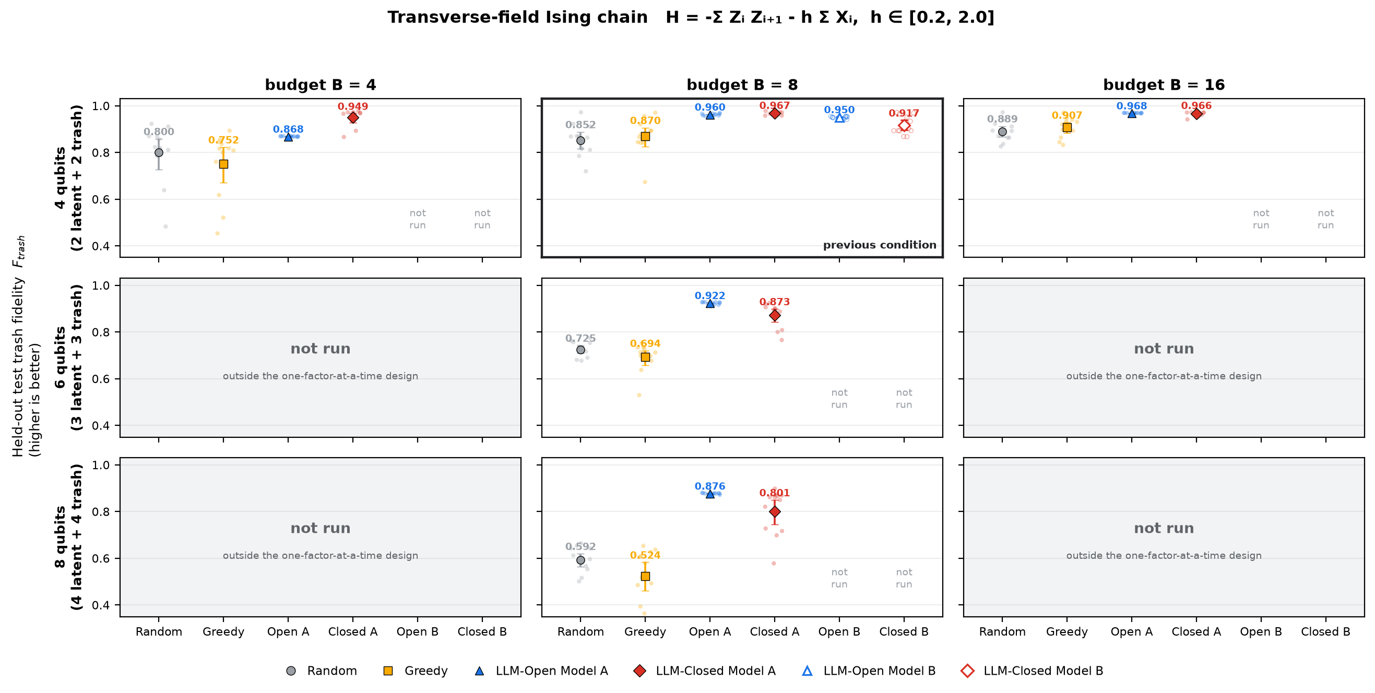
4 · RESULTS — HAMILTONIAN 1
Ising chain: the semantic methods stay on top in every cell run
H = −Σ Zᵢ Zᵢ₊₁ − h Σ Xᵢ, h ∈ [0.2, 2.0] · 5 of 9 cells run (one factor at a time) · Model B only in the baseline cell
Reading: going down the middle column, Random falls from 0.852 to 0.592 while LLM-Open (Model A) falls only from 0.960 to 0.876. Every number is a mean over 12 paired seeds; grey cells were not run.

Slide 6
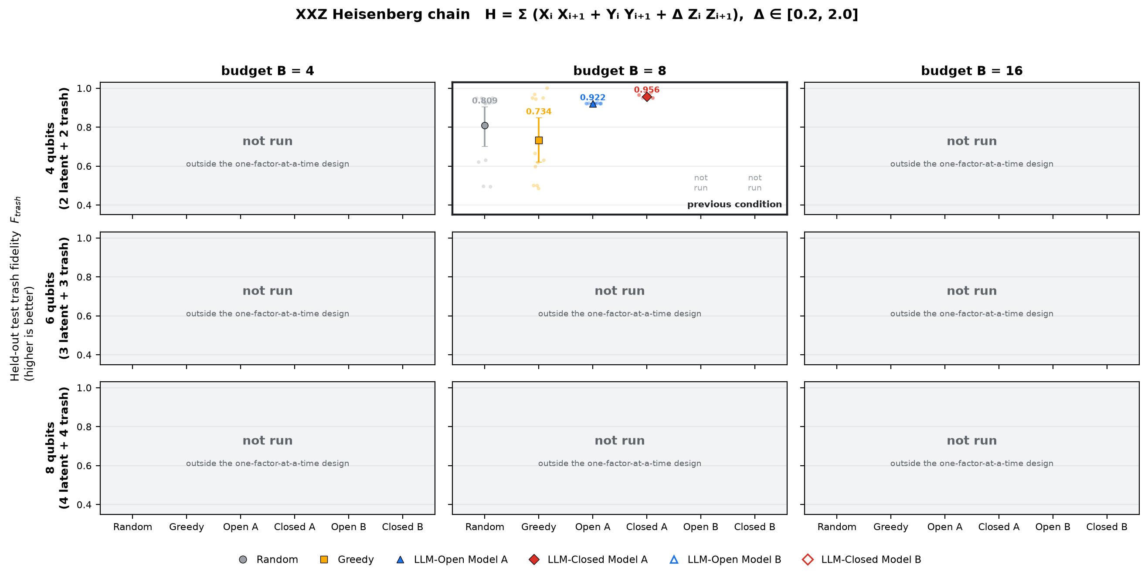
5 · RESULTS — HAMILTONIAN 2
XXZ chain: the same picture in the one cell that was run
H = Σ (Xᵢ Xᵢ₊₁ + Yᵢ Yᵢ₊₁ + Δ Zᵢ Zᵢ₊₁), Δ ∈ [0.2, 2.0] · 1 of 9 cells run (the baseline's qubit count and budget) · Model A only
Reading: at 4 qubits, B = 8 the ordering is LLM-Closed 0.956 > LLM-Open 0.922 > Random 0.809, with Random's seeds spread widely. The other eight cells were not run and are shown grey, not estimated.

Slide 7
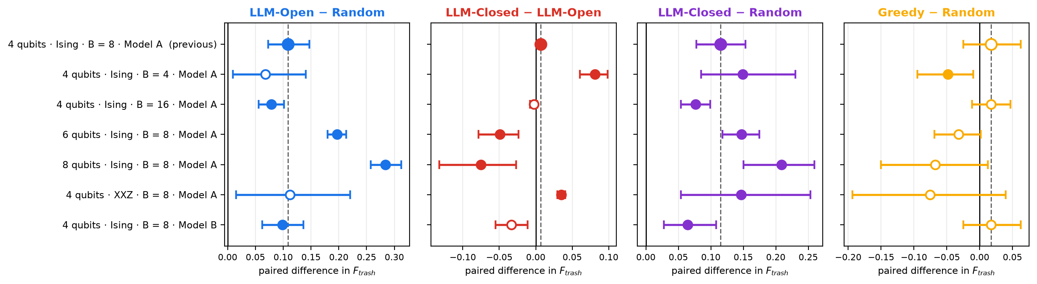
6 · CROSS-GRID SUMMARY
What consistently helps, and what is fragile
Rows = run cells; panels = paired per-seed differences (positive = the first method wins). Filled marker = p < 0.05; dashed line = the baseline's value.
ROBUST — physics-informed proposals beat non-semantic search
LLM-Open − Random keeps its sign in 6/6 varied conditions and is significant in 4/6; LLM-Closed − Random is significant in 6/6. The gap is largest at 8 qubits, where the non-semantic methods degrade fastest.
FRAGILE — the closed loop's edge over the open batch
LLM-Closed − LLM-Open keeps the baseline's sign in only 2/6 varied conditions: significantly positive at B = 4, the XXZ chain, significantly negative at 6 qubits, 8 qubits.
NEVER HELPS — single-gate greedy refinement
Greedy − Random is significantly positive in 0/6 conditions and significantly negative at B = 4: spending half of a small budget on single-gate steps costs breadth.
"Significant" = exact paired Wilcoxon p < 0.05 over 12 seeds; "keeps its sign" = the mean paired difference has the same sign as in the baseline. A non-significant cell is not evidence of no effect.

Slide 8
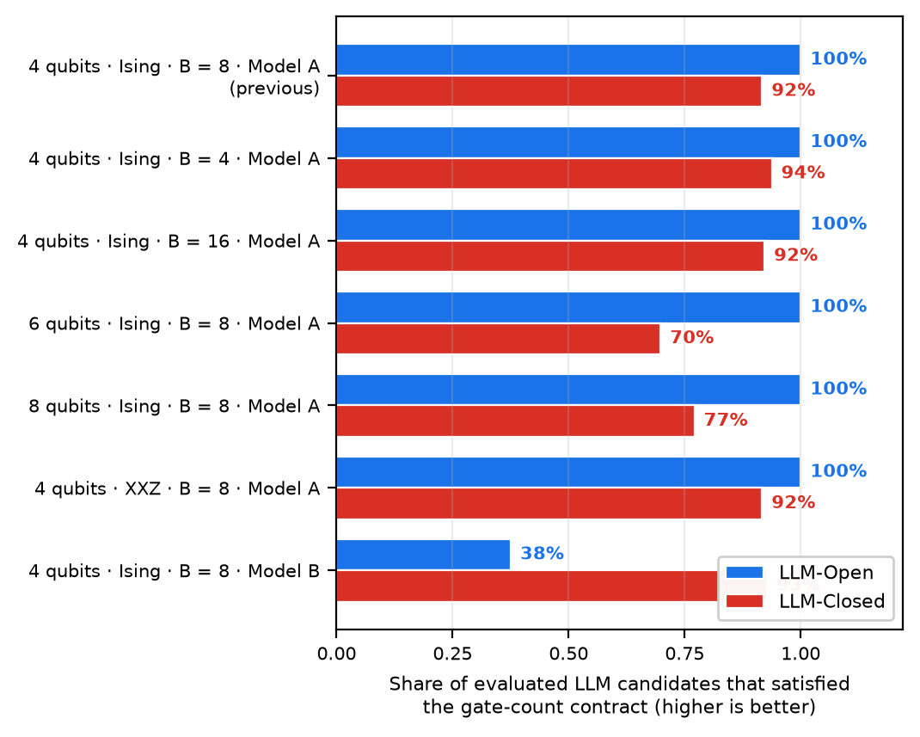
7 · INTERPRETATION
What the pattern implies — and what it does not
Four factors, read one at a time; the right-hand panel shows a failure mode that runs across all of them
Budget B
The closed loop's edge over the open batch is largest at the smallest budget (+0.0812 at B = 4), small at B = 8 (+0.0066) and gone at B = 16 (-0.0023). Free redesign is worth most when the open batch is thinnest; a wide open batch buys the same breadth without feedback.
Qubit count
Absolute fidelity falls for every method as the register widens, but the semantic advantage grows: LLM-Open − Random +0.1084 → +0.1968 → +0.2841. The closed loop reverses (-0.0494 at 6, -0.0752 at 8 qubits).
Hamiltonian family
On the XXZ chain the closed loop wins clearly (+0.0348, 12/12 seeds). LLM-Open − Random is +0.1121 on average but only 5/12 seeds: Random occasionally finds a very good circuit here, so the mean overstates a per-seed effect. Two families are two points.
Language model
With Model B the semantic advantage is essentially unchanged (+0.0982 vs +0.1084), even though only 65% of its evaluated proposals satisfied the gate-count contract. The closed loop does not keep its edge (-0.0336).
A separate failure mode: the gate-count contract = every proposal must contain exactly 3 rotations and 1 CNOT per qubit; a proposal that does not is replaced by a flagged random circuit and costs one of the B evaluations.
Which call breaks depends on the condition, not the method: with Model B the open batch fell to 38% valid (closed loop 93%); at 6 qubits the closed loop fell to 70% (open batch 100%). So part of an apparent method effect at larger registers or with a weaker model is a proposal-validity effect.
Not claimed: that the closed loop is bad in general, or that any one ingredient causes the semantic advantage. Greedy and LLM-Closed differ in search freedom as well as physics knowledge, by design.

Slide 9
8 · LIMITATIONS AND NEXT ACTION
What this study cannot say, and the concrete next step
Limitations of the evidence on the left; the next experiment, phrased as a measurable target, on the right
Limitations
• 12 paired seeds per cell: enough for large effects, underpowered for small ones — a "not detected" cell is not evidence of absence.
• One factor at a time: no interaction was measured (for example a large budget at 8 qubits); 4 of 9 Ising cells and 8 of 9 XXZ cells are empty.
• Two Hamiltonian families and two language models are two points each, not a survey; Model B was run only in the baseline cell.
• Noiseless state-vector simulation: no sampling noise, no device connectivity.
• The circuit width grows with the qubit count by a fixed rule, so "more qubits" also means "more gates"; the two were not separated.
• Greedy and LLM-Closed differ in search freedom as well as in physics knowledge, so that pair is not an information-matched comparison.
• Simulation cost, not model cost, is the binding constraint: state-vector training grows exponentially with the qubit count.
NEXT ACTION — target accuracy and minimum required budget
So far every comparison asks "which method is best at a fixed budget B?". The practical question is the reverse:
1 Target accuracy. Fix, before any run, the held-out trash fidelity the compressed state must reach for its downstream use — a target F_target (candidate levels 0.95 and 0.99, to be chosen with the application in mind).
2 Minimum required budget. For each method and condition, measure B_min = the smallest budget at which the selected circuit reaches F_target in at least 10 of the 12 paired seeds. Sweep B ∈ {2, 4, 8, 16, 32} at 4 and 8 qubits for both Hamiltonians and both models.
What already exists: Random's candidates are nested across budgets, so its B_min for B ≤ 16 can be read from the logged runs without new simulation; the LLM methods need new runs because their batches change with B.
Deliverable: one table of B_min per (method, qubit count, Hamiltonian, model) at each F_target, pre-registered like this study, with the same paired-seed statistics.
Also still open, in order: a full factorial grid (interactions), more Hamiltonian families and models, sampling noise and hardware topology.

Slide 10
9 · CONCLUSION
What is robust, what is fragile, what is open
Robust: physics-informed proposals beat non-semantic search
Same sign in 6 of 6 varied conditions (significant in 4) — a different budget, a wider register, a different Hamiltonian, a different language model. This is no longer a property of one setting.
Fragile: the closed loop's edge over the open batch
Significantly positive in 2 of 6 varied conditions and significantly negative in 2: it helps at small budgets and on the XXZ chain, vanishes at a large budget, and reverses at 6 and 8 qubits. The claim must be restated as budget- and width-dependent.
New and measurable: proposal validity is its own bottleneck
As few as 65% of evaluated proposals met the gate-count contract in the weakest cell, and each invalid proposal is spent as a random draw. Fixing generation validity is cheaper than richer feedback.
Open: the budget the application actually needs
Next: fix a target accuracy and measure the minimum budget each method needs to reach it — the question that decides whether any of this is worth using.
One-line message: the language model's advantage is in the proposals it writes, and that advantage survived every single-factor change; the feedback loop's advantage did not.
All figures and statistics come from the committed result tables via the committed build scripts; 12 paired seeds per cell; held-out test read once after validation-only selection.

