Slide 1
Does the quantum-autoencoder
search result hold up?
A controlled stress test of last meeting's finding: change one thing at a time and see what survives.
Evaluation budget
B = 4 / 8 / 16
Qubit count
4 / 6 / 8
Hamiltonian family
Ising / XXZ
Language model
two snapshots
Everything else is frozen: same methods, prompts, schema, trainer, optimizer, splits, selection rule and the same 12 paired seeds.
Held-out test trash fidelity, read once after selection. Higher is better.
Research meeting - 4 September 2026

Slide 2
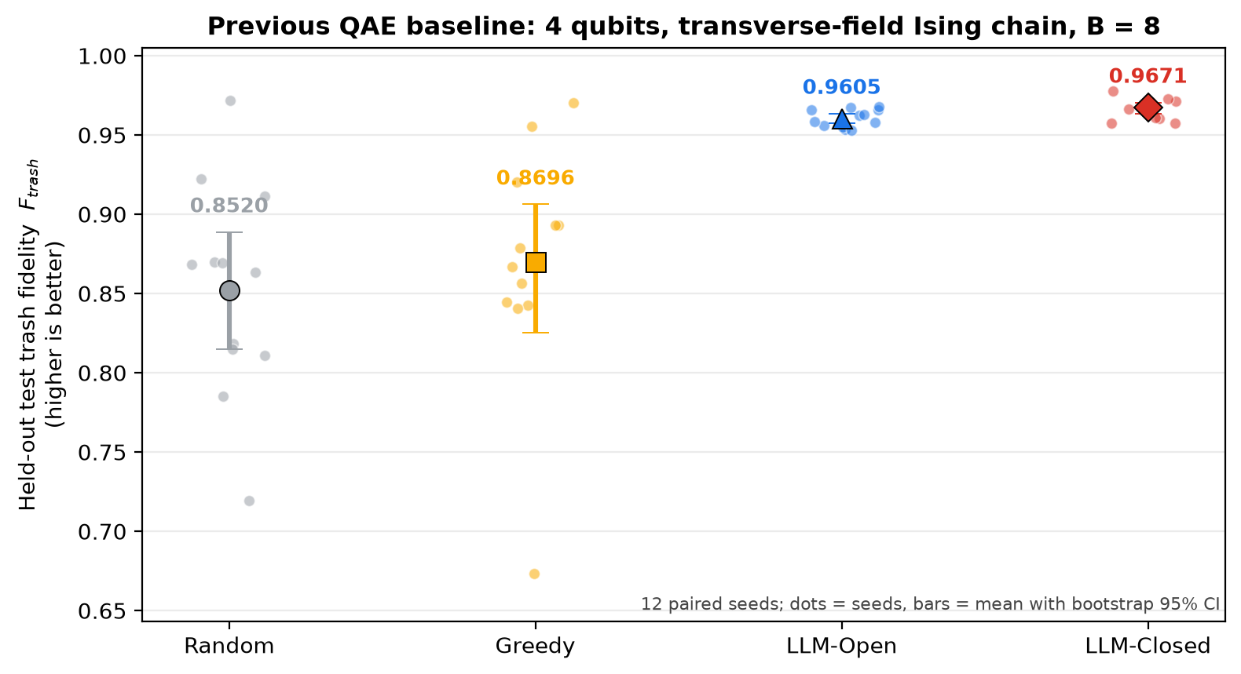
Where we left off: the previous baseline
4 qubits - transverse-field Ising chain - budget B = 8 - 12 paired seeds
The two claims to stress-test
1. Semantics is decisive.
Open - Random +0.1084 [+0.0726, +0.1471], 11/12 seeds, p < 0.001
2. Closed-loop redesign adds a little more.
Closed - Open +0.0066 [+0.0023, +0.0112], 11/12 seeds, p = 0.012
3. Non-semantic search is flat.
Greedy - Random +0.0175 [-0.0249, +0.0625], 6/12 seeds, p = 0.519
Selected-architecture means: Random 0.8520, Greedy 0.8696, Open 0.9605, Closed 0.9671.
Claim 1 was large and consistent. Claim 2 was small and had been detected exactly once - the fragile one.
Reference values read from the committed result tables of the previous study, not from last meeting's slide text.

Slide 3
How the comparison is kept honest
One factor at a time; every other setting held at the previous condition
Factor varied | Levels | Everything else
Evaluation budget B | 4 - 8 - 16 | 4 qubits, Ising, reference model
Qubit count | 4 - 6 - 8 | B = 8, Ising, reference model
Hamiltonian family | Ising - XXZ | 4 qubits, B = 8, reference model
Language model | reference - alternative | 4 qubits, Ising, B = 8
The four methods (unchanged)
Random - B independent uniform candidates.
Greedy - B/2 random starts, then B/2 single-change refinements.
Open - B semantic proposals, all written before any score is seen.
Closed - B/2 semantic starts, then B/2 free redesigns of the current best using validation feedback.
Scaling rules fixed in advance
Circuit width is 3 trainable rotations + 1 controlled-NOT per qubit for every method, so 4 qubits reproduces the previous contract exactly.
Latent and trash registers are always half and half.
Adaptive methods always split the budget 50/50 between exploration and refinement.
Selection and feedback use validation only. The held-out test set is read once, after selection.
Held constant, and checked mechanically
Prompt template, wording and output schema; validation and retry behaviour; sampling temperature; the trainer, optimizer, epochs and initialisation; the data splits; the selection rule; the gate set; every method's logic; the random-number streams; and all analysis conventions.
Each condition carries a fingerprint of all of the above. An automated check refuses to run a condition whose frozen block is not identical to the previous condition's, or that moves more than one factor.
The previous condition is reused rather than re-run; tests prove this code reproduces its data, prompts and trainer exactly.

Slide 4
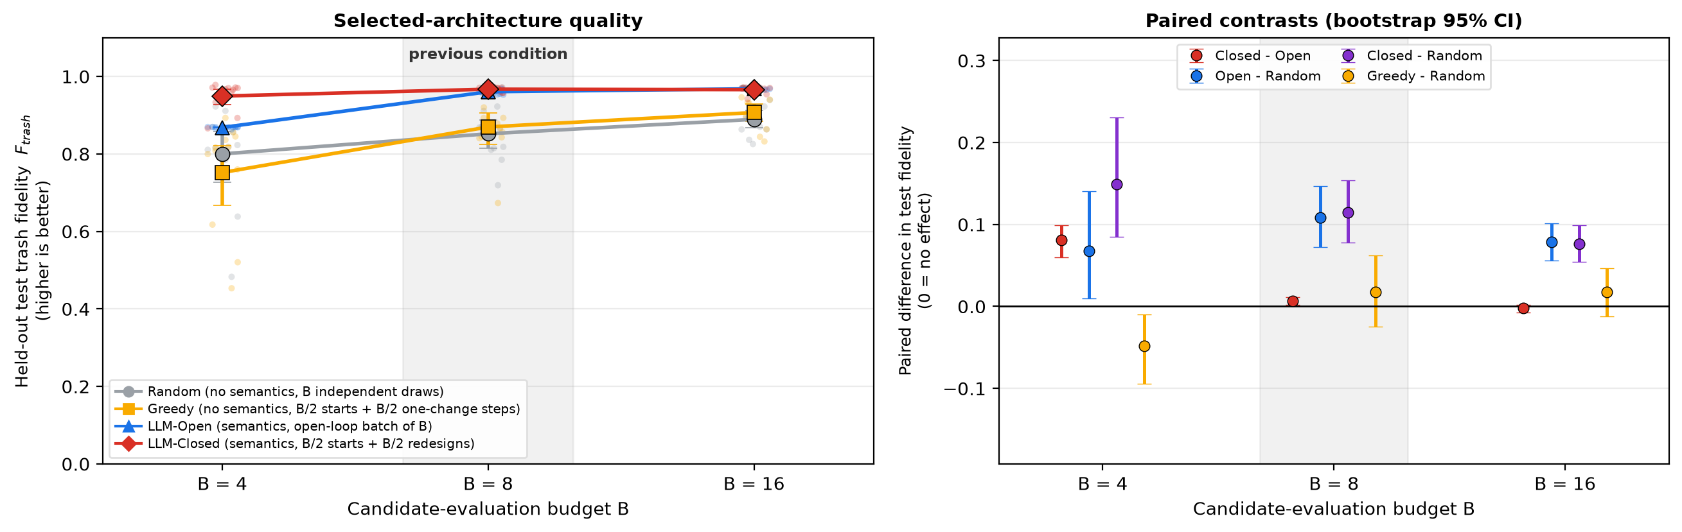
Changing the evaluation budget
4 qubits, Ising chain, reference model - only B moves. B = 8 is the previous condition.
Semantic proposals beat non-semantic search at every budget. The closed loop's edge over the open batch is budget-dependent: largest at the smallest budget and gone by the largest.
Paired contrast | B = 4 | B = 8 (previous) | B = 16
Open - Random | +0.0681 [+0.010, +0.141] 8/12 seeds, p = 0.064 | +0.1084 [+0.073, +0.147] 11/12 seeds, p < 0.001 | +0.0789 [+0.056, +0.101] 11/12 seeds, p < 0.001
Closed - Open | +0.0812 [+0.060, +0.099] 11/12 seeds, p < 0.001 | +0.0066 [+0.002, +0.011] 11/12 seeds, p = 0.012 | -0.0023 [-0.008, +0.002] 9/12 seeds, p = 0.677
Adaptive methods keep the 50/50 exploration/refinement split at every budget (2+2, 4+4, 8+8). All 12 seeds are shown as dots.

Slide 5
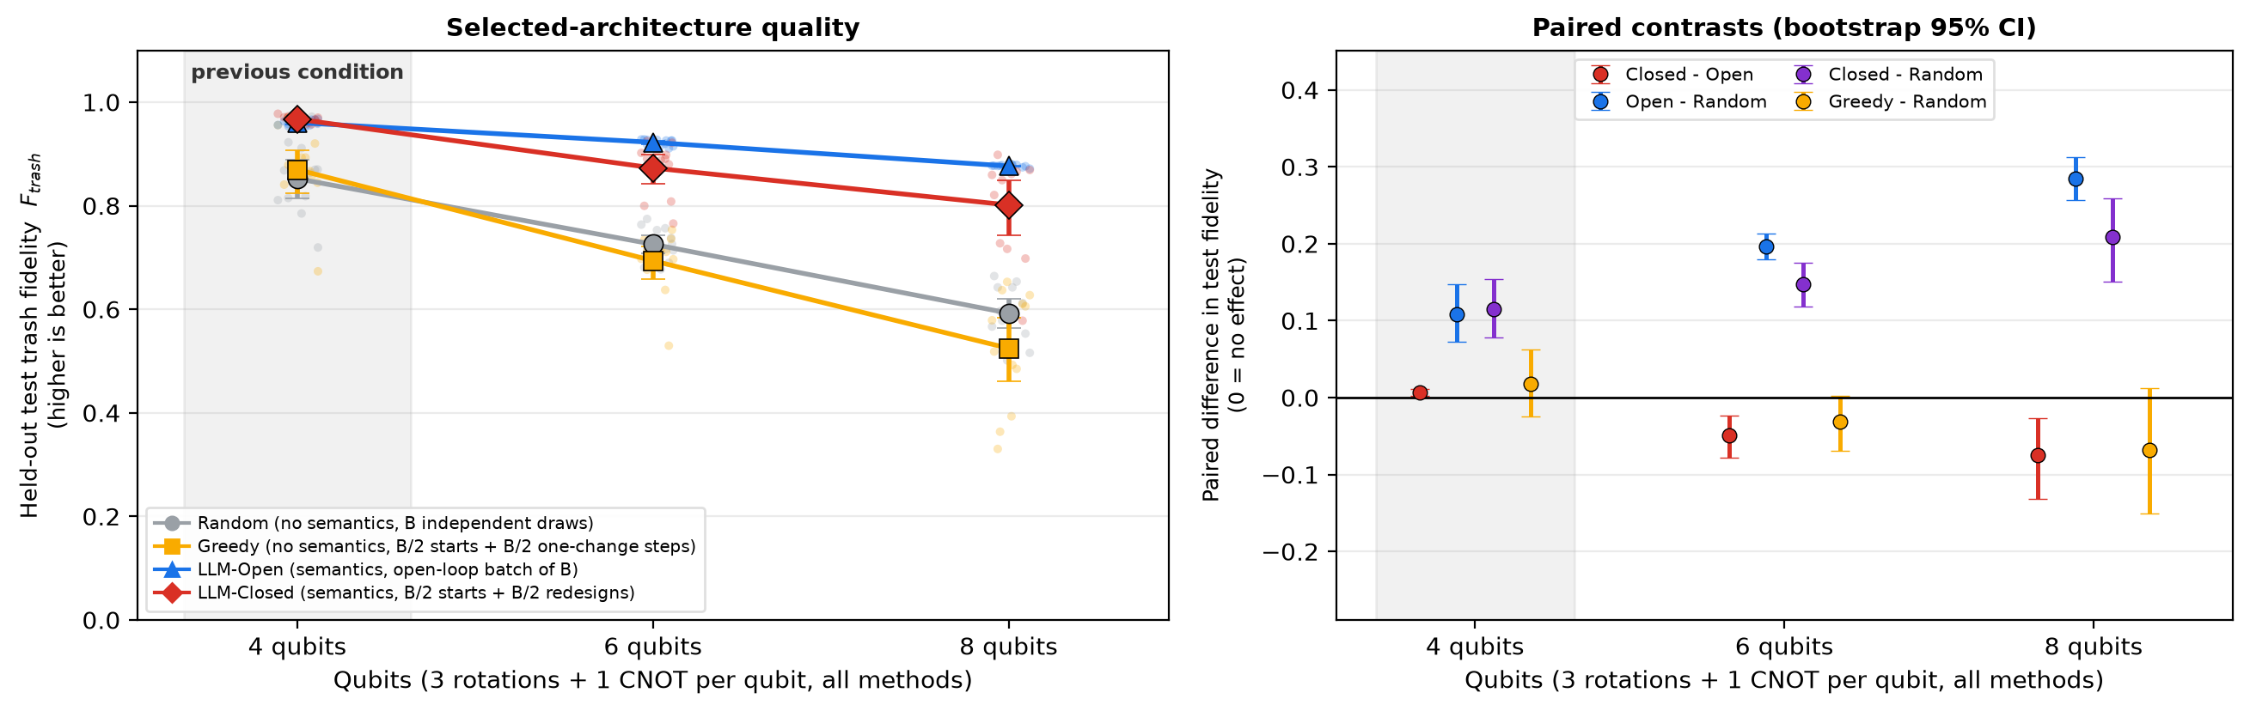
Changing the qubit count
Ising chain, B = 8, reference model - only the register size moves. 4 qubits is the previous condition.
The task gets harder with width, but the semantic advantage does not go away. The closed loop's edge does not survive the wider registers (only 85% of its candidates at 6 qubits were valid model proposals).
Paired contrast | 4 qubits (previous) | 6 qubits | 8 qubits
Open - Random | +0.1084 [+0.073, +0.147] 11/12 seeds, p < 0.001 | +0.1968 [+0.180, +0.214] 12/12 seeds, p < 0.001 | +0.2841 [+0.257, +0.313] 12/12 seeds, p < 0.001
Closed - Open | +0.0066 [+0.002, +0.011] 11/12 seeds, p = 0.012 | -0.0494 [-0.078, -0.024] 0/12 seeds, p < 0.001 | -0.0752 [-0.132, -0.027] 1/12 seeds, p = 0.007
Width scales deterministically: 3 rotations + 1 controlled-NOT per qubit for every method, latent and trash always half and half. A declared scaling rule, not a gate-count study.

Slide 6
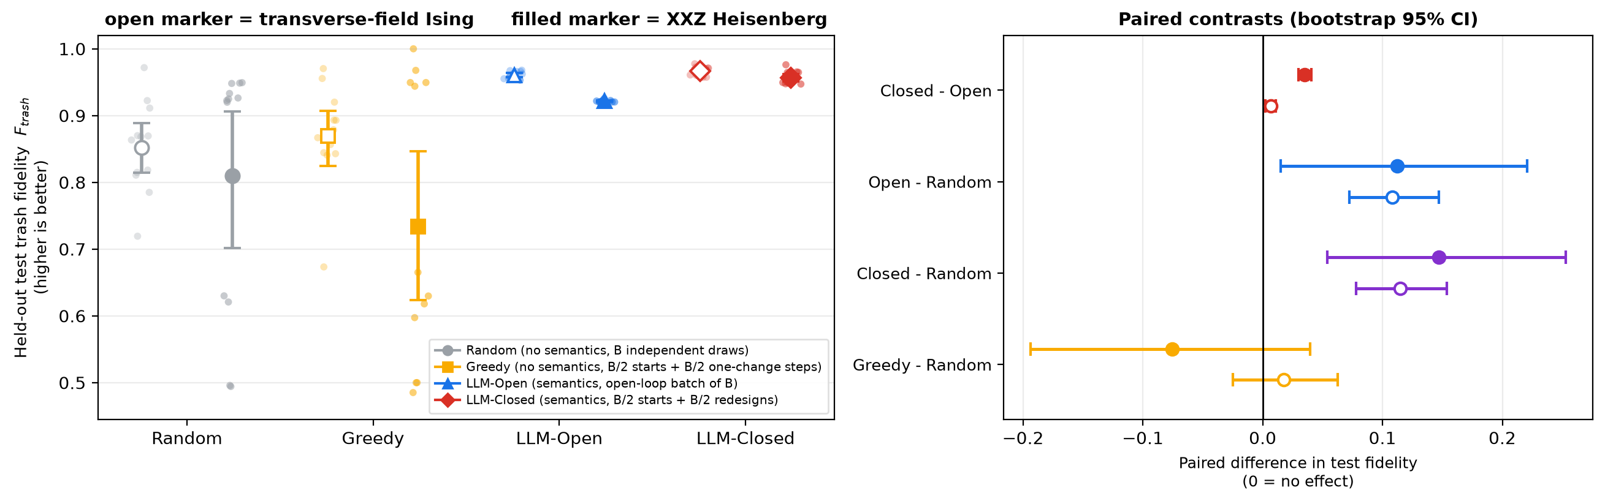
Changing the Hamiltonian family
4 qubits, B = 8, reference model - only the physics in the task description moves. The Ising chain is the previous condition.
A different, pre-declared state family - an XXZ Heisenberg chain over the same anisotropy range - with the same circuit space, trainer, seeds and prompt wording.
Paired contrast | transverse-field Ising (previous) | XXZ Heisenberg
Open - Random | +0.1084 [+0.073, +0.147] 11/12 seeds, p < 0.001 | +0.1121 [+0.015, +0.221] 5/12 seeds, p = 0.791
Closed - Open | +0.0066 [+0.002, +0.011] 11/12 seeds, p = 0.012 | +0.0348 [+0.030, +0.041] 12/12 seeds, p < 0.001
Only Hamiltonian facts were substituted into the frozen prompt - name, formula, parameter range and interaction type. An automated check confirms nothing else in the prompt changed.

Slide 7
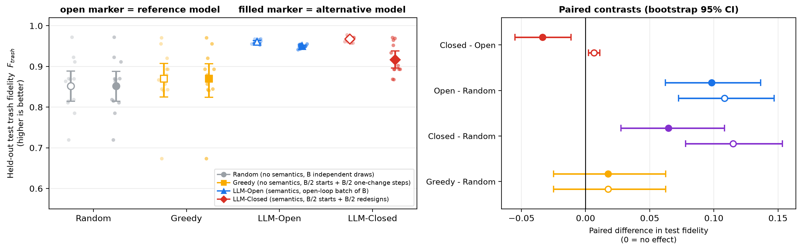
Changing the underlying language model
4 qubits, Ising chain, B = 8 - only the model identifier moves (reference gpt-5.4-mini, alternative gpt-4.1-mini).
Same prompt bytes, temperature, schema, retry policy and token limit. Resource-contract compliance falls from 96% to 65% of evaluated candidates, yet the semantic advantage is essentially unchanged.
Paired contrast | reference model (previous) | alternative model
Open - Random | +0.1084 [+0.073, +0.147] 11/12 seeds, p < 0.001 | +0.0982 [+0.062, +0.137] 11/12 seeds, p < 0.001
Closed - Open | +0.0066 [+0.002, +0.011] 11/12 seeds, p = 0.012 | -0.0336 [-0.055, -0.011] 4/12 seeds, p = 0.052
Invalid proposals are replaced by flagged random draws under the frozen policy, so a weaker model shows up both as lower fidelity and as a lower compliance rate.

Slide 8
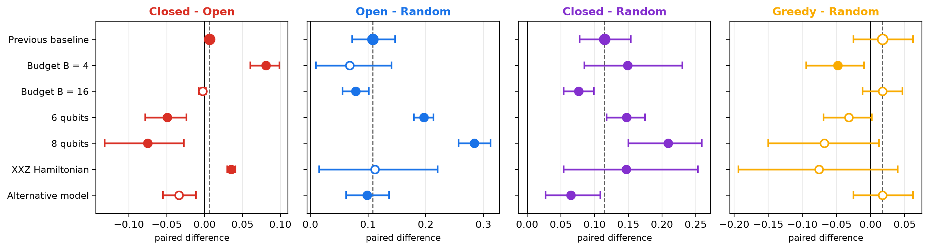
Everything at once: what survived
Paired difference in test fidelity with bootstrap 95% CI - filled = significant at p < 0.05, dashed line = the previous condition
Condition | Open - Random | Closed - Open | Greedy - Random
B = 4 | not detected | holds | reverses
B = 16 | holds | not detected | not detected
6 qubits | holds | reverses | not detected
8 qubits | holds | reverses | not detected
XXZ chain | not detected | holds | not detected
Alt. model | holds | not detected | not detected
Positive = the first method wins. "holds" = same sign as the previous condition and significant at p < 0.05; "not detected" = not significant at 12 seeds; "reverses" = significant with the opposite sign.

Slide 9
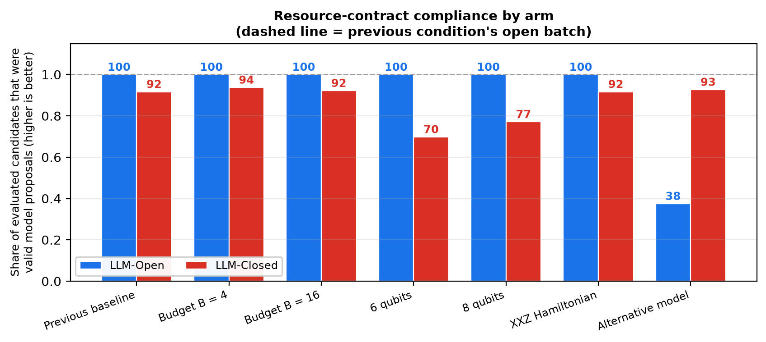
What this means, what it costs, what it does not show
Reading the pattern above rather than any single cell
Interpretation
The semantic advantage over non-semantic search is the durable part of the previous result: it keeps its sign in 6 of 6 conditions and is significant in 4; where it is not significant the effect is still positive but the per-seed win count is low.
The closed-loop advantage is NOT a stable property: it keeps the previous sign in only 2 of 6 conditions, is significantly positive in 2 (B = 4, the XXZ chain) and significantly negative in 2 (6 qubits, 8 qubits).
A separate failure mode is visible alongside the search results: resource-contract compliance. Which call breaks is condition-specific - in the alternative model the open batch fell to 38% while the closed loop stayed at 93%; in 6 qubits the closed loop fell to 70% while the open batch stayed at 100%. Every invalid proposal is spent as a flagged random draw under the frozen policy, so part of what looks like a method effect is a generation-validity effect.
Non-semantic refinement never helps: 0 of 6 conditions show a gain over a plain random sweep, and at B = 4 it is significantly worse - spending half a small budget on single-gate steps costs breadth without buying quality.
Limitations
Twelve paired seeds per cell: enough for large effects, underpowered for small ones. A "not detected" cell is not evidence of absence.
One factor at a time means no interactions were estimated - for example a large budget at eight qubits.
Two Hamiltonian families and two models are two points, not a survey.
Noiseless state-vector simulation throughout; no sampling noise and no device topology constraints.
The closed loop is given more search freedom than the single-change baseline, so that pair is not information-matched; capacity, gate set, parameter count, optimizer, data and budget are matched.
Cost and scaling
511 model calls across the whole study (428,651 input and 225,577 output tokens), under a hard spending cap.
Simulation cost, not model cost, is the binding constraint: state-vector training grows exponentially with the register, while the number of model calls grows only linearly in the budget.
Out of scope by design: any ablation of the prompt's semantic content.

Slide 10
Conclusions
The headline finding keeps its direction under every single-factor change.
Semantic proposals beat non-semantic search with the same sign in 6 of 6 varied conditions - a different budget, a different register size, a different Hamiltonian and a different language model - and significantly so in 4. This is no longer a property of one setting.
The closed-loop advantage does not generalise as stated.
It was the fragile claim, and it broke where it was tested hardest. Across budgets it runs +0.0812 to +0.0066 to -0.0023; across register sizes it runs +0.0066 to -0.0494 to -0.0752. Both ladders move against it, so the claim has to be restated as budget- and width-dependent rather than general.
Generating a valid circuit is a separate, measurable bottleneck.
Compliance with the exact resource contract fell as low as 65% of evaluated candidates, and which call breaks depends on the condition rather than on the method. Because an invalid proposal is spent as a random draw, fixing generation validity is worth more right now than richer feedback.
Next: interactions, more families and models, and noise.
The single-factor grid is clean but conservative. The open questions are whether the effects compound at larger widths and budgets together, and whether they survive sampling noise and hardware topology.
All figures and statistics produced from the committed result tables by the committed build scripts; 12 paired seeds per cell; held-out test read once after validation-only selection.

