Slide 1
LLM-Guided VQC Design
Building a Rigorous, Budget-Matched Benchmark
Interim update — classical baselines complete; the real-LLM matrix is blocked on API quota, not on budget approval
Tomoya Hatanaka
ML4SCI / Google Summer of Code 2026
July 31, 2026 · base commit f159d35 · experiment/bench-v2-real-llm-cost-minimal
Notes:
Short framing: this is an interim update. The classical half of the benchmark is finished, the LLM half has not run: the API account returned insufficient_quota, so nothing was spent. VQC = variational quantum circuit; QAS = quantum architecture search. Everything shown is generated from durable stores at commit f159d35.

Slide 2
QUESTION
Does LLM guidance actually help — compared with what?
Primary
At the same unique-candidate evaluation budget, does LLM-guided search beat random, evolutionary and greedy search?
Secondary
How do the selected circuits compare with fixed reference ansätze in predictive error and compiled resource cost?
Budget matching applies to the search arms. Fixed ansätze are anchors: they are evaluated through the identical training and test pipeline, but they do not run a search.
Anytime improvement alone proves nothing — random search also improves with more evaluations.
Gap addressed here: prior agentic-VQC work demonstrates feasibility, but does not isolate the value of the proposal strategy against budget-matched classical search with paired replicates and a protected final test.
Literature basis: docs/research/LITERATURE_REVIEW_QAS.md · claim C8
Notes:
The primary question compares search strategies at equal budget. The secondary question asks whether searching is worth it at all versus a textbook fixed ansatz. Be careful with the literature claim: I am not asserting that prior papers lack replication in general. The verified gap is narrower — nobody isolates the proposal strategy against budget-matched classical search with paired seeds and a protected test. That is the hole this benchmark fills.

Slide 3
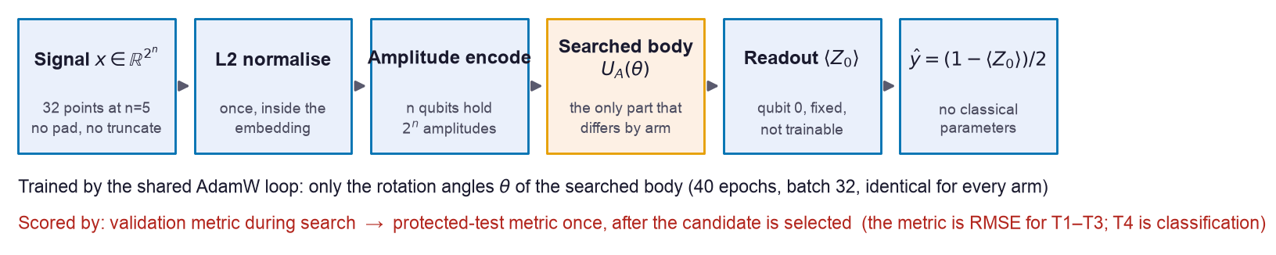
WHAT IS MEASURED
One pipeline; only the searched body changes
A length-2ⁿ signal fills the amplitudes of n qubits exactly — no padding, no truncation.
Zero classical parameters: no trainable dense layer anywhere, so a weak circuit cannot be rescued by a classical head.
Protected-test metric: the same metric formula, re-evaluated once per selected circuit on a final held-out split, after selection is frozen on validation. That formula is RMSE for T1–T3; T4 is classification, so the pipeline-level term is "protected-test metric", never "protected-test RMSE".
Implementation: llm_vqc/free_amplitude/model.py · llm_vqc/ir/compiler_pennylane.py
Notes:
Walk left to right. A 32-point signal is L2-normalised once, inside PennyLane's AmplitudeEmbedding, and loaded into 5 qubits. The searched body is the only thing that differs between methods. We measure Pauli-Z on qubit 0 and map it to a prediction in [0,1]. Crucially there are zero classical trainable parameters — no dense head can compensate for a bad circuit. Amplitude encoding removes global scale, which is why every task target is a shape parameter, never an absolute amplitude.

Slide 4
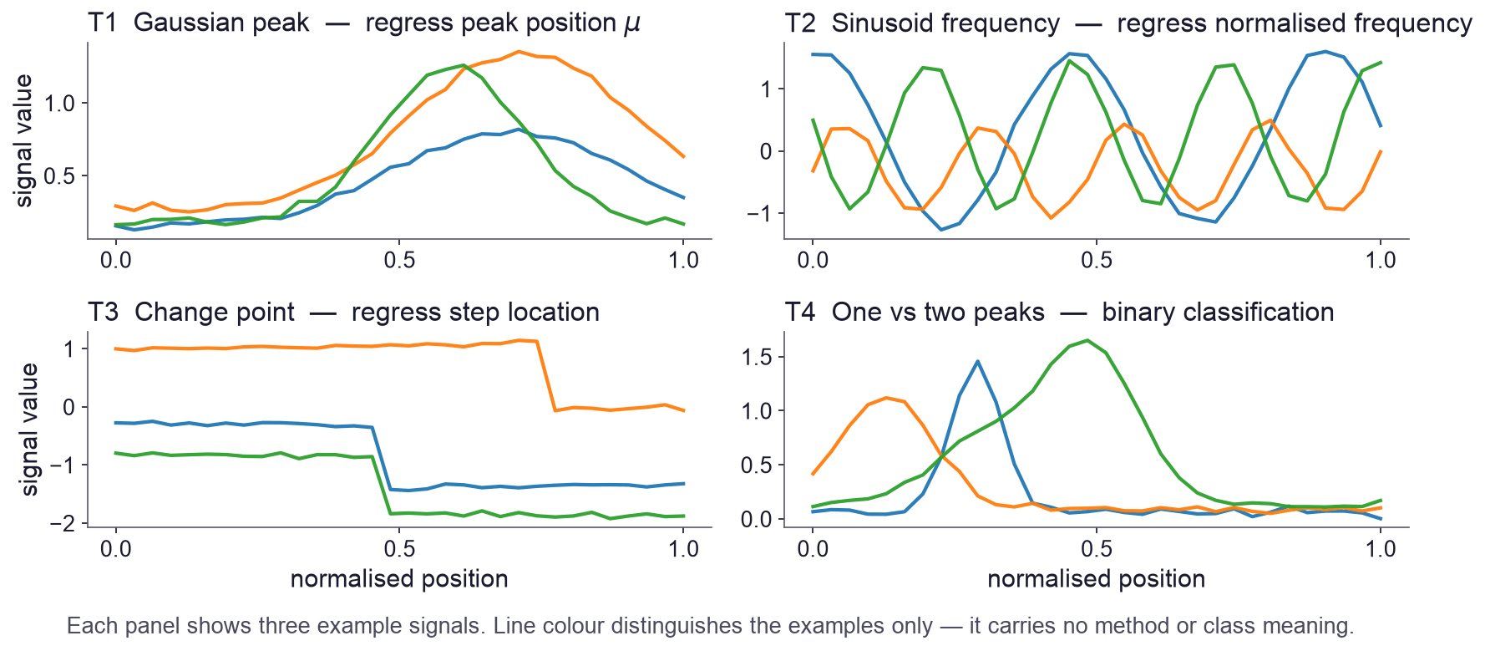
TASKS
Four controlled signal tasks, sized for amplitude encoding
2ⁿ points exactly
32 values at n=5; the signal is the amplitude vector.
Nuisances randomised
Amplitude, phase, baseline, width and noise vary, so no fixed convention leaks the label.
Scaling
T1 and T2 also run at n = 3, 4, 6 and 8.
Search-space constraint | Value
Qubits n | 5 for T1–T4; T1 and T2 also at n = 3, 4, 6, 8
Allowed gates | rotations RX / RY / RZ / H · entanglers CNOT / CZ / CRX / CRY / CRZ over line, ring, star, pairs or all-to-all
Max layer operations | max_ops = min(2n, 16) — 10 at n=5, 16 at n=8
Operation ≠ physical gate | one operation expands to many physical gates: a rotation layer becomes n single-qubit gates, an entangling layer up to n two-qubit gates
Splits
256 train / 256 validation / 2048 protected test, per replicate.
Line colour distinguishes the three example signals in a panel only — it encodes no method, arm or class · Generator: llm_vqc/tasks/signal_suite (signal_suite_v1) · data seed 1000
Notes:
Four tasks, all synthetic so I control difficulty and leakage. T1 regress the Gaussian peak position, T2 the sinusoid frequency below the Nyquist limit, T3 a change-point location, T4 one peak versus two peaks. Every signal has exactly 2^n points. Nuisance parameters are randomised so the label cannot be read off a fixed amplitude convention. No image datasets are used anywhere.

Slide 5
FAIRNESS
Two tracks separate architecture quality from angle luck
Track A — structure search (primary)
Track B — joint proposal (ablation)
Arms propose structure only
One shared AdamW loop trains θ: 40 epochs, batch 32, identical for every arm
θ-seed derived from the structural hash, so the same circuit gives the same result in any arm
Candidates carry gates, wires and numeric angles
θ is evaluated verbatim — no optimizer exists on this path
Candidate identity includes θ, so new angles make a new candidate
Matched across arms: unique candidate evaluations, training schedule, data splits, seeds, evaluator, protected-test rule. Not matched: wall-clock time, training FLOPs, generated tokens — and fixed references run no search at all.
Protocol §5 · runner enforces the budget on unique evaluations only
Notes:
This split is the methodological core. In Track A every arm proposes only a structure and one shared trainer fits the angles, so a win means the architecture is better. In Track B the proposer also supplies the angles and they are used verbatim, which tests a different skill. Without the split, a lucky set of angles would look like a good architecture. Note what is not matched: wall-clock, FLOPs and tokens differ, and fixed references do not consume a search budget.

Slide 6
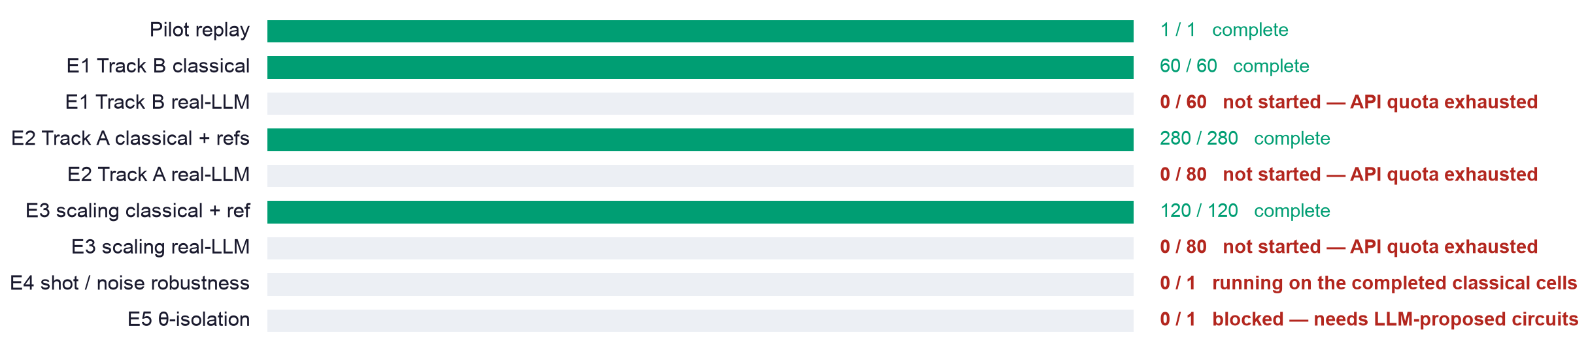
PROGRESS
Classical matrix complete; real-LLM matrix not started
460 / 460 classical cells complete, 0 failures · 0 / 220 real-LLM cells — the API account returned insufficient_quota, so $0.00 was spent · the benchmark as a whole is not complete
Counts regenerated from runs/bench_v2/*/cells/*.json · completion checker: 10 of 17 criteria pass, unweakened
Notes:
E0 replays the February pilot offline and reproduces it exactly with zero API calls. E1 is the joint track, E2 the main n=5 architecture search, E3 the qubit-scaling study. All 460 classical cells finished with no failures. The 220 LLM cells never started because the API account has no quota — not because the cap refused them; measured spend is zero. and E4 and E5 depend on them, so they are pending too. The completion checker reports 10 of 17 criteria — it fails correctly and I did not weaken it.

Slide 7
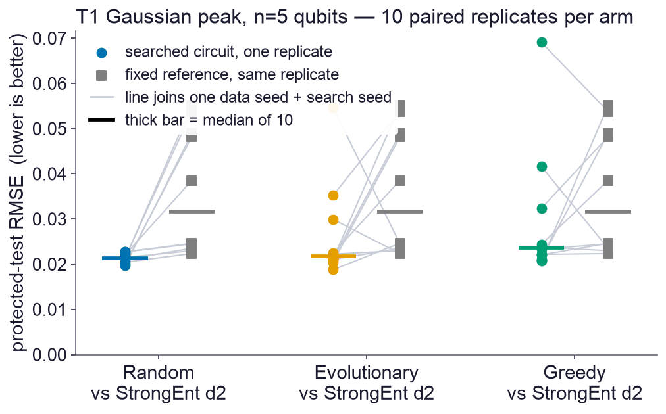
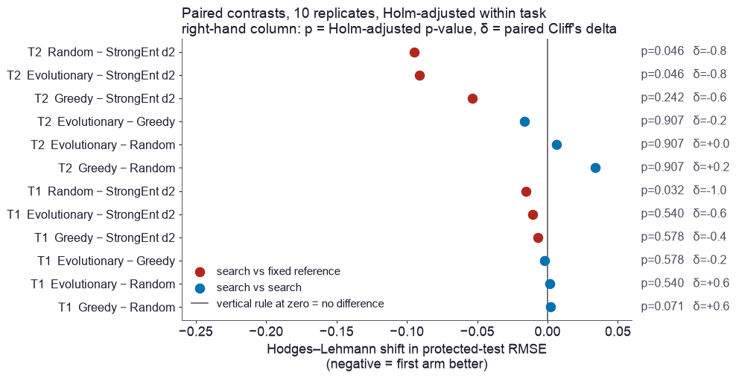
RESULT — 5 QUBITS
Search beats the fixed reference on T1/T2; no search-method difference was detected
No Holm-adjusted difference was detected among random, evolutionary and greedy on any task (smallest p = 0.071). This is not an equivalence claim.
Against the strongest reference the picture is task-dependent: on T2 random and evolutionary win (p = 0.046, δ = −0.8); on T1 only random is detected (p = 0.032) and the shift is small.
10 paired replicates · Hodges–Lehmann shift and paired Cliff's δ · outputs/bench_v2/E2/stats_*.csv
Notes:
Left: each line joins one replicate's searched circuit to the fixed reference on the same data and search seed. Right: the paired contrasts with Holm-adjusted p-values and Cliff's delta. Two messages. First, the three search strategies are not separated by this experiment — smallest adjusted p is 0.071. I say no difference was detected, not that they are equivalent; with ten replicates I cannot rule out small effects. Second, versus a shallow reference searching does pay, but versus the strongest reference the advantage is task dependent.

Slide 8
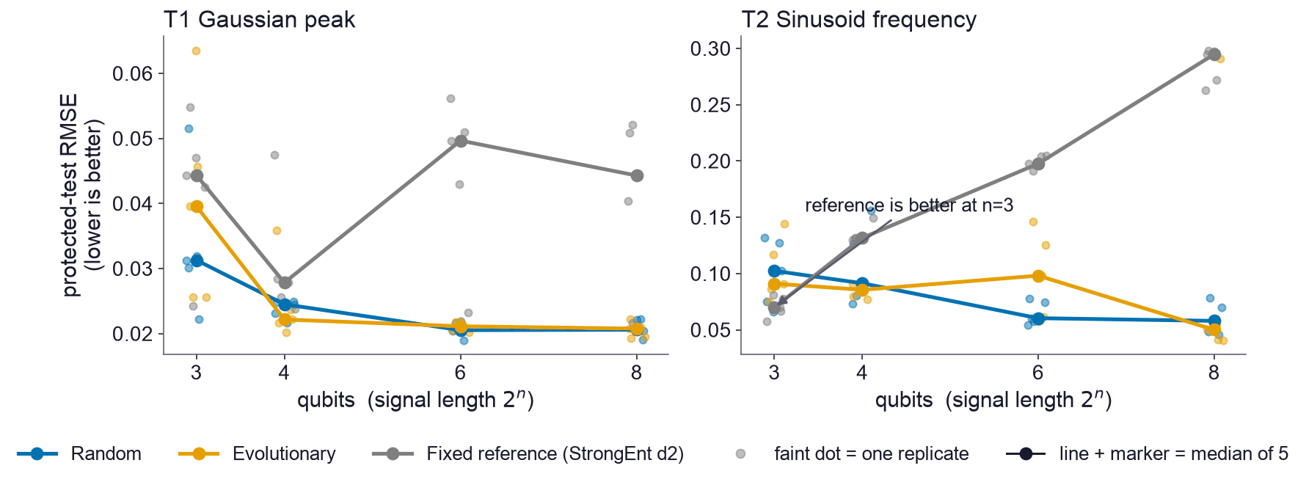
RESULT — QUBIT SCALING
A descriptive crossover: search pulls ahead at larger qubit counts
Descriptive, not confirmatory: at n=8 on T2 all 5 paired replicates favour search (δ = −1.0, median 0.058 vs 0.295), but with 5 replicates the smallest attainable p is 0.0625, so after Holm correction across 3 contrasts no result can reach 0.05.
All results are noiseless statevector simulation — no shots, no noise model, no quantum hardware
Notes:
Both panels: 5 paired replicates per point, faint dots are individual replicates, the line is the median. On T2 the fixed reference is actually better at 3 qubits and then degrades steadily, while the searched arms improve — a crossover, not a uniform win. Be explicit about the statistics: five replicates cap the smallest achievable p-value at 0.0625, so Holm correction makes significance unreachable by construction. I therefore call this descriptive. And say clearly: this is exact statevector simulation, not hardware.

Slide 9
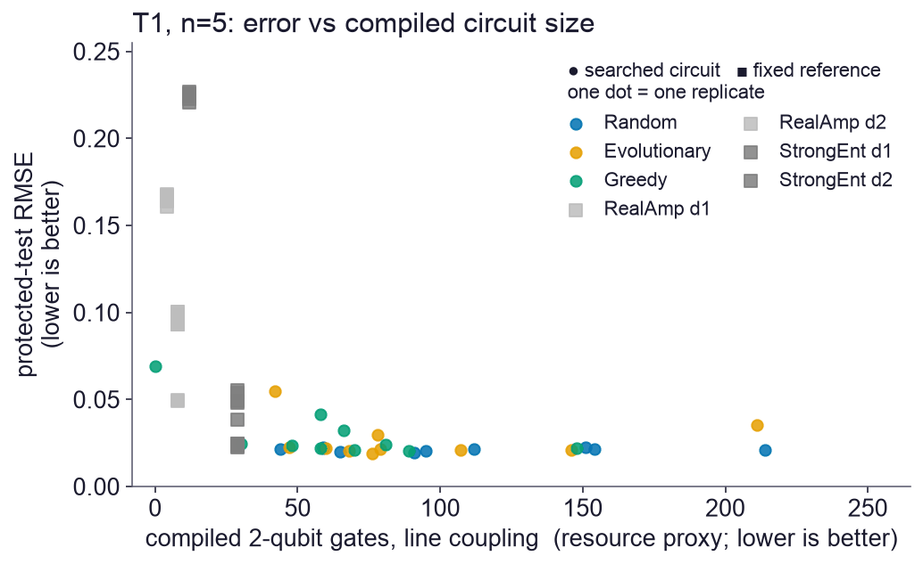
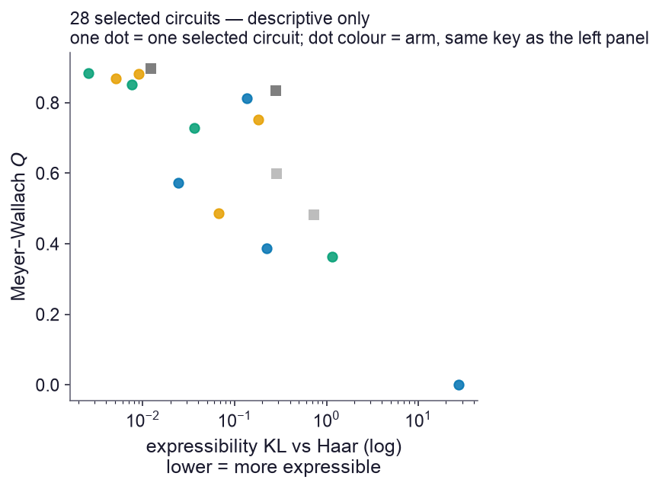
COST
Lower error comes with substantially larger compiled circuits
Median compiled 2-qubit gates: 58–85 for searched circuits vs 4–29 for the references.
A hardware-relevant proxy: state preparation is excluded (identical for every arm).
KL and Meyer–Wallach Q are descriptors; their link to accuracy is untested here.
Qiskit, basis [rz,sx,x,cx], line coupling, opt_level 1, seed 7 · 28 circuits = best-validation replicate per (task, arm)
Notes:
Left: predictive error against compiled two-qubit gate count for T1. The references sit far left — cheap but mostly worse. Searched circuits cluster low and right: better error, three to twenty times more entangling gates. Call it a resource proxy, not hardware cost: it excludes state preparation, which is common to all arms, and it is a transpiler estimate under a fixed line coupling, not a device measurement. Right: the 28 diagnostic circuits are the best-validation replicate for each of 4 tasks times 7 arms. Expressibility and entangling capability are descriptors — I am not claiming they predict accuracy.

Slide 10
Interim answer, and what is blocking the rest
Not yet. The LLM hypothesis is still untested. What exists today is a reproducible classical benchmark that defines the bar the LLM has to beat.
Spending control: implemented, not promised
Then, in order
Durable SQLite ledger shared by every cell, retry and restart — cumulative, not per cell
Cost settled from returned token counts against a dated price manifest
Model pinned to gpt-5-nano-2025-08-07; cumulative cap $2.00
Measured spend $0.00 — account returned insufficient_quota, reservations released
Restore API quota, then run the 220 real-LLM cells (both tracks)
E5 θ-isolation: is it the architecture or the angles?
E4 shot-noise and noisy-simulator robustness
Regenerate the statistical report; completion checker must pass unweakened
Blocked on API quota, not on approval: cap $2.00 cumulative, measured spend $0.00
Notes:
Lead with the honest answer: the headline question is not answered yet. What I can defend is the classical baseline and the machinery around it. The spending question is now settled in code rather than by a promise. A durable SQLite ledger reserves the estimated cost before each request and settles it from the returned token counts, so the cap is one cumulative total shared by every cell, every retry and every process restart. The model is pinned and priced from a dated manifest. The cumulative cap is $2.00 and the measured spend is exactly zero, because the API account returned insufficient_quota on the very first preflight request and the ledger released all three reservations. So the block is billing, not authorisation. If the cap ever binds mid-run the run stops cleanly and cells resume from their stores — no work is lost and the cap is never auto-raised.

Slide 11
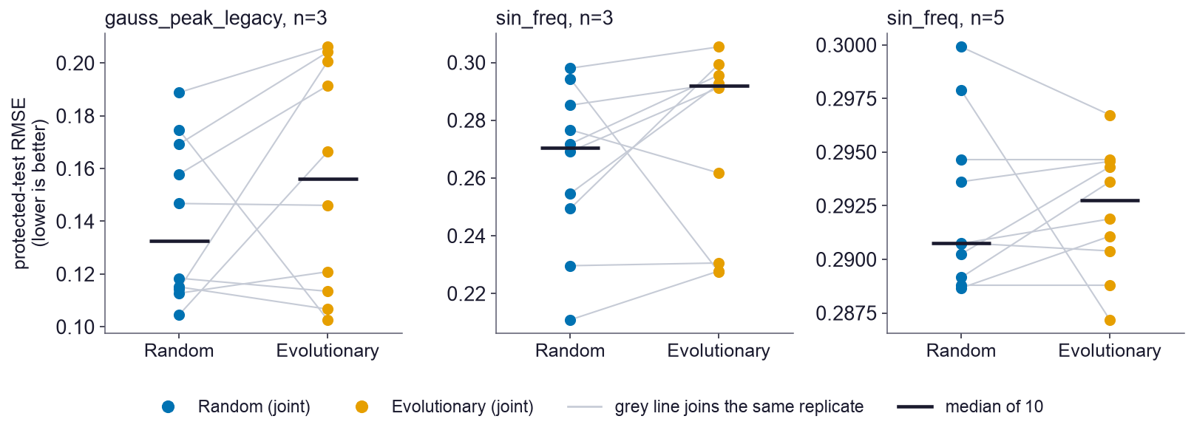
APPENDIX
A1–A2 Pilot replay (E0) and joint search (E1)
E0: all 21 candidates of the committed 2-seed real-LLM pilot were re-evaluated offline from stored operations and angles — validation and test values matched exactly, with zero API calls.
E1 (Track B, verbatim θ, B=16): no Holm-adjusted difference between random and evolutionary joint search on any of the three task/qubit cells (all p ≥ 0.28). T2 at n=5 sits near 0.29 RMSE for both.
outputs/bench_v2/E0/replication_report.json · outputs/bench_v2/E1/stats_paired_tests.csv

Slide 12
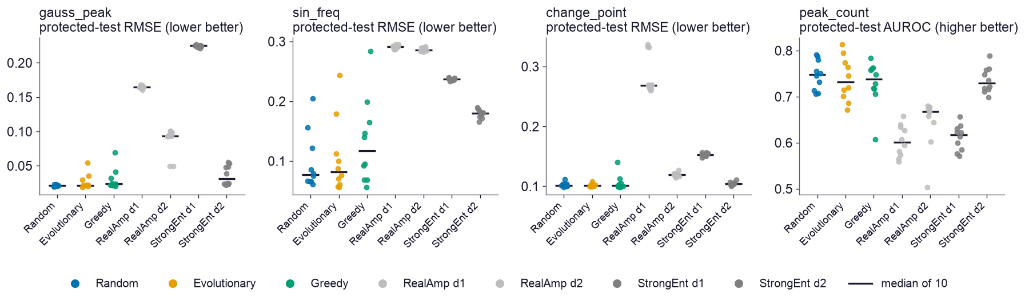
APPENDIX
A3 Full E2 results, all four tasks
T3 (change point) is saturated: every arm lands at RMSE ≈ 0.10 and all adjusted p-values are 1.00.
T4 (peak classification) shows no arm separation either: AUROC ≈ 0.73–0.75 across all arms.
outputs/bench_v2/E2/per_seed_E2.csv · 10 paired replicates per arm

Slide 13
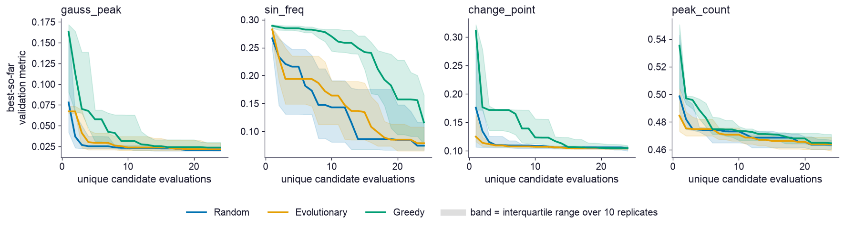
APPENDIX
A4 Anytime search behaviour (E2)
Median and interquartile band of the best-so-far validation metric against unique candidate evaluations.
Greedy growth is the slowest starter on T2 but converges to the same region by the 24-evaluation budget.
Budget axis is unique candidate evaluations; duplicates and invalid proposals never consume it

Slide 14
APPENDIX
A6, A8 Statistics, seeds and the protected test
Paired tests within each (task, n) family: exact Wilcoxon signed-rank plus a paired sign-flip permutation test on the mean difference (10,000 resamples, seed 20260729).
Multiplicity: Holm step-down applied to the permutation p-values inside each family.
Effect sizes: Hodges–Lehmann shift (median of Walsh averages, RMSE units) and paired Cliff's δ.
Verified p-value floor: 5 replicates ⇒ smallest two-sided p = 0.0625 ⇒ smallest Holm-adjusted value ≈ 0.19 across 3 contrasts. 10 replicates ⇒ 0.00195.
Seeds: data seed 1000+r, search seed 2000+r, shared by every arm in a comparison; θ-seed derived from (task, data seed, search seed, structural hash).
Protected-test metric: the same metric formula used for validation, re-evaluated once per selected circuit on a final held-out split of 2,048 examples, after selection has been frozen. RMSE = sqrt(mean((ŷ − y)²)) for the regression tasks T1–T3; AUROC for the T4 classification task, which is why the pipeline-level term is "protected-test metric".
Search modules cannot import the test gate, and the restriction is enforced by an AST test rather than by convention.
scripts/bench_v2/analyze_experiment.py · llm_vqc/bench_v2/test_gate.py

Slide 15
APPENDIX
A7, A10 Search space, candidate identity, diagnostic selection
Grammar scalable_layered_v1: ordered list of at most min(2n, 16) operations — rotation layers (RX/RY/RZ/H) and entangling layers (CNOT/CZ/CRX/CRY/CRZ) over line, ring, star, pairs or all-to-all patterns.
Encoding and readout are fixed by the profile, never proposed. Every structure must contain at least one trainable rotation.
Track A identity = structural hash of the canonical IR; Track B identity additionally includes θ, so re-proposing the same shape with new angles is a new candidate.
Diagnostic circuits: for each of the 4 tasks × 7 arms in E2, the replicate whose selected candidate had the best validation metric — 28 circuits, selected on validation only.
Expressibility: KL between the sampled fidelity distribution and the Haar distribution, 200 sampled states and 2,000 fidelity pairs, θ ~ U[−π, π], seeded by architecture hash.
Enforced parity for the LLM arms: one gate per rotation operation, entangler wires "all", and 1..floor(n/2) disjoint non-duplicate pairs — so no arm can pack several gate layers into one operation. A scan of all 25,973 operations produced by the completed classical search arms found zero violations, so the comparison already run is unaffected.
llm_vqc/bench_v2/space.py · llm_vqc/free_amplitude/expressibility.py

Slide 16
APPENDIX
A9 Resource and transpilation assumptions
Compiler: Qiskit; basis gates [rz, sx, x, cx]; optimization_level 1; seed_transpiler 7; coupling maps line, ring and all-to-all.
Routing SWAPs are decomposed into cx, so the reported two-qubit count already includes routing overhead.
Amplitude state preparation is excluded: its decomposition is identical for every arm at a given n and would dominate the body signal. The number is therefore a relative proxy, not a total device cost.
Logical counts (1-qubit, 2-qubit, controlled-rotation, parameters, depth) come from the shared IR and are recorded for every evaluated candidate.
Shot-noise (1,024 / 4,096) and the frozen depol_ro_v1 noisy profile belong to E4, which re-evaluates the best-validation selected circuit of every completed E2/E3 cell — it needs no LLM cells, so it runs on the classical matrix.
llm_vqc/bench_v2/resources.py

Slide 17
APPENDIX
A11 API cost model and the cumulative cap
Priced from a dated manifest and settled from returned tokens — no flat per-call charge
Quantity | Value | Source
Pinned model | gpt-5-nano-2025-08-07 | OPENAI_MODEL, verified before any client is built
Price (dated manifest) | $0.05 / 1M input, $0.40 / 1M output | configs/bench_v2/model_prices.json
Cells to run | 220 (E1 60, E2 80, E3 80) | protocol_v2.yaml
Candidates per call | 3 | llm_arms.py BATCH_SIZE
Expected total calls | ≈1,480 | ceil(B/3) + duplicate allowance, over 220 cells
Expected cost per call | ≈$0.0004 | measured prompt size × manifest price
Expected total cost | ≈$0.6 | 1,480 × $0.0004
Per-cell call guard | 40 calls (runaway guard — NOT the global cap) | llm_providers.py
Cumulative global cap | $2.00, durable across cells, retries and restarts | GlobalSpendLedger (SQLite, BEGIN IMMEDIATE)
Actual measured spend | $0.00 — 0 settled calls; account returned insufficient_quota | runs/bench_v2/preflight_ledger.sqlite
Cost is reserved before each request and settled from returned token counts; a claim that would exceed the cumulative cap is refused before the request is issued

Slide 18
APPENDIX
A12, A13 Integrity checks and references
Break-tests: three safeguards were deliberately broken to confirm the tests catch them. Two exposed real blind spots — a plain `import torch.optim` evaded the AST check, and a self-consistent budget break evaded the ledger test — both are now closed.
Completion contract: 17 machine-checked criteria; currently 10 pass. The failures are correct (missing LLM cells, E4/E5 markers, final report) and the checker was not modified.
The self-consistent budget break that once evaded the ledger test is now closed twice over: the cumulative SQLite ledger is proved to survive a restart in a separate OS process, and a cap breach is refused before the request is issued rather than detected after it.
Protocol content is hash-pinned in outputs/bench_v2/protocol_hashes.json. There was no external preregistration; the deck therefore says protocol-frozen throughout.
Key references: Sim et al. 2019 (expressibility, entangling capability); Knipfer et al. 2026 and Sakka et al. 2026 (LLM-driven VQC design); DQAS; QuantumNAS; EVQE and MoG-VQE; TD-QAS; PWMCTS; BenchRL-QAS.
docs/research/BREAK_TESTS.md · GOAL_CONTRACT.yaml · docs/research/LITERATURE_REVIEW_QAS.md

