Slide 1
LLM-Guided VQC Design:
From Pilot to Rigorous Benchmark
Amplitude encoding, quantum readout, and budget-matched evaluation of
quantum architecture search (QAS)
|0⟩→Z
Tomoya Hatanaka
ML4SCI / Google Summer of Code 2026 — weekly update
July 29, 2026 · branch research/rigorous-qas-benchmark-v2

Slide 2
MOTIVATION
Does LLM guidance actually help quantum architecture search?
“Does LLM guidance improve VQC architecture search over random, evolutionary, greedy, and reference ansätze under the same candidate-evaluation budget?”
1
Prior agentic-VQC work motivates the direction
Knipfer et al. 2026 and Sakka et al. 2026 show LLM agents can design VQCs — but with no budget-matched non-LLM baselines and no seed-replicated statistics.
2
Anytime improvement alone is uninterpretable
Random search also improves over iterations; only equal-budget comparison isolates the value of the proposal strategy.
3
Our contribution: the controlled evaluation layer
Same typed circuit grammar, same evaluator, same unique-candidate budget, paired seeds, protected test — for every arm, LLM or classical.
Lit review + claim discipline: docs/research/LITERATURE_REVIEW_QAS.md (C1–C8)

Slide 3
WHAT CHANGED
From a 2-seed pilot to a preregistered benchmark
 | July pilot (now: E0 provenance only) | bench_v2 (this benchmark)
Replication | 2 seeds | 10 paired replicates (5 for scaling), paired seeds per arm
Budget | B = 4 proposals | B = 16–24 unique candidate evaluations, exact ledgers
Tasks | Gaussian peak only (n=3) | signal_suite T1–T4; scaling n ∈ {3,4,6,8}
Method scope | joint structure+θ only | Track A (structure-only, shared trainer) + Track B (joint, verbatim θ)
Baselines | random only | random, evolutionary, greedy, 4 fixed reference ansätze, joint-evolutionary
Claims | descriptive (integration demo) | preregistered RQ1–RQ6, Holm-corrected paired tests, effect sizes
Integrity | protected test, 2 committed seeds | + resource metrics, machine-checked 17-criterion goal contract, break-tests
Pilot preserved as E0; protocol frozen before the matrix: docs/research/BENCHMARK_V2_PROTOCOL.md

Slide 4
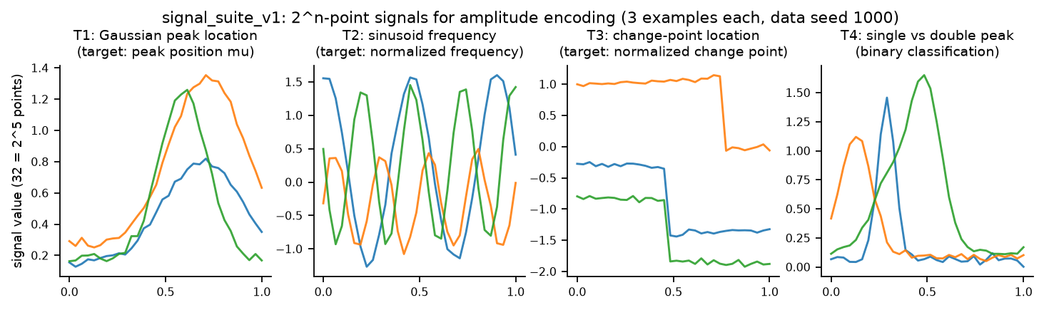
BENCHMARK DESIGN
Four controlled signal tasks, sized for amplitude encoding
2^n features
Every task generates exactly 2^n-point signals — the amplitude vector of n qubits. No padding, no truncation.
Nuisance randomization
Amplitude, phase, baseline, widths, noise randomized so no fixed convention leaks the label.
Scaling profiles
T1/T2 frozen for n ∈ {3,4,6,8} (E3, running); T3/T4 at n=5. Frequency cap N/4 keeps T2 below Nyquist.
Splits
256 train / 256 val / 2048 protected test per replicate; deterministic hashes; disjointness enforced.
Source: data/fig_tasks.csv (generated from frozen signal_suite_v1, data seed 1000)

Slide 5
METHODOLOGY
Two tracks separate architecture quality from angle luck
Track A — architecture search (primary)
Track B — direct joint proposal (ablation)
Arms propose structure only, in one shared layered grammar
One shared AdamW inner loop trains θ (40 epochs, frozen for every arm)
θ-seed = f(task, data seed, search seed, structural hash) — same circuit ⇒ same result in every arm (global cache)
Feedback to searchers: validation metric only
Candidates carry gates, wires, AND numeric angles
θ evaluated verbatim — structurally NO optimizer on this path (AST-enforced)
Candidate identity includes θ: same structure + new angles = new candidate
Mandatory classical rival: mixed discrete/continuous evolutionary search
Why it matters: a joint proposer can look good by guessing lucky angles rather than good architectures. Only the split design attributes credit correctly — E5 additionally re-optimizes θ on frozen LLM architectures at exactly matched objective-call budgets.
Protocol §5 (frozen): docs/research/BENCHMARK_V2_PROTOCOL.md

Slide 6
REPRODUCIBILITY
Evaluation hygiene is enforced by construction, then attacked
✓
Validation-only feedback
SearchFeedback has no field that could hold a test value; arms never see test data.
✓
Protected test, once
“Protected-test RMSE” = test metric of the validation-selected candidate, evaluated once after selection freeze — never feedback.
✓
Paired isolation
data seed 1000+r, search seed 2000+r shared across arms; θ-seeds derived, never global.
✓
Crash-resumable stores
Per-cell SQLite + budget ledger; interrupt-and-resume proven equal to an uninterrupted run.
✓
Machine-checked completion
17-criterion goal contract; checker currently fails honestly (matrix incomplete) and rejects removed or interrupted cells.
✓
Break-tests
Deliberately broke 3 safeguards: 2 exposed real blind spots (now closed with stronger tests). No secrets or raw transcripts in artifacts.
docs/research/BREAK_TESTS.md · GOAL_CONTRACT.yaml · scripts/check_goal_completion.py

Slide 7
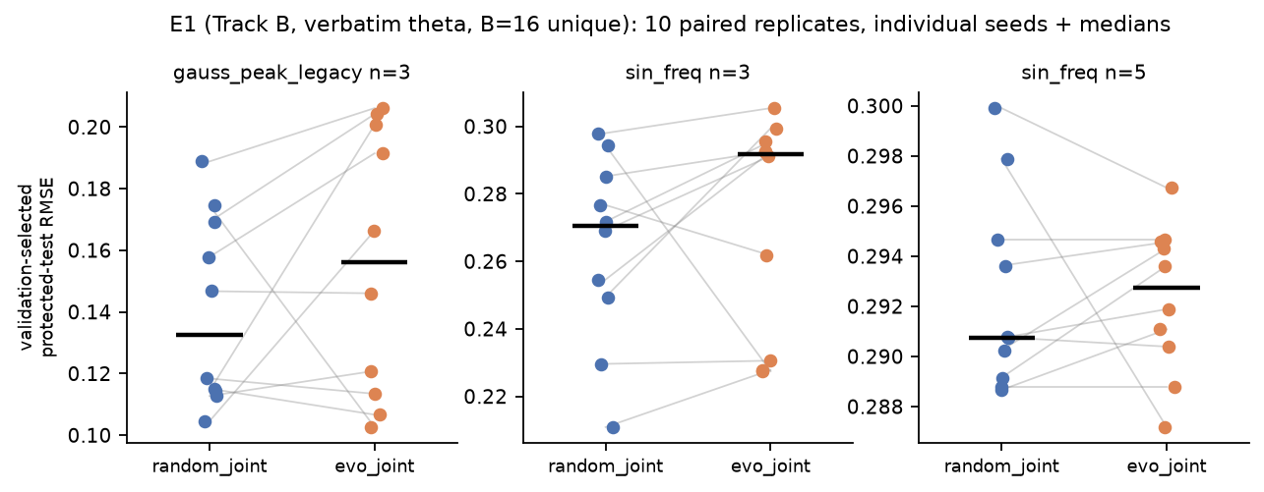
RESULTS — COMPLETE
Completed: E0 provenance replay and E1 classical joint search
E0 — pilot replay
All 21 committed real-LLM pilot candidates re-evaluated offline from stored operations + θ.
Exact match
validation AND test values, all 3 arms, both seeds
0 new API calls
The July numbers are provenance-verified — and remain a 2-seed integration demo, not evidence.
E1 (B=16, verbatim θ, 10 paired replicates): random_joint and evolutionary_joint are statistically close — no Holm-corrected difference (all p ≥ 0.28). T2 at n=5 appears difficult for both: test RMSE ≈ 0.29 for every replicate, near the target-scale spread — verbatim-θ proposals rarely beat it at this budget. LLM joint arms: pending budget authorization.
Sources: data/e0_replication_summary.csv · data/fig_e1_per_seed.csv · data/E1_stats_paired_tests.csv

Slide 8
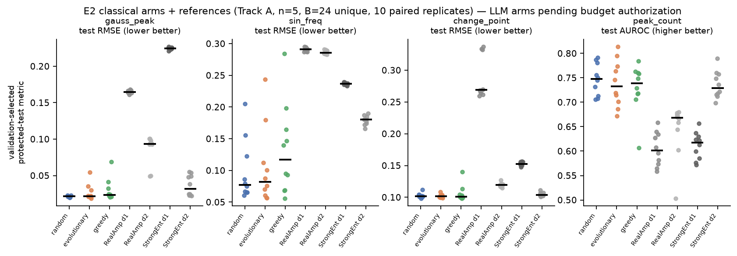
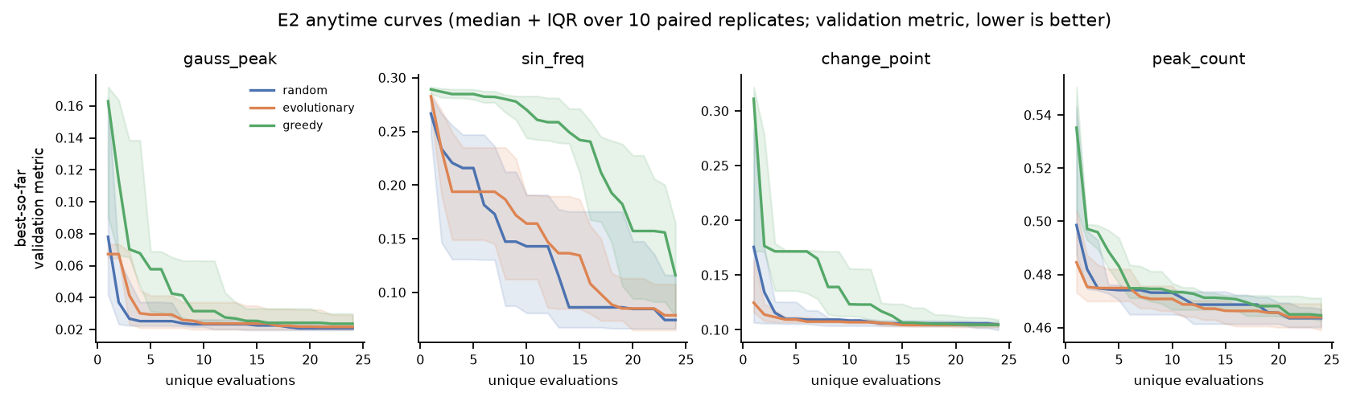
RESULTS — MAIN MATRIX
E2 classical matrix complete; E3 scaling is running now
cells | done | state
E1 classical (60) | 60 | complete
E2 classical (280) | 280 | complete
E3 classical (120) | running | running
LLM cells (220) | 0 | blocked*
E4 / E5 | — | pending
Findings (10 paired reps, Holm-corrected):
Searched circuits beat shallow references on the regression tasks (T1: random vs StrongEnt-d2, p_Holm = 0.032).
The three classical strategies are statistically indistinguishable from each other on every task.
T4 (AUROC ≈ 0.73–0.75) is flat across arms.
This is the bar any LLM arm must beat.
*LLM cells await LLM_API_BUDGET_USD (slide 10). Sources: data/fig_e2_per_seed.csv · data/fig_e2_anytime.csv · data/matrix_status.csv

Slide 9
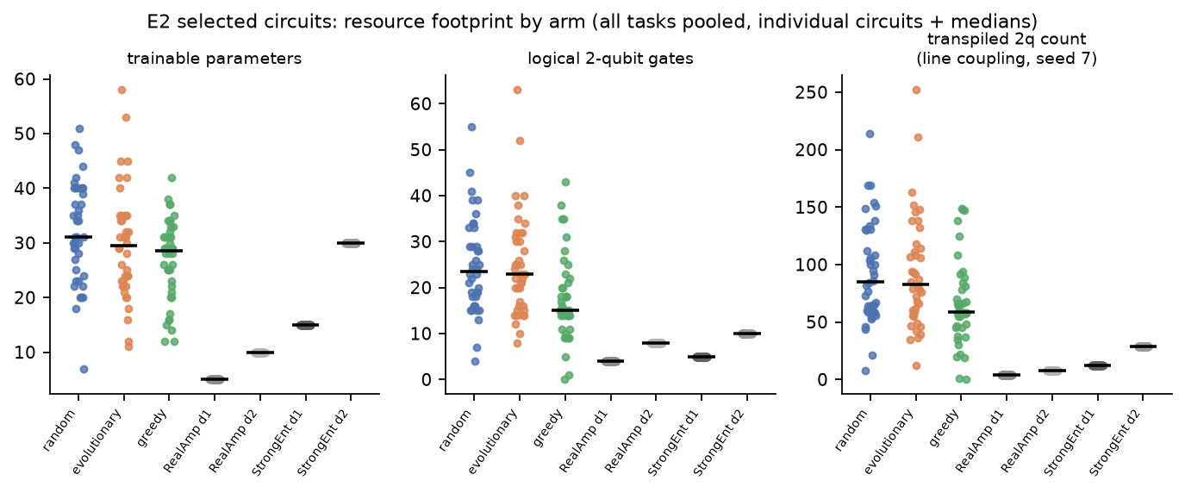
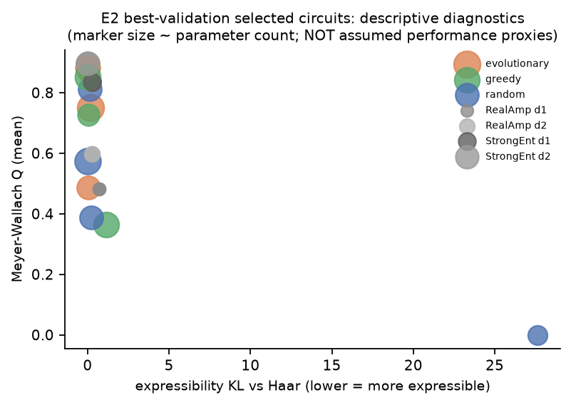
DIAGNOSTICS
Selected circuits: resources measured, diagnostics descriptive
Accuracy is bought with hardware cost: searched circuits use ~3–10× the transpiled 2-qubit gates of the fixed references (line coupling, fixed seed) — the Pareto view is part of the final analysis. Diagnostics characterize circuits; they are not assumed to predict task performance (Sim et al. framing; RQ5 tests the association empirically, with circuit-size controls). Expressibility KL + Meyer–Wallach Q computed for the 28 best-validation selected circuits. Shot-noise and noisy-simulator robustness (E4): pending — runs after the full matrix.
Sources: data/fig_e2_resources.csv · data/fig_e2_diagnostics.csv (KL/Q per circuit)

Slide 10
Next steps
Finish + verify E3 scaling (n ∈ {3,4,6,8}; running, resumable, ~120 classical cells)
Run the real-LLM matrix (220 cells, both tracks) once budget is authorized
Complete dependent analyses: E5 θ-isolation, E4 shot/noise robustness
Regenerate final paper-style figures + statistical report from stores (goal checker must exit 0)
Next mentor update: full budget-matched LLM-vs-classical comparison
Decision needed — API budget authorization
LLM_API_BUDGET_USD is not set, so all real-LLM cells are blocked by policy: an API key alone is not spending authorization, and a Claude Max subscription does not authorize experiment API spending.
Suggested cap 120 (conservative $0.05/call reservation, hard 40-call/cell cap); expected actual cost ≈ $5–20 on a mini-class model. One-line resume command in docs/research/BLOCKED.md.
All slide numbers trace to durable stores · sources in docs/presentation/bench_v2_weekly/data/

