Slide 1

PLANRACE
LOCALNET
Verified query optimization
as an open market
30
verified epochs
Miners discover executable index plans. Validators replay them on hidden workloads and reward only correct results.
TESTNET
NEXT
Checkpoint #1 · Localnet evidence
Notes:
PlanRace turns query optimization into an open competition. The evidence in this deck comes from a verified local Subtensor run. Testnet remains the next gate and is not claimed here. Sources: README.md, STATUS.md, results/localnet-v2/summary.json.

Slide 2
PROBLEM
02
Correct queries still become expensive
Schema changes, data distributions, traffic, and engine releases keep moving the target.
Today
Missing market
One engine advisor
One search strategy
Private evidence
Many optimizers compete
on the same hidden workload
The buyer receives an executable artifact plus validator-owned evidence, without trusting miner-reported timing or correctness.
Wedge: recurring regression work for database and data-platform teams
PlanRace · Bittensor Global Subnet Hackathon · Checkpoint draft
Notes:
Database-native optimizers remain the default alternative. PlanRace tests a complementary market for recurring regressions and query-cost reduction. Demand has not yet been validated with paying customers. Sources: MARKET_EVIDENCE.md and COMPETITOR_MATRIX.md.

Slide 3
DIGITAL COMMODITY
03
A bounded executable index plan
Miners optimize an already-correct query. They never return an answer or self-reported benchmark.
Validator-owned boundary
MINER OUTPUT
{
"table": "orders",
"key_columns": ["status", "customer_id"],
"include_columns": ["amount_cents"],
"predicate": "status = ?"
}
Structured grammar
No arbitrary miner SQL or executable code
Pinned engine
Same baseline, fixture, worker, and policy
Hidden holdouts
Seed and salt stay private until the deadline
Exact equality
Wrong output receives zero before timing
PlanRace · Bittensor Global Subnet Hackathon · Checkpoint draft
Notes:
The current commodity is intentionally narrow: a validator-compiled index plan for SQLite. This makes the artifact safe to replay and the correctness oracle objective. Sources: PROTOCOL_V2.md, BENCHMARK_POLICY.md, and planrace/models_v2.py.

Slide 4
PROTOCOL
04
Commit, compete, reveal, verify, reward
A deadline separates miner discovery from validator-owned hidden evaluation.
01
02
03
04
05
Commit
Compete
Reveal
Verify
Reward
Opaque task commitment binds engine, policy, family, fixtures, and deadline.
Receiver-bound requests and miner-signed artifacts enter a sealed set.
The validator reveals the CSPRNG seed only after submissions close.
Disposable workers enforce exactness, budgets, and measured baselines.
Conservative multi-epoch rewards become capped Bittensor weights.
Deadline
public challenge
private holdout becomes auditable
PlanRace · Bittensor Global Subnet Hackathon · Checkpoint draft
Notes:
The task commitment prevents validators from changing fixtures after seeing submissions. The reveal makes the challenge independently auditable after the deadline. Authentication binds each request and response to its intended hotkeys. Sources: PROTOCOL_V2.md and SECURITY.md.

Slide 5
EVALUATION
05
Correctness precedes performance
A fast wrong answer, a malformed artifact, or an abusive worker receives zero.
GATE 1
GATE 2
Canonical exact result
Measured value
NULL, numeric, text, bytes, duplicate-row and ordered semantics
Same-fixture baseline
Cold and warm latency
Setup and storage cost
Multiple reuse horizons
Reward uses conservative lower confidence speedup, then checks multi-family coverage and availability.
No eligible cohort means no new weight update
PlanRace · Bittensor Global Subnet Hackathon · Checkpoint draft
Notes:
The validator measures both baseline and candidate inside the same disposable worker. Only exact and policy-compliant artifacts reach performance scoring. An all-fail round creates no new update; prior on-chain weights may remain until network rules change them. Sources: SCORING.md, BENCHMARK_POLICY.md, and TESTNET.md.

Slide 6
MECHANISM EVIDENCE
06
512 seeded adversarial replications
Stored artifacts are hash-checked and regenerate from the committed seed and configuration.
What held
0 accepted false claims
100% all-fail no-update
25% maximum top share
Disclosed limit
Behavior-equivalent replicas can improve availability. Worst simulated allocation gain: 13.57 percentage points.
PlanRace · Bittensor Global Subnet Hackathon · Checkpoint draft
Notes:
The zero metrics are exact for this seeded experiment, not universal security proofs. The availability-replica gain remains disclosed because economically separate identities can improve uptime even when they cannot manufacture strategy diversity. Source: results/mechanism-v2/summary.json, configuration SHA-256 5bcf51d30323072739665ba2c823ef348b0f0a81b0639e13b2fd6bae226901d3.

Slide 7
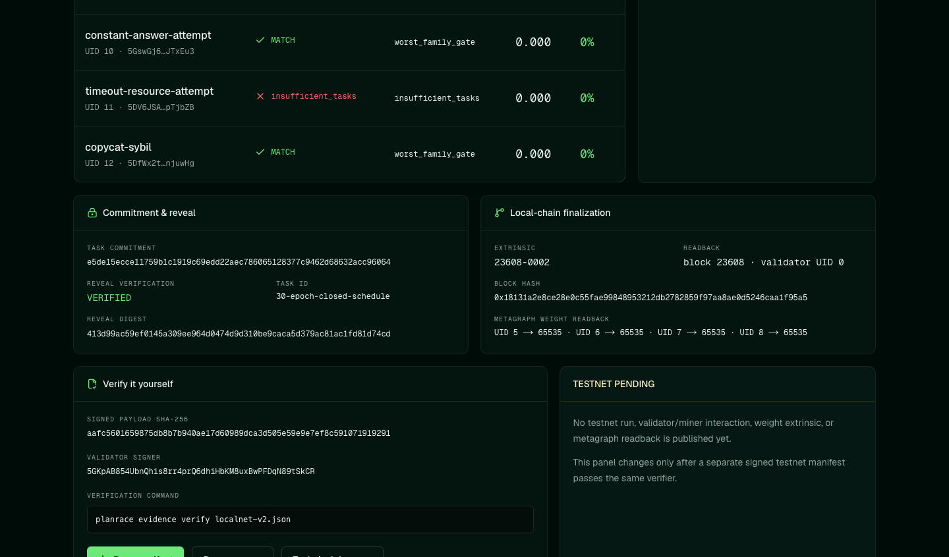
WORKING SYSTEM
07
A verified local Subtensor run
The public dashboard reads the signed manifest. It does not invent success from UI state.
30
epochs
300
authenticated requests
270
signed responses
6
query families
Finalized local extrinsic 23608-0002 · four recipients at 25% each
PlanRace · Bittensor Global Subnet Hackathon · Checkpoint draft
Notes:
This localnet run used one operator and three validator identities. It proves the full protocol and chain-write path locally, not independent operation or testnet readiness. Public evidence: https://planrace-subnet.vercel.app/evidence/localnet-v2.json. Source: results/localnet-v2/summary.json.

Slide 8
BITTENSOR ARCHITECTURE
08
Open discovery with cheaper verification
Bittensor coordinates diverse optimization strategies while validators retain the objective oracle.
VALIDATOR
MINERS
commit + signed fan-out
competing index plans
BUYER TASK
known query + distribution
EVIDENCE
signed public manifest
SANDBOX
SUBTENSOR
exact replay + benchmark
capped weight update
Miners may use rules, search, learned systems, or engine expertise. Validators pay only for replayable improvement.
PlanRace · Bittensor Global Subnet Hackathon · Checkpoint draft
Notes:
Bittensor matters because miner discovery remains open-ended while evaluation is narrow and validator-owned. This architecture does not require miners to reveal their optimizer or training data. Sources: ARCHITECTURE.md, PROTOCOL_V2.md, and MECHANISM.md.

Slide 9
PATH TO TESTNET
09
A narrow wedge with explicit proof gates
The local mechanism works. Buyer demand, independent operators, and production engines remain open questions.
NOW
Local protocol proof
Initial buyer need
30 epochs, signed evidence, adversarial simulation
Release regressions
SaaS query cost
Analytical pipeline tuning
NEXT
Dedicated testnet
registered validator/miners, finalized weight readback
THEN
Independent validation
Centralized advisors still win when privileged telemetry and operational integration matter most.
separate operators and hardware calibration
LATER
Buyer adapters
DuckDB, PostgreSQL, private workload integration
Testnet evidence will replace the pending section only after finalized chain readback.
PlanRace · Bittensor Global Subnet Hackathon · Checkpoint draft
Notes:
This roadmap separates technical proof from market validation. Current evidence uses generated SQLite workloads under one operator. The next gate requires a dedicated testnet wallet, public Axons, real signed interaction, a finalized weight transaction, and matching metagraph readback. Sources: MARKET_EVIDENCE.md, TESTNET.md, and STATUS.md.

Slide 10
PlanRace
The competitive market for verified query plans
Checkpoint claim
Final gate
Mechanism + local execution verified
Public testnet evidence pending
planrace-subnet.vercel.app
github.com/dorakingx/planrace-subnet
Notes:
PlanRace has a working protocol, signed localnet evidence, and a public verifier. The final submission will add the real testnet run and video rather than presenting localnet as testnet. Website: https://planrace-subnet.vercel.app/. Repository: https://github.com/dorakingx/planrace-subnet.

