Slide 1
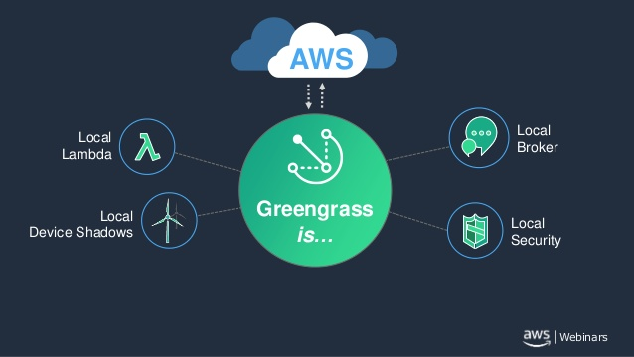
AWS GreenGrass-IoT/ Enterprise Message Queue with encrypted communication over the cloud
Team GreenFace
Hoa Nguyen
Minh Ngo
Viet Nguyen
(Reference: AWS)
Notes:
Good morning everyone
We are team GreenFace
I am Minh,….
Our project is based on AWS GreenGrass IOT. Specifically, we build an enterprise message queue with encrypted communication over the cloud.

Slide 2
Content
AWS overview
AWS IoT platform
AWS GreenGrass console
Technologies used
Project walkthrough
Message Queue
Traffic Light simulation
Notes:
Today, our presentation consists of…

Slide 3
AWS
AWS: cloud platform
Secure connection to cloud applications
Connect to many devices
Support multiple networks and protocols
Data extraction and custom rules
No load balancing issue
Notes:
From left to right and top to bottom
Lets have a quick review of AWS.
AWS amazon web service
AWS fully managed cloud platform
AWS can establish secure connection between devices and cloud applications.
It can also connect to thousands of devices easily (or scalability in another word)
AWS also manages physical devices across multiple networks and protocols
In certain situations, we can extract and filter data from our devices and take specific action with custom Rules (more on this later)
Do not have to worry about Load-balancing or other complications

Slide 4
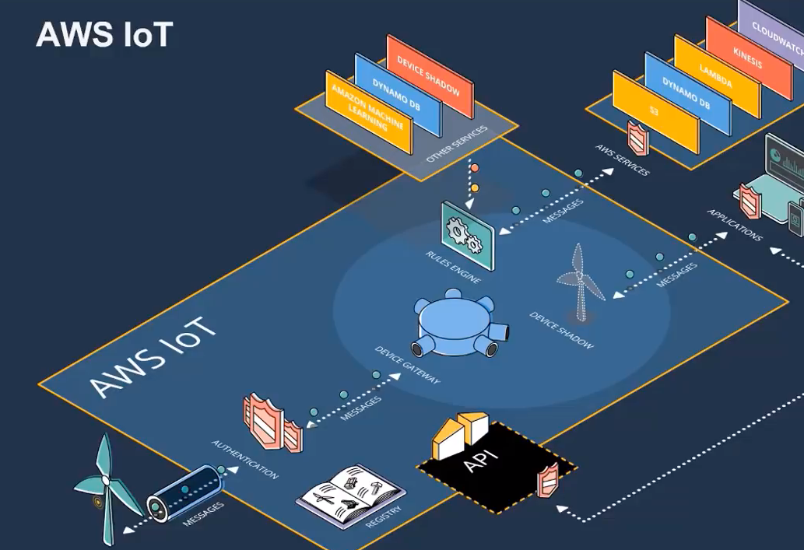
AWS IoT Overview
In AWS IoT, it works as follow:
Publish message to a Topic
Subscribe to that Topic and receive message
Registry stores information of all devices.
(Reference: AWS)
Notes:
We typically have a subscriber and publisher in AWS IoT platform.
The publisher sends the message or publish to a topic defined on the cloud.
The receiver or subscriber will get the message from the same subscription
Publisher and subscriber connect to the AWS IoT and cloud applications through the device gateway.
The registry contains all of the information about the publisher and subscriber’s information such as certificate.
Every devices connected to the Device Gateway needs its own certificate, also must be in the Registry

Slide 5
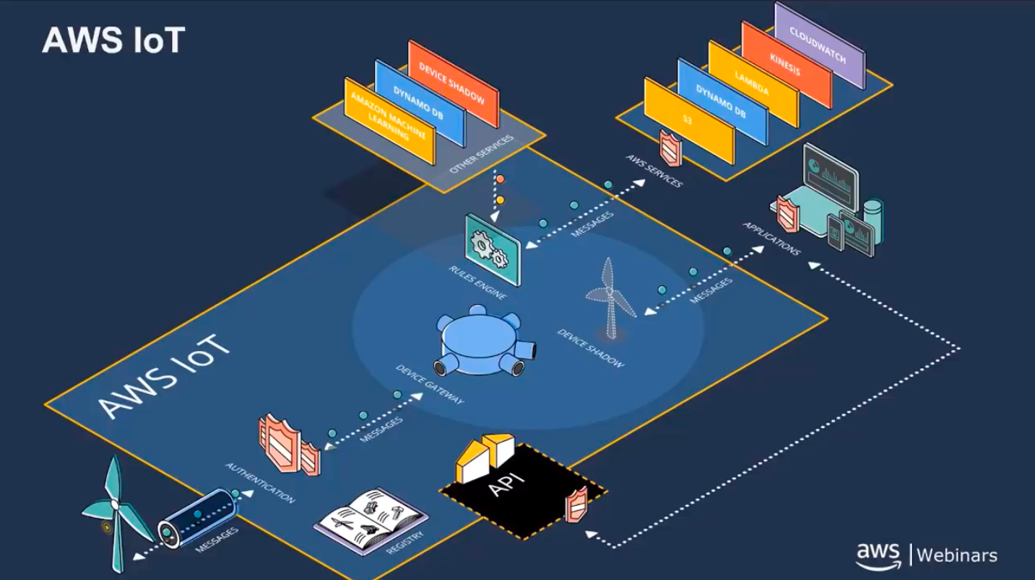
AWS IoT Overview
Policy: define what you can do
Uses MQTT protocol
Rule: how to receive data
Device Shadow: stores operational state of our devices
Lambda: add-on functionalities to messages sent to edge devices.
(Reference: AWS)
Notes:
Policy: define what you can do when the device connects to the Device Gateway
IoT devices constrained by MQTT protocol
MQTT is an ISO standard publish-subscribe-based messaging protocol. It works on top of the TCP/IP protocol.
Rule: define the way how we want to receive down-streamed data (applied rules (AWS IoT action) on multiple incoming messages → great capabilities)
Device Shadow: where we do all the commands and control operations. A critical part of GreenGrass. It stores operational state of our devices, reported back to Device Gateway.
Lambda: advanced computing server ~executing codes providing add-on functionalities to messages sent to edge devices.

Slide 6
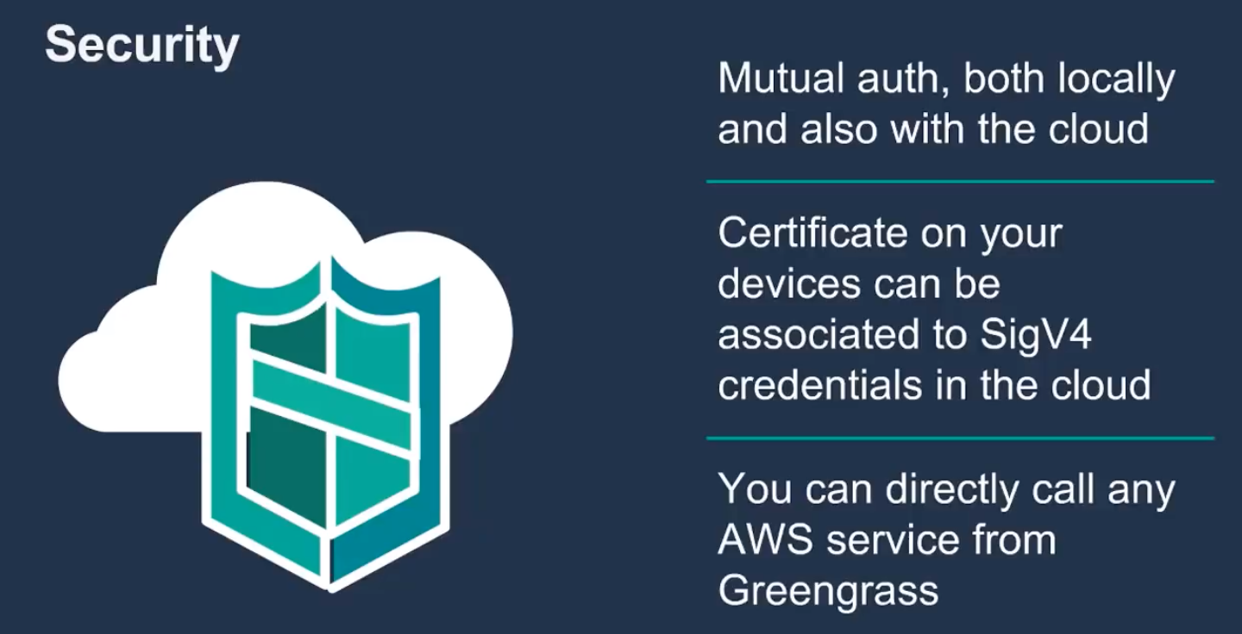
Notes:
To be more specific, AWS Requires the root CA and certificates/ keys for each device
Local GGCore has its own root certificate
Each device certificate is signed by GCC’s root certificate
After those processes, GGC can use local CA and device certificate for authentication.

Slide 7
GreenGrass- an extension of AWS IoT
Software package running on your own hardware (Raspberry Pi,…)
Inherits from AWS IoT:
Lambda (computing operation on edge devices)
Broker (connection to device on the cloud even without connection to the cloud)
Certificate
Shadow devices (operational state of device, command and controlling operation)

Slide 8
GreenGrass Main Components
GreenGrass Core (heart of GreenGrass): run lambda execution, handles device shadow, connection, message broker, security. Requires hardware such as Raspberry Pi or any hardware (ARM, X86)
IoT SDK (C, C++, Python, JS)
GreenGrass Group: set of Cores and devices talking to each other.

Slide 9
AWS GreenGrass Console

Slide 10
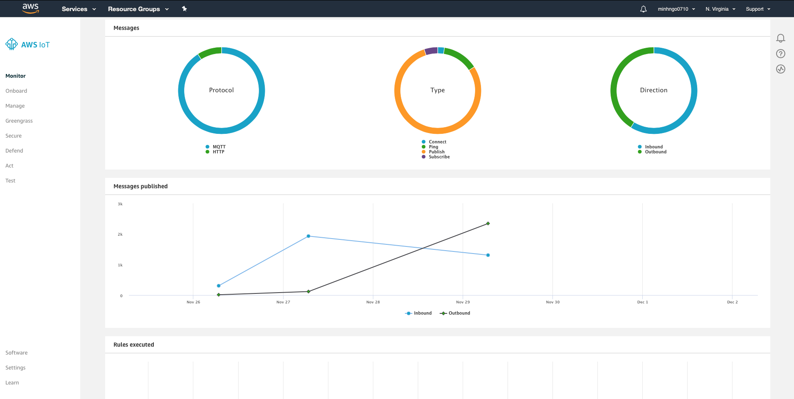

Slide 11
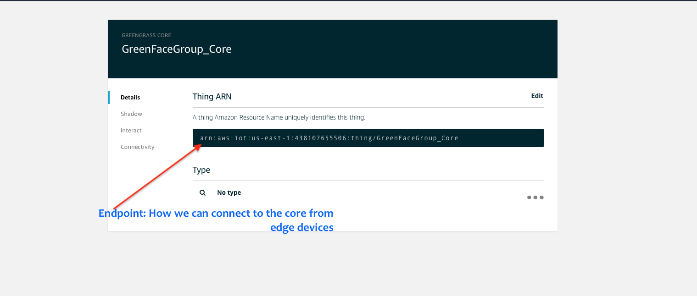
GreenGrass Core

Slide 12
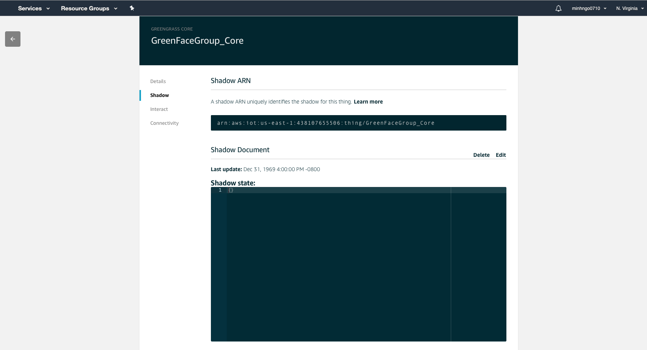
GreenGrass Core Shadow
Notes:
It is a Json document used to keep tracks of the state of your IoT devices and Lambdas.
We can sync this state of our local device to the cloud. (this can be showed in the demo later)

Slide 13
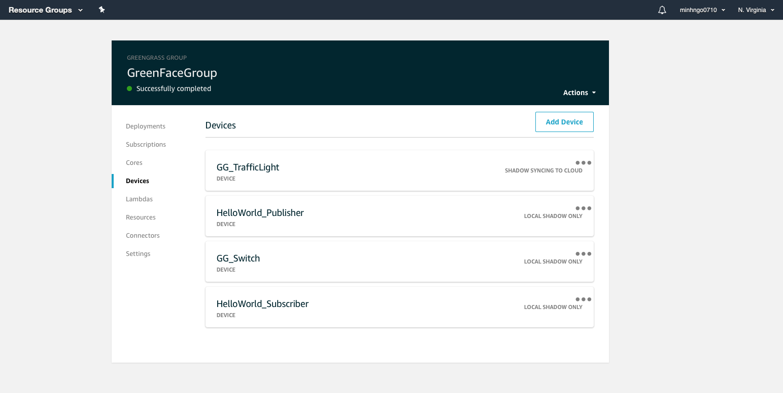
GreenGrass Devices

Slide 14
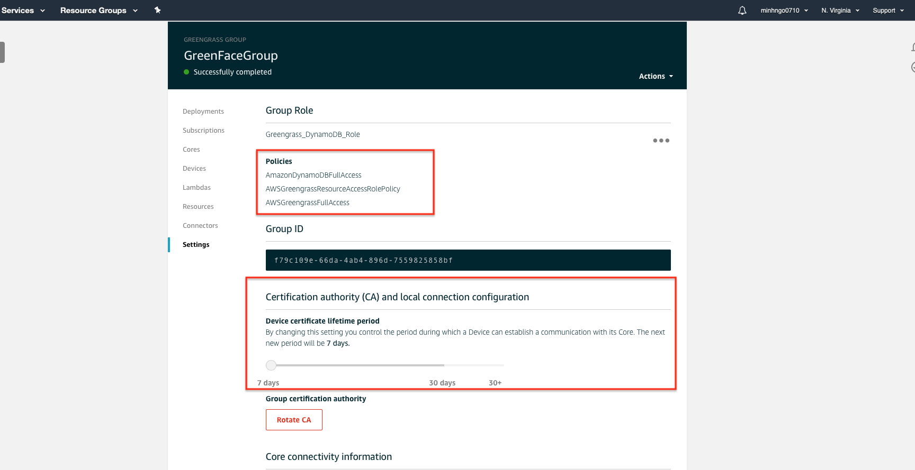
GreenGrass Group and Policy for the group
Notes:
GreenGrass Group has a GG core, multiple devices to that group.
Contains log-in information to allow connection the cloud

Slide 15
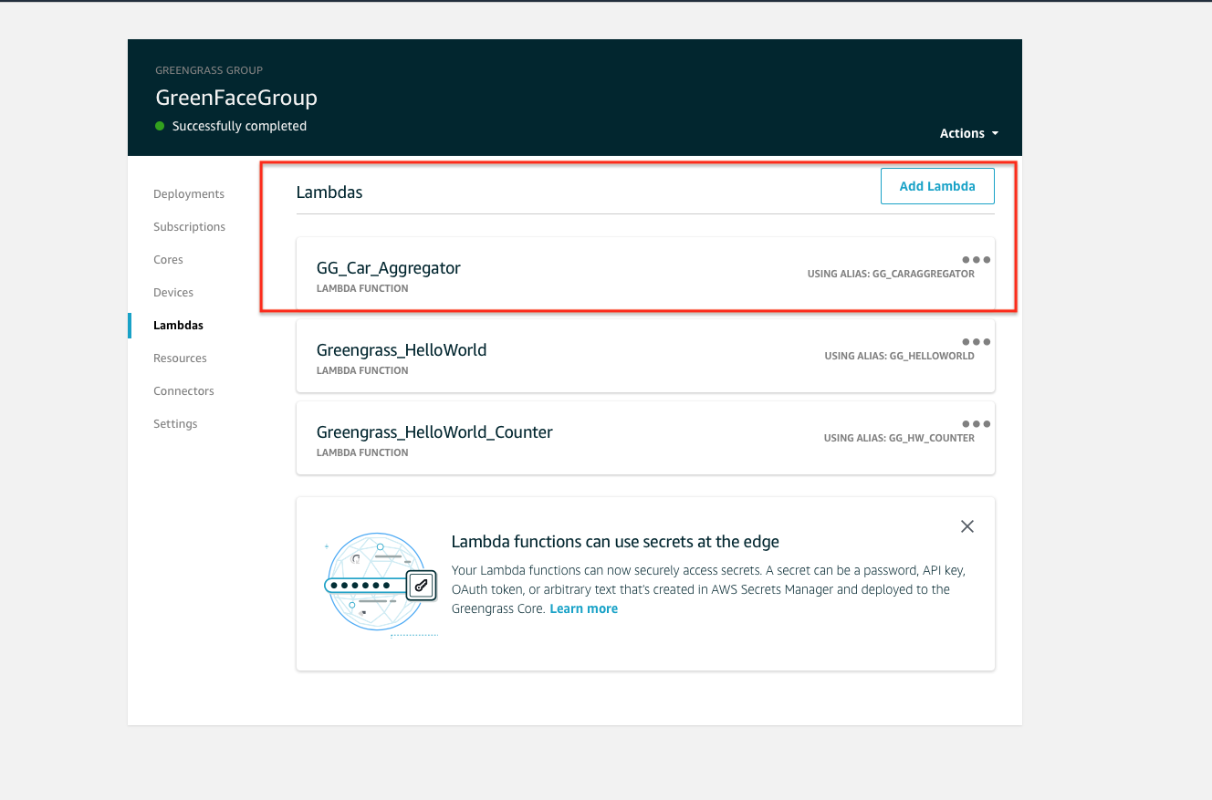
GreenGrass Lambda
Notes:
Lambda: event driven compute functions
Write lambda function right on the browser, upload to the cloud and deploy it to the devices locally as we wish.
Lambda can have the local version of itself: local-lambda.
Lambda can be scaled if you have thousands of them on thousands of devices.
Lambda operates in a container → scalability
Based on Python 2.7
Invoke Lambda functions with messages and shadow updates.
What can we do with Lambda?
Command and control data
Offline operation (if your device comes back online → resume operations)
Data filtering and aggregation (dynamic programming, divide and conquer approach)
Iterative learning (machine learning)

Slide 16
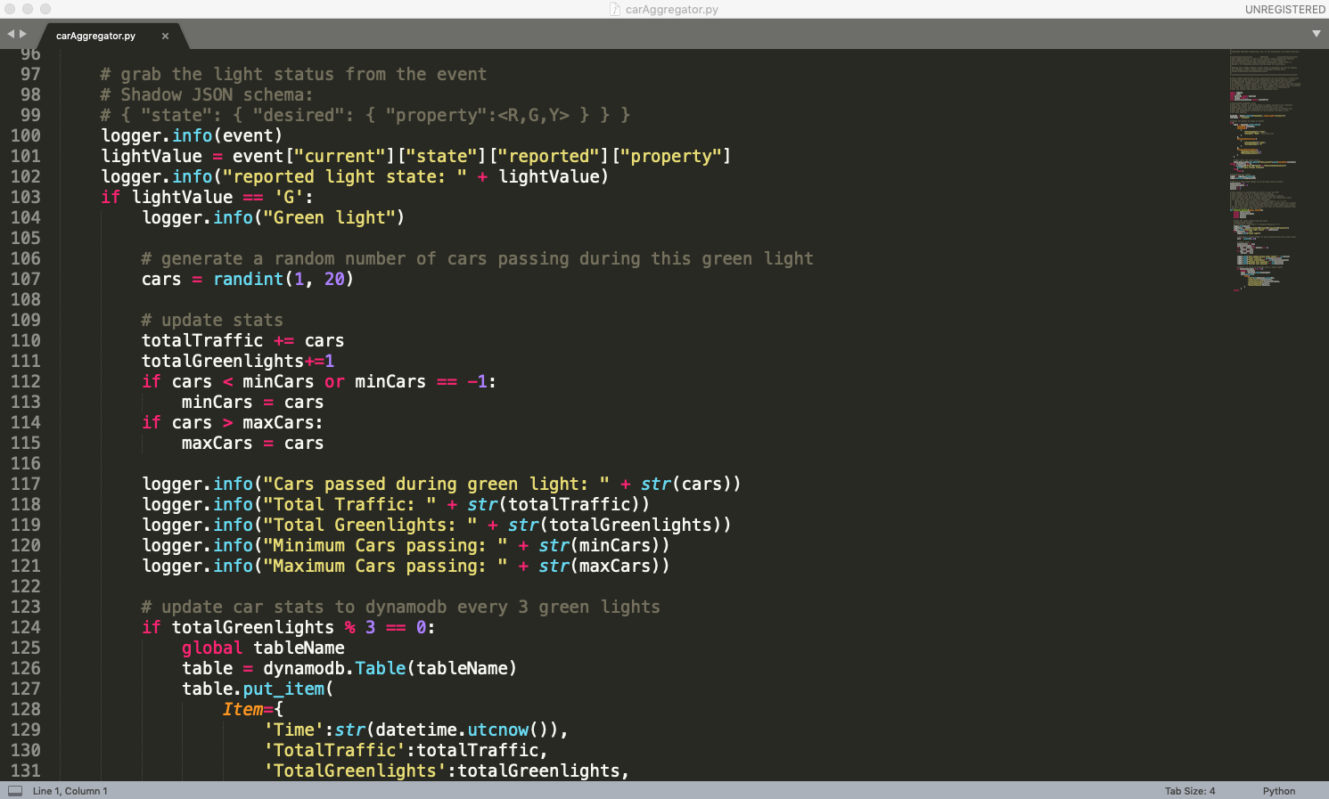

Slide 17
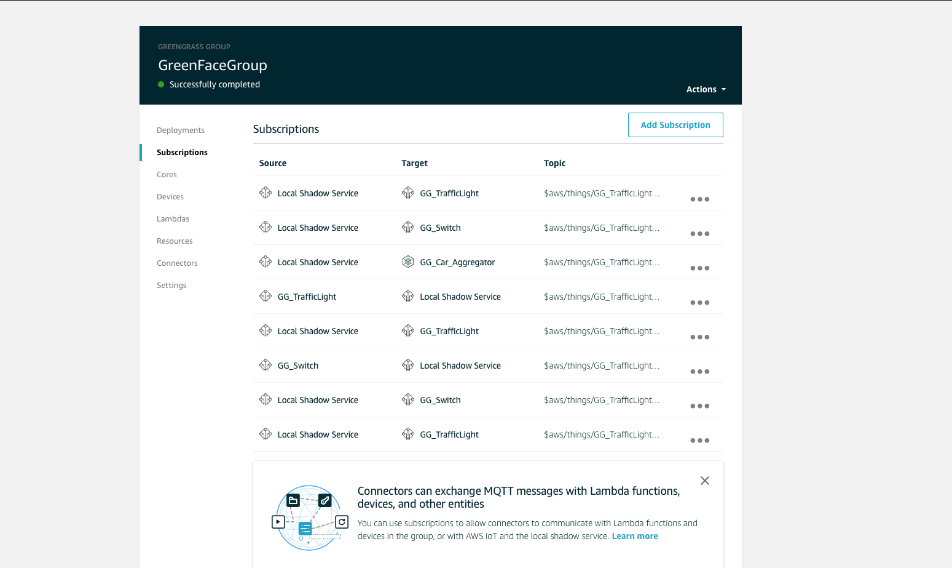
GreenGrass Group Device Subscriptions
Notes:
Subscription List maintained by the GreenGrass Group
It acts like the routing table defining the data going back and forth between a device/service on the cloud to a target or vice versa. The target can be a particular lambda function on the core.
Define the topic name for the subscription

Slide 18
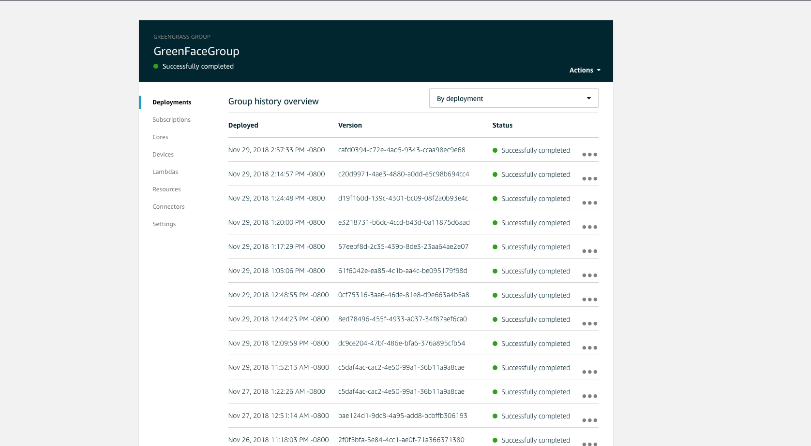
GreenGrass Deployments

Slide 19
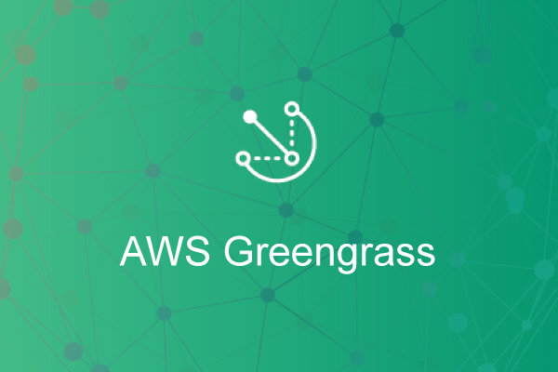
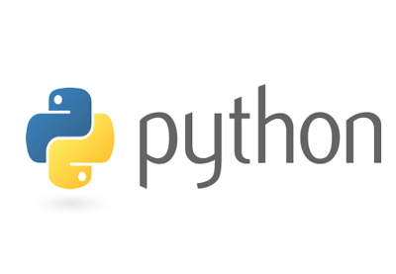
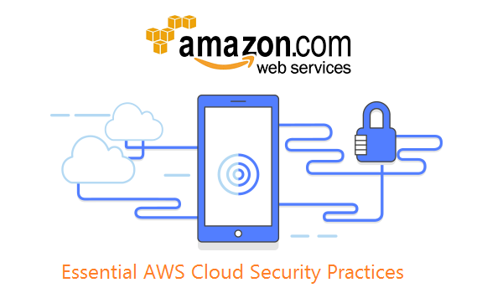
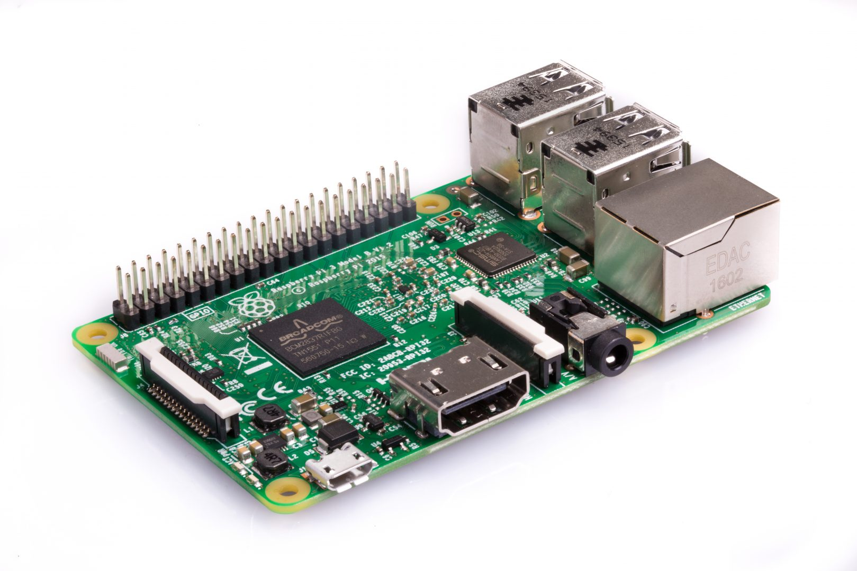
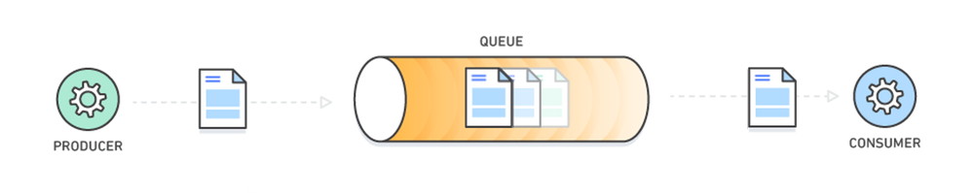
Project Resources & Technologies used
Notes:
From left to right~ top to bottom
AWS account with GreenGrass IoT services
AWS SDK & Python 2.7
AWS security policies and certificate for core and all IoT devices (obtain from Symantec and provided sources from AWS)
AWS message encryption and message queue services
Raspberry Pi 3 Model B with Raspbian Jessie

Slide 20
Project walkthrough
Install Raspberry Jessie, Python 2.7 and GreenGrass SDK onto the host pi (the Pi being used as the host device)
Create AWS account
Set up environment for GreenGrass
Installing GreenGrass core software
Design Lambda function on AWS GreenGrass IoT
Set up interaction between devices in AWS GreenGrass groups
Set up interaction with device shadows
Accessing AWS cloud services and deploy GreenGrass

Slide 21
Message Queue
Create a simplified Enterprise Message Queue between 2 devices
One will publish and one will receive encrypted messages over a queue

Slide 22
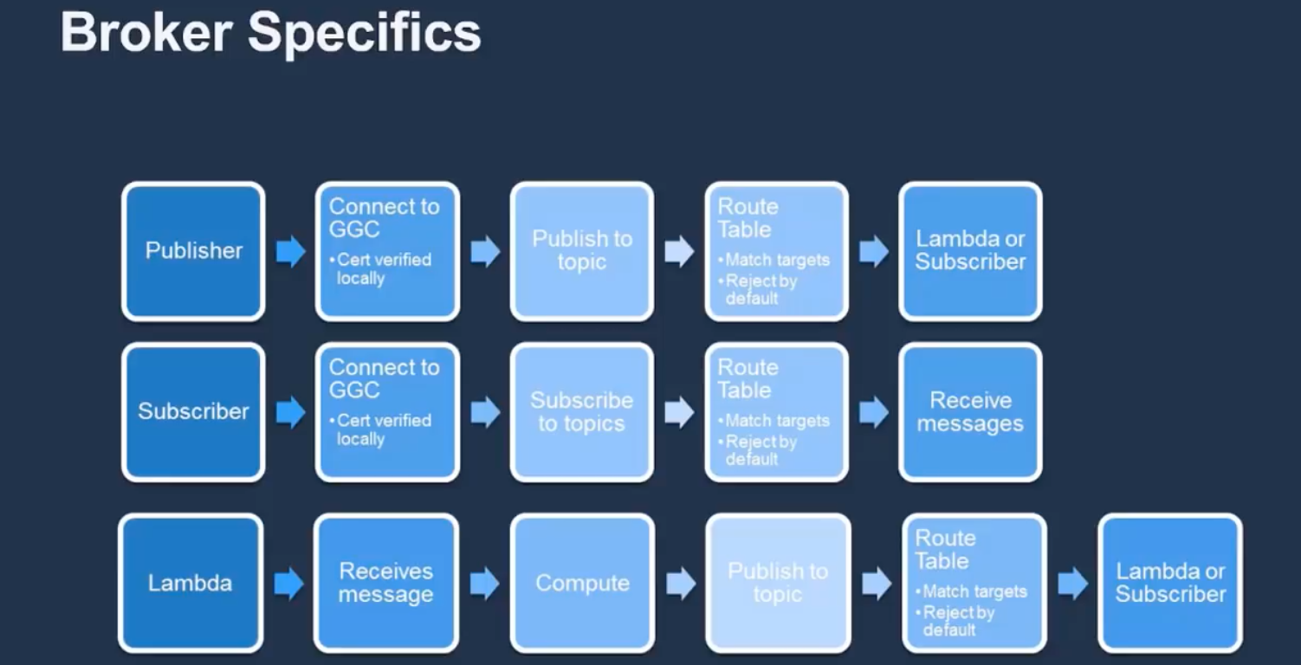

Slide 23
#1: Message Queue Demo
https://app.box.com/s/3lpwenr0e2nmjawjhapexj4pfwwce7oj
Notes:
Just in case
Enterprise Message Queue demo
1 will send a message to the queue based on the topic defined on GreenGrass Core
The receiver or subscriber to that topic will wait on the other side of the queue to receive the message.

Slide 24
Traffic Light Simulation
Create 2 devices: 1 will act as a switch, the other will act as the traffic light.
The switch and the light has 3 different states: G, Y, R.
As the switch changes its state (after every 20 second), the traffic light will do the same.

Slide 25
#2 Traffic Light demo
https://app.box.com/s/3lpwenr0e2nmjawjhapexj4pfwwce7oj

Slide 26
References
https://aws.amazon.com
https://www.raspberrypi.org/education/

