Slide 1
Before we begin: the mathematical building blocks of neural networks
2019. 09. 24
20182073 Hosu Lee
Notes:
Hello, My name is Hosu Lee who is in school of integrated technology at gist. we will present about chapter 2 that tile is ‘Before we begin: the mathematical building blocks of neural networks’ .

Slide 2
Contents
This chapter covers
A first example of a neural network
Tensors and tensor operations
How neural networks learn via backpropagation and gradient descent
2.1 A first look at a neural network
2.2 Data representations for neural networks

Slide 3

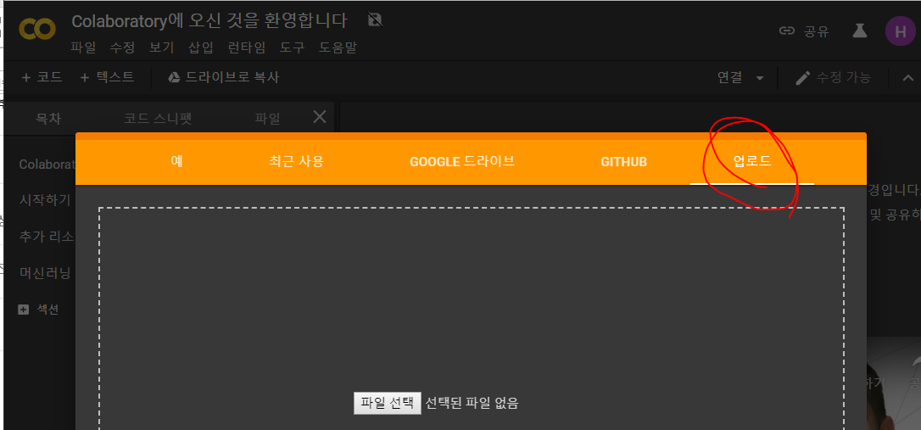
Prepare
- Let’s go to the colab
- Download the file (First_Hosu_Lee.ipynb) from Github
- Upload it at the colab

Slide 4

2.1 A first look at a neural network
1. A example
- The problem is to classify grayscale images of handwritten digits (28 × 28 pixels) into their 10 categories (0 through 9).
- MNIST: The most popular dataset
Training images (60,000), Test images (10,000)
Figure 2.1 MNIST sample digits
→ Let’s load the MNIST dataset in Keras
Training set
Test set
Notes:
You can think of “solving” MNIST as the “Hello World” of deep learning—it’s what you do to verify that your algorithms are working as expected. You will see the mnist in the many paper.

Slide 5
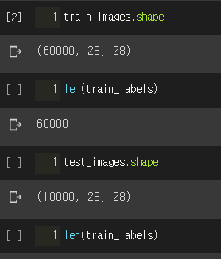
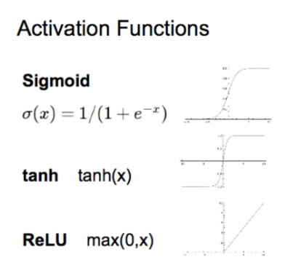
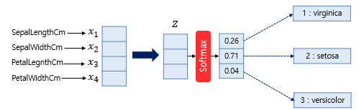
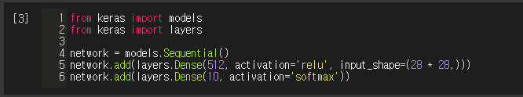
2.1 A first look at a neural network
(# of samples, height, width)
1. A example
→ Let’s make the structure or network (layers, relu, softmax)
Notes:
softmax will return an array of 10 probability scores (summing to 1). You don’t need to understand. It will be explained next chapter more detail.

Slide 6

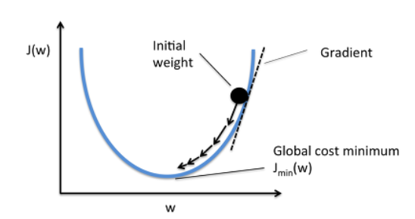

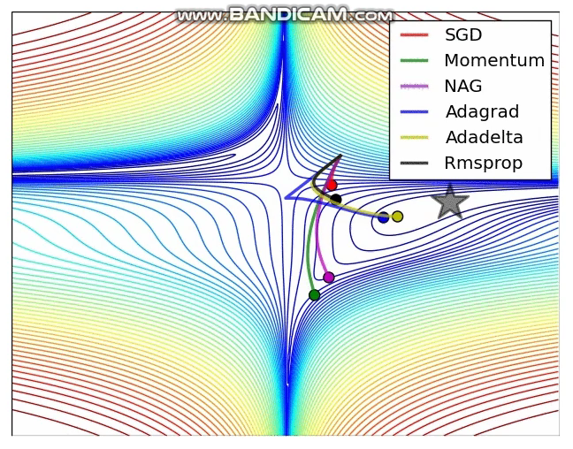
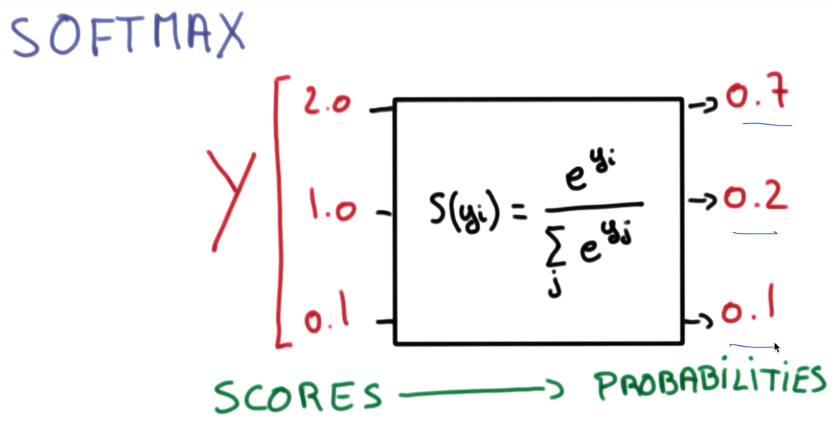
2.1 A first look at a neural network
1. A example
To make the network ready for training, we need to pick three more things,
as part of the compilation step:
A loss function
An optimizer
Metrics to monitor during training and testing – Accuracy
Logistic classification
Notes:
- A loss function—How the network will be able to measure its performance on the training data, and thus how it will be able to steer itself in the right direction.
- An optimizer—The mechanism through which the network will update itself based on the data it sees and its loss function.
- Metrics to monitor during training and testing — Here, we’ll only care about accuracy (the fraction of the images that were correctly classified).

Slide 7
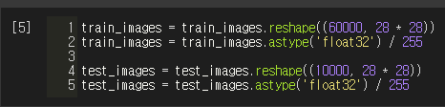
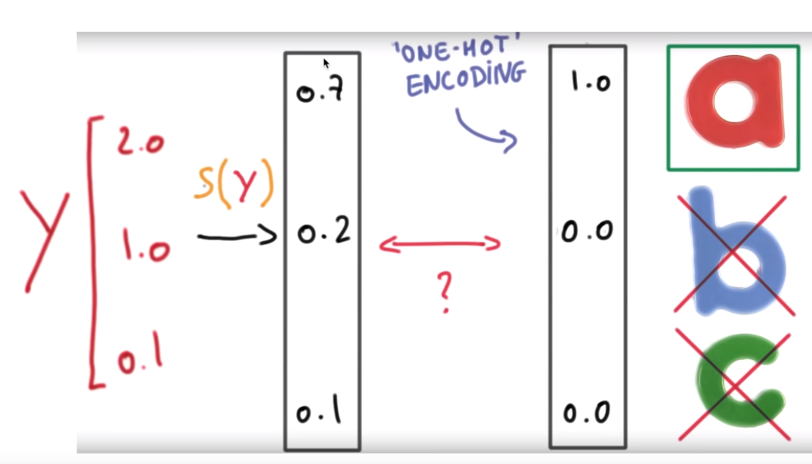

2.1 A first look at a neural network
1. A example
→ Let’s change the data by reshaping. Uint8(0~255), (60000, 28, 28) → Float32(0~1), (60000, 28*28)
→ We also need to categorically encode the labels,
a step that’s explained in chapter 3. ‘one-hot encoding’
Notes:
the network demands reshaping and scaling it so that all values are in the [0, 1]

Slide 8
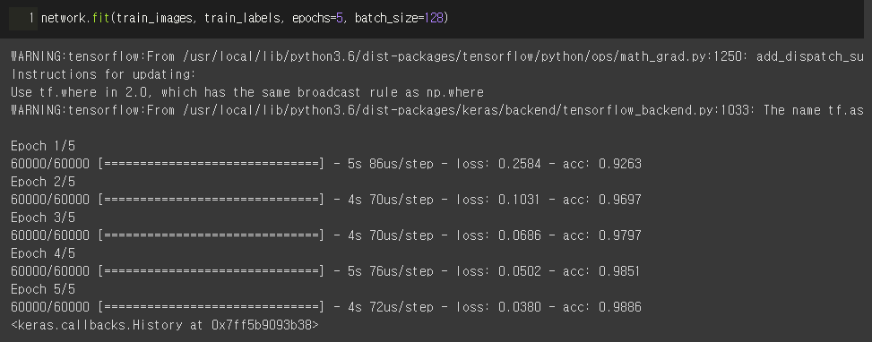
2.1 A first look at a neural network
1. A example
→ Now, let’s train the data!

Slide 9
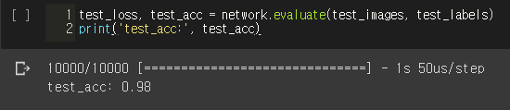
2.1 A first look at a neural network
1. A example
→ Now, let’s test the data!
Notes:
The test-set accuracy turns out to be 97.8%—that’s quite a bit lower than the training set accuracy. This gap between training accuracy and test accuracy is an example of overfitting:

Slide 10
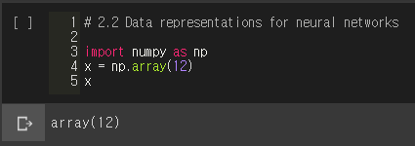

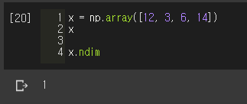
2.2 Data representations for neural networks
1. Scalars (0D tensors)
A scalar (or scalar tensor, or 0-dimensional tensor)
In Numpy, a float32, float64 number is a scalar tensor
ndim, tensor has 0 axes (ndim == 0)
2. Vectors (1D tensors)
- An array of numbers is called a vector, or 1D tensor
Notes:
Axes = dimension

Slide 11
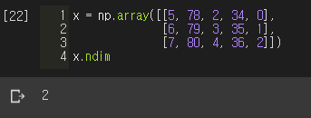
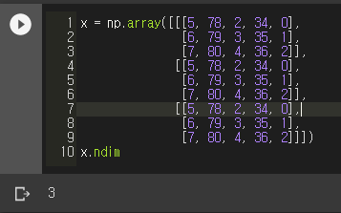
2.2 Data representations for neural networks
3. Matrices (2D tensors)
- An array of vectors is a matrix, or 2D tensor
4. 3D tensors and higher-dimensional tensors
5. Key attributes
Number of axes (rank)
Shape (3, 3, 5)
Data type: ‘dtype’ , float, uint8, float64, char…
Notes:
Axes = dimension , square brackets

Slide 12
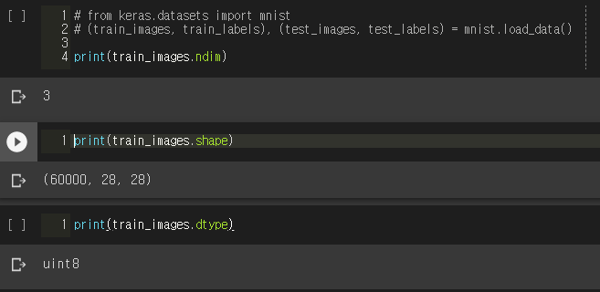
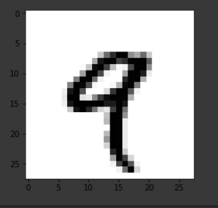
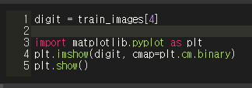
2.2 Data representations for neural networks
5. Key attributes
- Review our data set
Fifth sample in 3D tensor

Slide 13
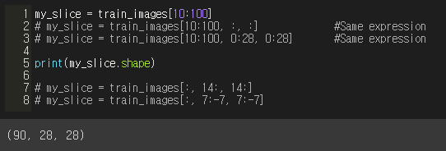
2.2 Data representations for neural networks
6. Manipulating tensors in Numpy
- tensor slicing
14
14
is equivalent to selecting the
entire axis

Slide 14

2.2 Data representations for neural networks
7. The notion of data batches
- Deep-learning models don’t process an entire dataset at once;
They break the data into small batches.
- When considering such a batch tensor, the first axis (axis 0) is called the batch axis or batch dimension.
Here’s one batch of our MNIST digits,
with batch size of 128:
And here’s the next batch:
And the nth batch:

Slide 15
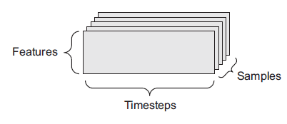
2.2 Data representations for neural networks
8. Real-world examples of data tensors
The data you’ll manipulate will almost always fall into one of the following
categories:
Vector data: 2D tensors of shape (samples, features)
Timeseries data or sequence data—3D tensors of shape
(samples, timesteps, features)
Images: 4D tensors of shape (samples, height, width, channels) or (samples, channels, height, width)
Video: 5D tensors of shape (samples, frames, height, width, channels) or
(samples, frames, channels, height, width)
Figure 2.3 A 3D timeseries data tensor
Notes:
Vector data is the most popular.
Timeseries data or sequence data
Images: channels. grayscale images is 1. Color image is 3
Video:

Slide 16
Thank you
Notes:
Vector data is the most popular.
Timeseries data or sequence data
Images: channels. grayscale images is 1. Color image is 3
Video:

