Slide 1
hello advanced deep learning
You can use PPT files to explain your results

Slide 2
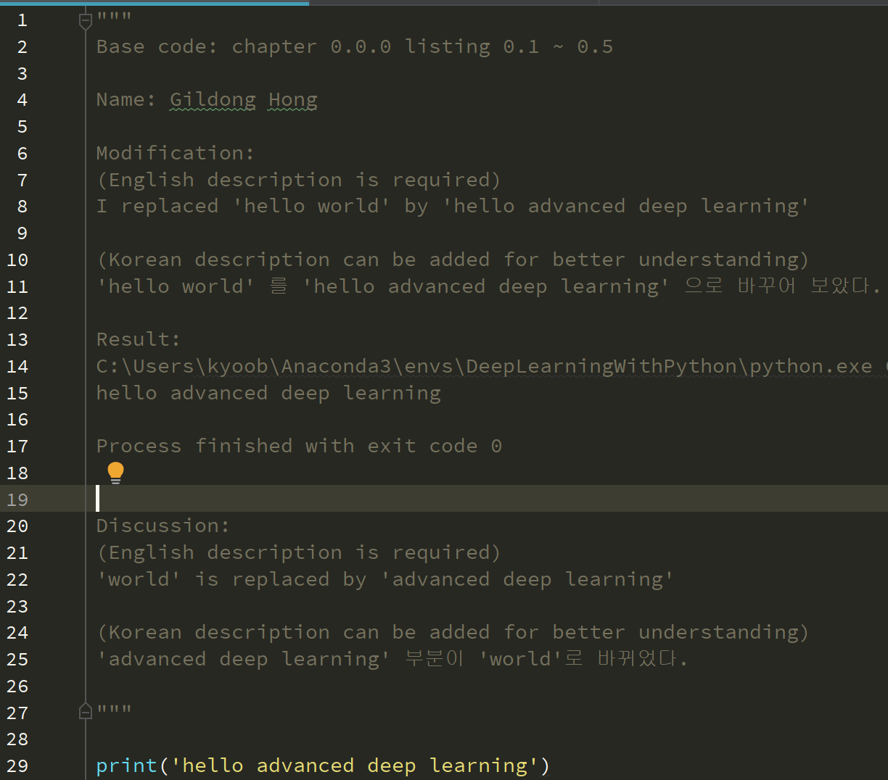
Hello Advanced Deep Learning

