Slide 1

2.3 The gears of neural networks : Tensor Operations
Lee Geon Hyup

Slide 2




2.3 The gears of neural networks : Tensor Operations
Example)
2D tensor
+
Vector
3 tensor operations
(1)
(2)
(3)

Slide 3
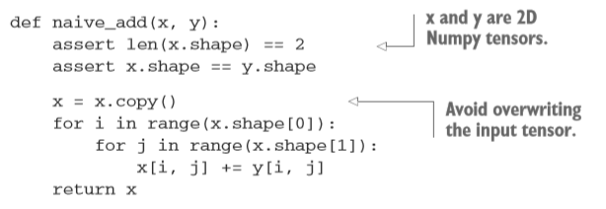
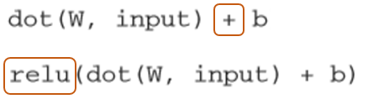
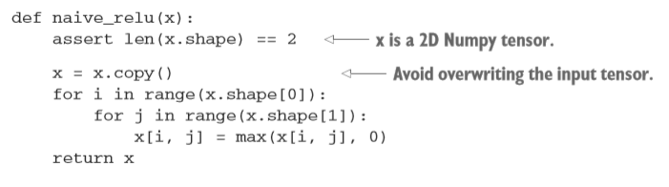
2.3 The gears of neural networks : Tensor Operations
2.3.1 Element-wise operations
Naïve python implementation – Using ‘for’ loop
<Addition>
From the previous example
<Relu>

Slide 4
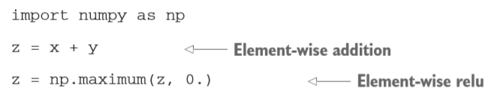
2.3 The gears of neural networks : Tensor Operations
2.3.1 Element-wise operations
Using Numpy functions
From the previous example
Easily implemented
Multiplication, subtraction, and so on

Slide 5
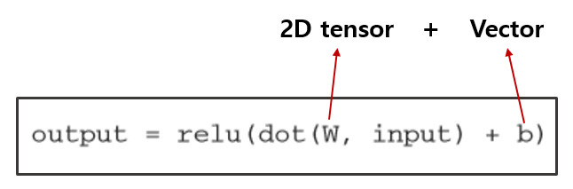
2.3 The gears of neural networks : Tensor Operations
2.3.2 Broadcasting
From the previous example
But, what happens with addition when the shapes of the two tensors being added differ?
Smaller tensor
Larger tensor
‘Broadcast’

Slide 6
2.3 The gears of neural networks : Tensor Operations
2.3.2 Broadcasting
Two steps
Axes(called broadcast axes) are added to the smaller tensor to match the ndim of the larger tensor
The smaller tensor is repeated alongside these new axes to match the full shape of the larger tensor.
Example
X : shape(32,10)
Y : shape(10,)
Y : shape(32,10)
- Y[ i, : ] == y for i in range (0,32)
Y : shape(1,10)
Add an empty first axis to y
Repeat y 32 times alongside this new axis

Slide 7
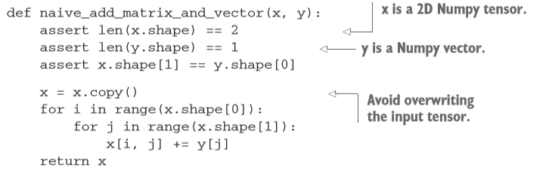
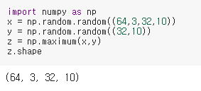
2.3 The gears of neural networks : Tensor Operations
2.3.2 Broadcasting
Naïve python implementation
Using Numpy functions – Element-wise maximum operation

Slide 8



2.3 The gears of neural networks : Tensor Operations
2.3.3 Tensor dot (Tensor product)
From the previous example
Combine entries in the input tensors.
Element-wise operation : ‘ * ’ (In Numpy, Keras, Theano, and Tensorflow)
Tensor dot : ‘ .dot ‘ (In Numpy, Keras)
: ‘ tf.matmul(x,y) ‘ (In Tensorflow)
Using Numpy function

Slide 9
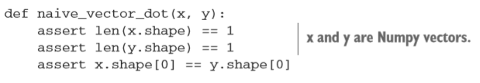
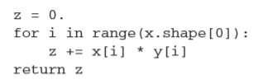
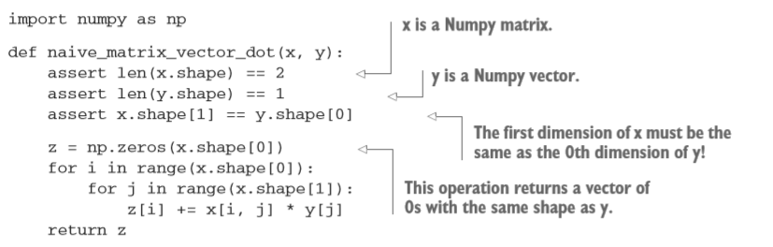
2.3 The gears of neural networks : Tensor Operations
2.3.3 Tensor dot (Tensor product)
1. Two vectors x and y
Compatible that only vectors with the same number of elements
2. Matrix x and vector y
Returns a vector

Slide 10
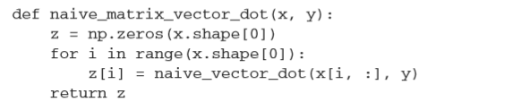
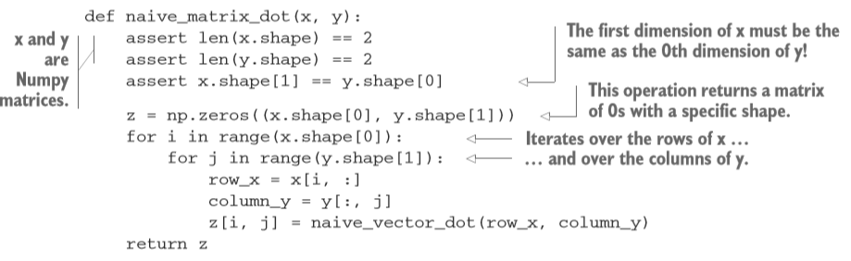
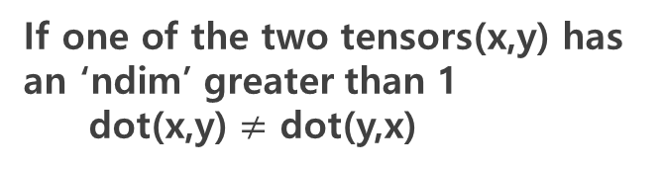
2.3 The gears of neural networks : Tensor Operations
2.3.3 Tensor dot (Tensor product)
3. Relationshop between a matrix-vector product and a vector product.
If one of the two tensors(x,y) has an ‘ndim’ greater than 1
dot(x,y) $≠$ dot(y,x)
4. Two matrices (Most common applications)
Only if x.shape[1] == y.shape[0]
dot(x,y)

Slide 11
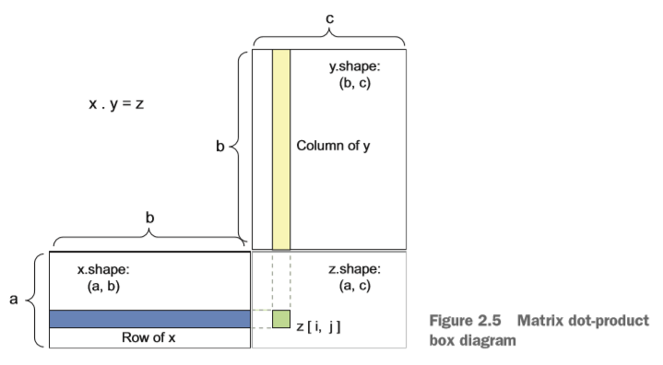
2.3 The gears of neural networks : Tensor Operations
2.3.3 Tensor dot (Tensor product)
Visualize the input and output 2D tensors
x.shape(a,b) . y.shape(b,c)
z.shape(a,c)

Slide 12
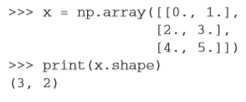
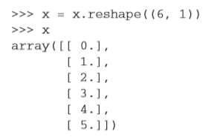


2.3 The gears of neural networks : Tensor Operations
2.3.4 Tensor reshaping
Preprocess the digits data before feeding it into the network
Reshaping a tensor means rearranging its rows and columns to match a target shape.
Example
Transposition

Slide 13
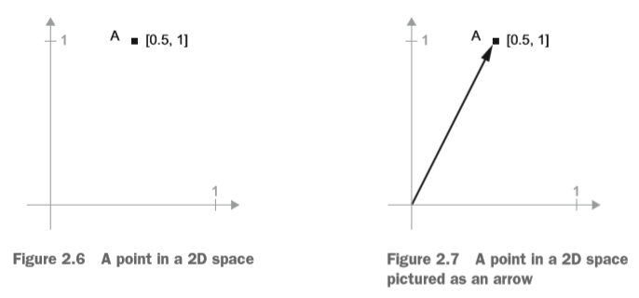
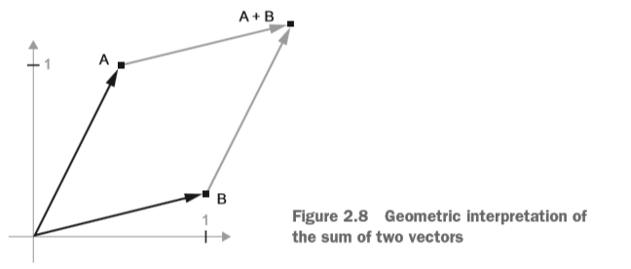

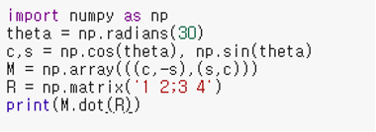
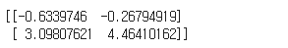
2.3 The gears of neural networks : Tensor Operations
2.3.5 Geometric interpretation of tensor operations
All tensor operations have a geometric interpretation
Example
Example of the rotation of a 2D vector by using dot product

Slide 14
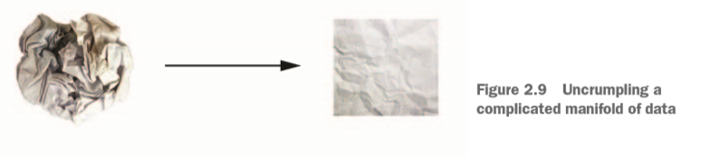
2.3 The gears of neural networks : Tensor Operations
2.3.6 A geometric interpretation of deep learning
Deep Learning
Complex, highly folded data
Finding neat representations

