Slide 1
Ch. 2-4, 2-5
Pyo, Sanghun

Slide 2
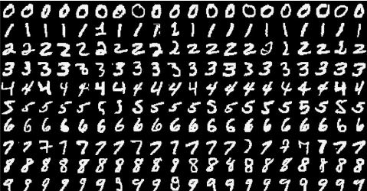
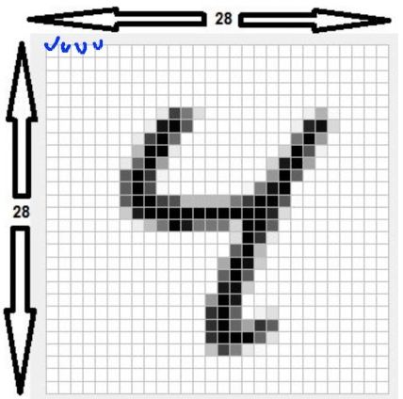
2.5 Reviewing the first example
from keras import models from keras import layers
from keras.datasets import mnist from keras.utils import to_categorical from keras.utils import plot_model (train_images, train_labels), (test_images, test_labels) = mnist.load_data()
MNIST data set
28X28X1 image file of handwritten digit number
Layer
A key component of neural networks which is a kind of data processing filter.
Extract more meaningful expressions from input data for a given problem.

Slide 3
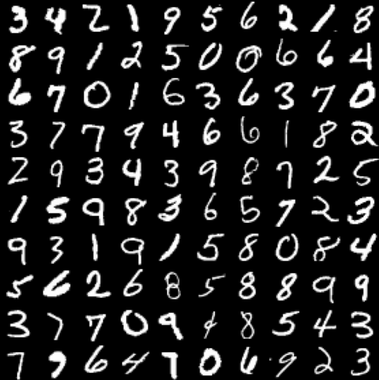
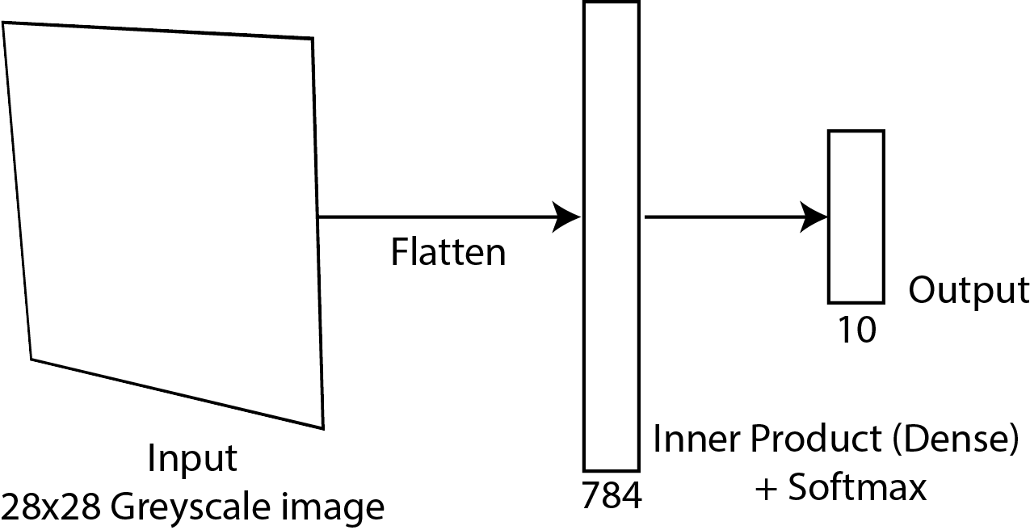
2.5 Reviewing the first example
print(train_images.shape) print(len(train_labels)) print(train_labels) print(test_images.shape) print(len(test_labels)) print(test_labels) train_images = train_images.reshape((60000, 28 * 28)) train_images = train_images.astype('float32') / 255 print("train_images_reshape?") print(train_images.shape)
-> (60000, 28, 28)
-> 60000
-> [3, 4, 2, 1....]
-> (10000, 28, 28)
-> 10000
# normalization
0
0.21
0.15
...
About “3”
60000
60000 x

Slide 4
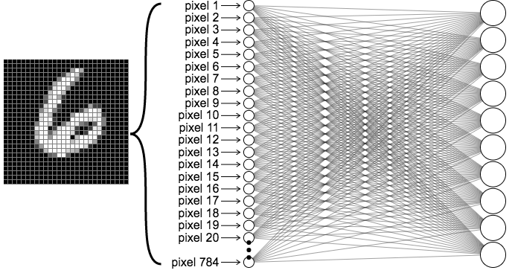

2.5 Reviewing the first example
train_labels = to_categorical(train_labels) print("train_labels_categorical") print(train_labels) test_labels = to_categorical(test_labels)
[3, 4, 2, 1....]
[[0, 0, 0, 1, 0, 0, 0, 0, 0, 0]
[0, 0, 0, 0, 1, 0, 0, 0, 0, 0]
[0, 0, 1, 0, 0, 0, 0, 0, 0, 0]
[0, 1,0 , 0, 0, 0, 0, 0, 0, 0]
....
The “dense” layer, which is fully connected to next dense layer or “softmax” layer needs the properly encoded labels
=1

Slide 5
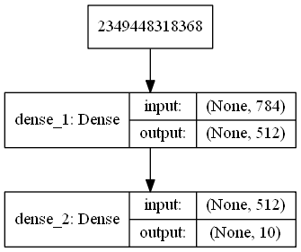
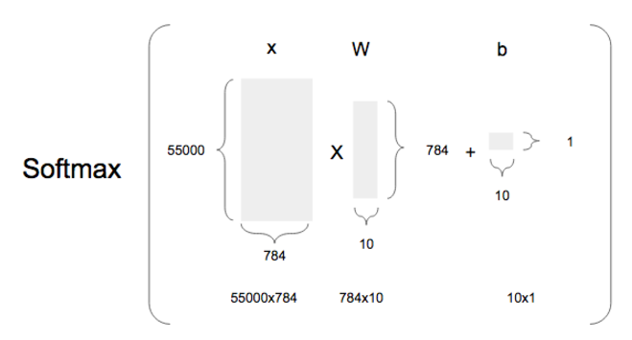
2.5 Reviewing the first example
network = models.Sequential() network.add(layers.Dense(512, activation='relu', input_shape=(28 * 28,))) network.add(layers.Dense(10, activation='softmax')) network.summary() plot_model(network, to_file='model.png',show_shapes=True, show_layer_names=True)
A user just need to set the shape of output. In Keras, the weigh and bias is automatically calculated.
The problem of this example is the classification problem. Thus, the later including “Softmax” needs to match up with the encoded labels.
60000
512
60000
60000
512
512
512

Slide 6
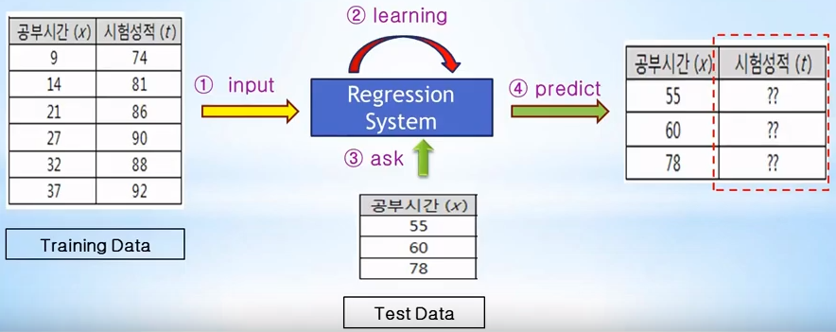
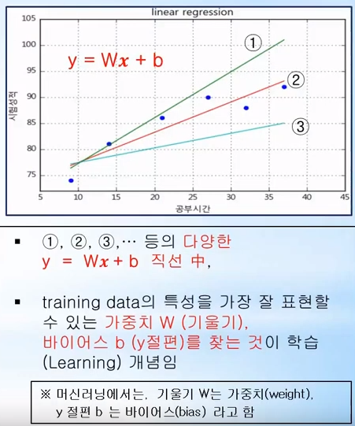
2.4 Neural Network Engine: Gradient-based Optimization
network.compile(optimizer='rmsprop', loss='categorical_crossentropy', metrics=['accuracy']) network.fit(train_images, train_labels, epochs=5, batch_size=128)
test_loss, test_acc = network.evaluate(test_images, test_labels) print('test_acc:', test_acc)
For example, if the batch size is 128, you will see only 128 data samples, get a gradient, and update the weight and bias. You can update weights much faster than gradient decent using the whole data. This method of obtaining weight is called Stochastic Gradient Descent method.
Gradient Descent for linear regression
X | t
9 | 74
14 | 81
21 | 86
27 | 90
X | t
55 | ?
60 | ?
X
55
60

Slide 7
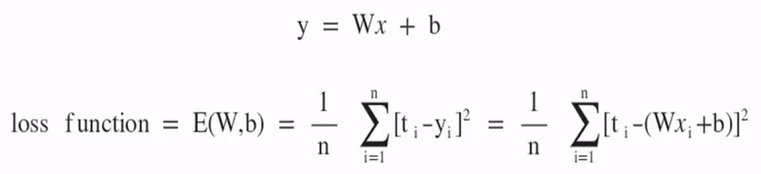


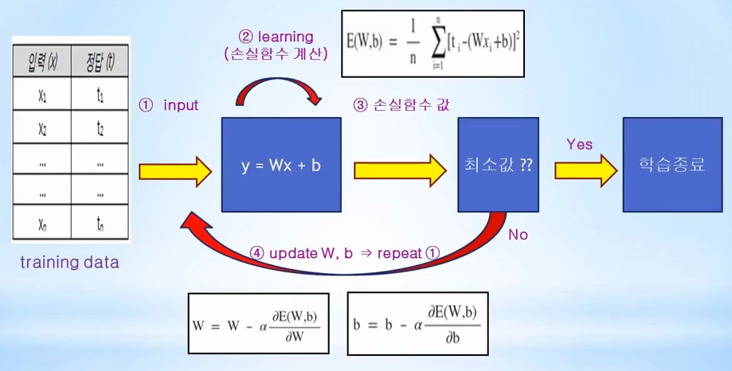
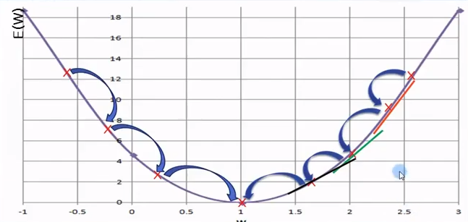
2.4 Neural Network Engine: Gradient-based Optimization
Gradient Descent for linear regression
Linear regression is changed to convex function optimization problem
Learning rate
Minimum?
Learning end

Slide 8
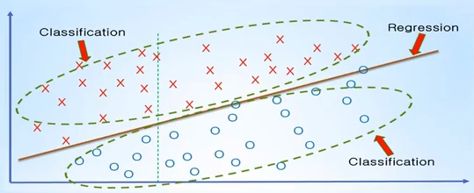
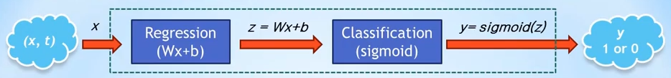
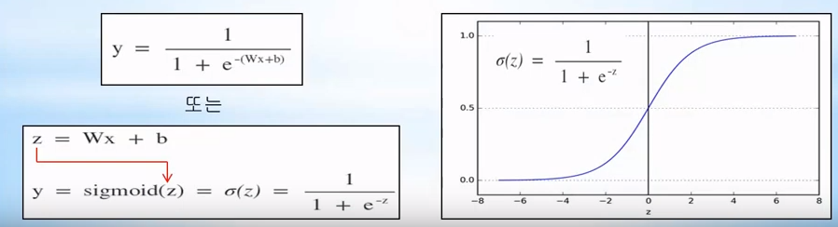
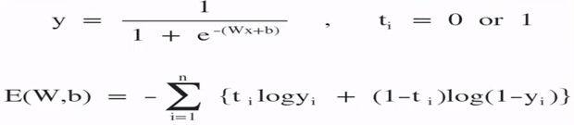


The concept of gradient descent for classification
Find the optimal fitted line representing the training data characteristics and distribution
Classify data as "up" or "down" based on its best fitted line
y=RELU(z)
The final output (y) of classification problem is logically 1 or 0 by the sigmoid or RELU function.
Thus, a loss function is needed that is different from linear regression with continuous values.
1
0
Cross-entropy
The result of linear regression

Slide 9
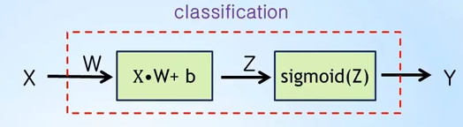
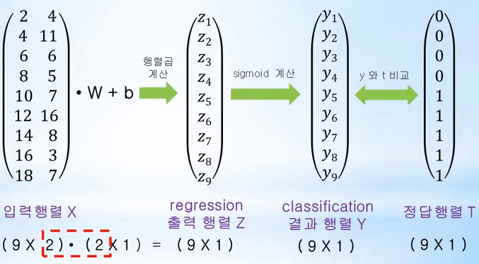
The concept of gradient descent for classification for multi variable case
network.compile(optimizer='rmsprop', loss='categorical_crossentropy', metrics=['accuracy']) network.fit(train_images, train_labels, epochs=5, batch_size=128)
RELU(Z)
X1 | X2 | T
2 | 4 | 0
4 | 11 | 0
6 | 6 | 0
8 | 5 | 0
10 | 7 | 1
12 | 16 | 1
14 | 8 | 1
16 | 3 | 1
18 | 7 | 1
Dot product
RELU
calculation
Comparison
Input
Ground truth
Output
Result

Slide 10
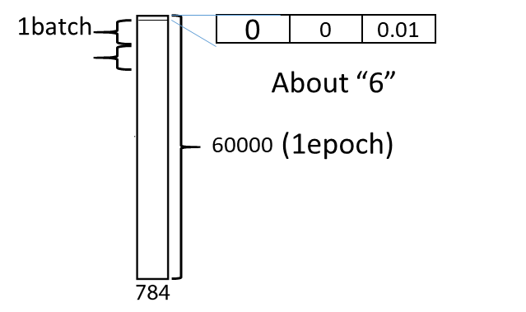
The concept of gradient descent for classification for multi variable case
network.compile(optimizer='rmsprop', loss='categorical_crossentropy', metrics=['accuracy']) network.fit(train_images, train_labels, epochs=5, batch_size=128)
If the this code is successfully excuted..
0.01
RELU/Sigmoid
0.03
0.04
0.02
0.1
0.09
0.6
0.07
0.03
0.01

Slide 11
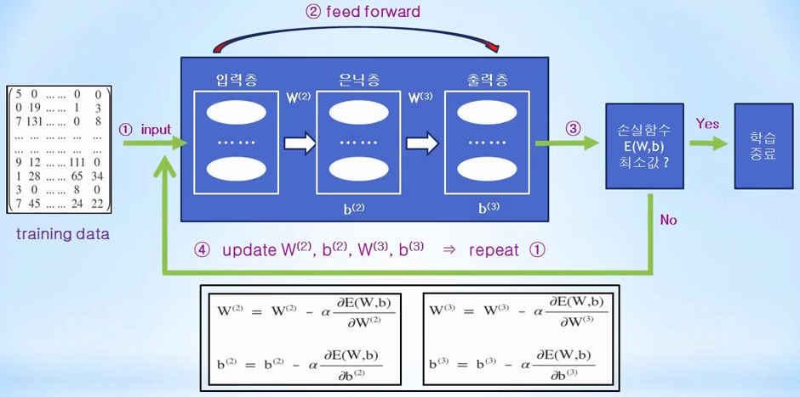
Back propagation – conceptual access with sigmoid
Problem of optimization process only using calculus
Input layer
Layer
Output layer
Minimizing Loss function
Termination
Excessive numerical differential operation causes increased computation cost!!

Slide 12
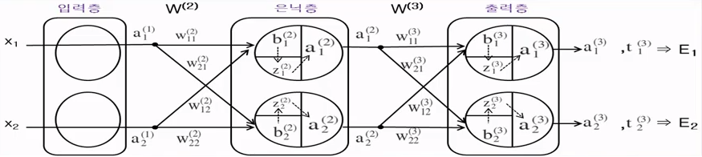
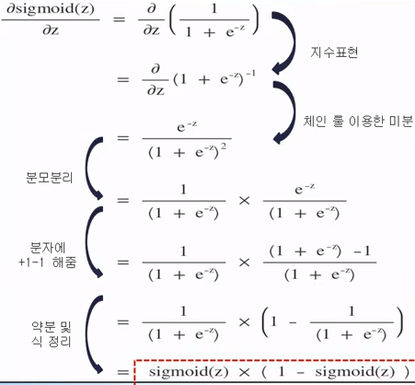
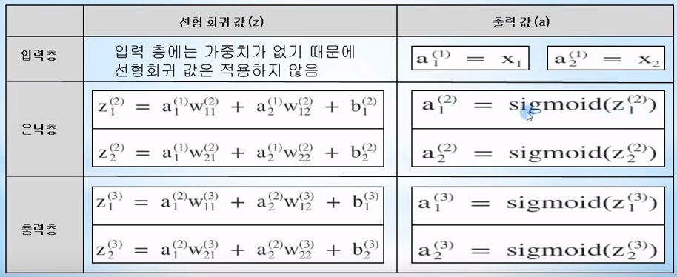

Back propagation – conceptual access with sigmoid
Input layer
Hidden layer
Output layer
Linear regression value (z)
Output (a)
Input
Hidden
output

Slide 13
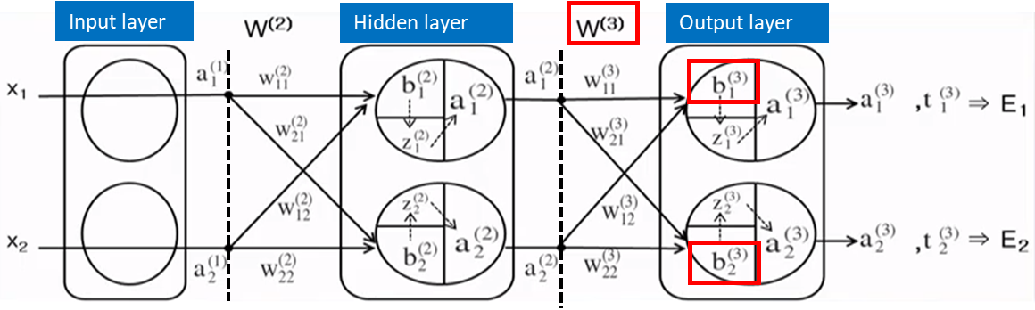
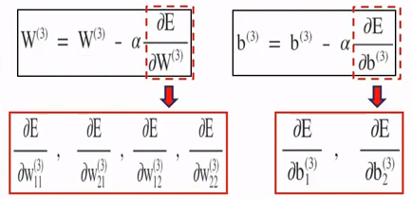
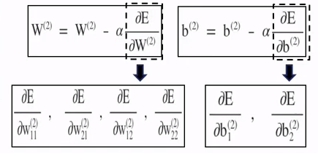
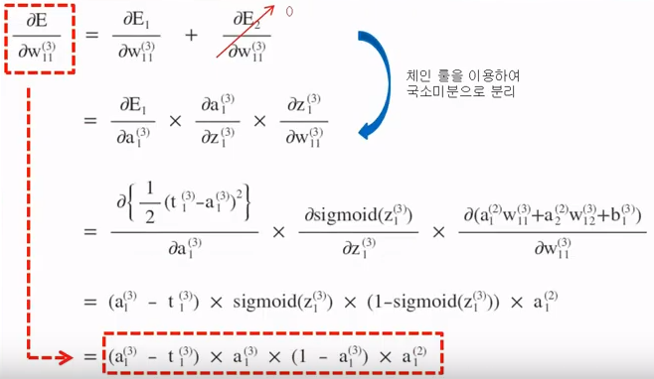
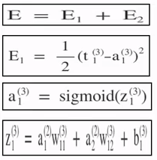
Back propagation – conceptual access with sigmoid : example (1)
where
Calculus becomes algebraic equation!

Slide 14
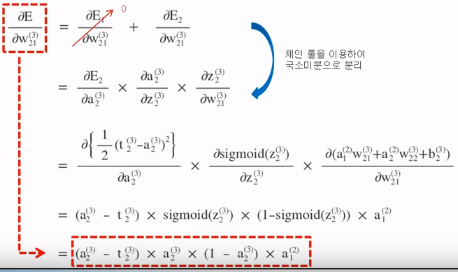
Back propagation – conceptual access with sigmoid : example (2)
where
Similarly, the others of weight in output layer (3) can be computed such as the back propagation of w₁₁ and w₁₂ in output layer.

Slide 15

Back propagation – conceptual access with sigmoid : example (3)
where
Let’s think about the back propagation between hidden layer to E

