Slide 1
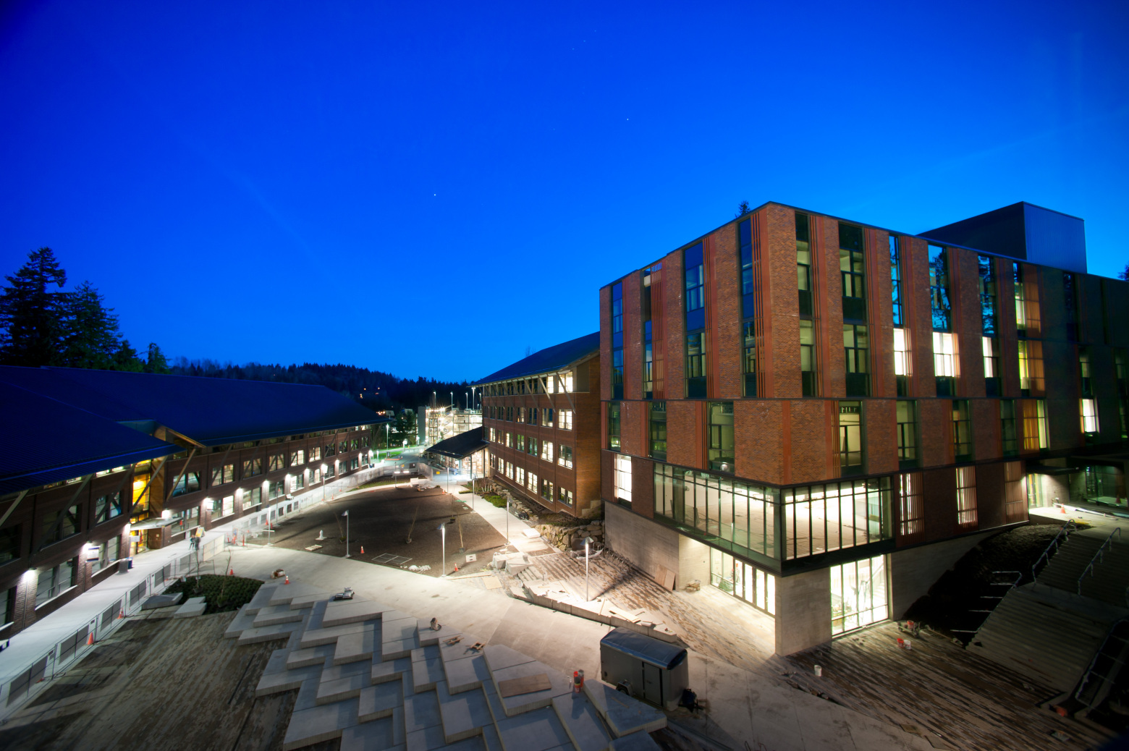
UWB CSS Faculty Research Faculty Advisor: Dr. Wooyoung Kim
WEB DEVELOPMENT for NETWORK MOTIF
CSS 497 Summer 2018 Capstone Project
Presented By : Jin Kim

Slide 2
Overview
What is Network Motif
FANMOD, Software for finding Network Motif
NemoLib, Library for finding Network Motif
Udemy, Online Course
Tools used
Application Demo
Why use Web?
Future Implementation
What I have learned
Notes:
2

Slide 3
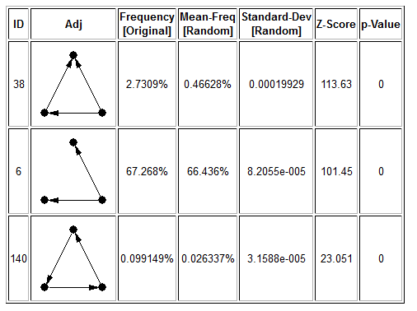
Network Motif
Identify certain small subnetwork that has significantly higher frequencies than random networks in many biological networks
Sub-graphs that repeat themselves in a specific network or even among various networks defined by particular interaction between vertices.
Used to uncover the structural design principles of biological networks
Uses directed network to find the pattern
Used widely in many biology application
Notes:
3

Slide 4
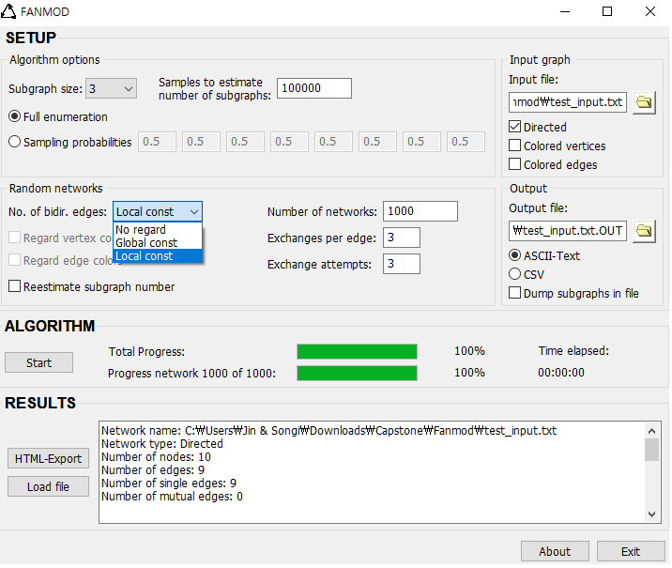
fanmod
Popular program used to find network motif
Provide many options
Free to use
Can only have numeric input
Requires installation
No update / Outdated

Slide 5
nemolib
Java Library / Can be used in many application
On-going library
Highly programmable
Provides extensibility

Slide 6

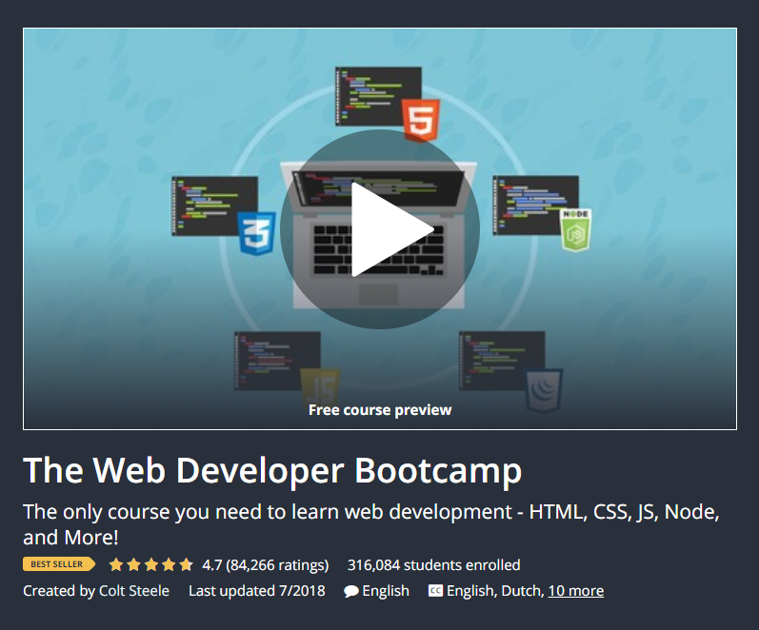
Udemy – online course
Offer variety of topics
Affordable course fee
Learn at your own pace
Able to skip lessons
Difficult to be motivated
Not as engaging
No in-depth material

Slide 7


TOOLS USED
Environment

Slide 8
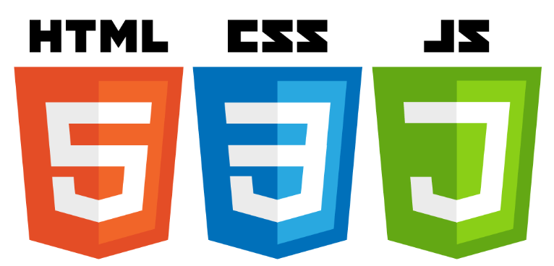

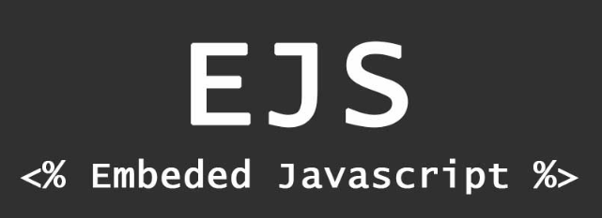
TOOLS USED
Environment
Front-end

Slide 9



TOOLS USED
Environment
Front-end
back-end

Slide 10

Environment
Most popular Linux operating system free to use for both community and professional.
Includes terminal to install and host server

Slide 11
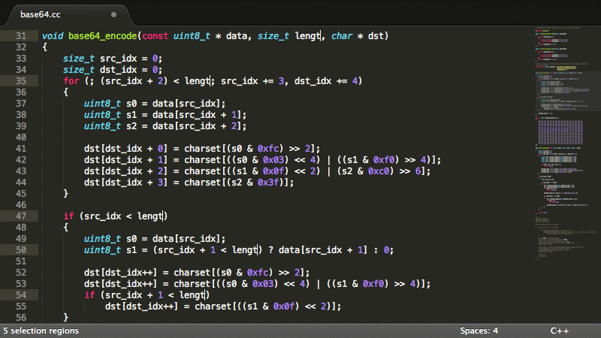
Environment
Most popular Linux operating system free to use for both community and professional.
Includes terminal to install and host server
Can be used without purchasing license for evaluation.
Powerful features to help and reduce coding
Can be used to code any language: C++, Java, JavaScript, HTML, CSS, etc.

Slide 12
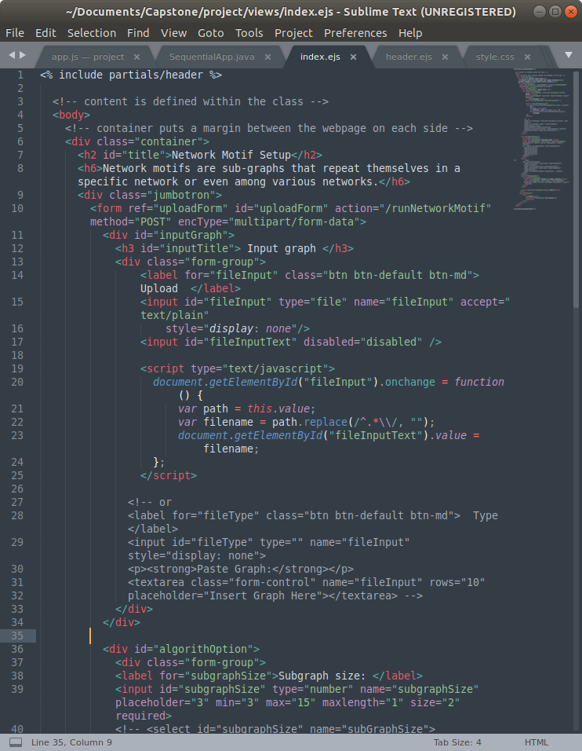
FRONT-END
Used the HTML for contents
Used the CSS for styling
Used JavaScript to script events
Used Bootstrap Framework for a professional look
EJS is used to implement JavaScript code within the HTML

Slide 13
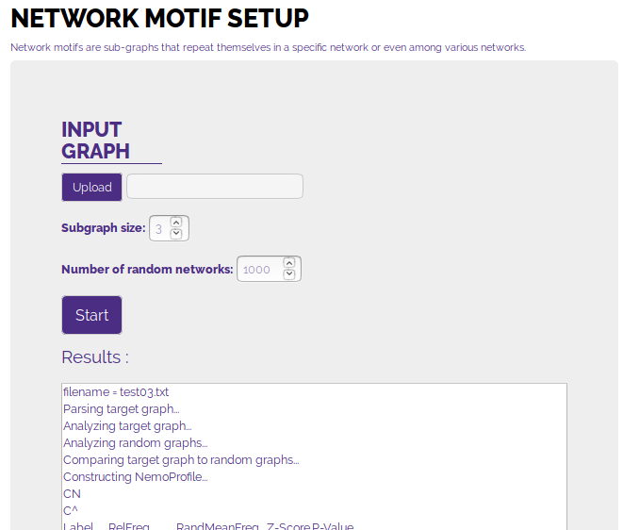
FRONT-END
Used the HTML for contents
Used the CSS for styling
Used JavaScript to script events
Used Bootstrap Framework for a professional look
EJS is used to implement JavaScript code within the HTML

Slide 14
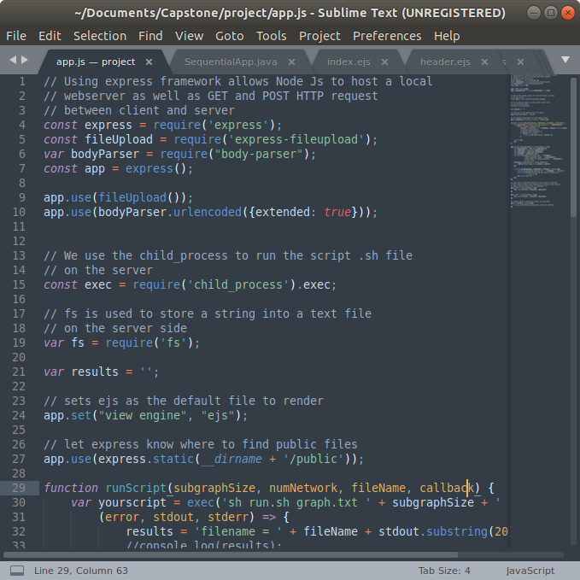
Back-end
Used node.js to create a back-end environment.
Used npm to install and add different JavaScript library into the server.
Express.js framework helped establishing server, and handle POST/GET HTTP request between front-end and back-end.

Slide 15
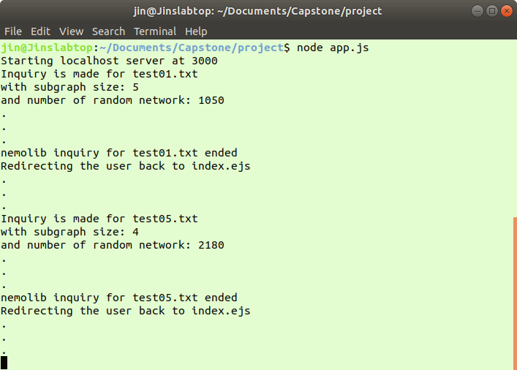
Back-end
Used node.js to create a back-end environment.
Used npm to install and add different JavaScript library into the server.
Express.js framework helped establishing server, and handle POST/GET HTTP request between front-end and back-end.

Slide 16
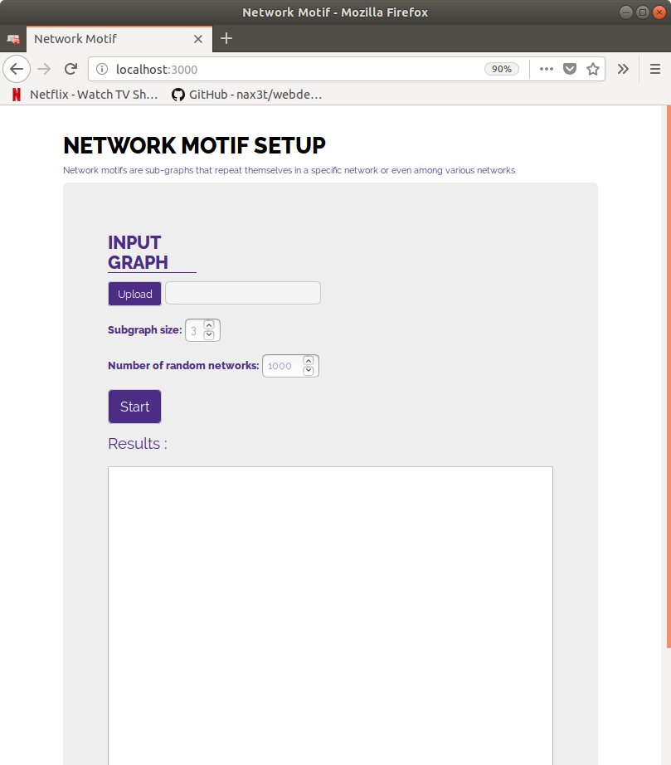
How it works

Slide 17
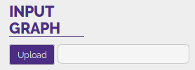
How it works

Slide 18
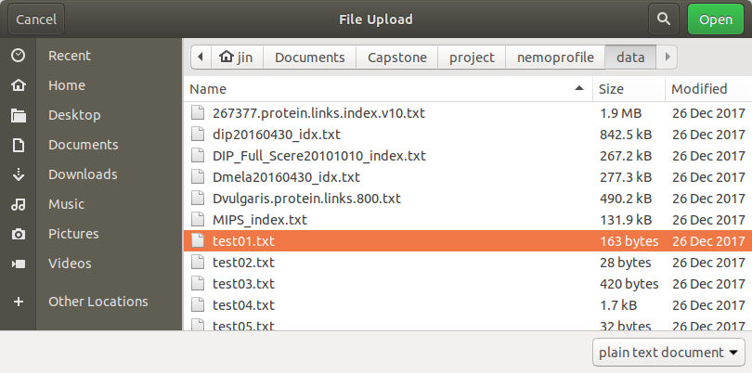
How it works

Slide 19
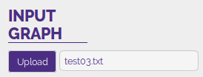
How it works

Slide 20

How it works

Slide 21
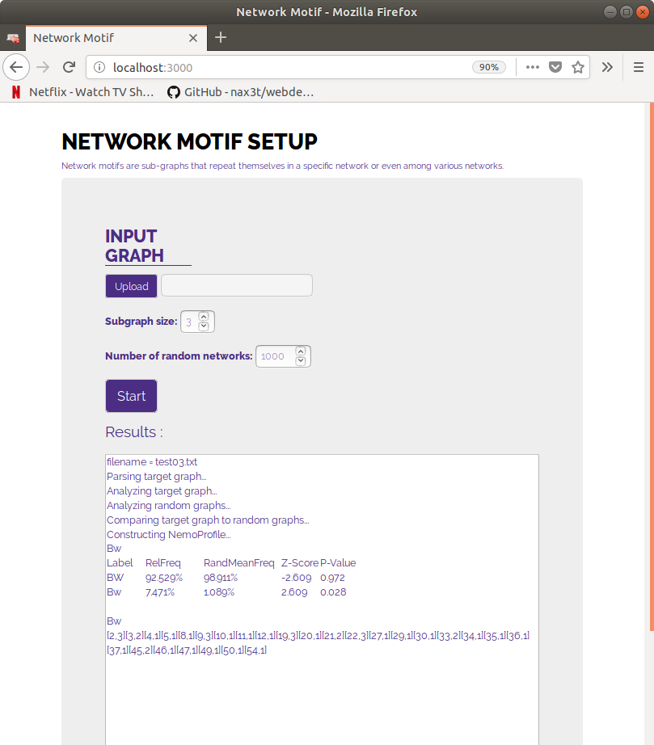
How it works

Slide 22
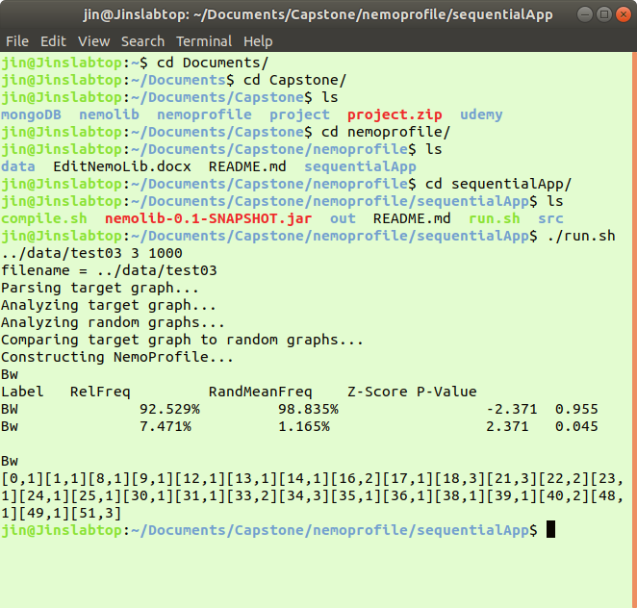
Why use Web?
Before
After

Slide 23
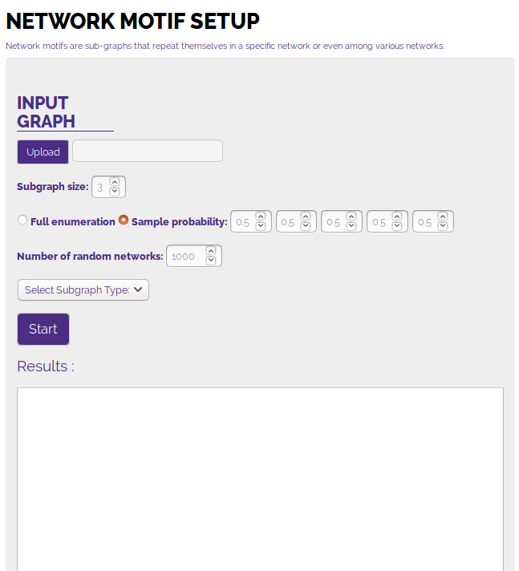
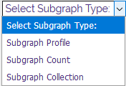
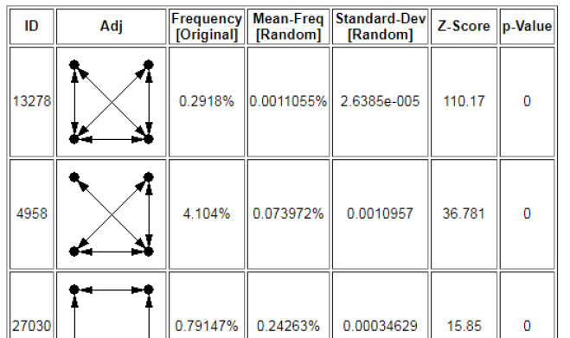
Future Work

Slide 24
Future Work

Slide 25
Future Work

Slide 26
What I’ve learned
To write in HTML, CSS, JavaScript + Other libraries and framework
To take over someone’s code and continued to build on top of it
To manage the time for completing the program
To search and use outside resources
To build a complete application as both front-end and back-end developer

Slide 27

THANK YOU
Questions?

