Slide 1
GEONS Ground Support System
Java 7, JavaFX and the
NetBeans Platform supporting
NASA Missions Operations

Slide 2
Java for NASA Mission Support
The GEONS Ground Support System (GGSS) is an independent software tool designed to support analysis and mission operations using NASA GEONS.
The GGSS uses the NetBeans Platform as the basis of the ground system software and will support a 2014 launch of the Magnetospheric Multiscale mission (MMS).
The GGSS is currently deployed in the MMS Mission Operations Control room at the Goddard Space Flight Center (GSFC) now for iterative acceptance testing.
The NetBeans Platform and the latest version of Java 7 has met all the base Mission Requirements for the GGSS.
JavaFX support for charting has been added to the original design as a means of rapid data exploration by both operators and analysts.

Slide 3
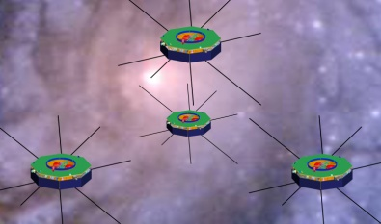
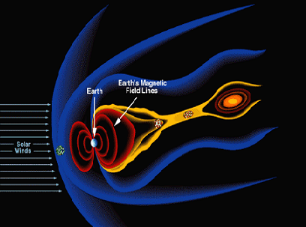
MMS Mission Overview
Earth
Solar
Wind
Sample regions of Scientific Interest at Dayside Magnetopause and the Nightside Neutral Sheet
for a 24 month mission lifetime.

Slide 4
Mission Planning Complexity
12 Planned Apogee raising burns
Tetrahedron Formation
Close Approach avoidance
Maneuvers occur in partial shadow
Sun
Orbits trace shown in Inertial Frame

Slide 5
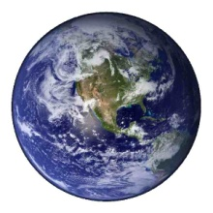


Orbit in the Life
Region of Interest
Real-time
GEONS
Telemetry
Maneuver #2
Orbit Only
GPS Rx OFF
Maneuver # 2 Planning
Maneuver #2
Perigee Raise Only
Apogee
Perigee
DSN Dumps
Of GEONS
Telemetry
Desired Tetrahedron
Maneuver #1
Orb/Att/Spin
50 hr GPS outage

Slide 6
Data Product Generation using NetBeans Platform
NetBeans Platform naturally well suited to fundamental need of all ground system software which is data product generation and management.
Plugin architecture makes integrating core GEONS-related functions easy
Platform is “easily” extendable for other missions flying GEONS
GGSS should be able to be ported outside of the FDOA (e.g. to the FDF) for support on other missions with minimum impact (e.g. platform independent with clean interfaces to integrate with external packages such as propagators, telemetry extraction, and product formatting utilities)
Routine operations can be automated (e.g. initiated via command line or script)
Highly desirable that GGSS not require costly non-portable licenses

Slide 7
Quick Data Exploration using JavaFX
JavaFX charting capabilities have enhanced the original design of the GGSS.
The GGSS can now provide easy and rapid chart views of different data vectors an a large variety of combinations.
JavaFX facilitated this by reducing the development time (and therefore cost) of the following points:
Easy Drag-And-Drop Event Handling
Easy Custom Serialized DataFormat and Clipboard support
Simplified Concurrency for GUI Rendering
The Combination of the NetBeans Platform custom File Type and the Swing Interop pattern made adding this JavaFX charting view straight forward.

Slide 8
Pros vs Cons on Adding JavaFX to Swing Applications
Should you add JavaFX to your Java GUI???
Pros
Highly reactive GUI components are simpler to develop
Reduced development time for rich GUI components
Reduced code footprint for new components reduces maintenance costs
Cons
Bidirectional Event monitoring between Swing and JavaFX is still a pain.
JavaFX and Heavyweight controls still do not play nice.
Making JavaFX components reusable for Swing and pure JavaFX not so easy
Most of what JavaFX offers is viable via combination of Swing and 3rd party libraries.

Slide 9
Suggestions for JavaFX Adoption
As a "Swing guy" I have really come to appreciate how easy Drag/Drop, Animation and GUI event handling in general is now in JavaFX.
Implementing the interactive Drag and Drop chart controls was FUN!
However JavaFX upgrades to Java are mostly extra nice to haves. To really sell the next generation of developers and convince the current generation to switch how about the following:
More and better 3D rendering support
Fix and Improve support for Heavyweight components for improved backward compatibility
Keep driving toward features that produce a measurable reduction in development time. You can’t argue with the bottom line!

Slide 10
Appendix of Links
Goddard Space Flight Center Portal
http://www.nasa.gov/centers/goddard/home/index.html#.Ufh0KW2f2HM
GEONS Technical Site
http://techtransfer.gsfc.nasa.gov/ft_tech_geons.shtm
MMS Mission Site
http://mms.gsfc.nasa.gov/
ai Solutions, Inc
http://www.ai-solutions.com/

