Slide 1
NASA GEONS Ground Support System
Java 7, JavaFX and the
NetBeans Platform supporting
NASA Missions Operations

Slide 2
Space Mission Ground Systems Support
Who Are We - a.i. solutions specializes in NASA/U.S. Air Force Ground Systems software and Flight Dynamics mission services. Mission Design, Analysis and Ground System Development for:
LEO – International Space Station, LDCM/LandSat-8
MEO/GEO - GPS, GOES
HEO – Magnetospheric MultiScale (MMS)
Lunar – Lunar Reconnaissance Orbiter
Libration Point - James Webb, MAP, ACE/WIND/SOHO
Deep Space – OSIRIS-Rex (Asteroid Sample Return)
Who Am I - Sean Phillips - Senior Software Engineer with a.i. solutions, inc.
Lead Developer for NASA GEONS Flight/Ground code trunk
Application Architect for the GEONS Ground Support System (GGSS) providing support both GEONS analysis and mission operations.

Slide 3
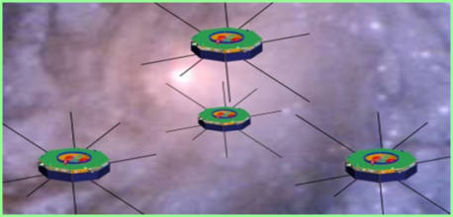
MMS Ground System Services
Space!!
Real-time
Operators
Flight Dynamics Ground System
Telemetry Tracking & Command
GGSS
Analysts
Scheduling & Automation
Guidance Navigation & Control
Attitude
NASA Goddard Space Flight Center
Ground

Slide 4
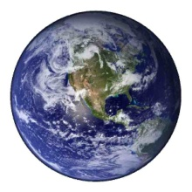


MMS HEO Orbit in the Life
Region of Interest
Real-time
GEONS
Telemetry
Maneuver #2
Orbit Only
GPS Rx OFF
Maneuver # 2 Planning
Maneuver #2
Perigee Raise Only
Apogee
Perigee
DSN Dumps
Of GEONS
Telemetry
Desired Tetrahedron
Maneuver #1
Orb/Att/Spin
50 hr GPS outage

Slide 5
Data Product Generation using NetBeans Platform
NetBeans Platform naturally well suited to fundamental need of all ground system software which is data product generation and management.
Plugin architecture makes integrating core GEONS-related functions easy and testing
Platform is “easily” extendable for other missions flying GEONS
GGSS should be able to be ported outside of the FDOA MOC for support on other missions with minimum impact (e.g. platform independent with clean interfaces to integrate with external packages such as propagators, telemetry extraction, and product formatting utilities)
Routine operations can be automated (e.g. initiated via command line or script)
Highly desirable that GGSS not require costly non-portable licenses

Slide 6
Mission Risk Aversion
“We spend billions of dollars making unique machines and send them at astronomical speeds to places where we will never be able to retrieve them.”
– David Rand (my boss)
“Mission Critical” for most space missions is defined more as high risk of total mission failure and loss.
Non-commercial Space Mission organizations are typically custom research missions with unique science and mission planning requirements.
Great amounts of cost and effort are expended during mission design to mitigate the perceived downstream flight risk, facilitating (rightfully so) risk aversion.
Since New Technology equals New Risk, mission designs rely on older proven implementations.

Slide 7
How can new Java technology enter this domain?
How is Custom mission design reconciled with this idea of Risk Aversion?
Duct Tape and Glue (Scripts and Manual Processes) to implement just enough of the new requirements to work. How can we break down this cycle?
How can new Java technology quantifiably reduce risk?
Keep driving toward features that produce a measurable reduction in development/operational costs. You can’t argue with the bottom line!
What are the ideal opportunities for new technology injection?
Identify Existing Risk areas or Accepted new risky mission design and pursue.

Slide 8
Appendix of Links
Goddard Space Flight Center Portal
http://www.nasa.gov/centers/goddard/home/index.html#.Ufh0KW2f2HM
GEONS Technical Site
http://techtransfer.gsfc.nasa.gov/ft_tech_geons.shtm
MMS Mission Site
http://mms.gsfc.nasa.gov/
ai Solutions, Inc
http://www.ai-solutions.com/

