Slide 2


Lessons Learned in Building Enterprise and Desktop Applications with the NetBeans IDE

Slide 3
Program Agenda
Introduction
Showcases
  PrimeFaces
  NATO Programming Centre
  ORKA

Slide 4
Cagatay Civici
(PrimeFaces)
JavaServer Faces Expert Group Member
Apache MyFaces PMC Member
Speaker, Author, Reviewer, Consultant, Trainer
Founder and Lead Developer of PrimeFaces

Slide 5
PrimeFaces
JavaServer Faces Component Suite
Open Source under Apache License
100+ Rich set of components
Themes, Push, Mobile Addons
Large and Active User Community

Slide 6
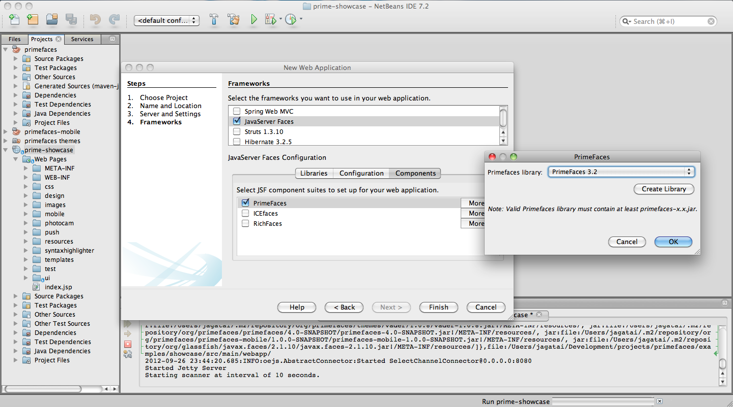

Slide 7
How Prime Team Uses NetBeans IDE
Maven Integration with Customized Project Actions
Java EE and JSF Tooling
  Convert to Composite Component
  Generate Forms and DataTable from Entities
  EL Code Completion
  Templating Features
Testing
Profiler
Debugger

Slide 8
Angelo D'Agnano
(NATO Programming Center)
Worked in the Italian Air Force in Air Defence for 10 years
Joined NATO Programming Centre in 2001
Worked on several projects in the Air Defence field
In 2008 appointed as Software Architect for the development of MICE

Slide 9
MICE
MICE (MASE Integrated Console Environment) is the platform at the heart of the newly developed MASE console. The MICE ambition is to be a rich-client platform for Air Defence Applications.
Developed using a framework allowing to support the SIL1 claim in accordance to the IEC 61508 standard.

Slide 10
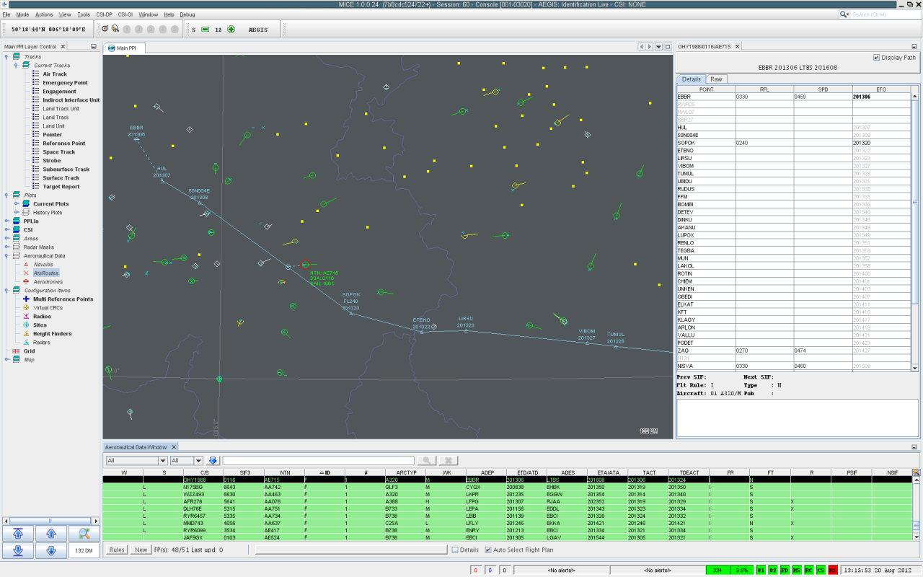

Slide 11
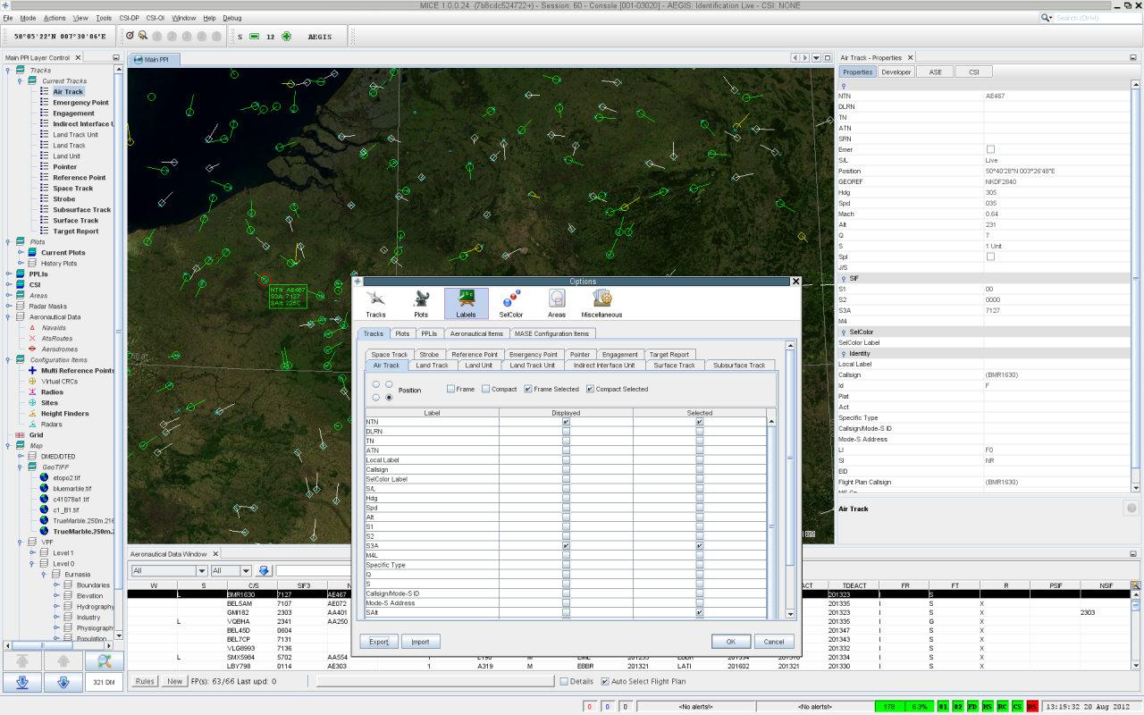

Slide 12
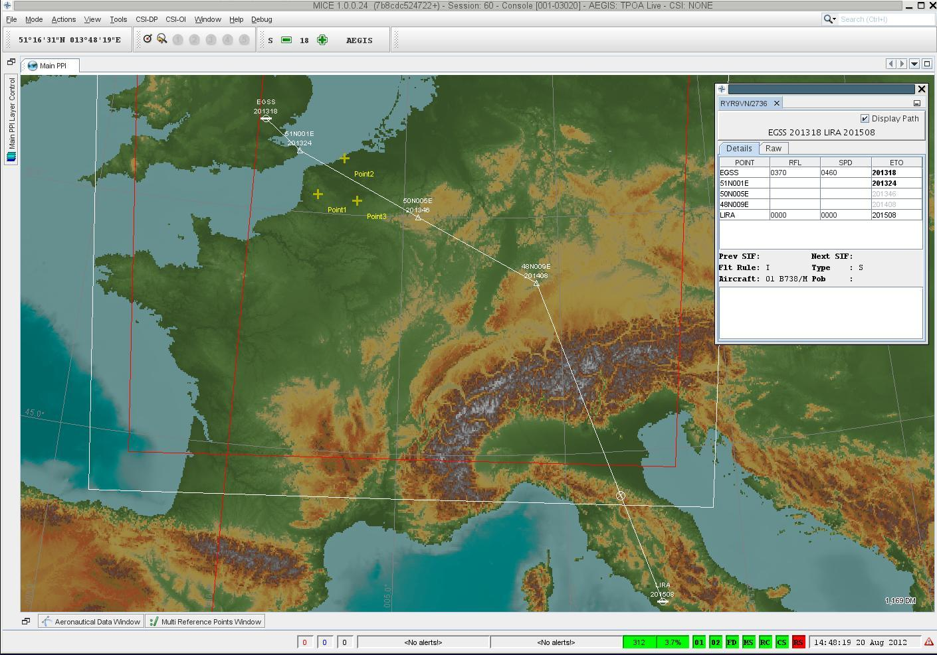

Slide 13
How MICE Benefits from NetBeans IDE
Integration in Version Control (Mercurial)
Automation of Unit Tests (JUnit, Cobertura)
Static Code Analysis (CheckStyle, PMD, FindBugs)
Connection to Issue tracking (Bugzilla) / Continuous Integration (Jenkins) Servers
CPU and Memory profiling
Powerful debugger
Showcase of NetBeans Platform functionality

Slide 14
Gerrick Bivins

Slide 15
ORKA: Limits
Limits is a reservoir engineering tool for shale gas and unconventional reservoirs.
Limits uses readily available and routinely collected pressure and rate data to determine feasible ranges of physical reservoir and completion parameters in order to estimate the uncertainty in the future performance of the well.

Slide 16
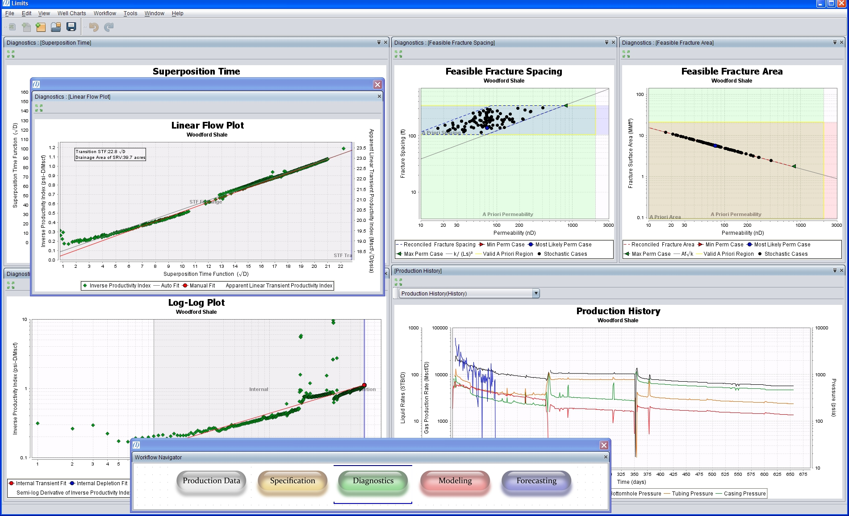

Slide 17
