Slide 2


Lessons Learned in Building Enterprise and Desktop Applications with the NetBeans IDE

Slide 3
Program Agenda
Introduction
Showcases
  PrimeFaces
  NATO Programming Centre
  ORKA

Slide 4
Cagatay Civici
(PrimeFaces)
JavaServer Faces Expert Group Member
Apache MyFaces PMC Member
Speaker, Author, Reviewer, Consultant, Trainer
Founder and Lead Developer of PrimeFaces

Slide 5
PrimeFaces
JavaServer Faces Component Suite
Open Source under Apache License
100+ Rich set of components
Themes, Push, Mobile Addons
Large and Active User Community

Slide 6
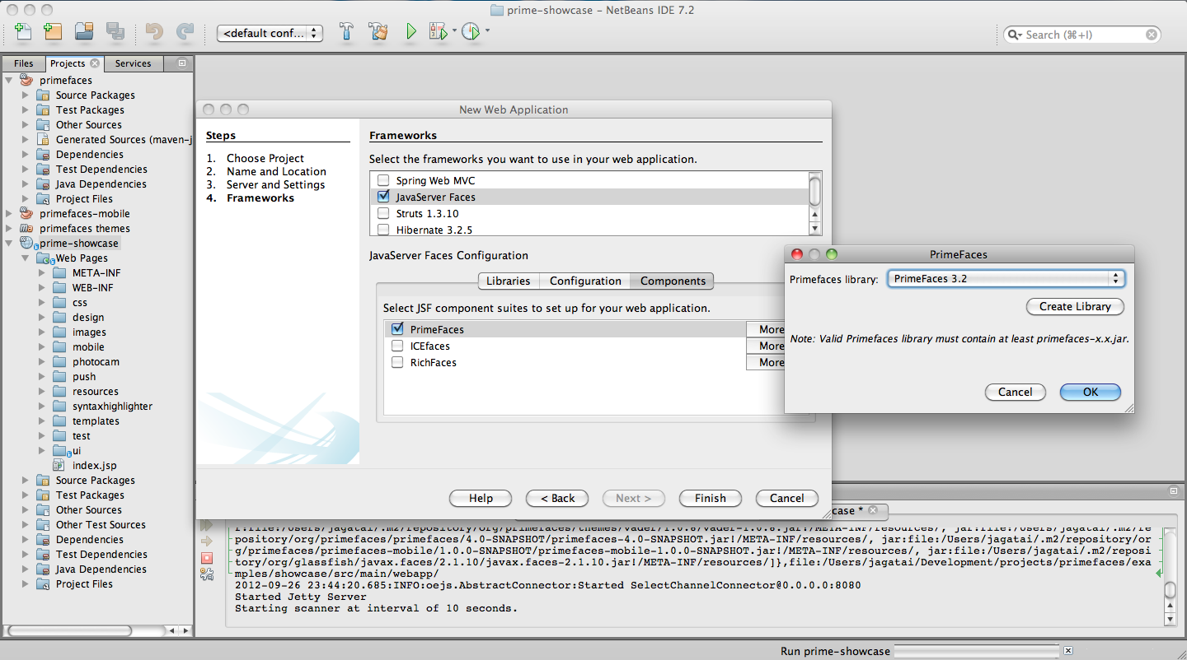

Slide 7
How Prime Team Uses NetBeans IDE
Maven Integration with Customized Project Actions
Java EE and JSF Tooling
  Convert to Composite Component
  Generate Forms and DataTable from Entities
  EL Code Completion
  Templating Features
Testing
Profiler
Debugger

Slide 8
Angelo D'Agnano
(NATO Programming Center)
Worked in the Italian Air Force in Air Defence for 10 years
Joined NATO Programming Centre in 2001
Worked on several projects in the Air Defence field
In 2008 appointed as Software Architect for the development of MICE

Slide 9
MICE
MICE (MASE Integrated Console Environment) is the platform at the heart of the newly developed MASE console. The MICE ambition is to be a rich-client platform for Air Defence Applications.
Developed using a framework allowing to support the SIL1 claim in accordance to the IEC 61508 standard.

Slide 10
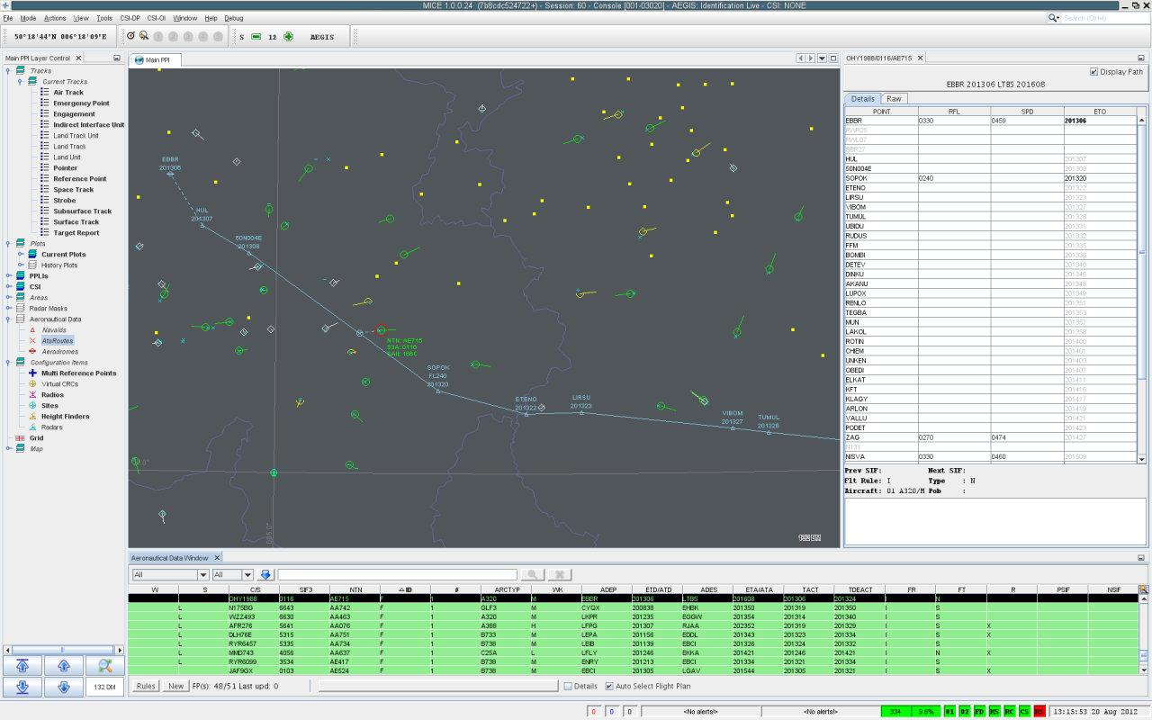

Slide 11
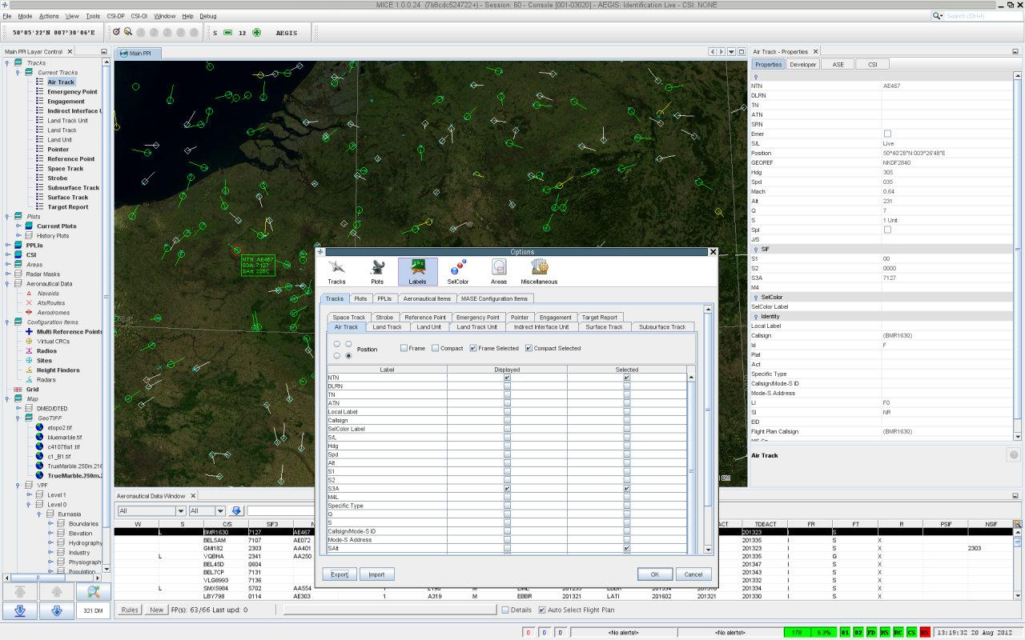

Slide 12
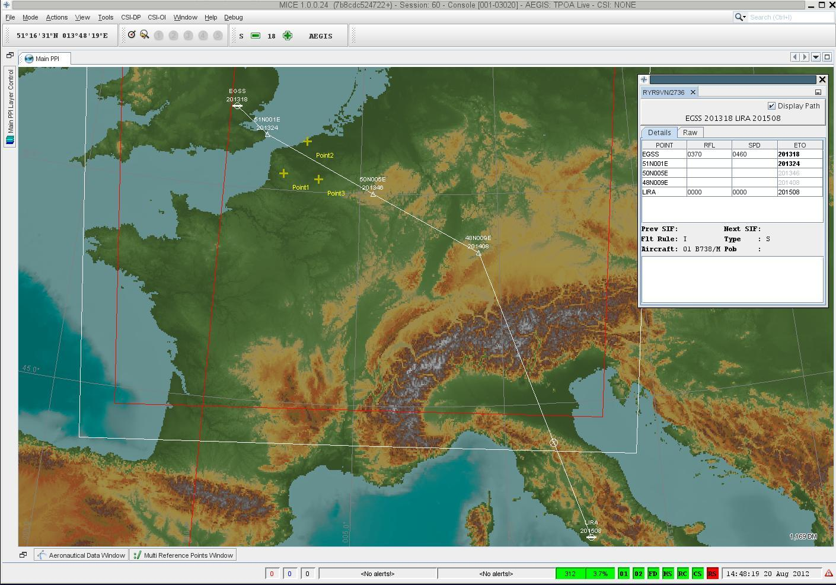

Slide 13
How MICE Benefits from NetBeans IDE
Integration in Version Control (Mercurial)
Automation of Unit Tests (JUnit, Cobertura)
Static Code Analysis (CheckStyle, PMD, FindBugs)
Connection to Issue tracking (Bugzilla) / Continuous Integration (Jenkins) Servers
CPU and Memory profiling
Powerful debugger
Showcase of NetBeans Platform functionality

Slide 14
Gerrick Bivins
(Landmark/Halliburton)
Aero E BS, ME MS
Engineering Animations Inc. 1998
CAD visualization
NURBS
Scientific Visualization (primarily Computational Fluid Dynamics data)
Virtual Reality Applicat ions Center @ Iowa State University
R&D 100 Award Winner 2006
Joined Object Reservoir in 2007, acquired by Landmark (Halliburton) 2011

Slide 15
What is ORKA?
Object Reservoir Knowledge Architecture
Modular platform for developing O&G applications based off of the NetBeans Platform

Slide 16
What is Limits?
Reservoir Engineering tool for Shale Gas and Unconventional Reservoirs
Not so successful implementations
  Derived in spreadsheet!!! (Not “commercial-izable”)
  Adobe Flex/RDF (Not practical, not enough time)
  Swing/Apache Derby (Successful but not scalable for dev team)
First successful application delivered on the ORKA platform

Slide 17
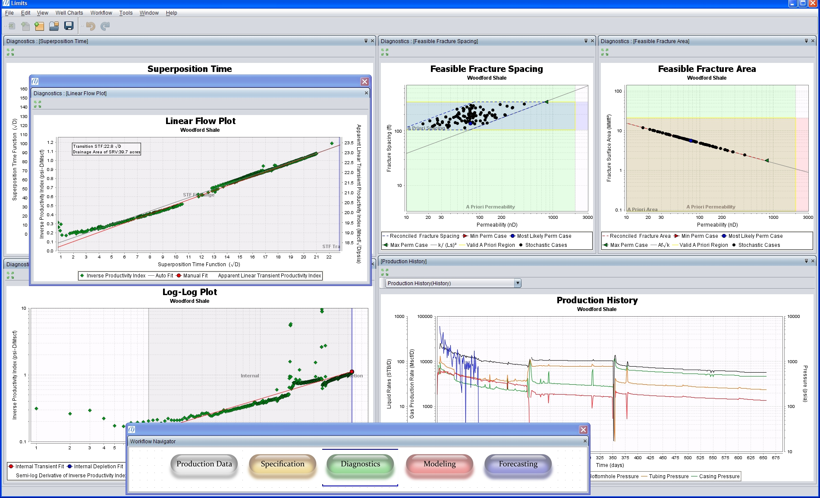

Slide 18
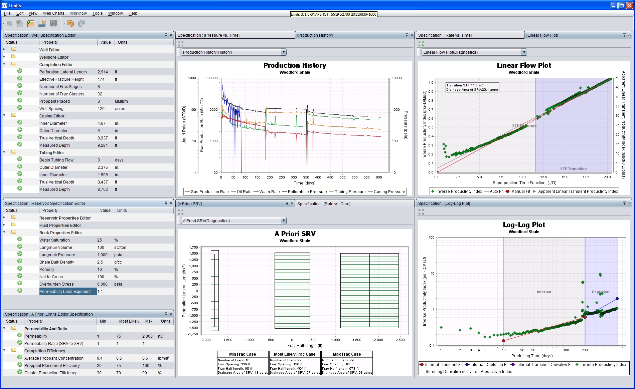

Slide 19
Why NetBeans IDE?
Development tool(s) integration: Maven!, Svn/Git, JUnit
Refactoring Tools (Monolithic -> Modular)
Code Generation (Beans especially)
Relatively low bar for small team (5) of relatively New Java/Swing Developers (3 of 5)
Straightforward developer concepts (Projects, Files, Editors)

