Slide 2


CON7050
How My Life Would Have Been So Much Better If We Had Used the NetBeans Platform

Slide 3
Program Agenda
Introduction to the Application
Architecture
Missing Architecture
Next Steps
Related Presentations @ JavaOne

Slide 4
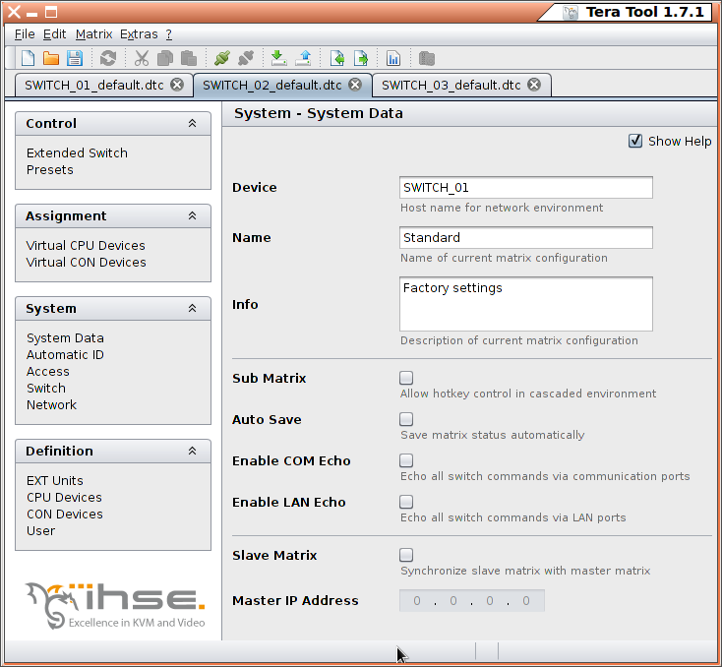
http://www.ihse.de
Device Configuration
Multiple configurations
Create/Store/Open
Cross operating system

Slide 5
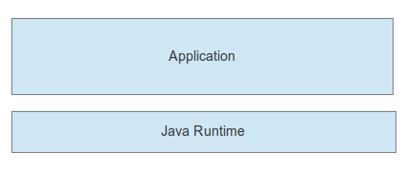
Architecture

Slide 6
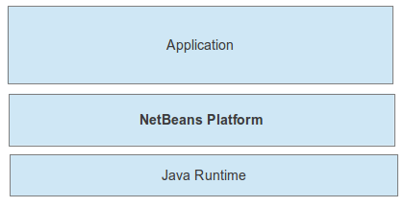
Missing Architecture

Slide 7
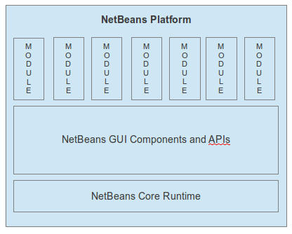

Slide 8
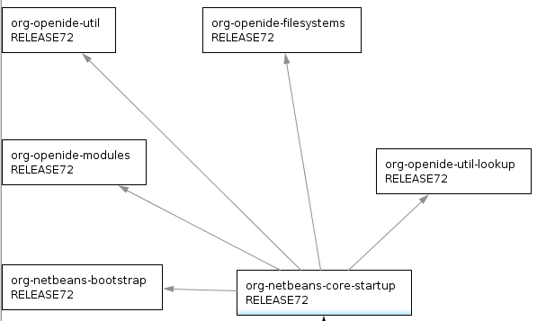
NetBeans Core Runtime
The only mandatory
pieces of the
NetBeans Platform.

Slide 9
NetBeans Core Runtime
Startup sequence
Module system
Application virtual file system
Loosely coupled communication mechanism

Slide 10
Advantages of NetBeans Core Runtime
Organize features into modules.
Provide different distributions to different users.
Version each feature, simpler to track change in application.
Possibility to create clean APIs and extension points.
Mechanisms for listening to events across modules.
No need to write startup/shutdown sequence.

Slide 12
NetBeans GUI Components and APIs
Windowing framework. Undockable/Resizable/Persistent window components.
Selection management. Mechanism to synchronize multiple views on common data.
Business object visualizers. Very quickly work on domain level of application.
Action framework. Mechanism for displaying menu items and toolbar buttons consistently.
Supporting mechanisms. Customization dialogs, JavaHelp support, Update mechanisms, Installer generators

Slide 13
Demos
Windowing framework.
Selection management.
Business object visualizers.
Action framework.
Supporting mechanisms.

Slide 14
JavaFX
Natively NetBeans Platform is a Swing application framework.
JFXPanel from JavaFX can be embedded in NetBeans Platform windows.
Integrate JavaFX charts, JavaFX WebView, etc...
CSS Stylesheet support for JavaFX interesting for NetBeans Platform apps.
Using JavaFX together with Swing, migrate components as needed.
JavaFX is icing on an application, but an application needs more than icing.

Slide 15
Conclusion
NetBeans Platform is an application framework for the Java desktop.
Very widely used in large applications and organizations.
Stable and free, used in several Oracle products too.
Many books, tutorials, training courses, support options.
NetBeans Platform courses in-house or in general courses.
Use it today!

Slide 16
Next Steps
http://platform.netbeans.org
http://platform.netbeans.org/screenshots.html
geertjan.wielenga@oracle.com

Slide 17
Related Presentations @ JavaOne
Today:
  15:00 CON5784: Rich Clients with JavaFX and the NetBeans Platform
Tomorrow:
  11:30 CON6139: Lessons Learned in Building Enterprise and Desktop Applications with the NetBeans IDE
Wednesday:
  13:00 CON3826: Patterns for Modularity: What Modules Don’t Want You to Know
Thursday:
  12:30 CON4952: NetBeans Platform Panel Discussion

