Slide 1
Hitchhiker's Guide
to the NetBeans Platform
Henry Arousell, Björn Lundén Information
Thomas Boqvist, Björn Lundén Information
Eirk Bakke, MIT
Bruce Schubert, Emxsys
Geertjan Wielenga, NetBeans

Slide 2
NetBeans: What Is It?
NetBeans IDE
NetBeans Platform
NetBeans Community
Notes:
I'll tech you about how to write your first NB Platform app
- point out that it's simple, non-technical introduction
- just to see the tools and possibilities that NB platform offers, but no code yet
- stress that creating, writing platform app is the same as creating modules for IDE. Always it's some set of existing modules plus your own modules
- When writing NB platform app, NB IDE is favored, but not necessary. NB IDE has advantage of having specialized wizards for building platform elements like actions, TopComponents etc.

Slide 3

December 1997
Notes:
I'll tech you about how to write your first NB Platform app
- point out that it's simple, non-technical introduction
- just to see the tools and possibilities that NB platform offers, but no code yet
- stress that creating, writing platform app is the same as creating modules for IDE. Always it's some set of existing modules plus your own modules
- When writing NB platform app, NB IDE is favored, but not necessary. NB IDE has advantage of having specialized wizards for building platform elements like actions, TopComponents etc.

Slide 4
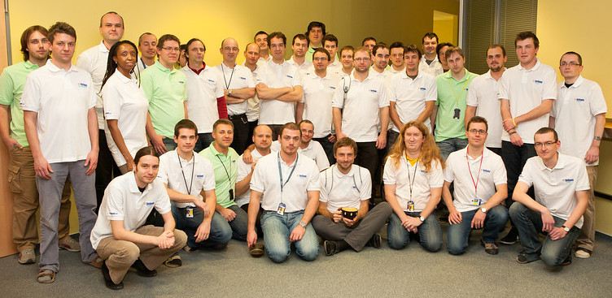
December 2011
Notes:
I'll tech you about how to write your first NB Platform app
- point out that it's simple, non-technical introduction
- just to see the tools and possibilities that NB platform offers, but no code yet
- stress that creating, writing platform app is the same as creating modules for IDE. Always it's some set of existing modules plus your own modules
- When writing NB platform app, NB IDE is favored, but not necessary. NB IDE has advantage of having specialized wizards for building platform elements like actions, TopComponents etc.

Slide 5
NetBeans Platform
Overview
  Framework for developing large Java desktop applications.
  Provides
    Runtime container.
    APIs solving typical desktop problems.
Notes:
I'll tech you about how to write your first NB Platform app
- point out that it's simple, non-technical introduction
- just to see the tools and possibilities that NB platform offers, but no code yet
- stress that creating, writing platform app is the same as creating modules for IDE. Always it's some set of existing modules plus your own modules
- When writing NB platform app, NB IDE is favored, but not necessary. NB IDE has advantage of having specialized wizards for building platform elements like actions, TopComponents etc.

Slide 6
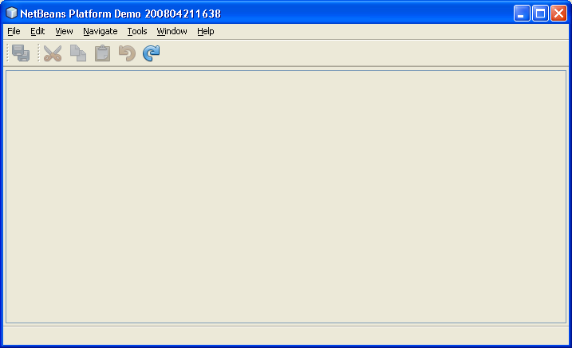
NetBeans Platform
Notes:
I'll tech you about how to write your first NB Platform app
- point out that it's simple, non-technical introduction
- just to see the tools and possibilities that NB platform offers, but no code yet
- stress that creating, writing platform app is the same as creating modules for IDE. Always it's some set of existing modules plus your own modules
- When writing NB platform app, NB IDE is favored, but not necessary. NB IDE has advantage of having specialized wizards for building platform elements like actions, TopComponents etc.

Slide 7
Why Use the NetBeans Platform?
Pre-defined generic features.
Code generators for custom features.
Less boilerplate code, less cycles.
Consistency of user interface.
Modularity & loose coupling.
Notes:
I'll tech you about how to write your first NB Platform app
- point out that it's simple, non-technical introduction
- just to see the tools and possibilities that NB platform offers, but no code yet
- stress that creating, writing platform app is the same as creating modules for IDE. Always it's some set of existing modules plus your own modules
- When writing NB platform app, NB IDE is favored, but not necessary. NB IDE has advantage of having specialized wizards for building platform elements like actions, TopComponents etc.

Slide 8
NetBeans Platform Features
Pluggable:
  menubar
  toolbar
  window system/docking framework
  Options settings
  JavaHelp
  custom features
Update Mechanism
Modularity
Generators for launchers, ZIP distributions, installers, and JNLP.
Notes:
I'll tech you about how to write your first NB Platform app
- point out that it's simple, non-technical introduction
- just to see the tools and possibilities that NB platform offers, but no code yet
- stress that creating, writing platform app is the same as creating modules for IDE. Always it's some set of existing modules plus your own modules
- When writing NB platform app, NB IDE is favored, but not necessary. NB IDE has advantage of having specialized wizards for building platform elements like actions, TopComponents etc.

Slide 9
Examples
http://platform.netbeans.org/screenshots.html
Boeing
Northrop Grumman
South African Defence Force
Swedish Defence Force
Banks
Bioinformatics
Mining
...
Notes:
I'll tech you about how to write your first NB Platform app
- point out that it's simple, non-technical introduction
- just to see the tools and possibilities that NB platform offers, but no code yet
- stress that creating, writing platform app is the same as creating modules for IDE. Always it's some set of existing modules plus your own modules
- When writing NB platform app, NB IDE is favored, but not necessary. NB IDE has advantage of having specialized wizards for building platform elements like actions, TopComponents etc.

Slide 10
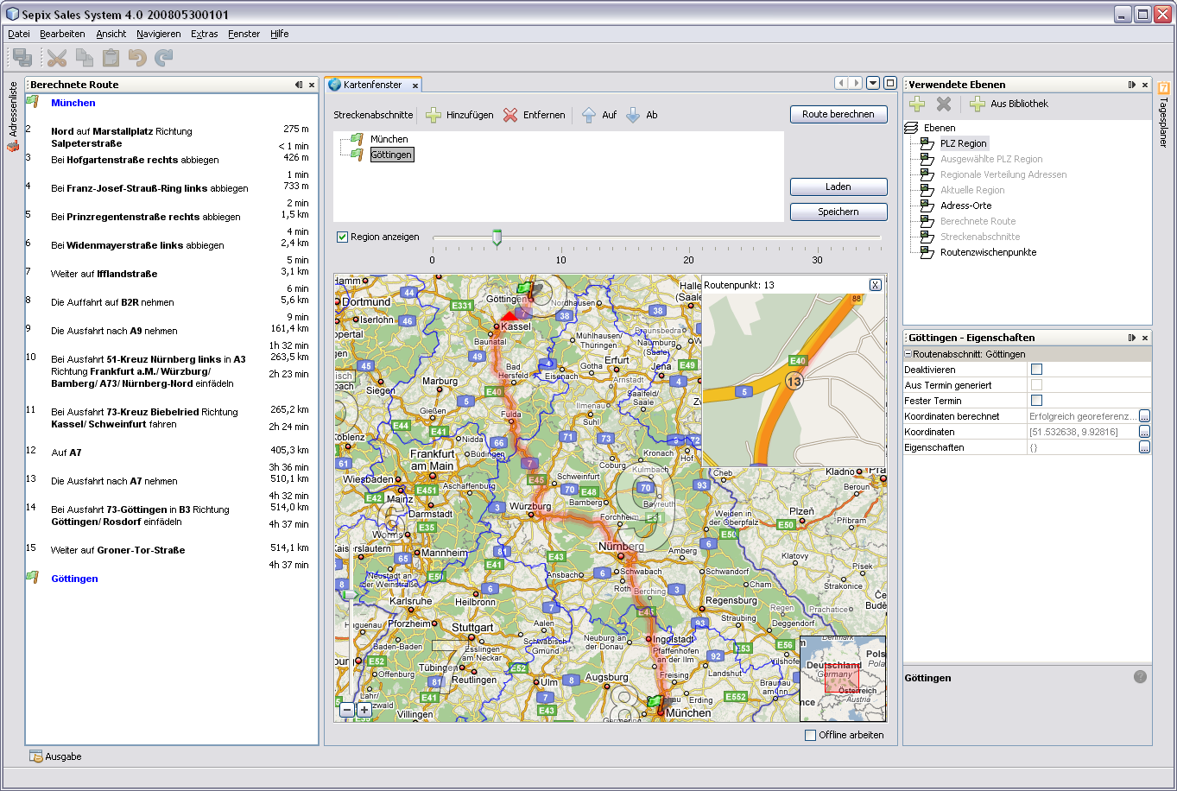
Examples
Notes:
I'll tech you about how to write your first NB Platform app
- point out that it's simple, non-technical introduction
- just to see the tools and possibilities that NB platform offers, but no code yet
- stress that creating, writing platform app is the same as creating modules for IDE. Always it's some set of existing modules plus your own modules
- When writing NB platform app, NB IDE is favored, but not necessary. NB IDE has advantage of having specialized wizards for building platform elements like actions, TopComponents etc.

Slide 11
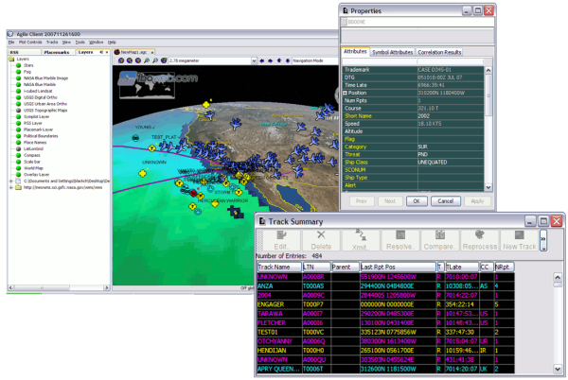
Examples
Notes:
I'll tech you about how to write your first NB Platform app
- point out that it's simple, non-technical introduction
- just to see the tools and possibilities that NB platform offers, but no code yet
- stress that creating, writing platform app is the same as creating modules for IDE. Always it's some set of existing modules plus your own modules
- When writing NB platform app, NB IDE is favored, but not necessary. NB IDE has advantage of having specialized wizards for building platform elements like actions, TopComponents etc.

Slide 12
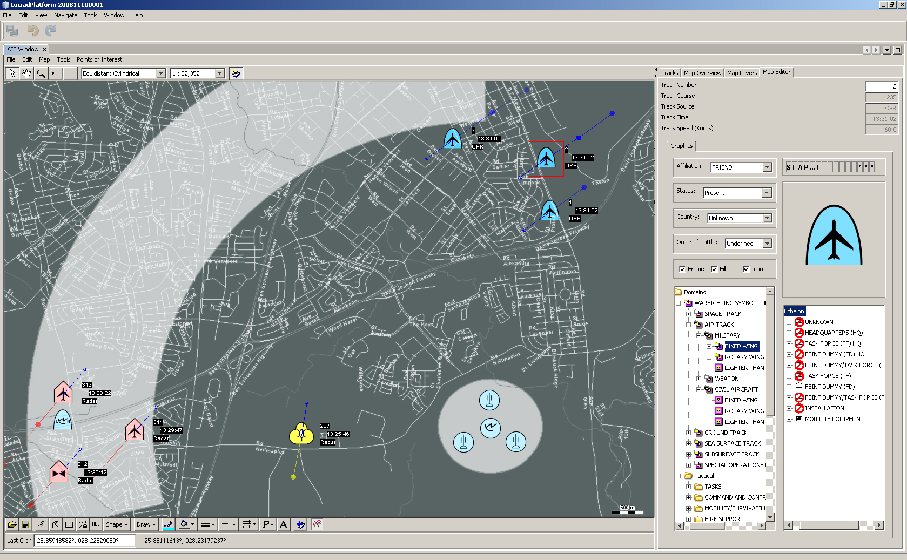
Examples
Notes:
I'll tech you about how to write your first NB Platform app
- point out that it's simple, non-technical introduction
- just to see the tools and possibilities that NB platform offers, but no code yet
- stress that creating, writing platform app is the same as creating modules for IDE. Always it's some set of existing modules plus your own modules
- When writing NB platform app, NB IDE is favored, but not necessary. NB IDE has advantage of having specialized wizards for building platform elements like actions, TopComponents etc.

Slide 13
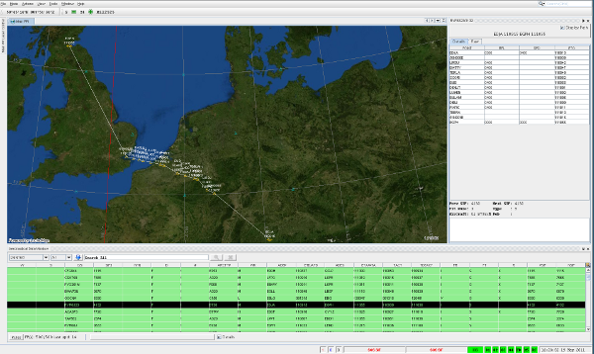
Notes:
I'll tech you about how to write your first NB Platform app
- point out that it's simple, non-technical introduction
- just to see the tools and possibilities that NB platform offers, but no code yet
- stress that creating, writing platform app is the same as creating modules for IDE. Always it's some set of existing modules plus your own modules
- When writing NB platform app, NB IDE is favored, but not necessary. NB IDE has advantage of having specialized wizards for building platform elements like actions, TopComponents etc.

Slide 14
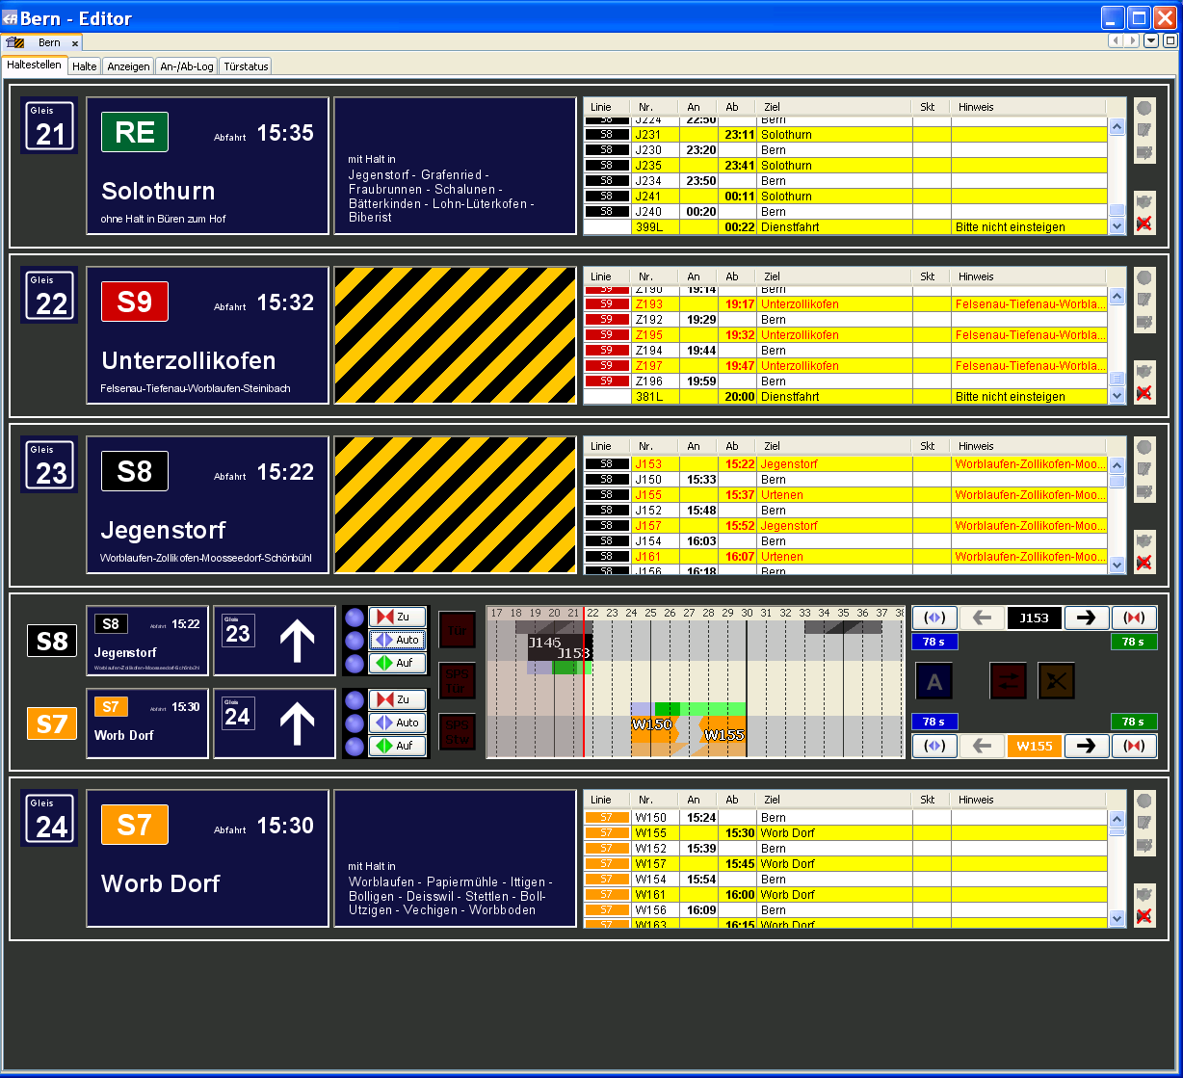
Examples
Notes:
I'll tech you about how to write your first NB Platform app
- point out that it's simple, non-technical introduction
- just to see the tools and possibilities that NB platform offers, but no code yet
- stress that creating, writing platform app is the same as creating modules for IDE. Always it's some set of existing modules plus your own modules
- When writing NB platform app, NB IDE is favored, but not necessary. NB IDE has advantage of having specialized wizards for building platform elements like actions, TopComponents etc.

Slide 15
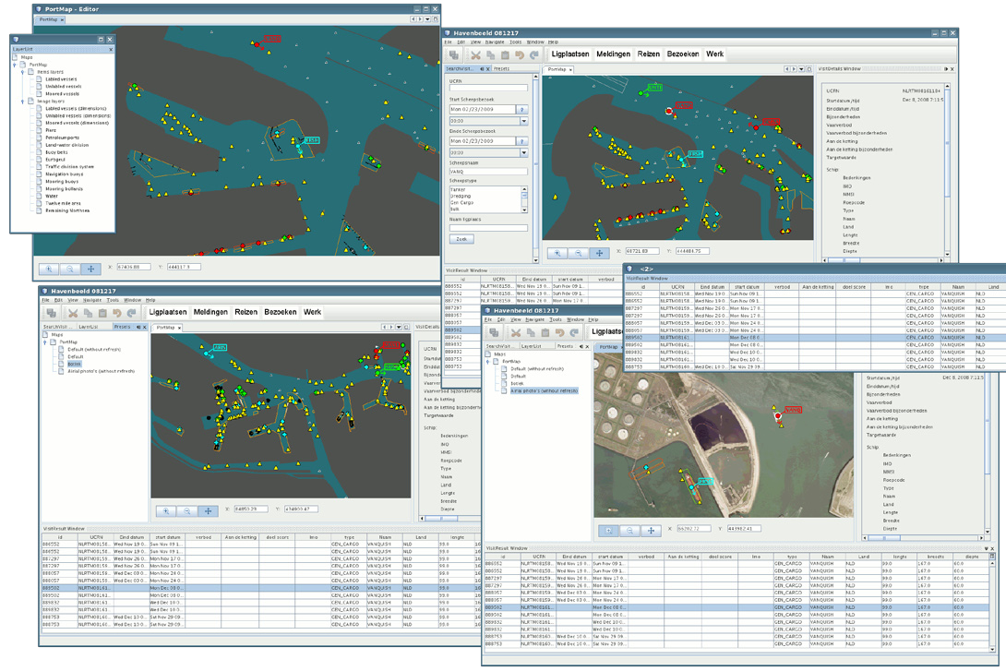
Notes:
I'll tech you about how to write your first NB Platform app
- point out that it's simple, non-technical introduction
- just to see the tools and possibilities that NB platform offers, but no code yet
- stress that creating, writing platform app is the same as creating modules for IDE. Always it's some set of existing modules plus your own modules
- When writing NB platform app, NB IDE is favored, but not necessary. NB IDE has advantage of having specialized wizards for building platform elements like actions, TopComponents etc.

Slide 16
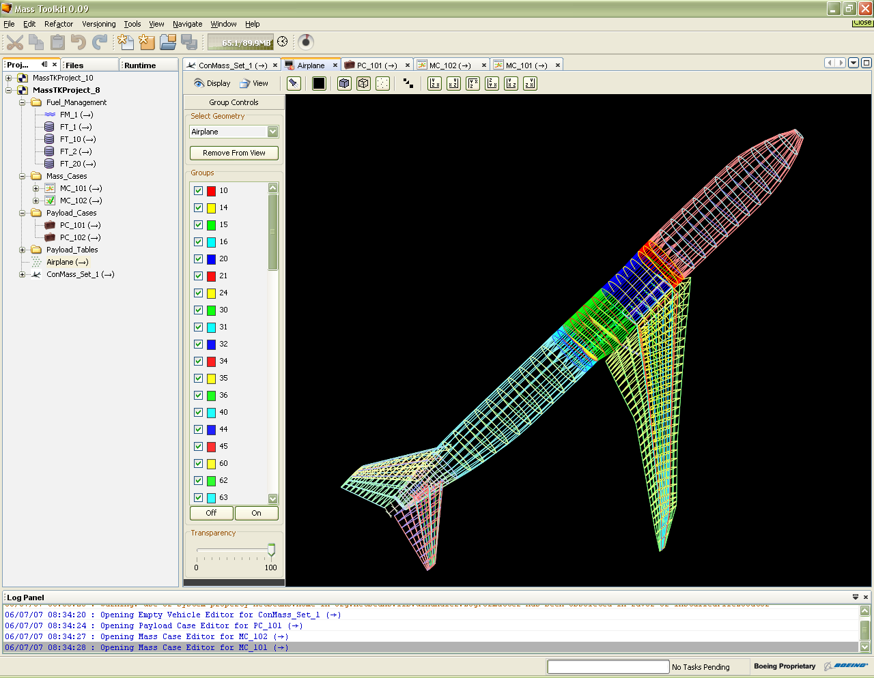
Examples
Notes:
I'll tech you about how to write your first NB Platform app
- point out that it's simple, non-technical introduction
- just to see the tools and possibilities that NB platform offers, but no code yet
- stress that creating, writing platform app is the same as creating modules for IDE. Always it's some set of existing modules plus your own modules
- When writing NB platform app, NB IDE is favored, but not necessary. NB IDE has advantage of having specialized wizards for building platform elements like actions, TopComponents etc.

Slide 17
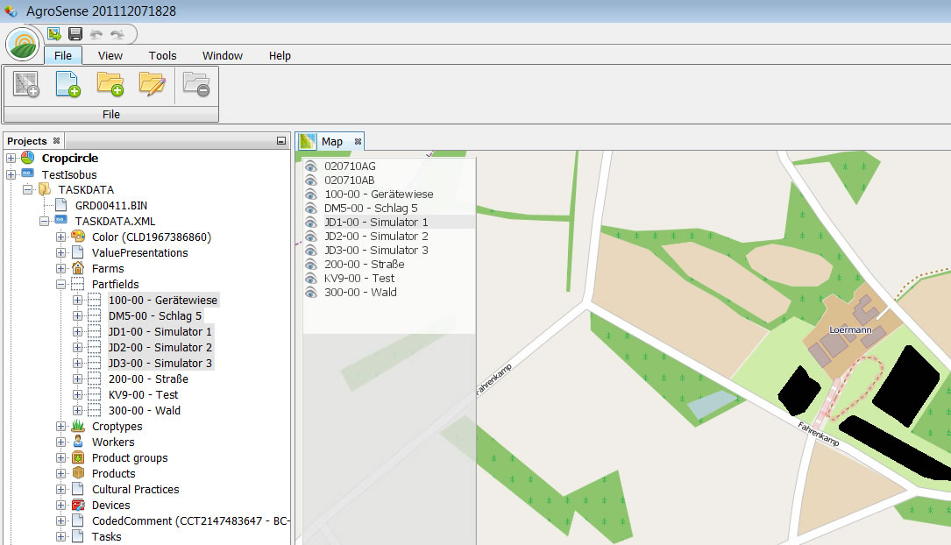
http://agrosense.nl
Notes:
I'll tech you about how to write your first NB Platform app
- point out that it's simple, non-technical introduction
- just to see the tools and possibilities that NB platform offers, but no code yet
- stress that creating, writing platform app is the same as creating modules for IDE. Always it's some set of existing modules plus your own modules
- When writing NB platform app, NB IDE is favored, but not necessary. NB IDE has advantage of having specialized wizards for building platform elements like actions, TopComponents etc.

Slide 18
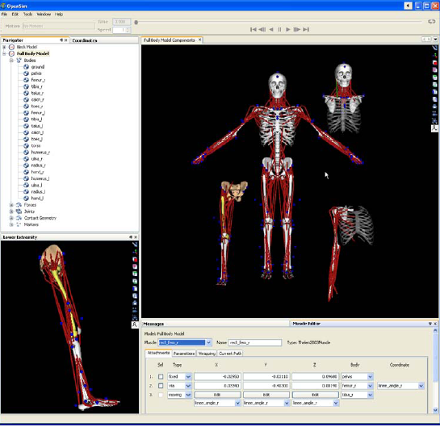
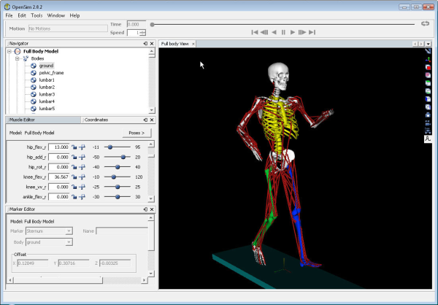
Notes:
I'll tech you about how to write your first NB Platform app
- point out that it's simple, non-technical introduction
- just to see the tools and possibilities that NB platform offers, but no code yet
- stress that creating, writing platform app is the same as creating modules for IDE. Always it's some set of existing modules plus your own modules
- When writing NB platform app, NB IDE is favored, but not necessary. NB IDE has advantage of having specialized wizards for building platform elements like actions, TopComponents etc.

Slide 19
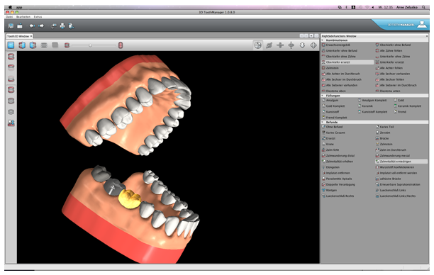
Notes:
I'll tech you about how to write your first NB Platform app
- point out that it's simple, non-technical introduction
- just to see the tools and possibilities that NB platform offers, but no code yet
- stress that creating, writing platform app is the same as creating modules for IDE. Always it's some set of existing modules plus your own modules
- When writing NB platform app, NB IDE is favored, but not necessary. NB IDE has advantage of having specialized wizards for building platform elements like actions, TopComponents etc.

Slide 20
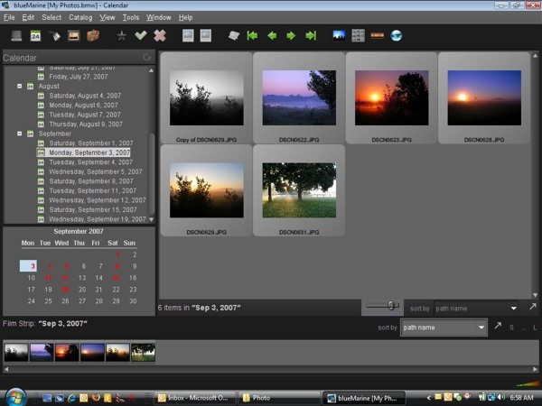
Examples
Notes:
I'll tech you about how to write your first NB Platform app
- point out that it's simple, non-technical introduction
- just to see the tools and possibilities that NB platform offers, but no code yet
- stress that creating, writing platform app is the same as creating modules for IDE. Always it's some set of existing modules plus your own modules
- When writing NB platform app, NB IDE is favored, but not necessary. NB IDE has advantage of having specialized wizards for building platform elements like actions, TopComponents etc.

Slide 21
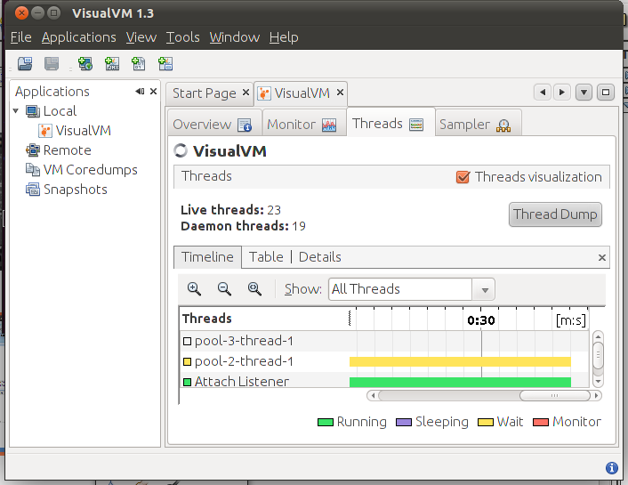
Examples
Notes:
I'll tech you about how to write your first NB Platform app
- point out that it's simple, non-technical introduction
- just to see the tools and possibilities that NB platform offers, but no code yet
- stress that creating, writing platform app is the same as creating modules for IDE. Always it's some set of existing modules plus your own modules
- When writing NB platform app, NB IDE is favored, but not necessary. NB IDE has advantage of having specialized wizards for building platform elements like actions, TopComponents etc.

Slide 22
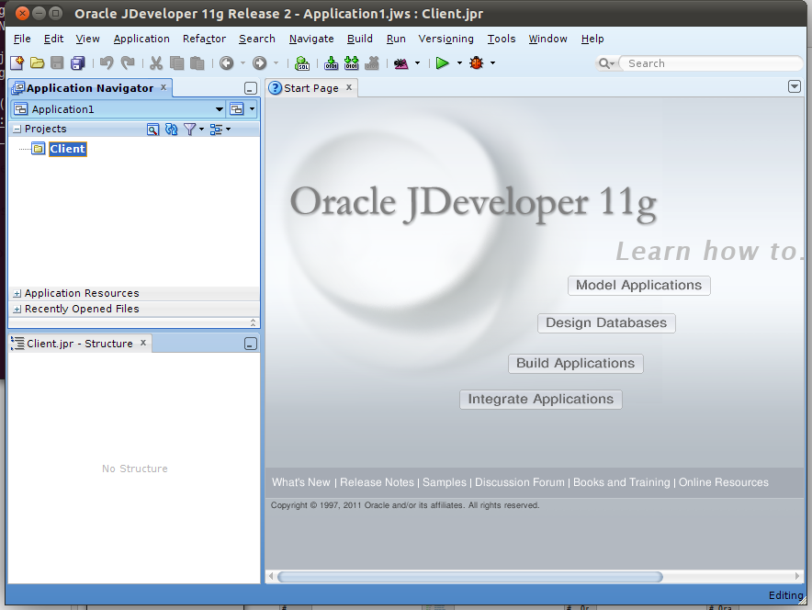
Examples
Notes:
I'll tech you about how to write your first NB Platform app
- point out that it's simple, non-technical introduction
- just to see the tools and possibilities that NB platform offers, but no code yet
- stress that creating, writing platform app is the same as creating modules for IDE. Always it's some set of existing modules plus your own modules
- When writing NB platform app, NB IDE is favored, but not necessary. NB IDE has advantage of having specialized wizards for building platform elements like actions, TopComponents etc.

Slide 23
Common Basis
Runtime container
handles lifecycle.
APIs provide extension
points & utilities.
App Module 1
App Module 3
App Module 2
App Module 4
App Module 6
App Module 5
API Modules/Plugins
Runtime Container
Notes:
I'll tech you about how to write your first NB Platform app
- point out that it's simple, non-technical introduction
- just to see the tools and possibilities that NB platform offers, but no code yet
- stress that creating, writing platform app is the same as creating modules for IDE. Always it's some set of existing modules plus your own modules
- When writing NB platform app, NB IDE is favored, but not necessary. NB IDE has advantage of having specialized wizards for building platform elements like actions, TopComponents etc.

Slide 24
Example Scenarios
– Bruce Schubert, Emxsys
– Eirk Bakke, MIT
– Henry Arousell, Björn Lundén Information
– Thomas Boqvist, Björn Lundén Information

Slide 25


Slide 26
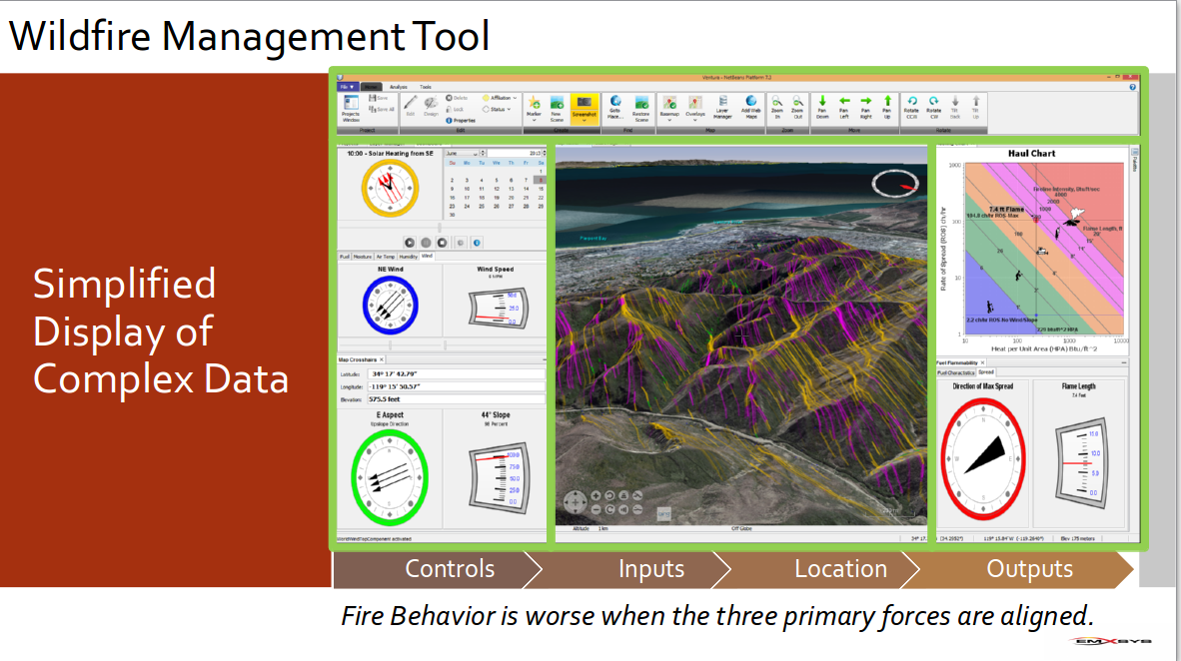

Slide 27
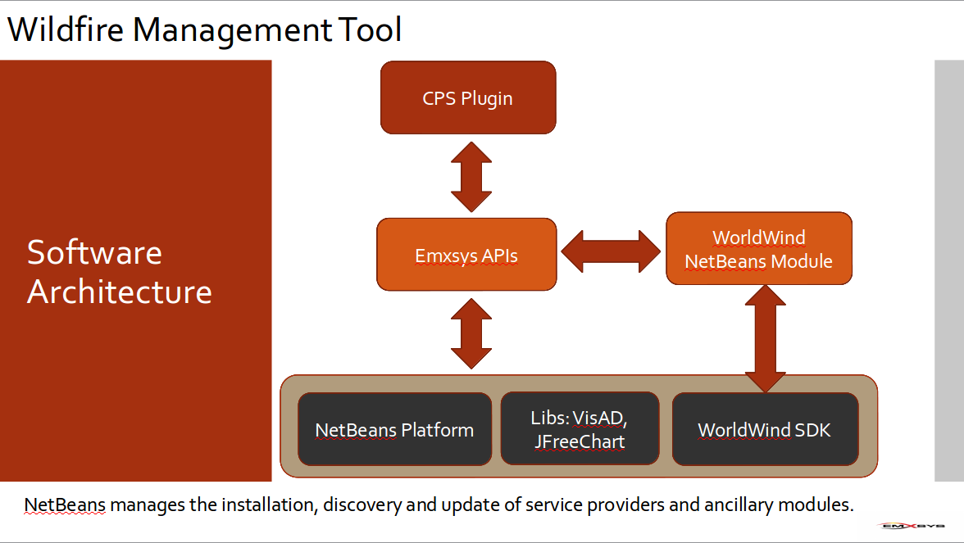

Slide 28
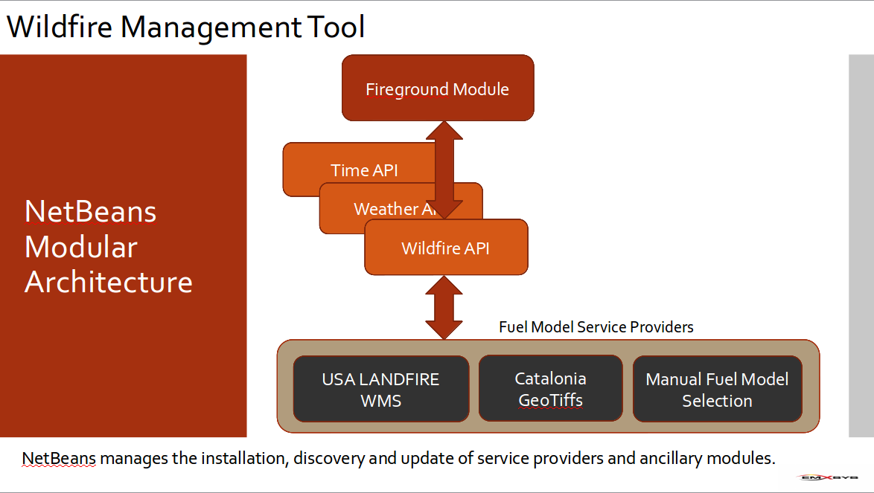

Slide 29
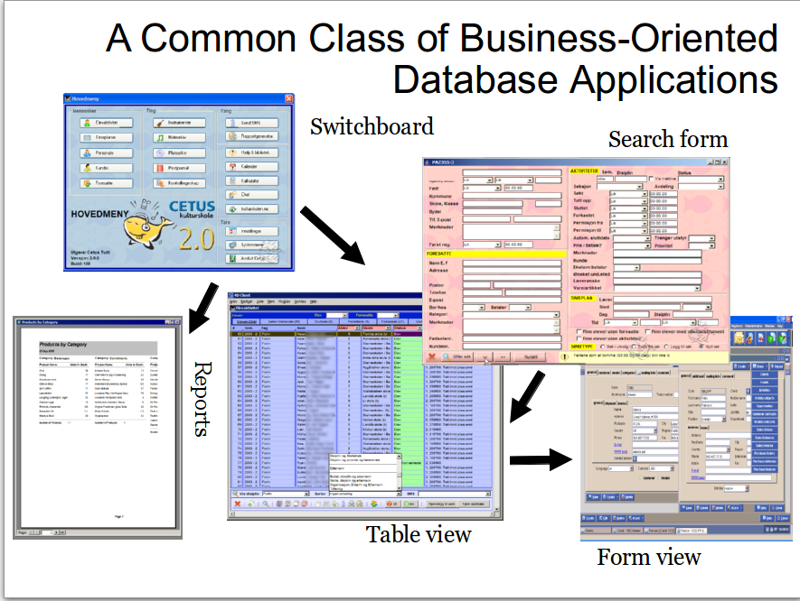
Eirik Bakke

Slide 30
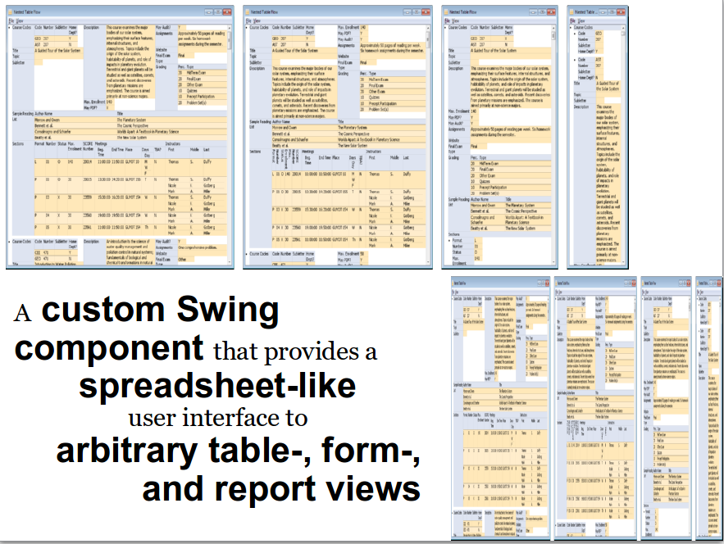
Eirik Bakke

Slide 31
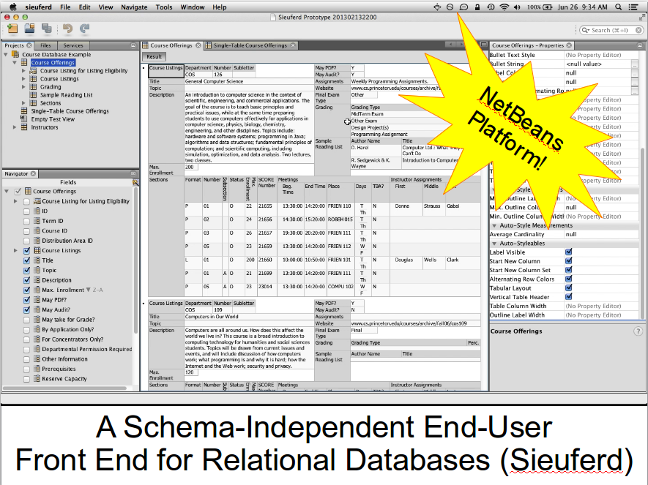
Eirik Bakke

Slide 32
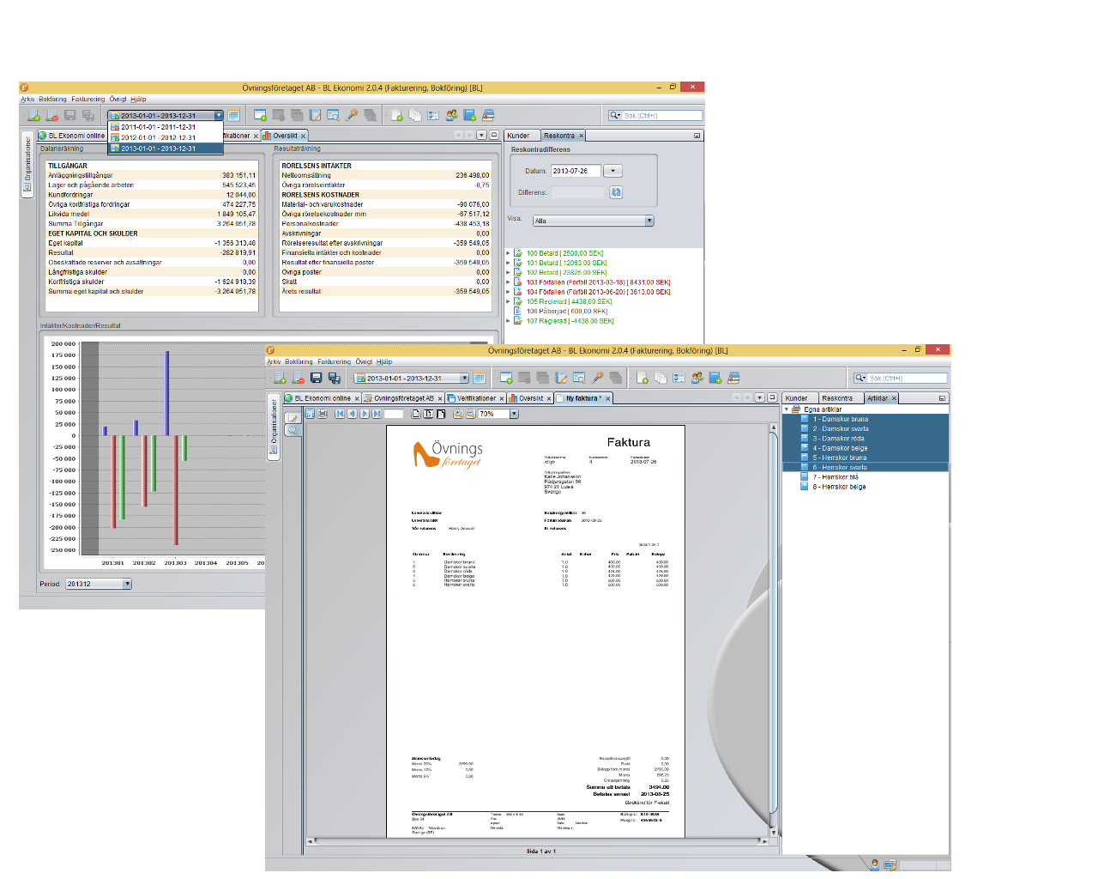
BL Ekonomi – example screenshots

Slide 33
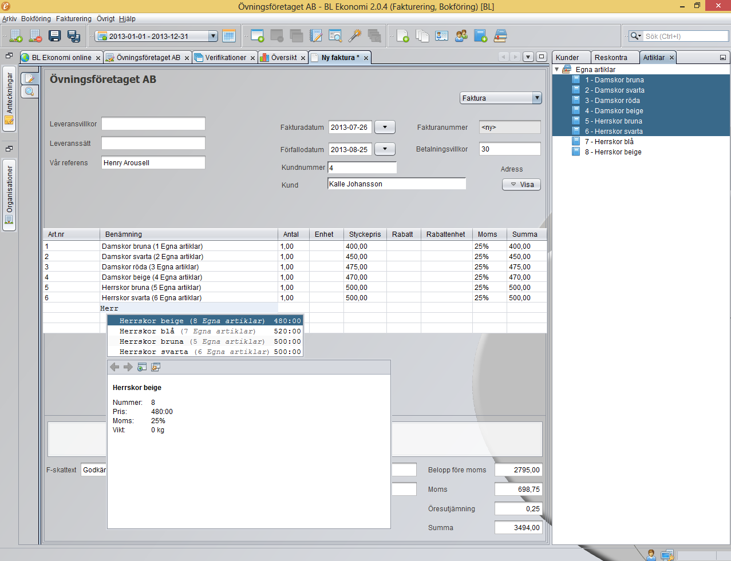
BL Ekonomi – spreadsheet component

Slide 34
Notes:
I'll tech you about how to write your first NB Platform app
- point out that it's simple, non-technical introduction
- just to see the tools and possibilities that NB platform offers, but no code yet
- stress that creating, writing platform app is the same as creating modules for IDE. Always it's some set of existing modules plus your own modules
- When writing NB platform app, NB IDE is favored, but not necessary. NB IDE has advantage of having specialized wizards for building platform elements like actions, TopComponents etc.

Slide 35
Migrating to NetBeans Platform
Keep all algorithms, processors, etc.
Port everything to modules.
Wrap JPanels in TopComponents.
Wrap business objects in Nodes.
Move to BeanTreeView from Jtree, etc.
Integrate NetBeans RCP features.
Leverage/reuse as much as you can.
Focus on domain, not infrastructure.
Porting is a process.
Notes:
I'll tech you about how to write your first NB Platform app
- point out that it's simple, non-technical introduction
- just to see the tools and possibilities that NB platform offers, but no code yet
- stress that creating, writing platform app is the same as creating modules for IDE. Always it's some set of existing modules plus your own modules
- When writing NB platform app, NB IDE is favored, but not necessary. NB IDE has advantage of having specialized wizards for building platform elements like actions, TopComponents etc.

Slide 36
Technical Concepts
Module
Lookup for Loose Coupling
Central Registry
TopComponent
Cookies/Capabilities
Node
Explorer Views
Actions: Global/Context Sensitive
Notes:
I'll tech you about how to write your first NB Platform app
- point out that it's simple, non-technical introduction
- just to see the tools and possibilities that NB platform offers, but no code yet
- stress that creating, writing platform app is the same as creating modules for IDE. Always it's some set of existing modules plus your own modules
- When writing NB platform app, NB IDE is favored, but not necessary. NB IDE has advantage of having specialized wizards for building platform elements like actions, TopComponents etc.

Slide 37
Summary
NetBeans Platform:
  Framework simplifying the development of modular, scalable, Swing applications.
  Free & open source.
  Stable & very extensive.
  Used internationally in many companies.
Notes:
I'll tech you about how to write your first NB Platform app
- point out that it's simple, non-technical introduction
- just to see the tools and possibilities that NB platform offers, but no code yet
- stress that creating, writing platform app is the same as creating modules for IDE. Always it's some set of existing modules plus your own modules
- When writing NB platform app, NB IDE is favored, but not necessary. NB IDE has advantage of having specialized wizards for building platform elements like actions, TopComponents etc.

Slide 38
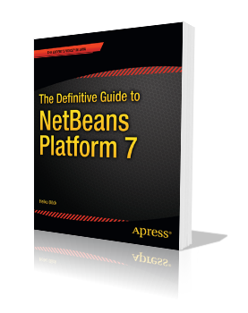

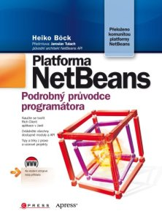
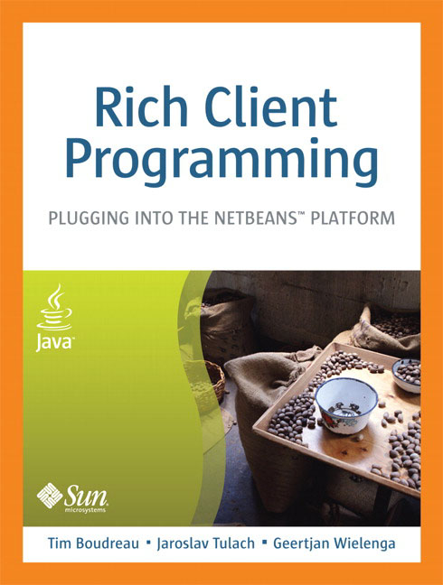
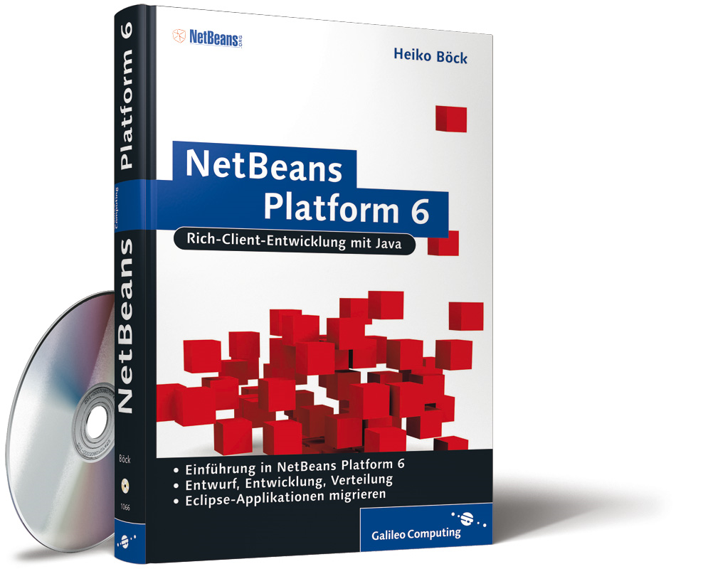


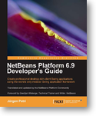
Books
Notes:
I'll tech you about how to write your first NB Platform app
- point out that it's simple, non-technical introduction
- just to see the tools and possibilities that NB platform offers, but no code yet
- stress that creating, writing platform app is the same as creating modules for IDE. Always it's some set of existing modules plus your own modules
- When writing NB platform app, NB IDE is favored, but not necessary. NB IDE has advantage of having specialized wizards for building platform elements like actions, TopComponents etc.

Slide 39
Course
Basic Course
  Cover all the basic NetBeans APIs.
  A lot of hands on work & coding.
  One lecture/one workshop pattern.
  Very practically oriented, free book.
Porting Workshop
  Brief overview of NetBeans APIs.
  Step by step guided migration of your app.
  Simple prototype ready for demo.
3 or 5 days, X number of engineers
Notes:
I'll tech you about how to write your first NB Platform app
- point out that it's simple, non-technical introduction
- just to see the tools and possibilities that NB platform offers, but no code yet
- stress that creating, writing platform app is the same as creating modules for IDE. Always it's some set of existing modules plus your own modules
- When writing NB platform app, NB IDE is favored, but not necessary. NB IDE has advantage of having specialized wizards for building platform elements like actions, TopComponents etc.

Slide 40
Resources
http://wiki.netbeans.org/
NetBeansDeveloperFAQ
http://platform.netbeans.org/tutorials/
nbm-porting-basic.html
http://edu.netbeans.org/courses/
nbplatform-certified-training/
dev@platform.netbeans.org
http://platform.netbeans.org

Slide 41
Questions & Answers

