Slide 1
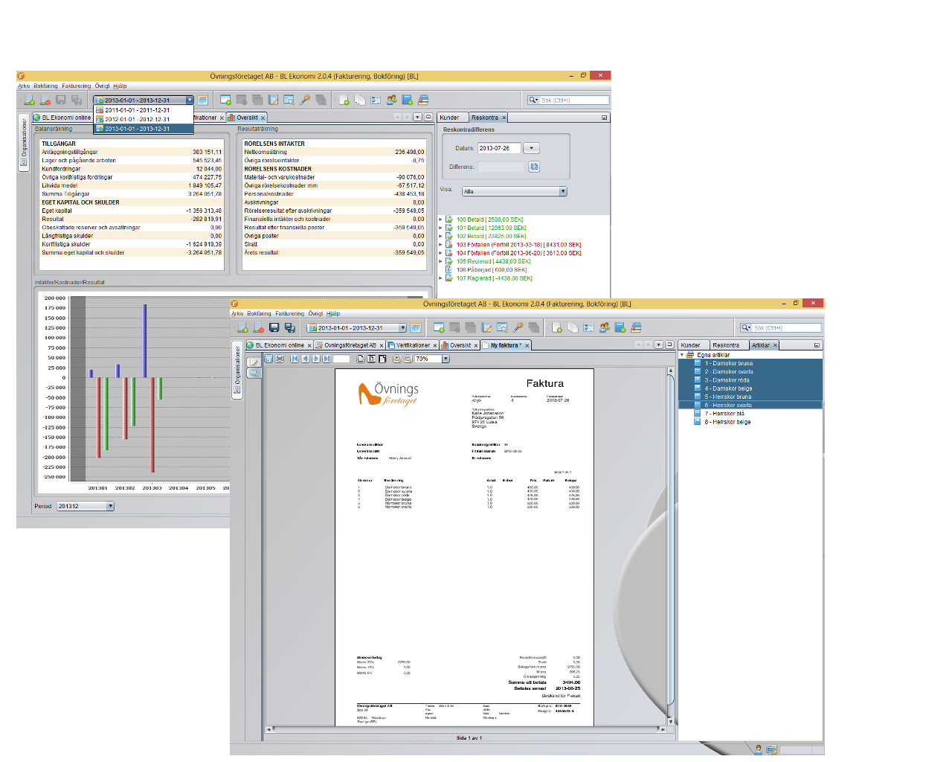
BL Ekonomi – example screenshots

Slide 2
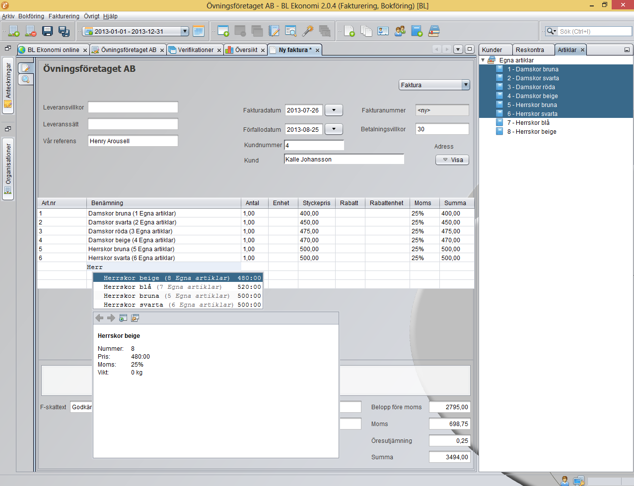
BL Ekonomi – spreadsheet component

