Slide 1
Team 3 Group Project
Fraud Transaction Management System
Dorina Habravan, Reece Gilliland, Romaan Mahood, Sean Meaney

Slide 2
What our Application does
Import (Backend) – Bank transactions are pulled in from the Plaid API and stored in MySQL.
Access (Middle Tier) – Every transaction is checked against various fraud rules and allocated a Green, Amber or Red flag.
Investigation (Frontend) – A user is then able to group transactions into a case, which can be updated or deleted.

Slide 3
Project Motivation
It is a bank's responsibility to track & catch potentially fraudulent activity and we wanted to create an application that would make identifying fraudulent behaviour easier.
In 2025 £1.28 Billion was stolen through fraud in the UK, which is an increase of 4% from 2024.
There was also just over 4 Million confirmed cases in the same year
These figures highlight the current need for fraud prevention.
Statistics from the Annual Fraud Report 2026 - https://www.ukfinance.org.uk/system/files/2026-06/UK%20Finance%20Fraud%20Report%202026.pdf

Slide 4
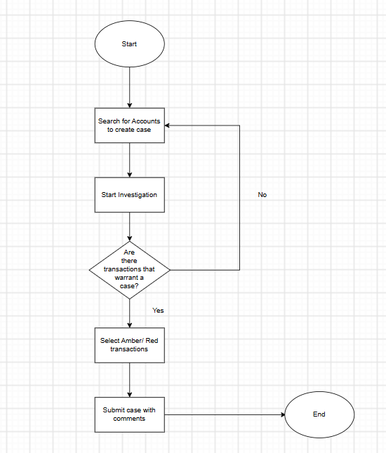
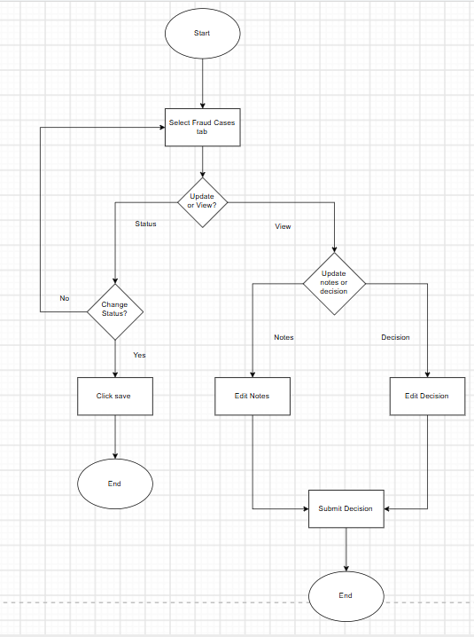
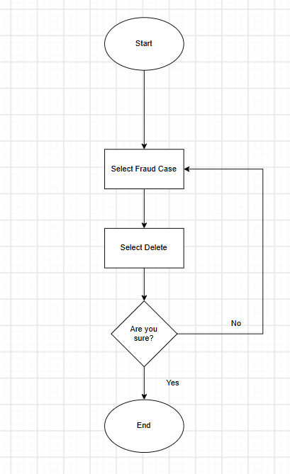
Project Flowcharts
Flowcharts designed for each path.
Create
Update
Delete

Slide 5
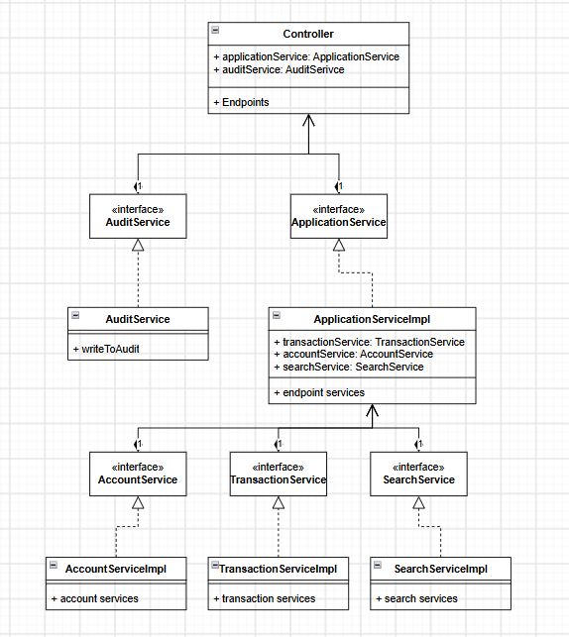
Project Design – UML Class Diagram
The Class diagram here showcases the different layers and features involved to establish the project.

Slide 6
Why we build it this way
Explainable – Every flag states which rule was alerted by a transaction and why giving a user further explanation.
User forward – Although the application determines fraudulent transactions, it is up to the user to determine if these transactions are worthy of a case.
Real banking data – By using Plaids API we are able to gain better insight into what data makes up a transaction and account for a more realistic application.

Slide 7



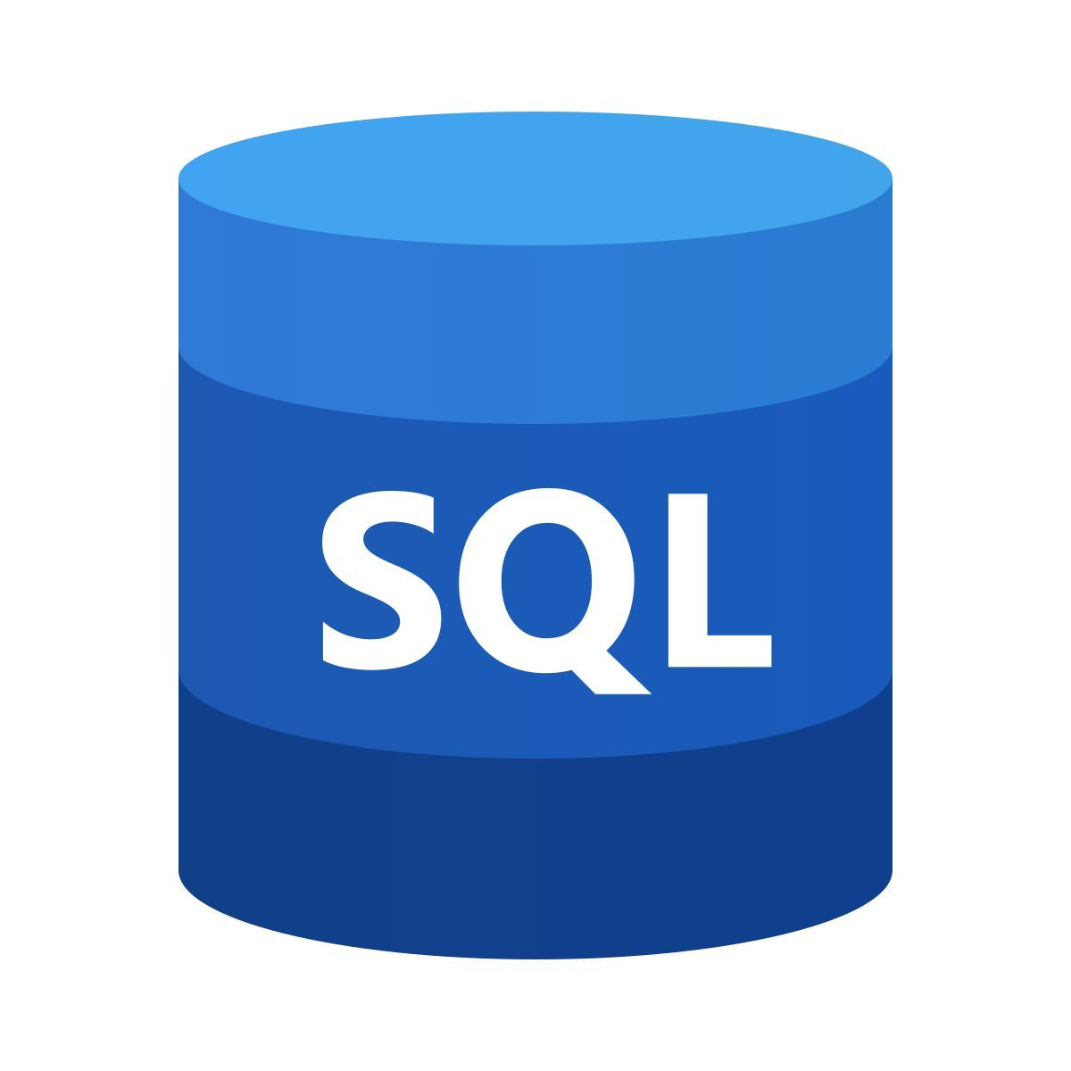

Technology Stack
React front end
Java Service Layer
HTTP endpoints
SQL Database
Spring Boot

Slide 8
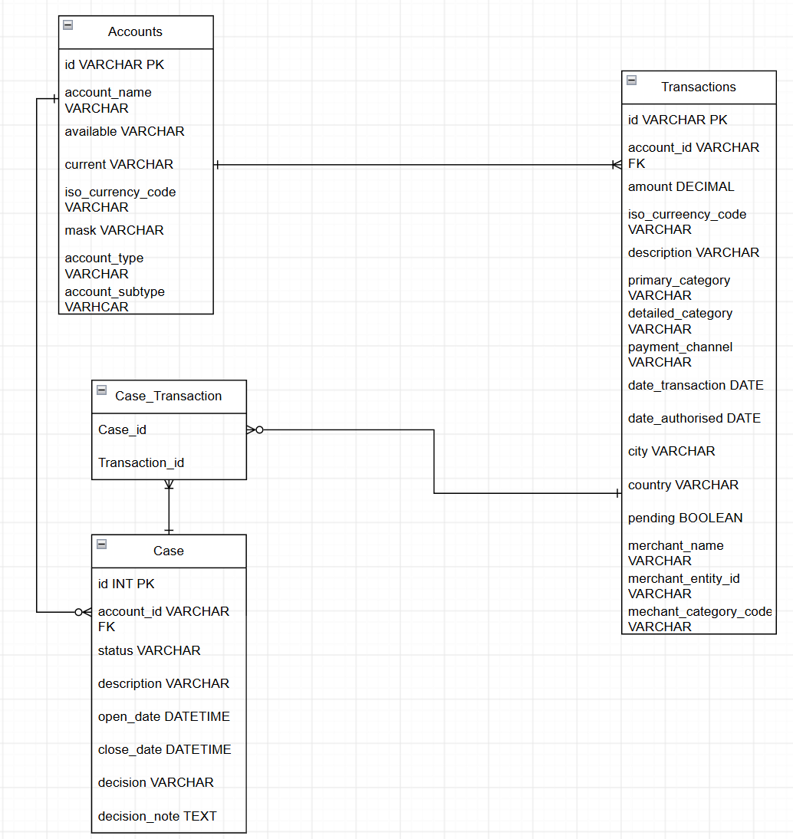


Backend Database Setup
HTTP
request
Returns
Loads using
Converts
Notes:
Romaan

Slide 9
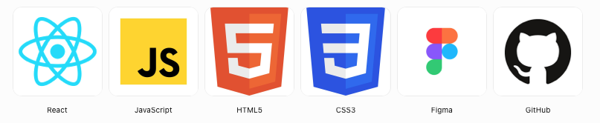
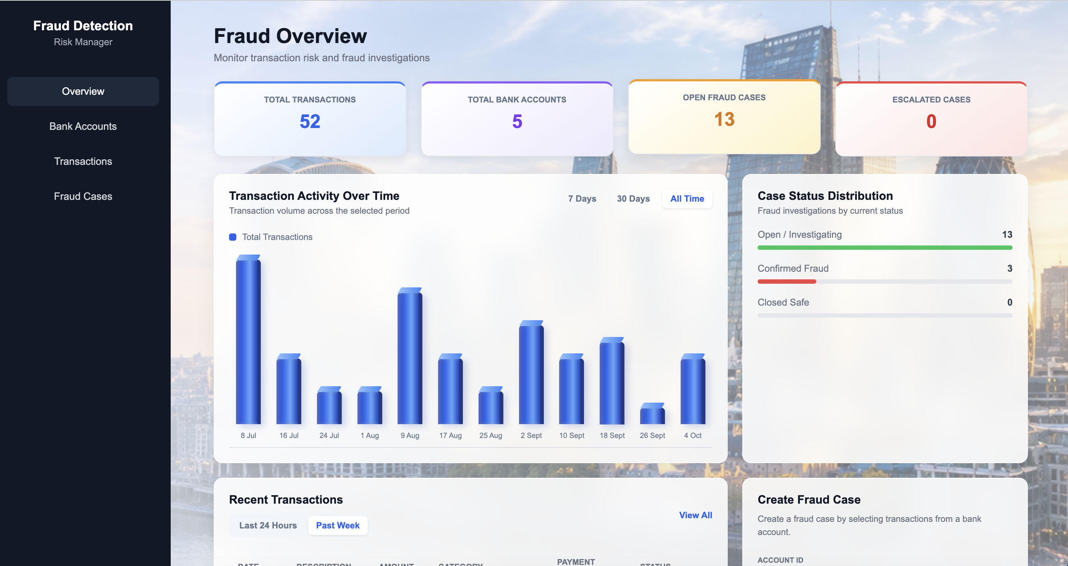
Frontend Implementation​
Design & Development
• Translated Figma designs into reusable React components
• Built a responsive interface using JavaScript, HTML and CSS
• Implemented navigation with React Router
Backend Integration
• Connected React to Java REST APIs
• Retrieved accounts, transactions and fraud cases
• Implemented case creation, transaction selection and case updates

Slide 10
Frontend Testing & Integration​
Validating user workflows and backend communication​
Functional Testing
Page navigation
Account search
Transaction selection
Case creation & decisions
API Integration​
React ↔ Spring Boot
REST API requests
Data retrieval
Backend response display​
Issues Resolved​
CORS configuration
Currency display
Risk reasons
Team debugging​
TESTING OUTCOME​​
Core frontend workflows manually tested and integrated with backend services.​​
Integration issues resolved, including CORS, currency mapping, and risk reason display.
Notes:
Ronnie said to shorten the time spent here

Slide 11

Project Run Through
Let's do a demonstration!

Slide 12
Project Evaluation
-
Lessons Learned
Collaborative Programming:
  Being aware of the rest of the project
  Commits and merging
Agile development:
  Rapid design implementation
  Cleaning up redundant code
User Requirements:
  Researching financial auditing

Slide 13
Version 2
+Multiple simultaneous users
+Auditor accounts with log in and action logs
+Display similar transactions
+Attach supporting documents to case
+https communications between frontend and rest API

Slide 14
Any Questions?

