Slide 1

King County House Analysis
Presented By:
Evah Wangari
Dorine Langat
Grace Nyongesa
Maureen Anduuru
Stella Kitur
Vivian Adhiambo

Slide 2
Business Understanding
Business Overview
Real estate is one of the most important sectors of any economy.
Understanding the key drivers of housing prices can provide valuable insights for both buyers and sellers in the market.
In this project, we analyze a data set of house sales in a northwestern county to identify the factors that influence housing prices in the area.

Slide 3
Challenges
The agency currently lacks a reliable method for predicting the impact of home value. Therefore, the agency is unable to provide accurate advice to homeowners about the potential return on investment.
Houses that stay longer in the market before being sold depreciate in value over time
Most homeowners Improving the value of the houses
Housing affordability : some houses were over valued while others were undervalued as compared to the normal market rate.

Slide 4
Proposed Solutions
Develop a reliable method for predicting the impact of home improvements on the estimated value of a home.
To prevent houses from depreciating in value due to longer time in the market, the real estate agency can work with homeowners to set realistic prices based on market trends, property condition, and location. The agency can also help homeowners to prepare their homes for sale by renovating the property.
Provide homeowners with a list of home improvements that can increase the value of their homes, and offer advice on which improvements will provide the greatest return on investment.
Conduct market research and analysis to determine the appropriate value for each home based on its location, size, and other factors.

Slide 5
Problem Statement
To identify features influencing the pricing.
To analyze trends in house prices over time (time series analysis) and predict future prices.
To identify undervalued properties (outlier detection) and recommend better pricing strategies

Slide 6
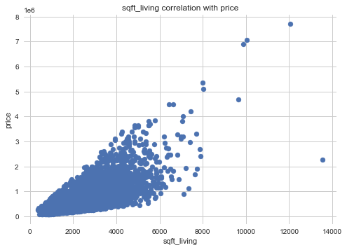
Correlation between price and Square footage of living space
The correlation between square footage of living space and price of the home is a strong positive correlation.

Slide 7
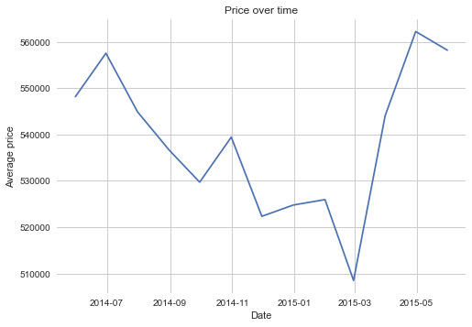
House prices according to months
There appears to be a decrease in price especially in the month of March 2015, however, after that there seems to be a sharp increase.

Slide 8
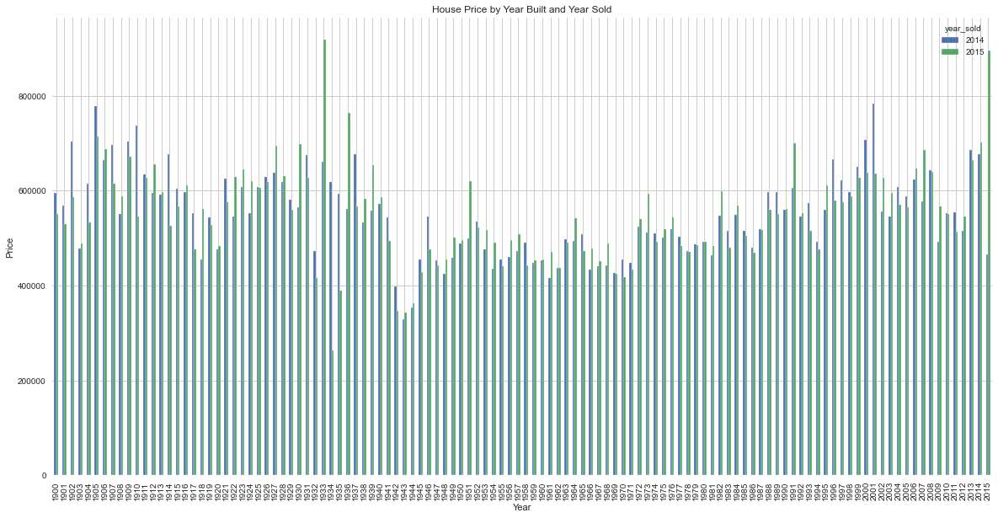
House prices by year built and year sold

Slide 9
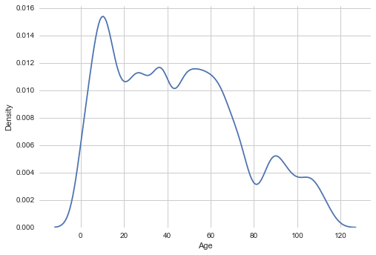
Density plot representing the house ages
Most houses are distributed within 10 to 50 years, while a small portion of the properties are above 90+ years.

Slide 10
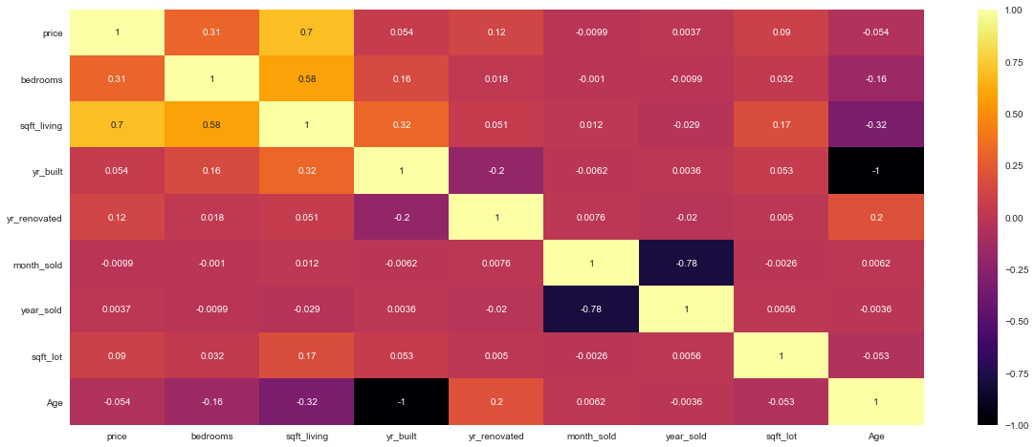
Correlation Heatmap with House Age

Slide 11
Conclusions
1. Some of the features that influence the pricing of houses include:
Square footage of living space in the home: an additional square footage increases the price by $199.09
Waterfront: the presence of a waterfront has an associated increase in price of $70,000
Condition of the house: houses in good conditions have an associated increase in price of $35,650 compared to houses with average condition.

Slide 12
2. For every additional year in the age of a house, there is an associated decrease in price of $626.09
3.
Some of the overvalued properties were found to be older than 50 years of age
The square footage of interior housing living space for the nearest 15 neighbors influences the pricing of houses, in that, an additional square footage leads to an increase in price by $48.35

Slide 13
Recommendations
We recommend that:
1. There is a need to do further exploration into other variables in order to better understand the determinants of house prices.
2. The agency should consider re-purposing the old houses and targeting business owners rather than homeowners.
3. The agency should consider investing in properties with waterfronts as this could increase
their profitability.

Slide 14
Next Steps
Additional cleaning and feature engineering can be performed to improve the data's quality because the dataset contains some missing values and inconsistencies. Missing data, for example, might be imputed using proper procedures, and new features can be generated from existing ones to provide more insights into the housing market.
2. Conduct further exploration to visualize the location of the properties on a map. This will help us compare the affordability of properties per region. It will also help in determining the best regions to invest in.
3. Retrieve more recent data that would allow us to make better models in order to predict prices based on the current market trends.

Slide 15
Thank You

