Slide 1

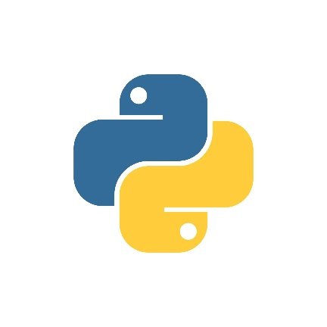







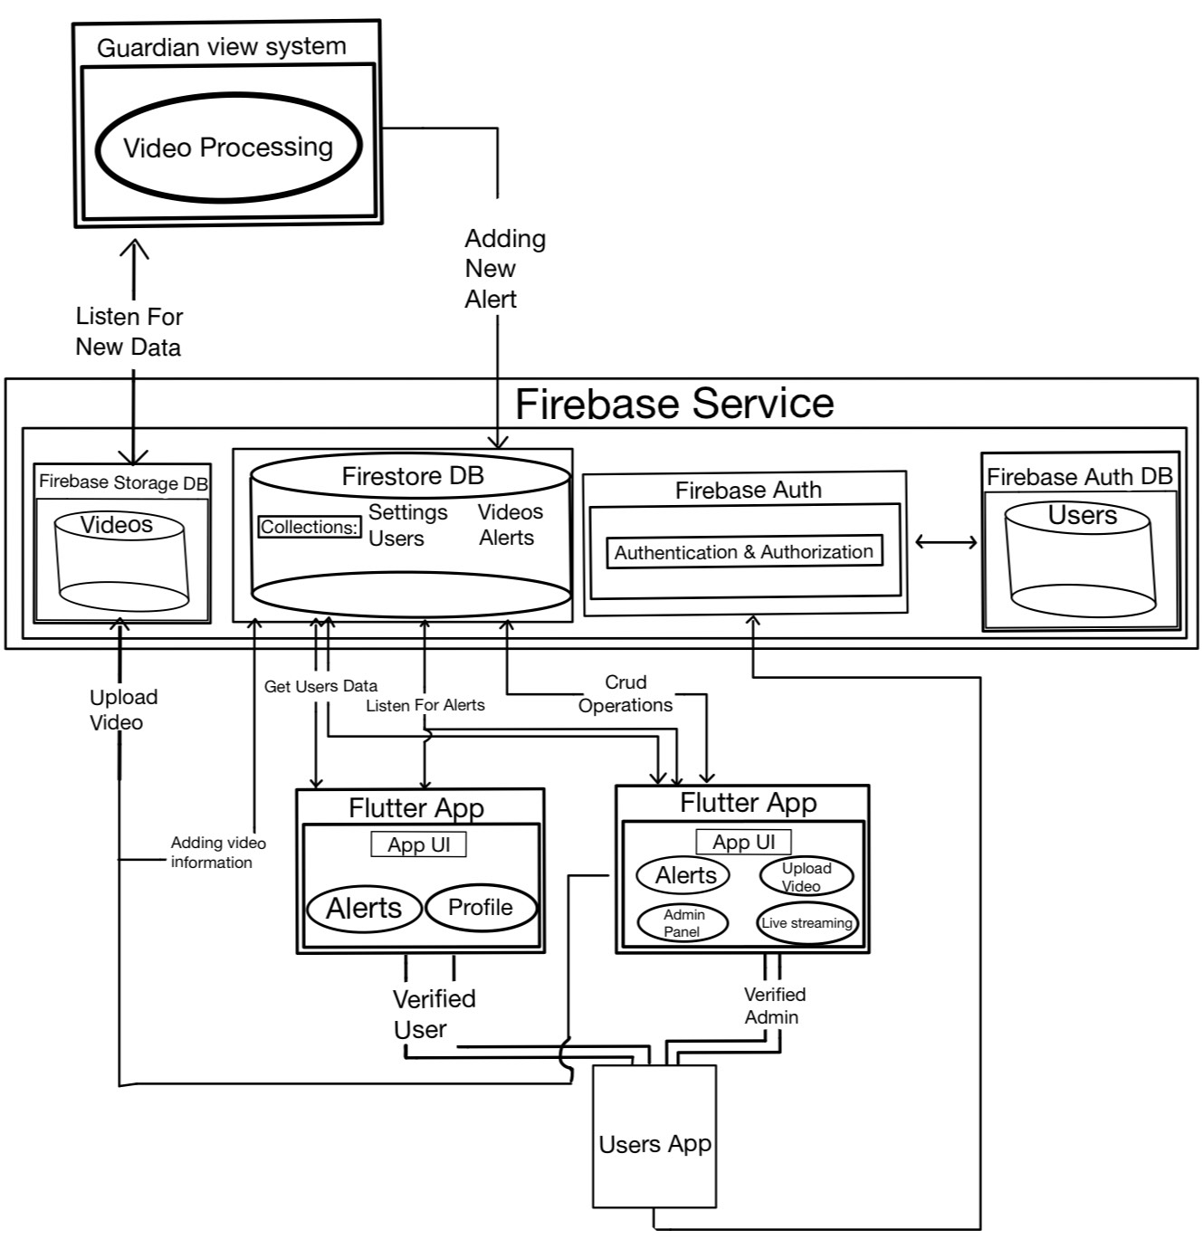
Guardian View : AI-Powered Real -Time Threat Detection System
Dor rozen & omer iny
Advisor: Mr.Rozewaks Yoram
1. Problem description
4. Technologies
Public spaces such as shopping malls, airports, and city streets face continuous security challenges from potential threats. Currently, security incident reports rely on human observers or real-time monitoring of security camera feeds. This approach has critical limitations:
Incidents may be missed due to lack of witnesses or momentary inattention to specific camera feeds.
Human reporting introduces delays in communicating crucial details like location and nature of the threat and even problems speaking in the same language or there is noise in the place.
Time lost in explaining the situation to authorities can be critical in life-threatening scenarios.
Team management tools - Monday,PlantUML, WhatsApp, Microsoft Teams Git.
Backend development technologies: Python Firebase, VSCode, Ultralytics.
Client development technologies: Android Studio and Flutter.
5. Development process
Project managed with Monday.com for task tracking and Git for version control.
Developed an AI-powered surveillance system for real-time threat detection in public spaces.
Implemented YOLOv8 model for accurate and fast object detection in video feeds.
Designed and developed a Flutter-based frontend for a user-friendly interface, enabling security personnel to receive instant alerts and visual verification of threats.
Integrated Firebase services (Firestore, Auth, Storage) for robust data management, user authentication, and video storage.
Developed a Python backend to process video data, interact with the YOLO model, and communicate with Firebase services.
Implemented a real-time alert system to notify security personnel of potential threats instantly.
Created a scalable architecture using Docker for consistent development and deployment environments.
Designed and implemented a Firestore database structure to efficiently manage users, videos, settings, and alerts.
Developed a video processing service to analyze uploaded and live-streamed video data for potential security threats.
Implemented location-based alerting to notify near to detected threats.
2. Research goals
Implementing and developing an AI-based system for continuous, automated threat detection across multiple video feeds.
Providing instant, detailed alerts to relevant authorities, eliminating delays in threat reporting, delivering precise information about the incident's location and reduce reaction time.
The project's goal is to significantly reduce response times to potential security threats recognizing that every second saved can be crucial .
3. Architecture
The architecture chosen for the project is Event-Driven, as it deals with real-time data processing and alert generation. This architecture allows for efficient handling of incoming data and quick responses to events.
6. Conclusions
With the integration of AI-powered object detection and real-time video processing, we can efficiently identify potential security threats in public spaces.
Our main challenge was to train the classification model to distinguish between regular videos and real threats in it.
Our system features an intuitive interface with streamlined pages, allowing security personnel to quickly access alerts, view threat details, and respond to incidents efficiently. The system's ability to provide instant, location-based alerts to nearby responders significantly enhances the speed and effectiveness of security responses in public spaces.

