Slide 1

Introduction to ASP.NET & Visual Studio 2013 Web Tools
Michael Palermo
Microsoft
mpalermo@microsoft.com
@palermo4
Notes:
Description
We'll start out by explaining the One ASP.NET experience in Visual Studio 2013, showing how to create hybrid web applications. Next, we'll introduce new features for web developers in Visual Studio 2013 and Web Essentials, explaining how Visual Studio is the best editor for HTML, CSS and JavaScript as well as your back end code. We'll also look at some new features across the ASP.NET platform including new Bootstrap templates, the new scaffolding system, and the new membership and identity system.

Slide 2
Agenda
One ASP.NET
Visual Studio 2013 + Web Essentials
What’s new in ASP.NET

Slide 3
One ASP.NET
Sites
Services
Web
Forms
Web
Pages
Single
Page
Apps
MVC
Web
API
SignalR
ASP.NET

Slide 4
One ASP.NET
Sites
Services
YOU!
Web
Forms
Web
Pages
Single
Page
Apps
MVC
Web
API
SignalR
YOU!
ASP.NET

Slide 5
One ASP.NET
Sites
Services
YOU!
Web
Forms
Web
Pages
Single
Page
Apps
MVC
Web
API
SignalR
YOU!
ASP.NET

Slide 6
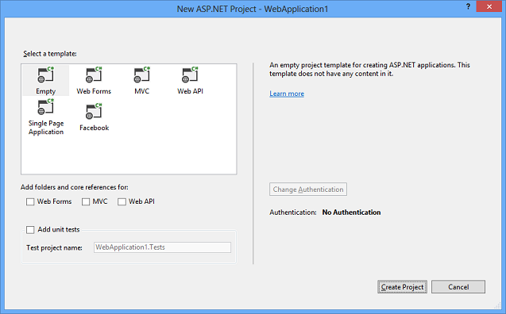
One ASP.NET
Visual Studio 2013 – New ASP.NET Project

Slide 7
Demo
02OneASPNET /DEMO/OneASPNET
Notes:
DEMO-One-ASP-NET
## Overview ## In this demo you will walk through the process of creating a new site using the new One ASP.NET tooling in Visual Sudio. You will start with a Web Forms application, create a simple model "Person" and use the new tooling to scaffold an MVC and a Web Api controller for it.
### Goals ###
In this demo, you will see how to:
1. Create a new site using the new One ASP.NET tooling
2. Create a simple model "Person" 3. Scaffold an MVC controller for Person
4. Scaffold a Web API controller for Person

Slide 8

New ASP.NET Core Features

Slide 9
ASP.NET Core Features
Bootstrap templates
Identity
Scaffolding
Owin
Notes:
This slide introduces these features at a high level. The demo for these features is included in the next section.
http://www.asp.net/identity
http://owin.org/

Slide 10
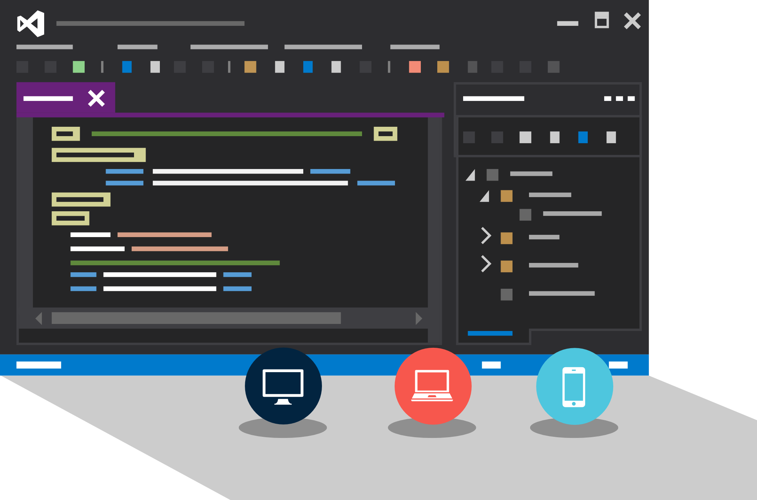
Visual Studio Web Tools

Slide 11
Visual Studio 2013 – Web Tools
Browser Link
HTML Editor
Web Essentials
Side Waffle

Slide 12
Demo
02VSWebTools /DEMO/VisualStudioandWebEssentials

