Slide 1
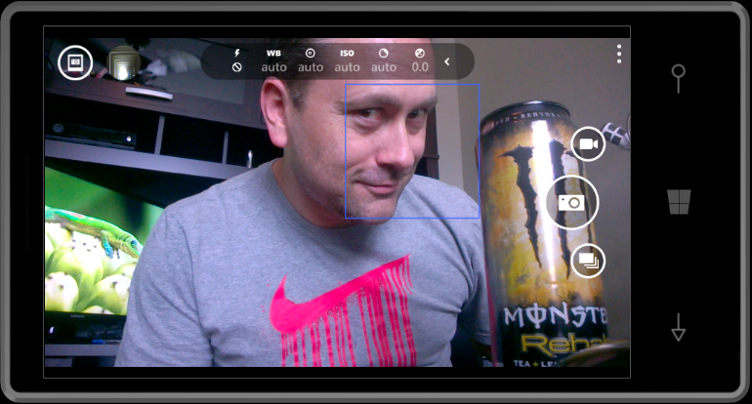
Client-side development for modern web
Michael Palermo
Microsoft
mpalermo@microsoft.com
@palermo4
Notes:
Description
We'll start out by explaining the One ASP.NET experience in Visual Studio 2013, showing how to create hybrid web applications. Next, we'll introduce new features for web developers in Visual Studio 2013 and Web Essentials, explaining how Visual Studio is the best editor for HTML, CSS and JavaScript as well as your back end code. We'll also look at some new features across the ASP.NET platform including new Bootstrap templates, the new scaffolding system, and the new membership and identity system.

Slide 2
Agenda
Modern web standards overview
JavaScript library overview
Building the GeekQuiz front-end

Slide 3


Slide 4
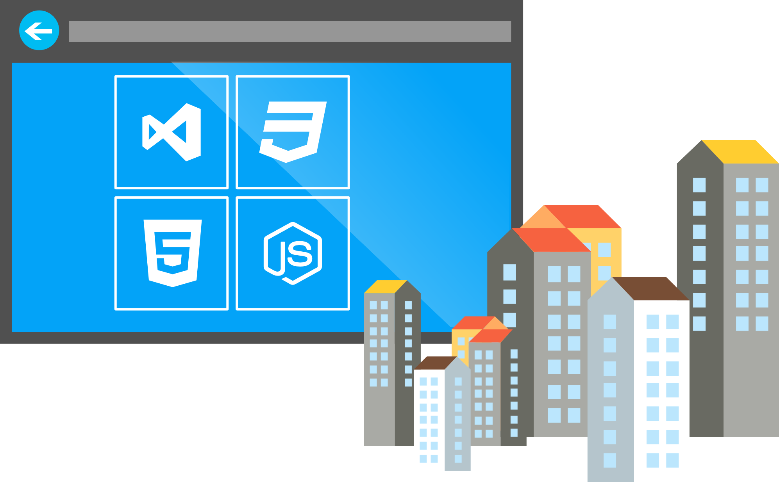

What is HTML5?
Umbrella term: vNext HTML, CSS, ECMAScript
Not a marketing message
A new standard for
a new web
A language with support on a variety of devices

Slide 5

Why do you care?
Browsers have become really powerful
Standards mean you can target features, not browsers

Slide 6
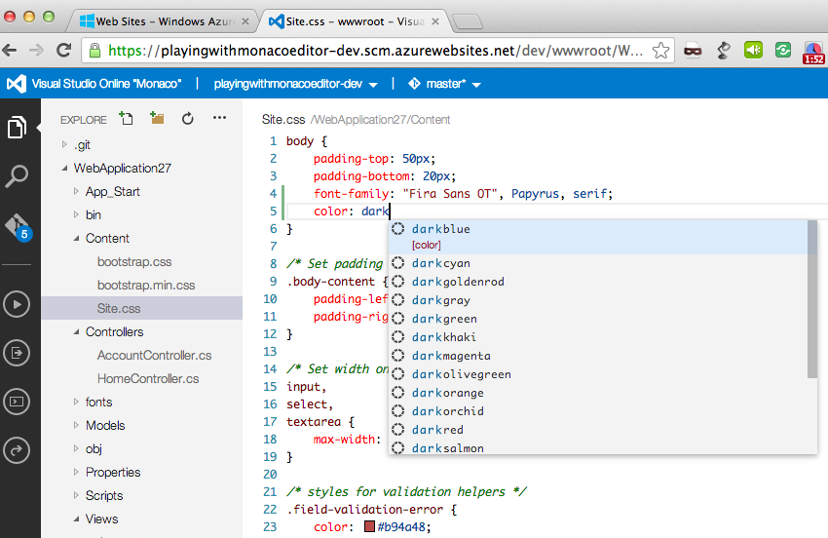
Visual Studio Online

Slide 7
Map of Web Browser Standards
HTML
CSS
Web Apps
SVG
Geolocation
ECMA Script 262
Standard
W3C
ECMA
Standards
Body

Slide 8
ECMAScript 262 APIs
Geolocation API
Basic Shapes
DOM L2 Style
Web SQL Database
CSS Text
Filters
Document Structure
DOM L2 Events
Web DOM Core
CSS Cascading And Inheritance
HTML5 Diff From HTML4
Fonts
DOM L3 Abstract Schemas
DOM L2 Views
Uniform Messaging Policy
CSS Values And Units
CSS Writing Modes
HTML5 Markup
DOM L2 Core
Server-sent Events
CSS Speech
Smil
DOM L3 Views And Formatting
Element Traversal
CSS Color
CSS Print Profile
Html+rdfa
Dom L1
Selectors API L2
CSS Media Queries
Gradients And Patterns
DOM L3 Xpath
Cors
CSS Paged Media
Microdata
Xmlhttprequest L2
Selectors API
CSS Template Layout
Styling
DOM L3 Validation
CSS Animations
CSS Namespaces
Canvas 2D Context
Xmlhttprequest
Progress Events
CSS Multi-column Layout
Scripting
DOM L3 Load And Save
CSS Transitions
CSS Snapshot 2007
Html5
Web Workers
CSS Basic Box Model
Painting, Filling, Color
DOM L3 Events
CSS 3D Transformations
Text Alternatives
Web Storage
CSS Fonts
Transforms
DOM L3 Core
Programmable HTTP Caching And Serving
CSS 2D Transformations
Polyglot Markup
Web Sockets API
Index DB
CSS Backgrounds And Borders
Text
Dom L2 Html
CSS Image Values
Paths
DOM L2 Traversal And Range
Web IDL
File API
CSS Generated Content For Paged Media
CSS Flexible Box Layout
CSS Grid Positioning
CSS Line Grid
CSS Ruby
CSS Scoping
CSS Basic User Interface

Slide 9
Building with standards
Modern.ie
Can I Use
Compat Inspector
Modernizer
CSS Resets (Normalize.css)

Slide 10
New HTML5 Markup Elements
From this:
<div class=“header”></div>
<div class=“nav”></div>
To this:
<header></header>
<nav></nav>

Slide 11
New HTML5 Markup Elements
Eliminate the “generic” tagging
Native tags DOM parsing is quicker than class searching
Accessibility
Standardizing tags
Why?

Slide 12
Canvas
A block element that allows developers to draw 2d graphics using JavaScript
Methods for drawing include: paths, boxes, circles, text…
<canvas id="myCanvas" width="200" height="200">
Your browser doesn’t support Canvas, sorry.
</canvas>
<script type="text/javascript">
var example = document.getElementById("myCanvas");
var context = example.getContext("2d");
context.fillStyle = "rgb(255,0,0)";
context.fillRect(30, 30, 50, 50);
</script>

Slide 13
HTML 5 <video>
Support for the HTML5 <video> element
Industry-standard MPEG-4/H.264 video
Video can be composited with anything else on the page
HTML content, images, SVG graphics
Hardware accelerated, GPU-based decoding

Slide 14
HTML 5 <video> Attributes
src – specifies the location to pull the source file
autoplay – if present starts playing as soon as it’s ready
controls – if present displays controls
preload – if present loads source at page load
loop – if present loops back to the beginning of the video
<video src="video.mp4" id="videoTag">
<!-- Only shown when browser doesn’t support video -->
<!-- You Could Embed Flash or Silverlight Video Here -->
</video>

Slide 15
Multiple HTML 5 <video> Sources?
source – child element used to specify the location to pull the source file(s)
<video poster="video.jpg">
<source src="video.mp4"/>
<source src="video.ogv"/>
<p>This is fallback content</p>
</video>

Slide 16
HTML 5 <audio>
Industry-standard MP3 and AAC audio
Fully scriptable via the DOM
Attributes
src – specifies the location to pull the source file
autoplay – if present starts playing as soon as it’s ready
controls – if present displays controls
preload – if present loads source at page load
<audio src="audio.mp3" id="audioTag" autoplay controls>
<!-- Only shown when browser doesn’t support audio -->
<!-- You could embed Flash or Silverlight audio here -->
</audio>

Slide 17
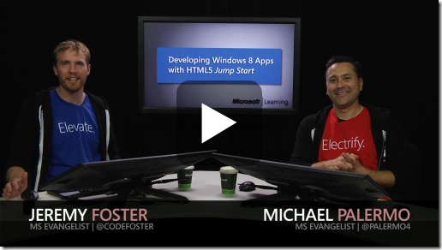
aka.ms/70-480

Slide 18
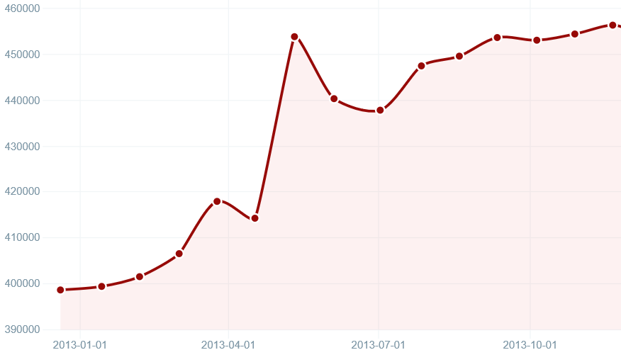
Who Uses jQuery?
Over 59 million sites
66.2% of the top 10k
Source: http://trends.builtwith.com/javascript/jQuery

Slide 19

jQuery – why so popular?
Easy to learn
Loads of Plugins
Powerful DOM Selection
Lightweight
Community Support

Slide 20
jQuery Community
jquery.com
api.jquery.com
forum.jquery.com
meetups.jquery.com
plugins.jquery.com
jqueryui.com
Downloading
Documentation
Community
Local Community
Extending
UI Widgets and Effects

Slide 21
jQuery Fundamentals
Find something, Do something
Functional Syntax
DOM Manipulation
Changing of events
<script>
$(function() {
$('.submit').click( function(){
$('.submit').css('color', '#ff0000');
$('#container')
.append($('<span>Clicked!</span>')
.click(function(){ alert('foo'); }));
});
});
</script>
<script>
$(‘div’).hide();
</script>
<div>This will be hidden</div>
<div>So will this</div>
<div>Even this</div>
<script>
$(function() {
$('.submit').click(function(){
alert('post form');
});
});
</script>
<input class=“submit” type=“button” value=“Submit”/>
<script>
$(function() {
$('.submit').click(function(){
alert('post form');
});
});
</script>
<input class=“submit” type=“button” value=“Submit”/>

Slide 22
Single Page Applications
Overview and frameworks

Slide 23
Comparison: standard page requests
Client Browser
Request: http://site.com/products/
Web Server
HTML
CSS
Images
Javascript
Response: Full page
Request: http://site.com/products/6
Response: Full page
HTML
CSS
Images
Javascript

Slide 24
Comparison: Single Page Application
Client Browser
Request: http://site.com/products/
Web Server
HTML
CSS
Images
Javascript
Response: Full page
Request: http://site.com/products/6
Response: Tiny bit of data
{product}

Slide 25
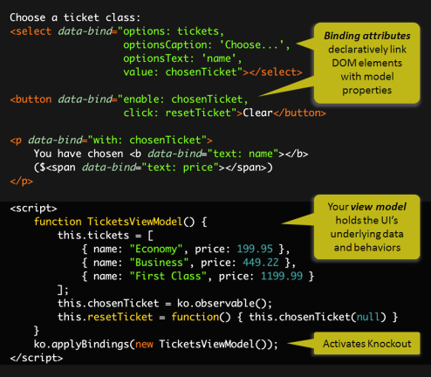
Knockout.js
Declarative Bindings
Automatic UI refresh
Dependency Tracking
Templating

Slide 26
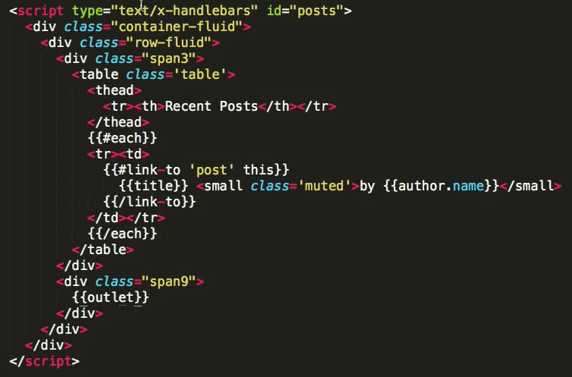

Ember.js
Ember is a framework
Convention over config
URLs are important

Slide 27

AngularJS
<!doctype html>
<html ng-app="app">
<body>
<tabs>
<pane title="Localization">
Date: {{ '2013-04-01' | date:'fullDate' }} <br>
Currency: {{ 123456 | currency }} <br>
Number: {{ 98765.4321 | number }} <br>
</pane>
<pane title="Pluralization">
<div ng-controller="BeerCounter">
<div ng-repeat="beerCount in beers">
<ng-pluralize
count="beerCount“
when="beerForms">
</ng-pluralize>
</div>
</div>
</pane>
</tabs>
</body>
</html>
Custom Tag Attributes
Powerful Directives
Declarative Style
Strict Separation

Slide 28
Demo
04SPA
/HOL/AspNetApiSpa

Slide 29
Summary
Modern web standards overview
Single Page Applications
Building the GeekQuiz front end

Slide 30
LUNCH!

