Slide 1

API services for both web and devices
Michael Palermo
Microsoft
mpalermo@microsoft.com
@palermo4
Notes:
Description
We'll start out by explaining the One ASP.NET experience in Visual Studio 2013, showing how to create hybrid web applications. Next, we'll introduce new features for web developers in Visual Studio 2013 and Web Essentials, explaining how Visual Studio is the best editor for HTML, CSS and JavaScript as well as your back end code. We'll also look at some new features across the ASP.NET platform including new Bootstrap templates, the new scaffolding system, and the new membership and identity system.

Slide 2
Agenda
How does ASP.NET Web API fit in?
Understanding HTTP APIs
Introduction to Web API

Slide 3
How ASP.NET Web API Fits In



HTML
JSON
XML
Web Forms
Web Pages
MVC
Web API
ASP.NET Core
Notes:
1. We’ve seen how ASP.NET provides a common core which supports several different toolsets.
2. [click for first animation] On the left side, we have tools which produce HTML, which will be viewed in browsers by people.
3. [click for second animation] On the right, we have Web API, which produces other formats which are consumed by machines (represented by this happy robot) – JSON, XML, and other custom formats which are read by JavaScript code, other programs, other servers, etc.

Slide 4
Introduction to ASP.NET Web API

Slide 5
Sample Read-only Model and Controller
Step 1:
Create a Model
public class Person
{
public int Id { get; set; }
public string Name { get; set; }
}
Step 2:
Make an API Controller
public class PersonController : ApiController
{
List<Person> _people;
public PersonController()
{
_people = new List<Person>();
_people.AddRange(new Person[]
{
new Person { Id = 1, Name = "Chuck Norris" },
new Person { Id = 2, Name = "David Carradine" },
new Person { Id = 3, Name = "Bruce Lee" }
});
}
}

Slide 6
Read-only Controller Actions to return data
Step 3:
Return everything
// GET /api/person
public IEnumerable<Person> Get()
{
return _people;
}
Step 4:
Return one item
// GET /api/person/5
public Person Get(int id)
{
return _people.First(x => x.Id == id);
}

Slide 7
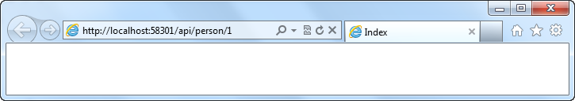
Routing a Web API
Routing:
Familiar syntax, conventional approach
public static void RegisterRoutes(RouteCollection routes)
{
routes.MapHttpRoute(
name: "DefaultApi",
routeTemplate: "api/{controller}/{id}",
defaults: new { id = RouteParameter.Optional }
);
}

Slide 8
Manipulating HTTP Responses
Return HttpResponseMessage<T> to modify response headers
Example
Find a person and return it, but what happens if we don’t find a match?
// GET /api/person/5
public HttpResponseMessage<Person> Get(int id)
{
try
{
var person = _people.First(x => x.Id == id);
return new HttpResponseMessage<Person>(
person,
HttpStatusCode.OK
);
}
catch
{
return new HttpResponseMessage<Person>(HttpStatusCode.NotFound);
}
}

Slide 9
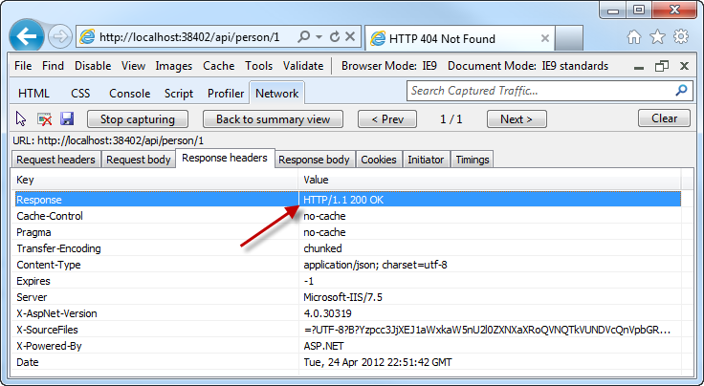
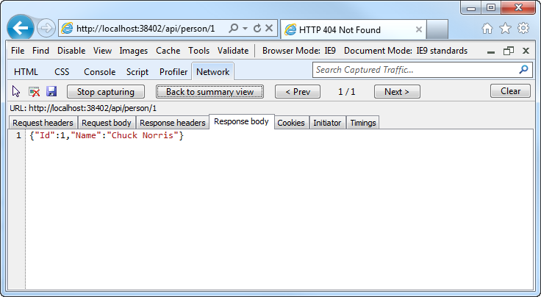
Manipulating HTTP Responses
A successful API call returns an HTTP OK and the JSON data

Slide 10
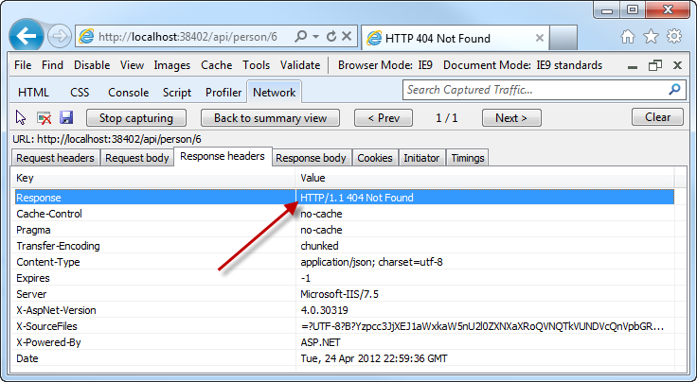
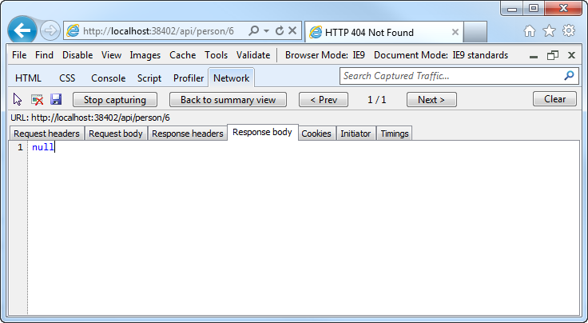
Manipulating HTTP Responses
An unsuccessful API call returns an HTTP 404 (and no JSON)

Slide 11
Posting Data to a Web API
Use HTTP Post:
Pass a Model
public HttpResponseMessage Post(Person person)
{
person.Id = _people.Count + 1;
if (_people.Any(x => x.Id == person.Id))
return new HttpResponseMessage(HttpStatusCode.BadRequest);
try
{
_people.Add(person);
}
catch
{
return new HttpResponseMessage(HttpStatusCode.BadRequest);
}
return new HttpResponseMessage(HttpStatusCode.OK);
}

Slide 12
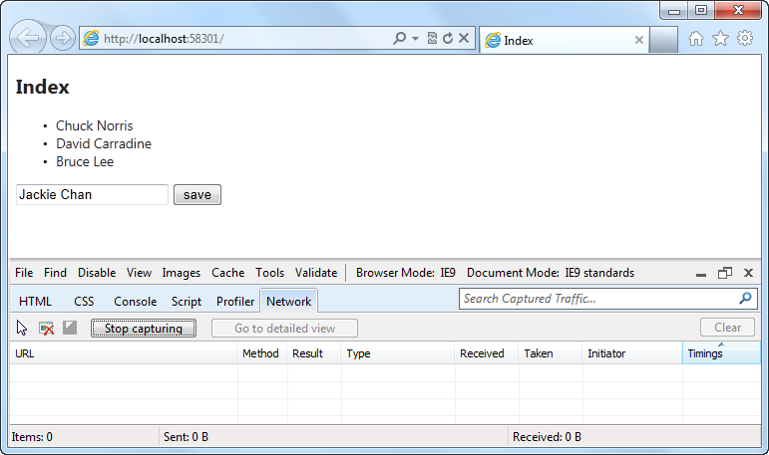
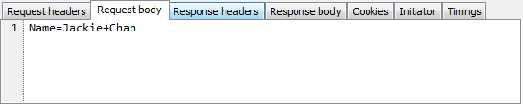
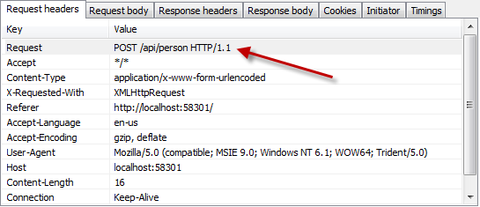
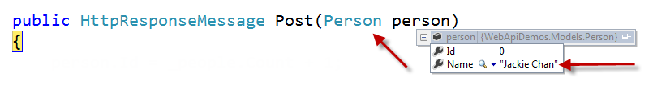
Posting Data to a Web API

Slide 13
Recap
How does ASP.NET Web API fit in?
Understanding HTTP APIs
Introduction to Web API
Consuming Web APIs in web apps
Consuming Web APIs in client apps

