Slide 1

Running, improving and maintaining a site in the real world
Michael Palermo
Microsoft
mpalermo@microsoft.com
@palermo4
Notes:
Description
We'll start out by explaining the One ASP.NET experience in Visual Studio 2013, showing how to create hybrid web applications. Next, we'll introduce new features for web developers in Visual Studio 2013 and Web Essentials, explaining how Visual Studio is the best editor for HTML, CSS and JavaScript as well as your back end code. We'll also look at some new features across the ASP.NET platform including new Bootstrap templates, the new scaffolding system, and the new membership and identity system.

Slide 2
Agenda
Scenario: Scale
Scenario: Adapt to Change
Scenario: Environments

Slide 3
Scenario description
Your site load varies over time.
You need to adapt.
Smoothly.

Slide 4
Load profiles
BATCH
PREDICTABLE
No
load
Load
Load
INCREASING
UNPREDICTABLE
Load
Load

Slide 5
Step 1: Preserve server bandwidth
PROBLEM:
Your servers are wasting bandwidth serving static files.

Slide 6
Step 1: Preserve server bandwidth
SOLUTION:
Serve static files from blob storage.
This is a step towards to delivering content from a content delivery network (CDN).

Slide 7
Step 2: Caching
PROBLEM:
Your servers have finite resources.
You don’t want to repeat work you don’t have to.

Slide 8
Step 2: Caching
SOLUTION:
Store ASP.NET page output cache in Windows Azure Caching Service.

Slide 9
Step 3: Manual scale
PROBLEM:
You need more server resources.

Slide 10
Step 2: Manual Scale
SOLUTION:
Add more servers (horizontal scaling).
Use more powerful servers (vertical scaling).

Slide 11
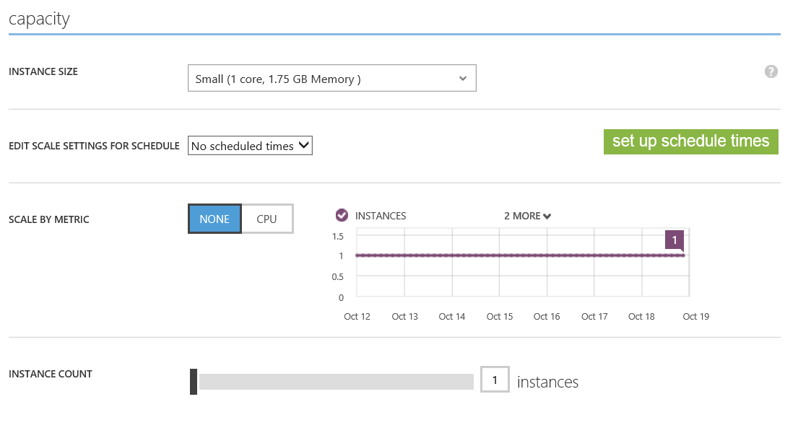

Slide 12
Step 3: Auto-scale
PROBLEM:
Manual scaling reaction time means outages.
Manual scaling is busy work.

Slide 13
Step 2: Auto-scale
SOLUTION:
Use auto-scale.

Slide 15
Scenario description
Your site isn’t done when you deploy to production.
You need to add new features.
Change adds risk.

Slide 16
Step 1: Manage database schema
PROBLEM:
Your database and application code need to stay in sync.

Slide 17
Step 1: Manage database schema
SOLUTION:
Use Entity Framework Data Migrations.

Slide 18
Step 2: Manage deployments
PROBLEM:
People sometimes make misteaks.

Slide 19
Step 2: Manage deployments
SOLUTION:
Use deployment rollback.

Slide 20
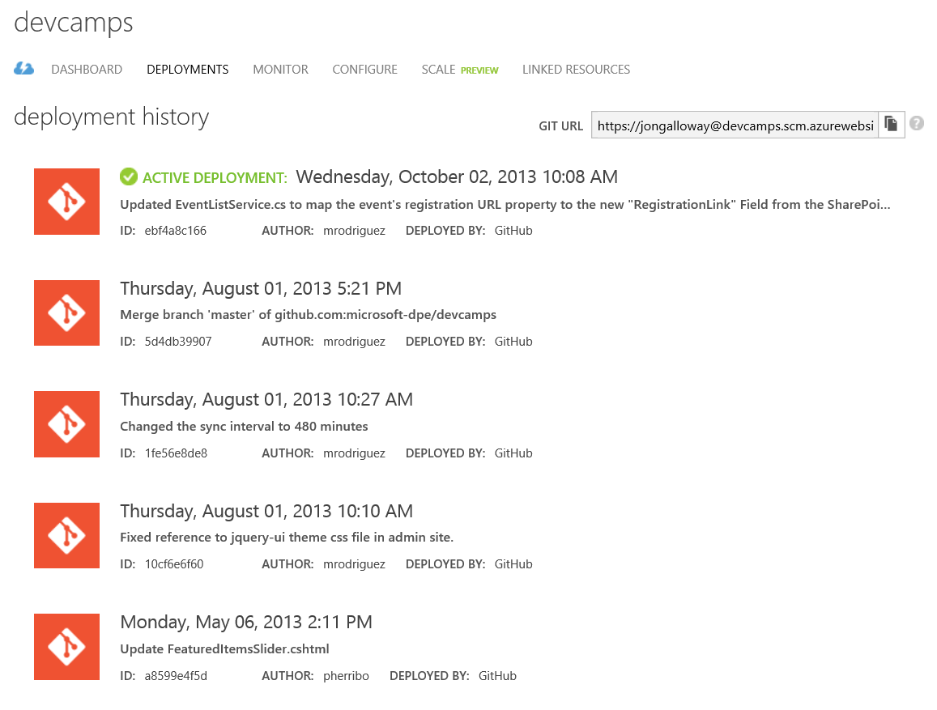

Slide 21
Step 3: Leverage services
PROBLEM:
Large changes often require you to add new features quickly.

Slide 22
Step 3: Leverage services
SOLUTION:
Take advantage of available Windows Azure services.

Slide 23
Scenario description
Running a real site requires multiple internal environments.
Global availability requires multiple worldwide deployments.

Slide 24
Step 1: Dev / Test environments
PROBLEM:
Setting up development web server environments is time consuming.
You need to see your code running somewhere other than deployment before deploying.

Slide 25
Step 1: Dev / Test environments
SOLUTION:
Environment consistency via deployment setup in Windows Azure Web Sites or VM images.
Cost savings by paying only for what you need.

Slide 26
Step 2: Global Reach
PROBLEM:
It’s hard to deploy a consistent environment in multiple datacenters.

Slide 27
Step 2: Global Reach
SOLUTION:
Use automated deployment workflow to ensure consistency in deployment process.

Slide 28
Step 3: Continuous Delivery
PROBLEM:
Bugs and issues in your code get harder to fix the longer it takes to find out about them.
Deployment is a risky, error-prone operation.

Slide 29
Step 3: Continuous Delivery
SOLUTION:
Use continuous integration to automate build, unit & integration testing.
Use automated deployment workflow to ensure consistency in deployment process.

Slide 30
Break

