Slide 1
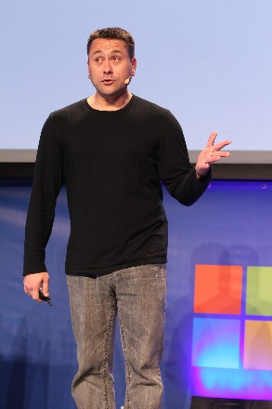
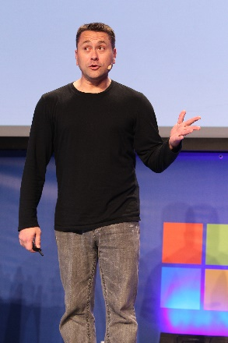

Real-time communications with SignalR
Michael Palermo
Microsoft
mpalermo@microsoft.com
@palermo4
Notes:
Description
We'll start out by explaining the One ASP.NET experience in Visual Studio 2013, showing how to create hybrid web applications. Next, we'll introduce new features for web developers in Visual Studio 2013 and Web Essentials, explaining how Visual Studio is the best editor for HTML, CSS and JavaScript as well as your back end code. We'll also look at some new features across the ASP.NET platform including new Bootstrap templates, the new scaffolding system, and the new membership and identity system.

Slide 2
Agenda
Introduction to the real-time web
ASP.NET SignalR
Building a real-time

Slide 3
Without real-time
Got Data?
Got Data?
Got Data?
Got Data?
Client Browser
Web Server
Here’s some data!
Got Data?
Got Data?
Got Data?
Got Data?
Notes:
This demonstrates the way SignalR works over an HTTP connection using long polling or one of the other pre-Web Socket or pre-Server Sent Events methods.
The web server makes an outbound request to the web server. CLICK
If the web server is ready to return something, it does so. CLICK
Once the server responds, the client begins making the requests again until the server responds. CLICK

Slide 4
With real-time
I do real time, do you?
Client Browser
Web Server
Absolutely!
Let’s Party in Real-time!
Notes:
This demonstrates the way SignalR works over an HTTP connection using Web Sockets or Server Sent Events.
The client makes the request to determine if the server does real-time. CLICK
The server responds to the client to let the client know Web Sockets or SSE are supported. CLICK
The real-time connection is established and used for the lifetime of the conversation. CLICK
If both ends of the connection support one of the later, real-time connection methods, real-time communication is enabled.

Slide 5
Basically…
Client Browser
SignalR!!!
Web Server
Notes:
This demonstrates the way SignalR works over an HTTP connection using Web Sockets or Server Sent Events.
The client makes the request to determine if the server does real-time. CLICK
The server responds to the client to let the client know Web Sockets or SSE are supported. CLICK
The real-time connection is established and used for the lifetime of the conversation. CLICK
If both ends of the connection support one of the later, real-time connection methods, real-time communication is enabled.

Slide 6
Introducing SignalR
Abstraction over transports
Events instead of task/async
Connection management
Broadcast or target specific client

Slide 7
What does SignalR do?
Client to Server persistent connection over HTTP
Easily build multi-user, real-time web applications
Auto-negotiates transport

Slide 8
SignalR Fallback
Long Polling
Forever Frames
Server Sent Events
Web Sockets

Slide 9
What does SignalR do?
Allows server-to-client push and RPC
Built async to scale to 1000’s of connections
Scale out with Service Bus, SQL Server & Redis
Open Source on GitHub

Slide 10

SignalR Backplanes
Load balancing via a common transport mechanism
Backplane
Load Balancer
Notes:
SignalR needs a backplane to scale. In a multi-server or multi-instance environment, communication sent from the client will only land on the server from which the originating call was made. If other users are actively connected to the application, but on different servers, the real-time communication won’t cross the servers. Click to play first animation.
If your application needs to run in a multiple-instance manner, a backplane is necessary. Click to fade in the backplane
Now that the backplane has been added to the architecture, the server or instances nodes can transmit data between the other servers or instances, enabling load-balanced real-time communication. Click to play the animation showing multi-server communication

Slide 11
Demo
07SignalR
/HOL/RealTimeSignalR
Notes:
http://jsbin.com/ijucaq/2/edit

