Slide 1
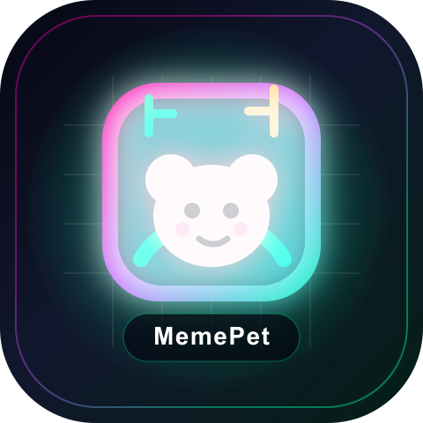
HACKATHON BUIDL
MemePet
Your wallet hatches a living meme-trading companion.
It reacts to BSC trade behavior, remembers your style, celebrates green candles, comforts red ones, and turns wallet activity into a pet you can actually care about.
MOOD
MEME
wallet DNA
live trade pulse
AI agent pet
HYPED
87/100

Slide 2
THE GAP
02 / 06
Meme trading has feelings. Tools do not.
Aha moment
The wallet is not just an address. It is pet DNA.
Most dashboards show charts, balances, and buttons. The user is alone with FOMO, volatility, and regret.
ape in
+32% / -27%
feed / hatch
FOMO is lonely
P/L lacks memory
Retention needs ritual
Trading decisions happen fast, but the product experience is silent until after the damage is done.
A wallet can tell a rich behavioral story, yet most apps treat every session like a cold restart.
Meme culture is emotional and social. A living pet creates habit loops that charts cannot.

Slide 3
VISION
03 / 06
Make on-chain behavior feel alive.
MemePet turns trading signals into emotional state, growth, appetite, personality, and companion behavior.
AGENT
observe
remember
react
grow
Wallet
Pet DNA
Living State
Companion
Trades, wins, losses, token taste
Risk profile, patience, meme affinity
Mood, energy, satiety, level
Cheers, comforts, nudges, evolves

Slide 4
DEMO FLOW
04 / 06
A 90-second story judges can understand instantly.
LIVE TRADE PULSE
+32% GREEN
tail spinning, XP +18
No giant chat box. The pet stays as a small window companion while the trader acts.
01
02
03
04
05
06
Connect
Hatch
Pulse
React
Care
Mint
Wallet connects and becomes pet DNA.
Personality and starter mood appear.
BSC-style trade events hit the cockpit.
Pet celebrates, worries, or comforts.
Feed Market, Hot Today, Market Pulse.
On-chain identity becomes shareable.

Slide 5
AI AGENT
05 / 06
Yes. MemePet is an AI agent, not a chatbot skin.
BUIDL answer
Yes: observes, remembers, reasons, and acts.
It perceives wallet and trade events, keeps memory, reasons over state, and acts through pet behavior and care loops.
Perception
Memory
Reasoning
Action
Reads wallet-connected behavior and live trade pulse events.
Stores pet personality, goals, XP, mood, satiety, and interaction history.
Maps trader behavior into emotional state and companion response.
Changes UI state, gives tiny companion messages, rewards, and care prompts.

Slide 6
WHAT WE SUBMIT
06 / 06
A polished MVP with a credible path to production.
One sentence
A wallet should hatch a companion, not just hold trades.
The current build is demo-ready. The next milestone is live BSC data, wallet persistence, and mintable pet identity.
MVP
build
aha
Ready now
Next hardening
Judge takeaway
Unified hatch-to-cockpit UI, living pet metrics, BSC-style event simulation, care actions, logo, README, demo script, and pitch deck.
Connect real wallet events, persist memory per address, tune state transitions, add guardrails for trading-friendly companionship.
A meme trading companion that makes chain activity emotionally legible. Not a dashboard. Not another oversized chat window.

