Slide 1




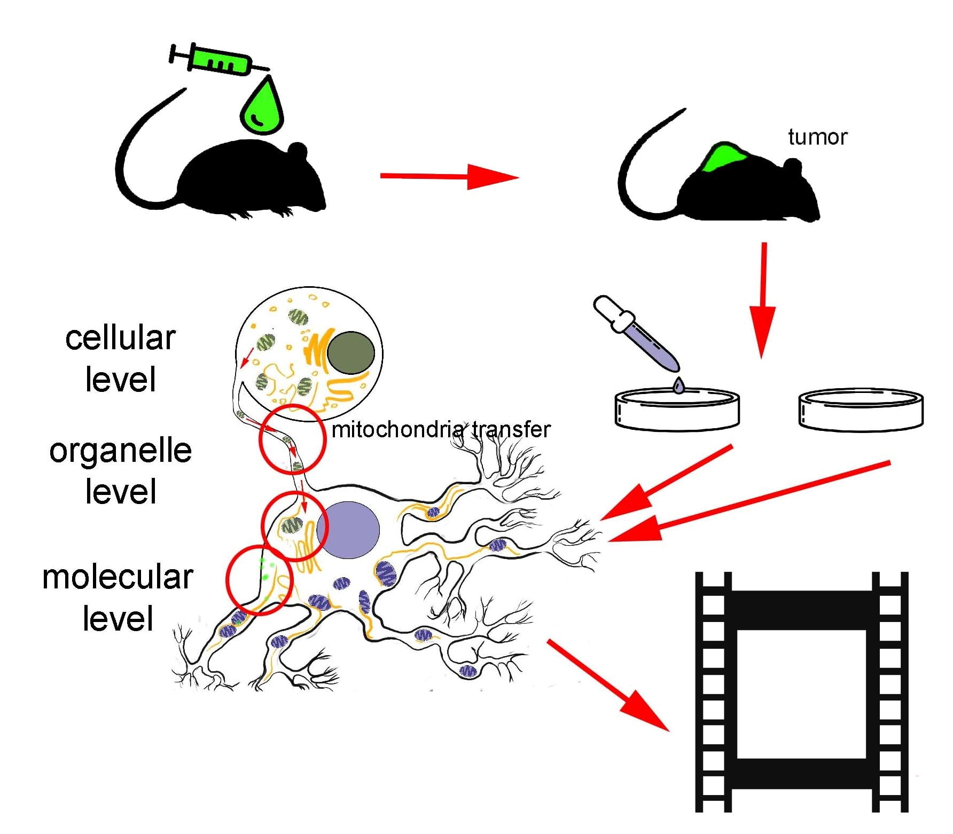
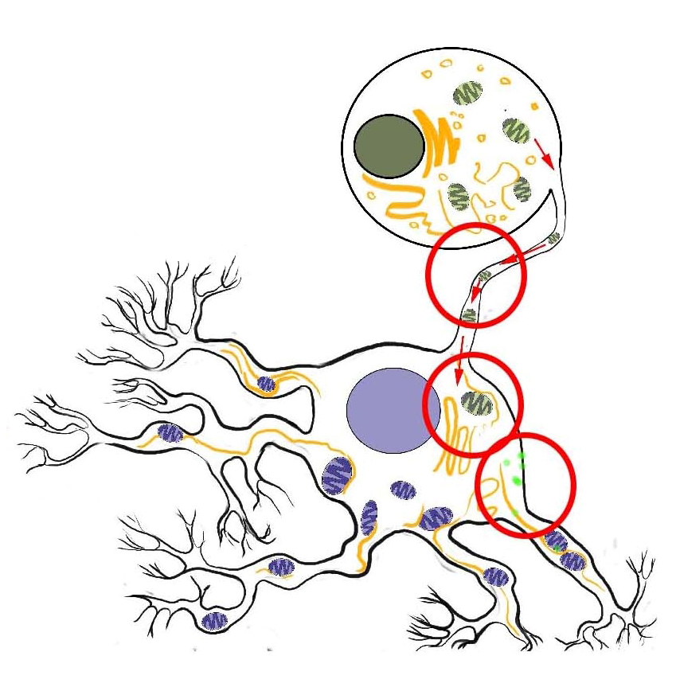
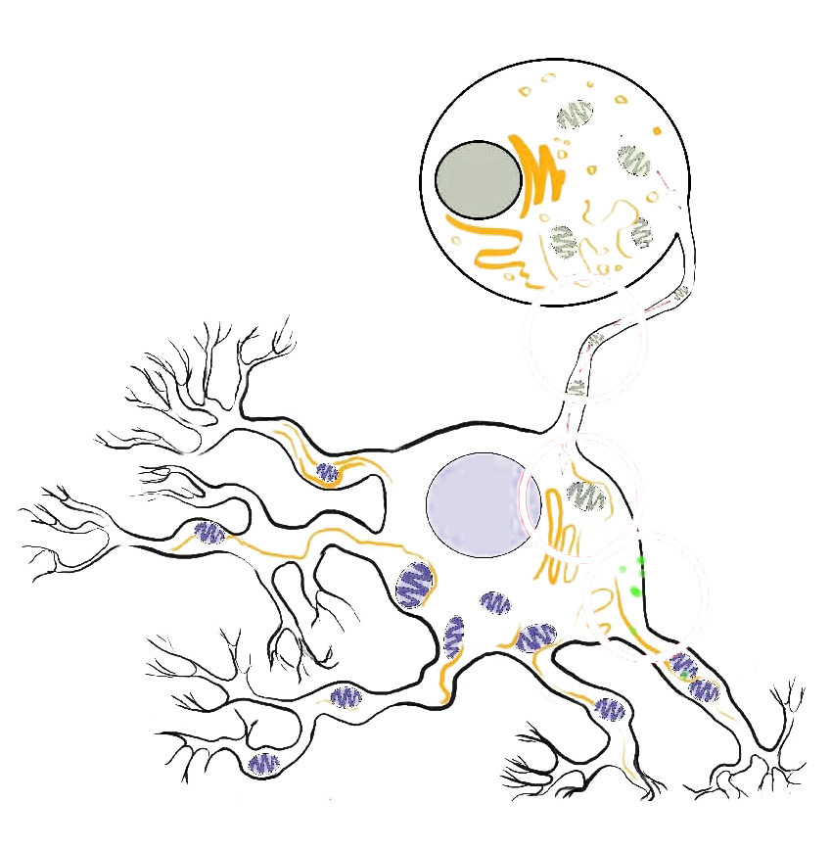

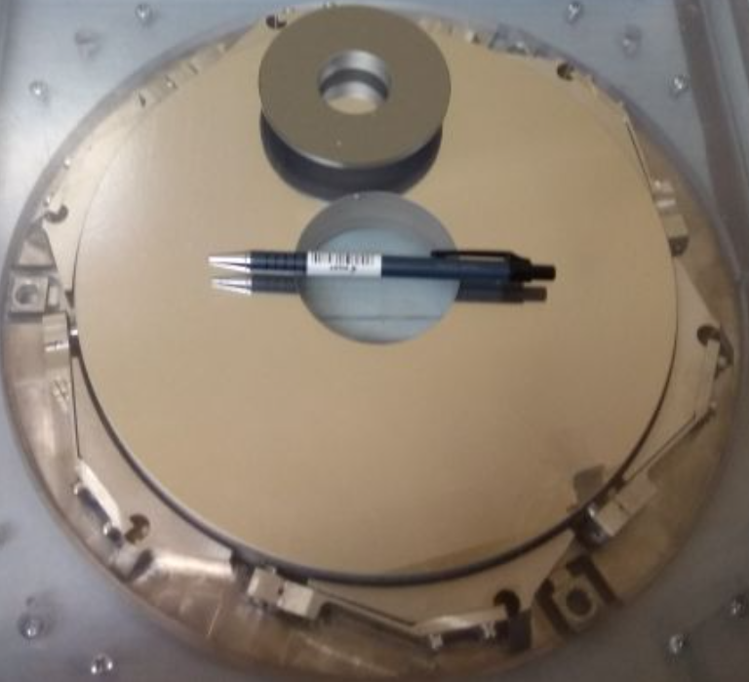






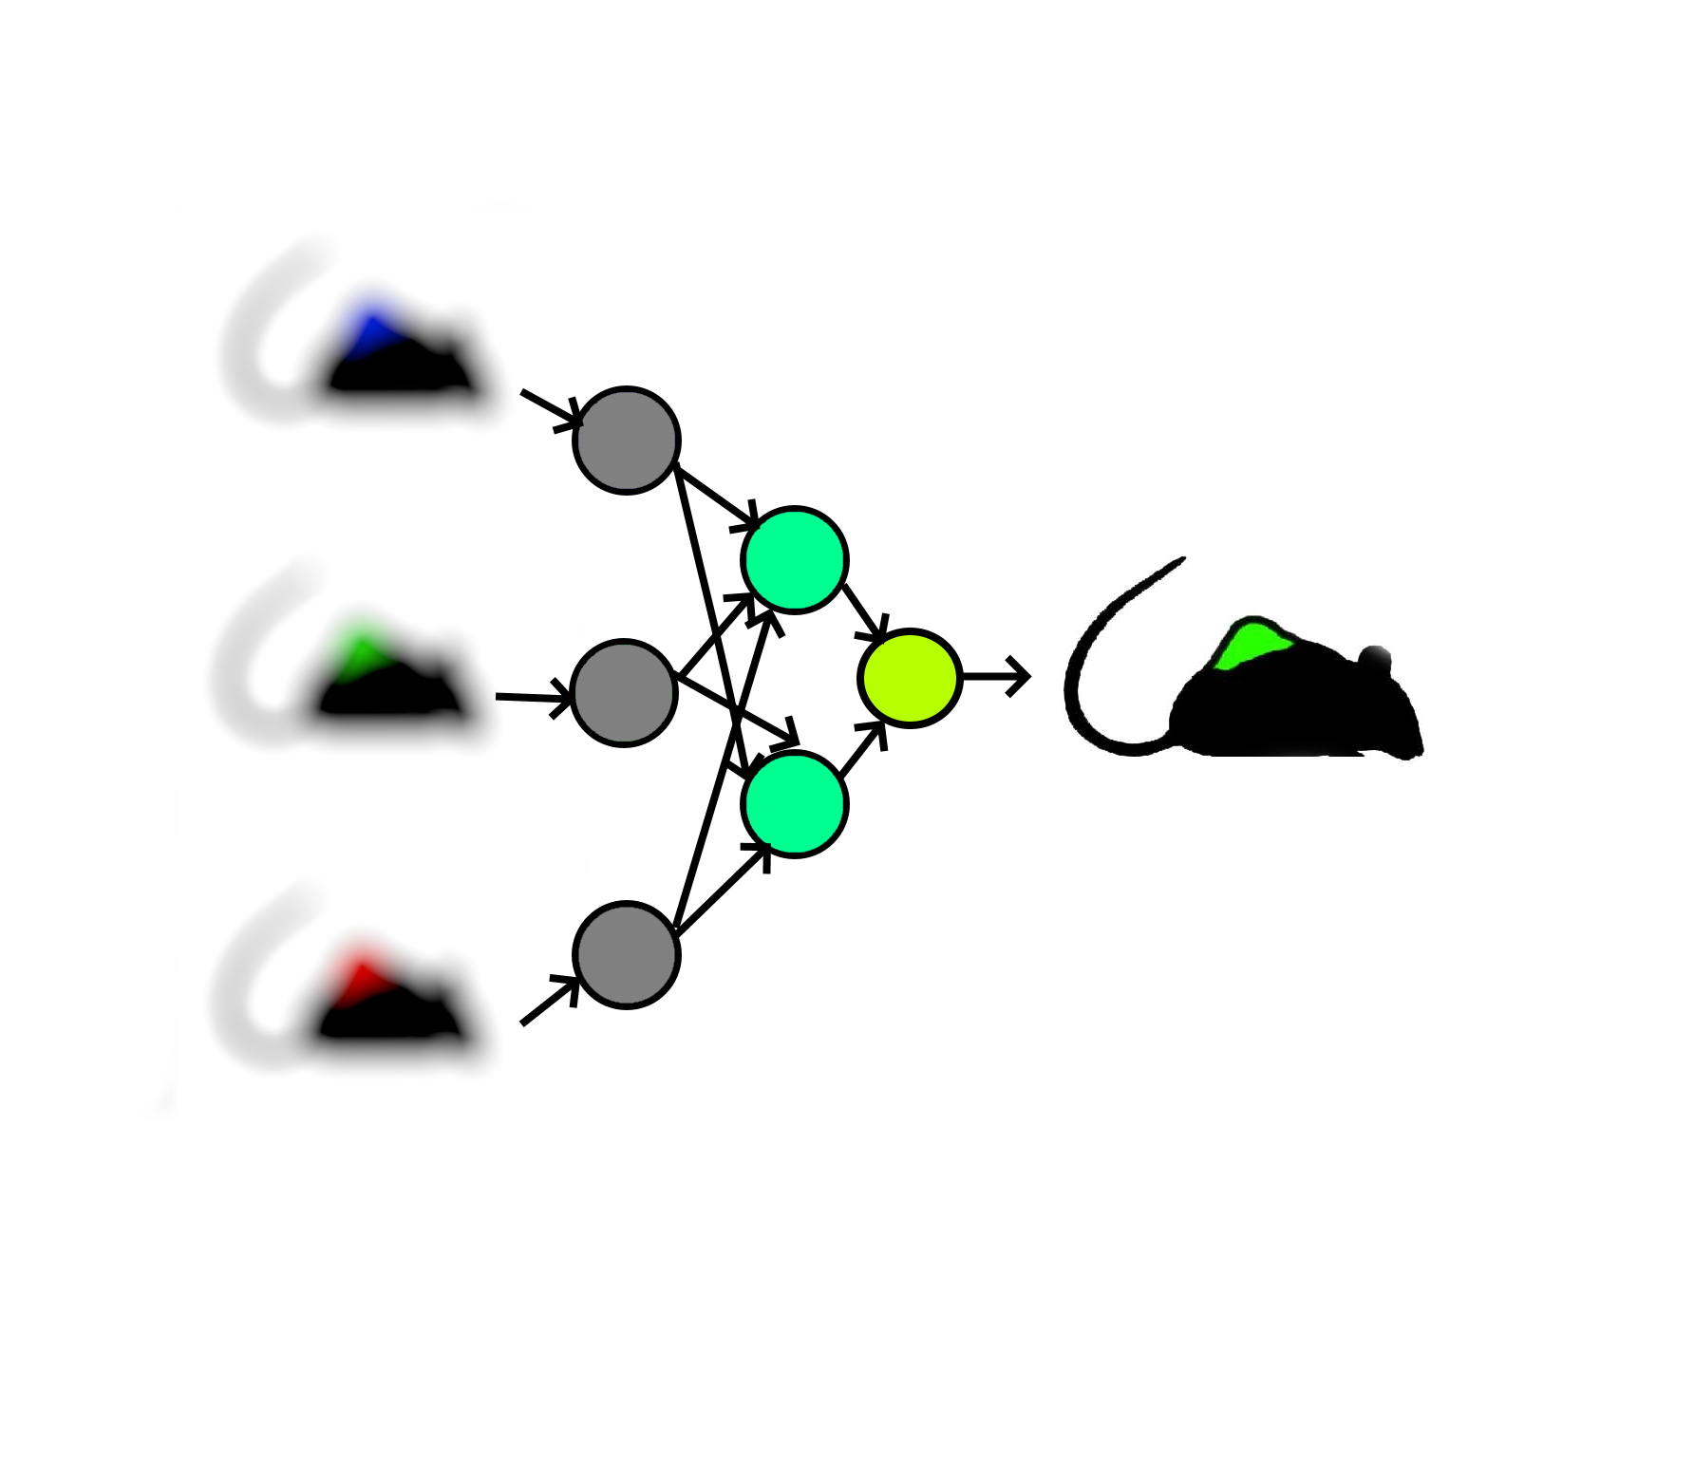
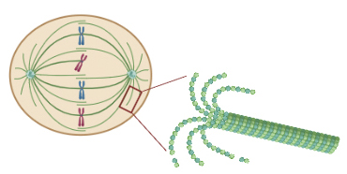
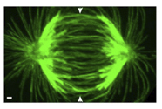
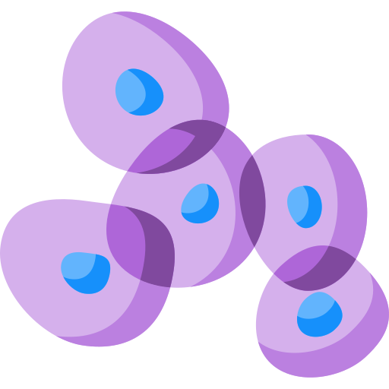





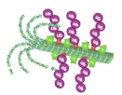





X-Ray Molecular and Cellular Movie
I. A. Venediktova¹, Ya. V. Rakshun¹, Yu. V. Khomyakov¹, S. A. Rylov¹, A. V. Pindyurin², A. A. Ogienko², I. V. Malyshev³, N. I. Chkhalo³, O. M. Shirokova⁴, I. V. Mukhina⁴, V. I. Shcheslavskiy⁴, A. A. Neustroeva⁵
¹Federal Research Center for Information and Computational Technologies, Novosibirsk 630090, Russian Federation; ²Institute of Molecular and Cellular Biology SB RAS, Novosibirsk 630090, Russian Federation; ³Institute for Physics of Microstructures – Branch of Federal Research Center Institute of Applied Physics RAS, Nizhny Novgorod 603087, Russian Federation; ⁴Federal State Budgetary Educational Institution of Higher Education “Privolzhsky Research Medical University” of the Ministry of Health of the Russian Federation, Nizhny Novgorod 603005, Russian Federation; ⁵Specialized Educational Scientific Center on Physics, Mathematics, Chemistry and Biology of Novosibirsk State University, Novosibirsk 630090, Russian Federation
INTRODUCTION
The significance of direct observation of molecular-cell processes in vivo at the ultrastructural level leads to development of a new approach to biological research using Synchrotron Radiation (SR). This new approach lies in the combination of new possibilities of ultra-low emittance SR sources (SKIF), X-ray optics and AI technologies.
tumor
mitochondria transfer
cellular level
organelle level
Molecular-cell processes to be observed
molecular level
TECHNOLOGICAL OPPORTUNITIES
High SR coherence
— SKIF “Nanoscope” — MAX IV “SoftiMAX” — DIAMOND “I06: Nanoscience”
High photon flux
Coherent fraction (CF)
D = 250 mm
High-reflectance multilayer mirrors
Big data analysis provided by Center for Scientific IT Services (FRC ICT¹)
Energy, eV
X-ray multilayer mirror with record reflectivity: R(λ = 3.37 nm) = 8-10%
R(λ = 13.88 nm) = 65-69%
Coherent radiation fraction in the spectra of the APPLE-II undulator at the stations from the SKIF, MAX IV and DIAMOND sources
10¹⁶
10¹⁵
10¹⁴
10¹³
10¹²
10¹¹
10¹⁰
10⁹
10⁸
Flux density, ph/s/mm²/0.1%
— SKIF “Nanoscope” — MAX IV “SoftiMAX” — DIAMOND “I06: Nanoscience”
Energy, eV
Comparison of the photon flux from the SKIF, MAX IV and DIAMOND APPLE-II undulators (for a distance of 25 m from the source)
NEW APPROACH
ISSUES TO RESOLVE
The proposed instrumental features enable the development of a new approach to in vivo biological research based on statistical and dynamical data. Key features of the new approach:
Image enhancement with machine learning
Sample preparation and sample environment
Observation of cell and cell components functionality
microtubule composed of α- and β-tubulin
Live cell without labeling
GFP
Combining data obtained by various tools using machine learning
dividing cell with microtubules
auxin-inducible degron (AID) system
High lateral (few nm) and temporal (down to μs) resolution
1. Adding “tags” to tubulin in a living cell
Image enhancement
proteasome
+ auxin
Analysis, impact from employing AI
microtubule with tags
microtubule with ubiquitin labels
tubulin disruption
dividing cell without microtubules
2. Auxin-dependent disruption of tubulin in a living cell
Virtual symposium: X-ray imaging in life sciences 26 August 2021

