Slide 1





MECHANISM
DETAILED
DESCRIPTION
MEMBERS
ILLUSTRATION
FUNCTION

Slide 2



ILLUSTRATION

Slide 3
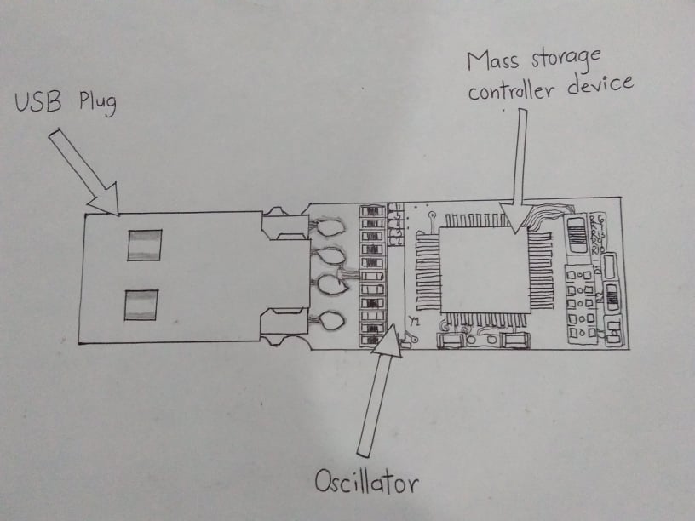
DRAWING

Slide 4
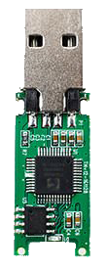
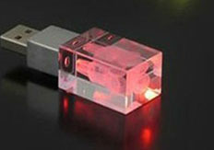
LABELED PARTS
USB PLUG
CRYSTAL OSCILLATOR
MASS STORAGE
CONTROLLER DEVICE
LED

Slide 5
USB PLUG
PARTS EXPLANATION
The small silver extension
that extends from the main
USB device
Commonly known as
memory chip
A black chip placed on
the main circuit board of
the USB drive
Serves as memory of
Information
Contains different
amounts of memory
depending on the device
and its memory
capacity
CRYSTAL OSCILLATOR
MASS STORAGE
CONTROLLER DEVICE
A small component on the flash
drive’s circuit board that sends a
frequency signal
Controls the output provided by
the flash drive
Note: Modern USB connectors come
with a switch that pulls the
connector into the main
compartment to prevent
damage.
Light components that indicate processing or connection from the user. A green LED is used to mean ready and a red LED indicates an issue from the connection
LED

Slide 6
BRIEF DESCRIPTION
A USB flash drive is a data storage device that includes flash memory with an integrated USB interface. It is typically removable, rewritable and much smaller than an optical disc. Weighing at an average of less than 30g, USB flash drives are often used for storage, data back-up and transferring of computer files.
Compared to floppy disks or CDs, they are smaller, faster, have significantly more capacity, and are more durable due to a lack of moving parts. The standard storage capacity of flash drives range between 32-128 Gigabytes(GB), although, the more high end products boast a storage capacity greater that most computers, reaching well over 1-2 Terabytes(TB).
Additionally, they are immune to electromagnetic interference, and are unharmed by surface scratches.

Slide 7



FUNCTION

Slide 8
FUNCTIONS
USB flash drives are often used for storage, data back-up and transferring of
Computer files.
Compared with floppy disks or CDs, they are smaller, faster, have significantly
More capacity, and are more durable due to a lack of moving parts.
USB flash drives hold a variety of amounts of data, such as 2GB or more.
USB flash drives can store important files and data backup, carry favorite
settings or applications, run diagnostics to troubleshoot the computer.

Slide 9
STEPS ON HOW TO USE A FLASH DRIVE
PLUG THE DRIVE IN ANY AVAILABLE USB PORT
- wait a few moments while the computer automatically sets the drive up to be accessed
2. WAIT FOR THE DRIVE TO APPEAR
-once the drive is successfully installed, it will appear on your desktop
3. COPY AND PASTE/CLICK AND DRAG FILES AND FOLDER ONTO THE DRIVE
-once the transfer process is complete, you can remove the drive from the computer/eject
it from the computer

Slide 10

MEMBERS
Canonigo, Aljae
Embradora, Ardreav
Engbino, Kaye
Leron, Leonardo Gwen
Sanchez, Dexmart

