Slide 1
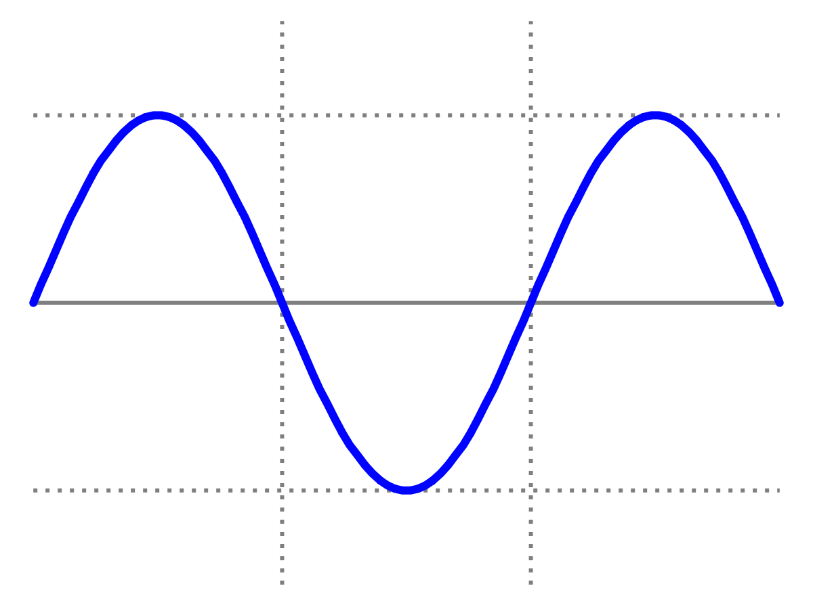
Introduction to Quantum Physics
(F3241)
Dr Lily Asquith
Week 4

Slide 2
This week & Next week
Tomorrow 3pm we have our first
problem solving session
Tomorrow 4pm office hour with Lily
(optional).
Next Monday we will have my lecture on the Compton effect and x-rays
Next Tuesday you choose! (poll tomorrow)
Attendance: can you sign in with “the app”?

Slide 3
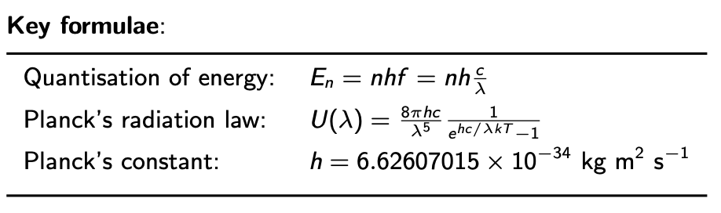
Recap: Planck

Slide 4
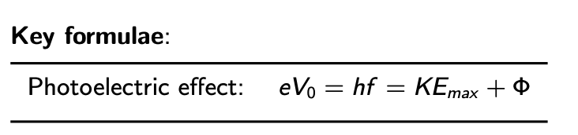
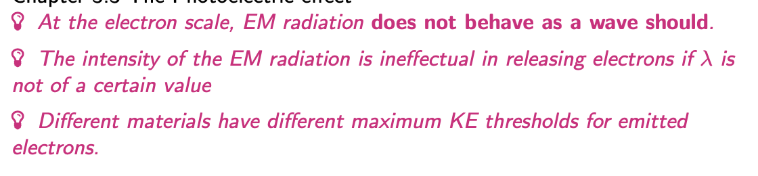
4 The photoelectric effect

Slide 5
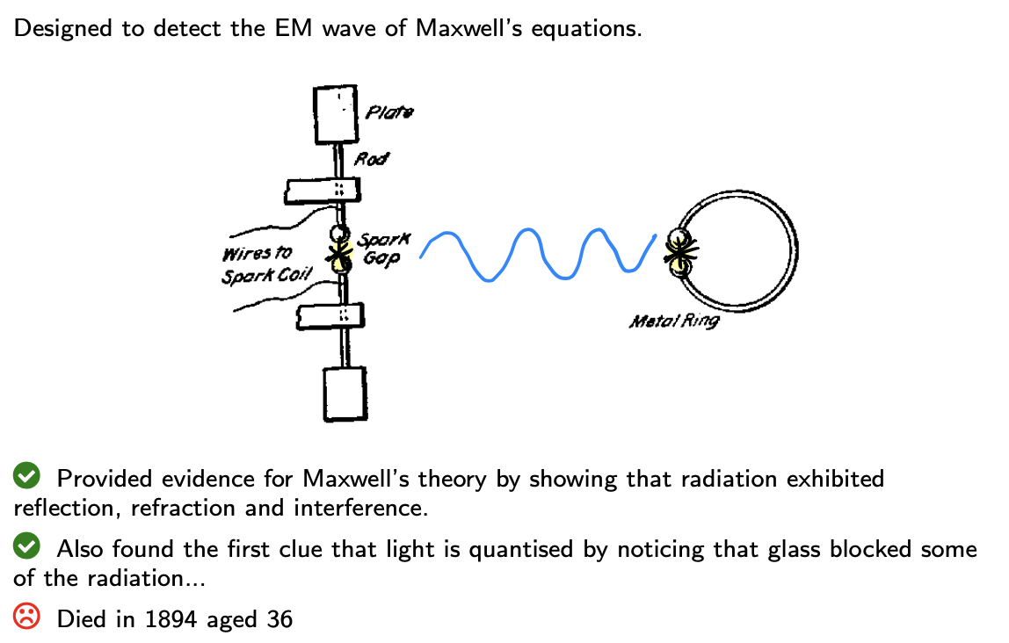
4.1 Hertz’ radio 1887

Slide 6
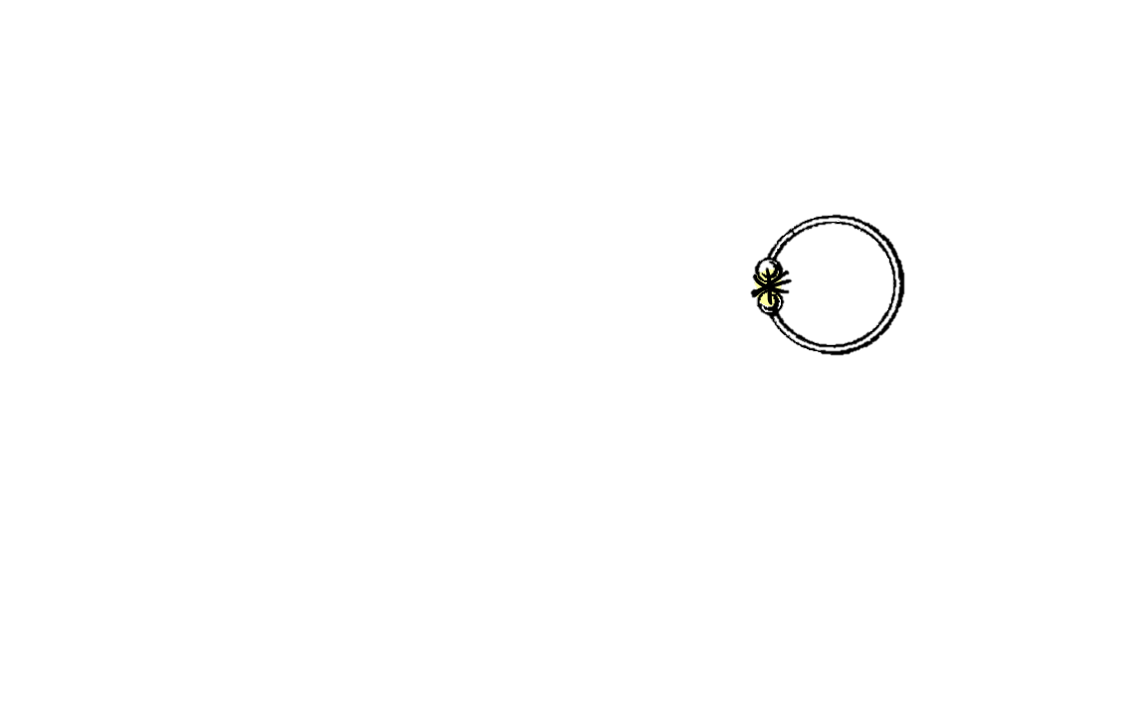
4.1 Hertz’ radio 1887

Slide 7
4.1 Hertz’ radio 1887

Slide 8
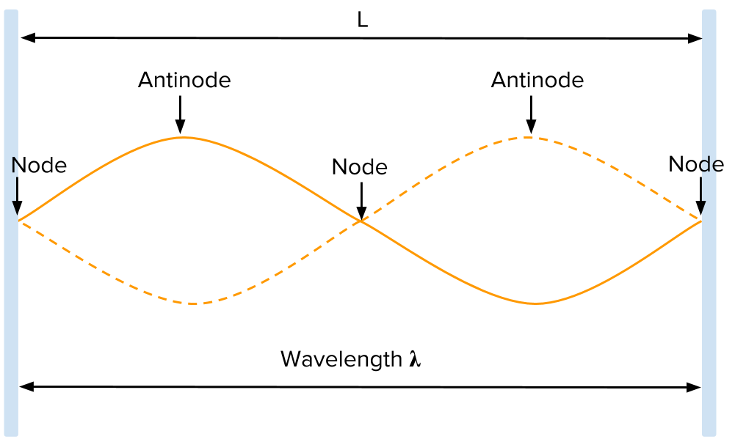
4.1 Hertz’ radio 1887

Slide 9
4.1 Hertz’ radio 1887

Slide 10
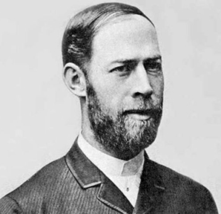
4.1 Hertz’ radio 1887

Slide 11
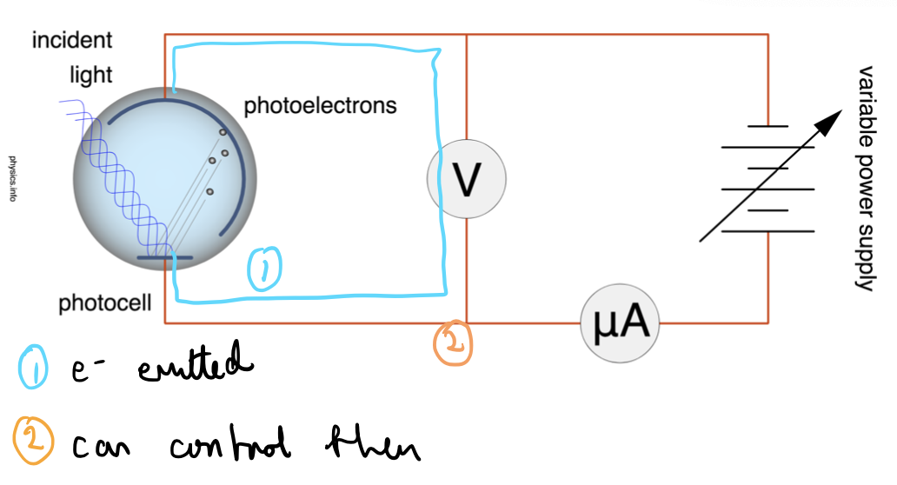
4.2 Lenard experiment (after Hertz)

Slide 12
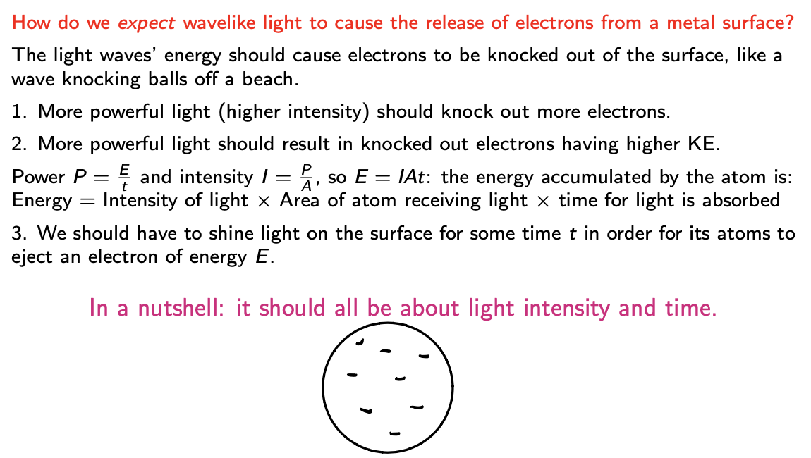
4.2 What do we expect?

Slide 13
4.2 What do we observe?
We can measure the number of electrons emitted from the
photocell by the charge deposited on the detector.
Increasing the intensity of the light did indeed result in more
electrons emitted.

Slide 14
4.2 What do we observe?
If we increase the voltage, forcing electrons in the opposite direction, we can measure the stopping potential required to get zero electrons reaching the detector.
KE_{max} = eV₀
Increasing the intensity of the light did NOT result in any change in the KE_{max} of emitted electrons…

Slide 15
4.2 What do we observe?
There appeared to be no time lag between turning on the light source and detecting the electrons…

Slide 16
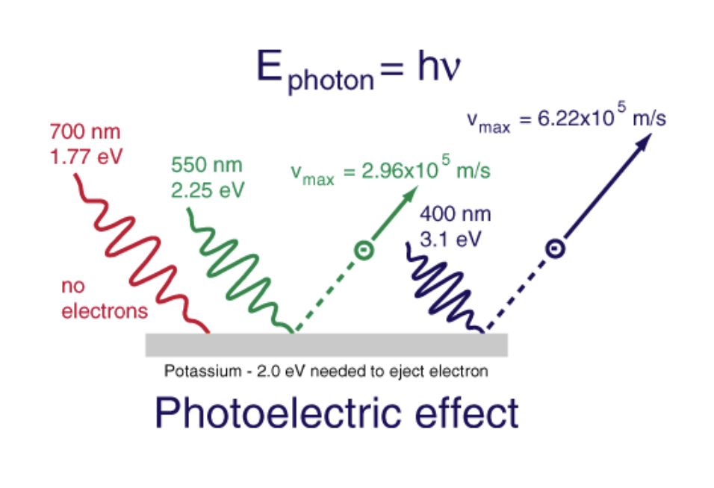
4.2 What else do we observe?
Perhaps most fascinating of all: if the light source were altered in terms of frequency all sorts of unexpected things were observed…
If we lower the frequency far enough, we get no electrons emitted. Call this the cut-off frequency (or cut-off wavelength).
AND
If we change the photocell material, we find a different cut-off frequency.
KE_{max} = eV₀
AND
If we vary the frequency above this cut-off or threshold, then
the KE_{max} = eV₀ also varies.
Incident light frequency

Slide 17
4.2 Lenard experiment (after Hertz)

Slide 18
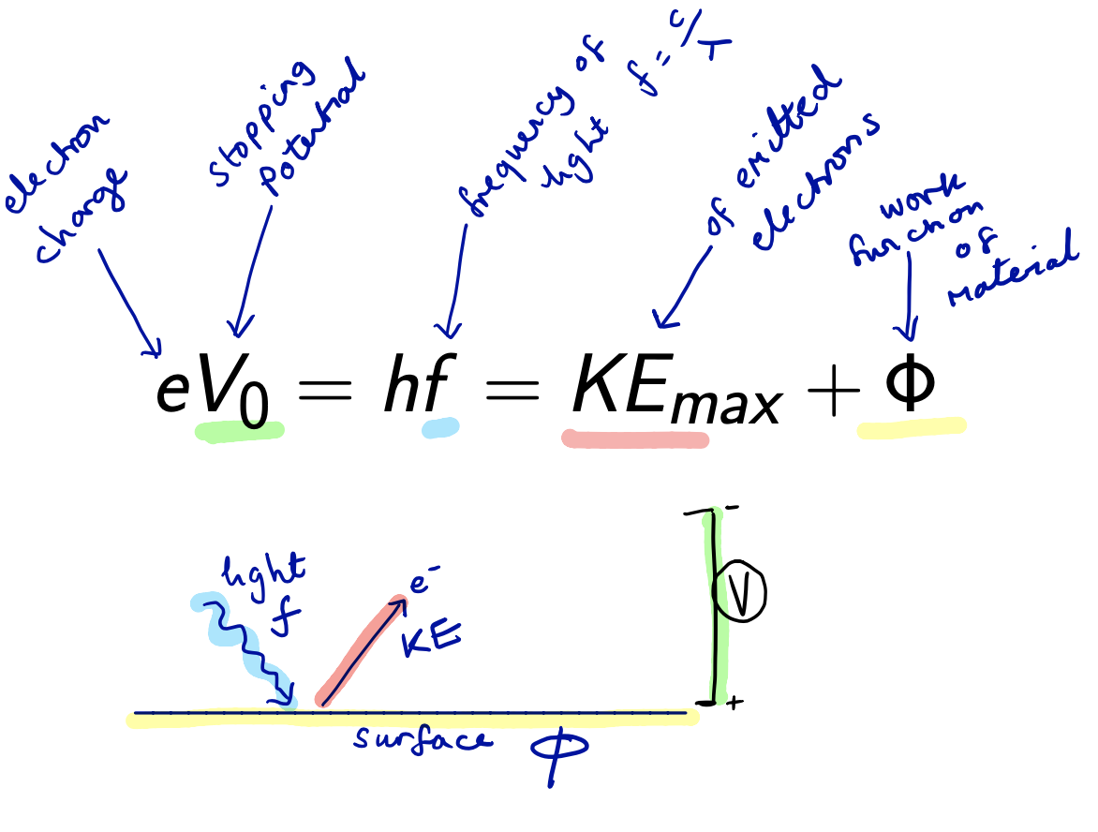
4.3 The Formula

Slide 19
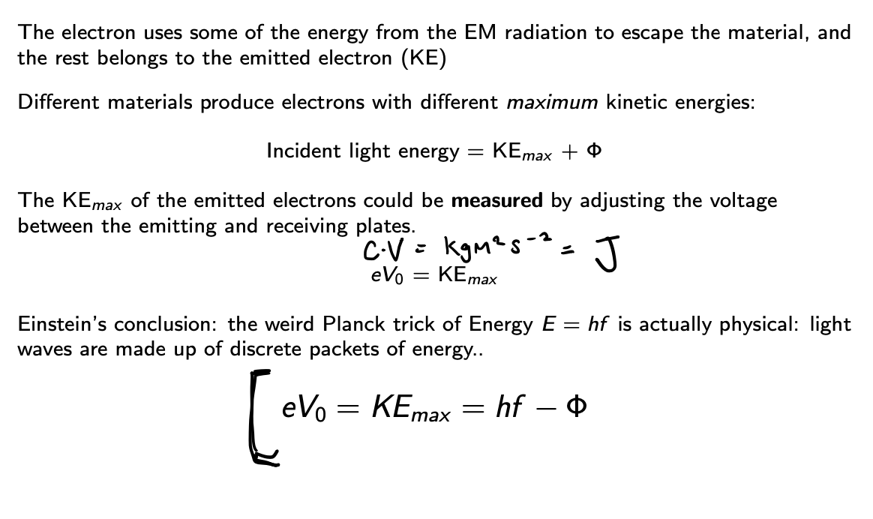
4.3 What does it all mean?

Slide 20
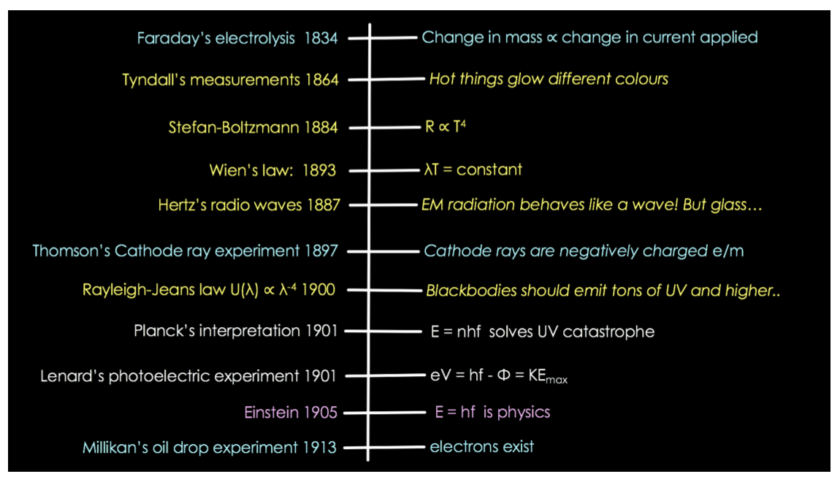
4.4 How it all fits together so far

