Slide 1
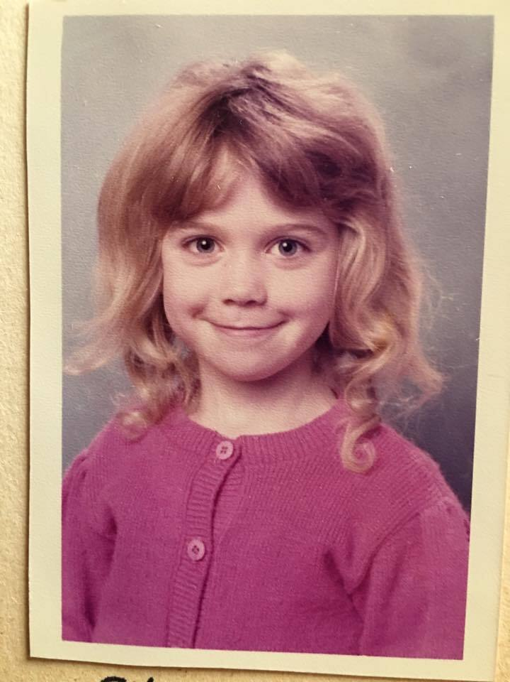
Who am I?
Experimental Particle Physicist:
Diploma in Physics and Maths Birkbeck College 1999-2001
Undergraduate UCL 2001 -2005 (MSci Physics)
PhD from UCL 2005 - 2009 (Higgs search, ATLAS)
LHCSound 2009-2010 (Sonification of ATLAS data)
Argonne National Laboratory 2010 – 2014 (Higgs and QCD, ATLAS)
Royal Society Fellowship 2014-2019 (Higgs, QCD, top physics, Monte Carlo techniques, ATLAS)
Secondment to Foreign & Commonwealth Office 2018 (Illegal Wildlife Trade)
Senior Lecturer at Sussex 2019 - present (Neutrino oscillations, Machine Learning, NOvA & DUNE)

Slide 2
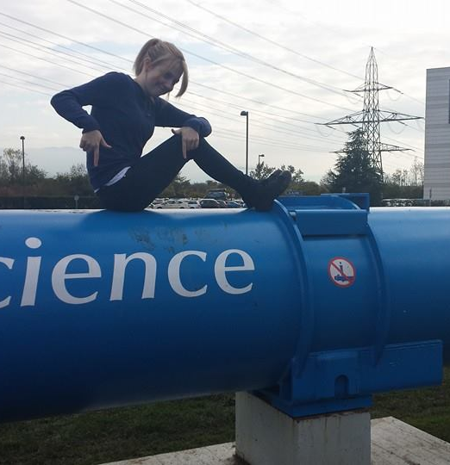
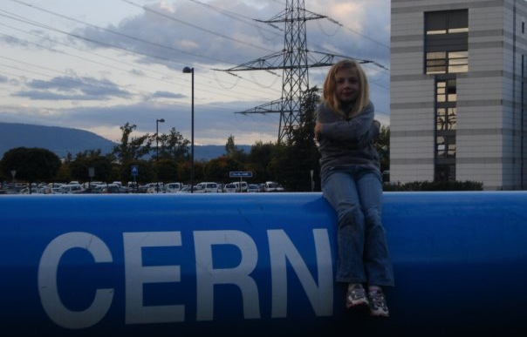
Who am I?
Lecturer & Advisor:
Mechanics & Relativity 2017-present (was classical mechanics)
Intro to Quantum Physics 2019-present (was modern physics)
Four PhD students (ATLAS Higgs, QCD; NOvA ML)
Person:
Born in 1978, grew up in South London
Probably not neurotypical
Mother since 19, J is now 22

Slide 3
What do I want from you?
Come to lectures (in person or on zoom)
Submit your weekly homework
Do the 'pre-lecture' quizzes
Go to your weekly workshop

Slide 4

What do you want from me?
pollev.com/ilovephysics

Slide 5
What are the pre-lecture quizzes?
There is a quiz attached to every lecture – 33 in total.
They are adaptive: the more you understand, the less time they will take to complete.
They direct you to the right sub-sections of the eTextbook to read.
You have unlimited attempts at these quizzes.
These little quizzes will make up 10% of your mark for this module.
If you are having any issues at all with canvas and cannot access the assignments, tell me now (or at the end of lecture)

Slide 6
What about the lectures?
I will live broadcast all lectures on zoom, password: physics
These will be recorded, and available on canvas.
I will also record a local copy.
Skeleton slides should appear Monday.
Completed slides will be on canvas after lecture.

Slide 7
What is the weekly workshop?
You have all been assigned to small groups and have one timetabled workshop per week, starting next week.
You will have both MM1 and M&R questions to do in the workshops.
You should attempt the questions before the workshop so you know what you want to ask / check.
Your attempts to solve one question from each of MM1 and M&R should be photographed ad uploaded to canvas by Friday at midday (12:00).
These uploads will make up 10% of your mark for this module.

Slide 8
Workshop/ homework submission example
This week in M&R we will have three lectures on kinematics.
Look at the kinematics workshop questions this week.
Have a go at them during this week, or at the end of this week.
Take any problems you have to the workshop next week.
Take a photo of your solution and upload it to canvas.

Slide 9
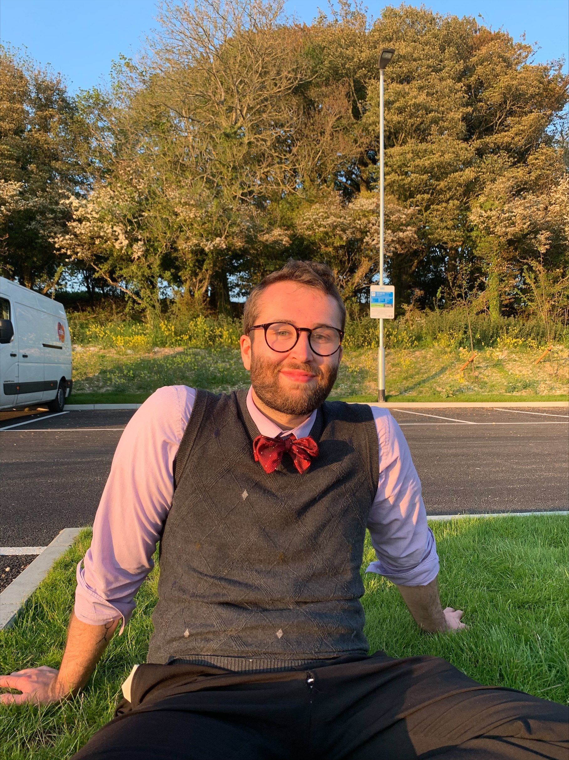
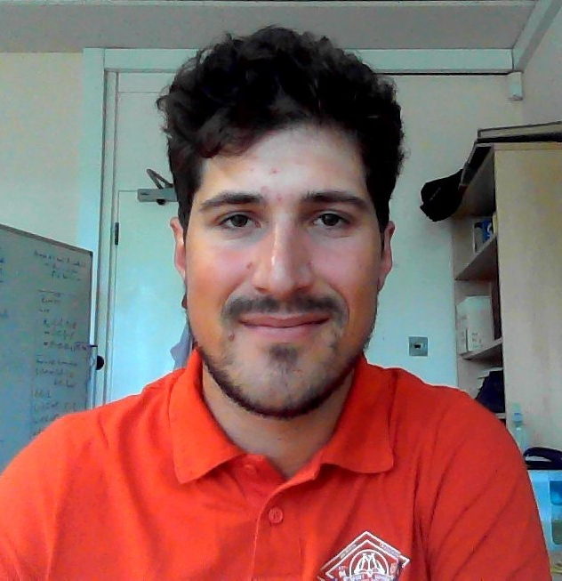
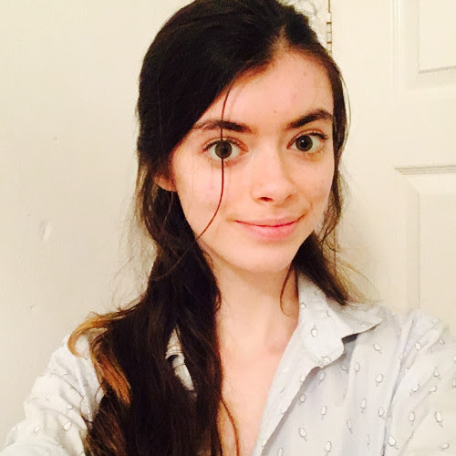
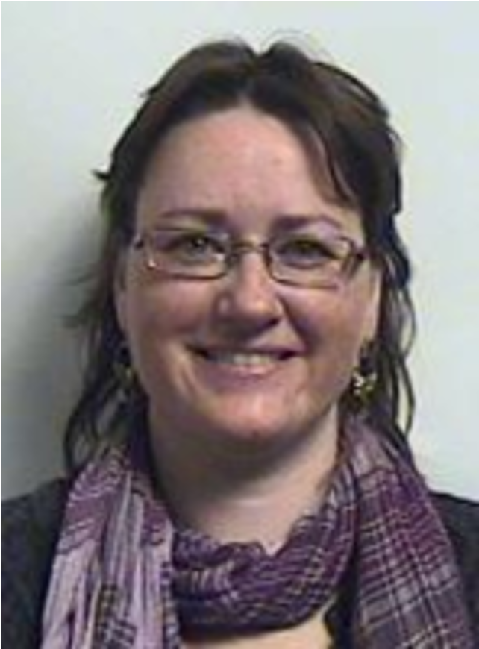
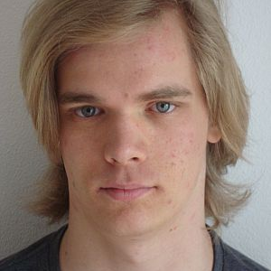
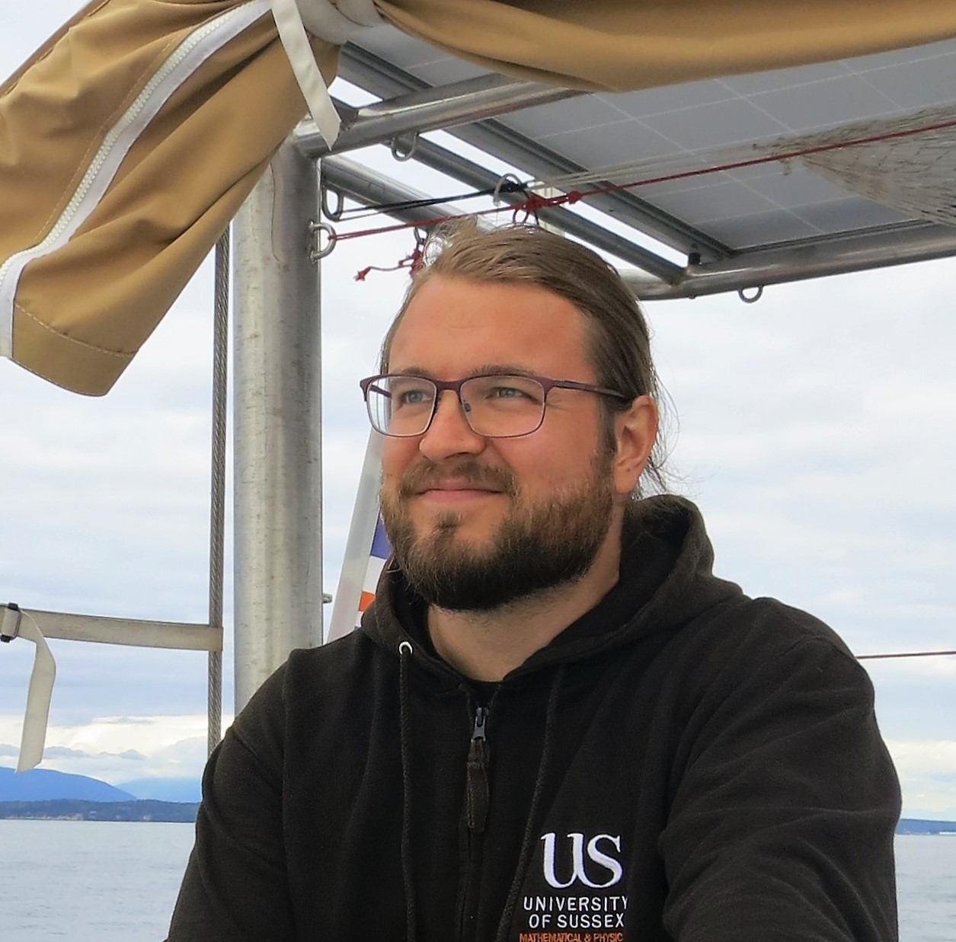
Rob Clemenson
Nicolo Tuccori
Zoe Earnshaw
Timo Schwandt
Doctoral Tutors
Rachel Kerr
Jussi Kuusisto

Slide 10
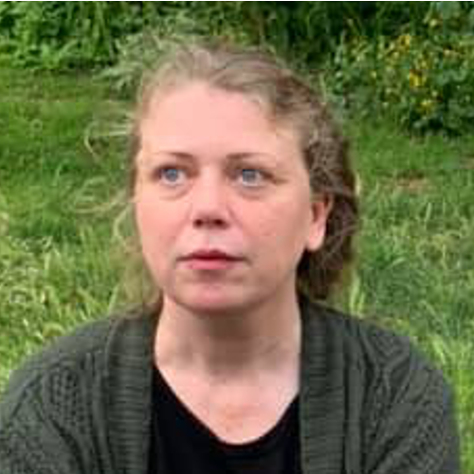
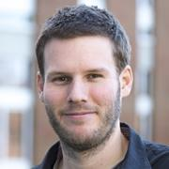
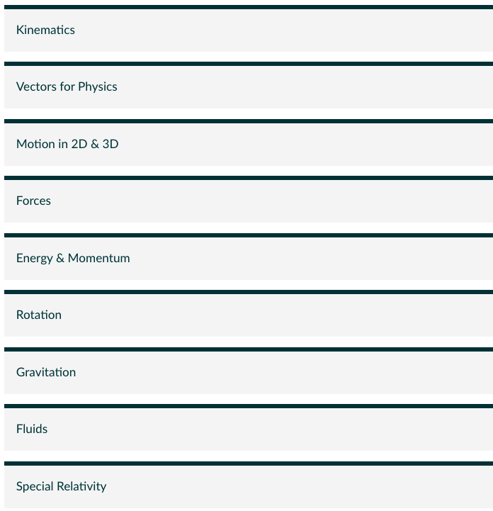
What will you learn here?

Slide 11
Attendance & Punctuality
The attendance app is open for 20 mins.
Wednesday 9 am lectures are sure to be a challenge for us all.
I do my best work in the morning, but I am old.
You may have noticed the buses are often full between 8 and 9.
Just do your best to get it in. Uni rules are that you should attend in person if you can.
If you arrive late, its fine to just sit down.

