Slide 1

Who am I?
Experimental Particle Physicist:
Diploma in Physics and Maths Birkbeck College 1999-2001
Undergraduate UCL 2001 -2005 (MSci Physics)
PhD from UCL 2005 - 2009 (Higgs search, ATLAS)
LHCSound 2009-2010 (Sonification of ATLAS data)
Argonne National Laboratory 2010 – 2014 (Higgs and QCD, ATLAS)
Royal Society Fellowship 2014-2019 (Higgs, QCD, top physics, Monte Carlo techniques, ATLAS)
Secondment to Foreign & Commonwealth Office 2018 (Illegal Wildlife Trade)
Senior Lecturer at Sussex 2019 - present (Neutrino oscillations, Machine Learning, NOvA & DUNE)

Slide 2
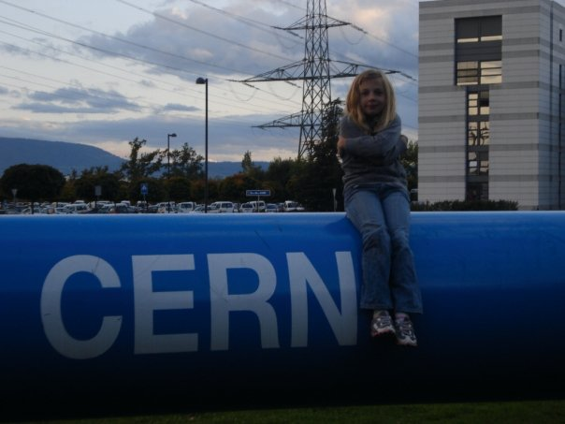
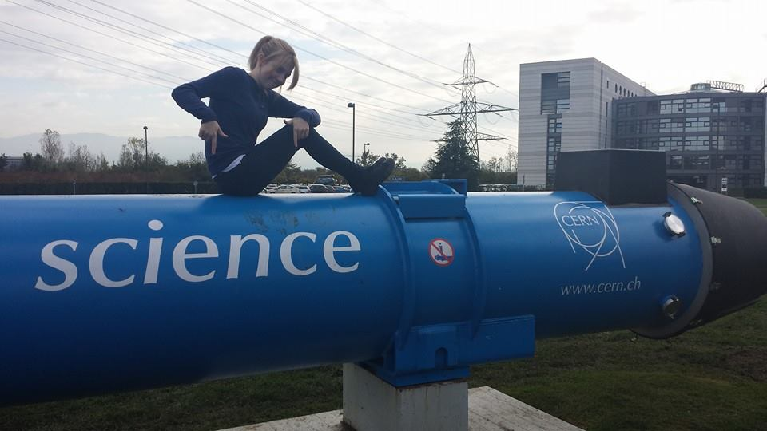
Who am I?
Lecturer & Advisor:
Mechanics & Relativity 2017-present (was classical mechanics)
Intro to Quantum Physics 2019-present (was modern physics)
Four PhD students (ATLAS Higgs, QCD; NOvA ML)
Person:
Born in 1978, grew up in South London
Probably not neurotypical
Mother since 19, J is now 22

Slide 3
What do I want from you?
Come to lectures (in person or on zoom)
1
Ask questions
2
Work hard
3

Slide 4
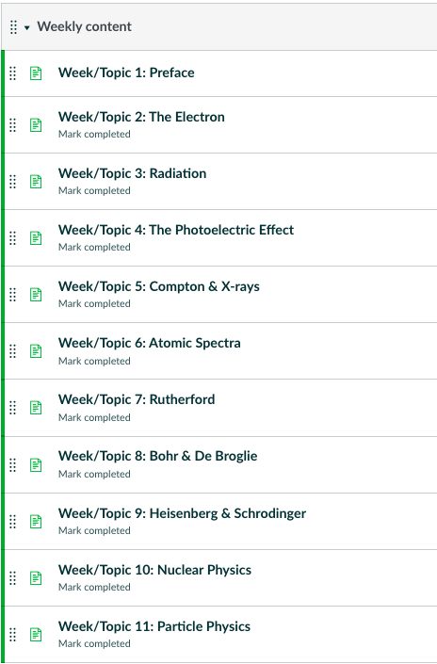
What will you learn here?

Slide 5

What do you want from me?
pollev.com/ilovephysics

