Slide 1
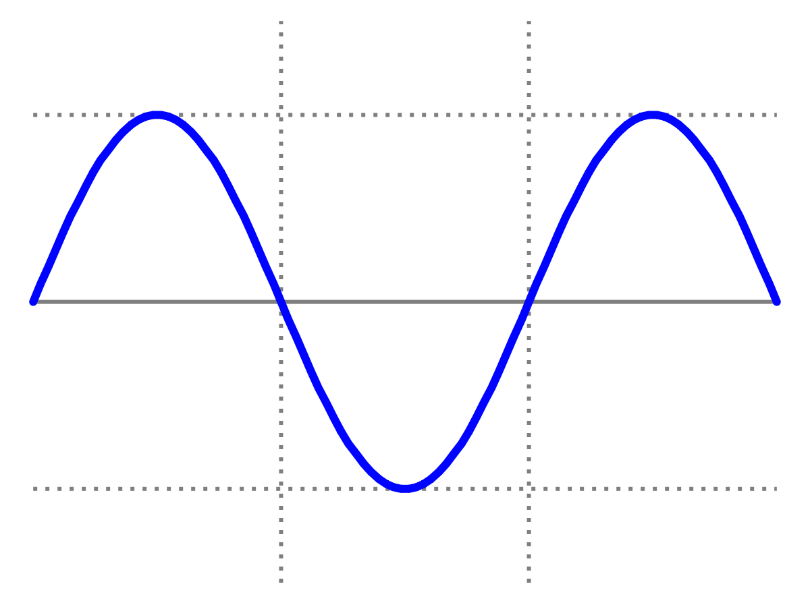
Special Class: COLLISIONS
Dr Lily Asquith
Week 6

Slide 2
Momentum
F = ma
KE = ½ mv²
E² = m²c⁴ +p²c²
E = hf = hc/𝝺
pollev.com/ilovephysics

Slide 3
Elastic and Inelastic collisions
pollev.com/ilovephysics

Slide 4
Kinetic Energy is only conserved in elastic collisions
m₁
m₂
( SILENT BOING )
m₁
m₂
The bodies within our closed system must remain intact.

Slide 5
Momentum is conserved in all collisions
m₁
m₁
m₂

Slide 6
Closed Systems
Here is a collision in a closed system:
m₁
m₂
Did this collision make a noise?
pollev.com/ilovephysics

Slide 7
Photoelectric effect
Is momentum conserved in the photoelectric experiment?
pollev.com/ilovephysics

Slide 8
Compton Scattering
A photon with wavelength 300 pm undergoes Compton scattering off a stationary, free electron. The photon scatters at = 90º from its initial direction.
What is the electron’s kinetic energy?
Suggested steps:
What is the energy of the initial photon?
What is the wavelength shift between the incoming and outgoing photon?
What is the energy of the outgoing photon?
What is the electron’s kinetic energy after the scattering?
pollev.com/ilovephysics

Slide 9
Compton Scattering
A photon with wavelength 300 pm undergoes Compton scattering off a stationary, free electron. The photon scatters at = 90º from its initial direction.
What is the energy of the initial photon?
What is the wavelength shift between the incoming and outgoing photon?
What is the energy of the outgoing photon?
What is the electron’s kinetic energy after the scattering?
pollev.com/ilovephysics

