Slide 1
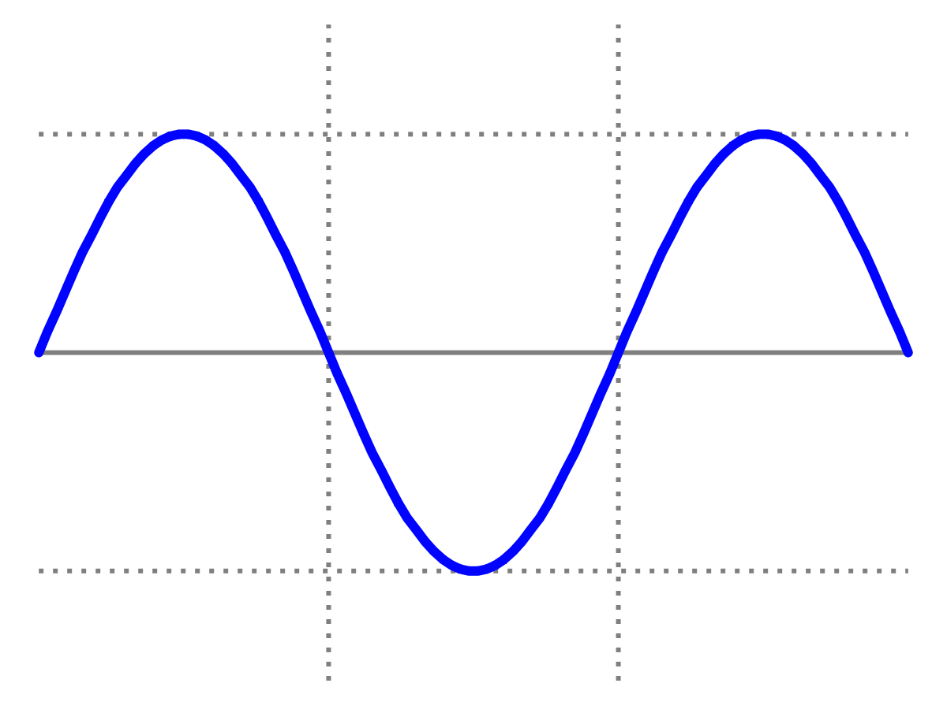
Introduction to Quantum Physics
(F3241)
Dr Lily Asquith
Week 6

Slide 2
This week & Next week
Tomorrow 3pm Special class on collisions
Tomorrow 4pm office hour with Lily
(optional).
Next Monday we will have my lecture on Rutherford scattering
Next Tuesday Matthias Keller: atoms and molecules
Attendance: can you sign in with “the app”?

Slide 3
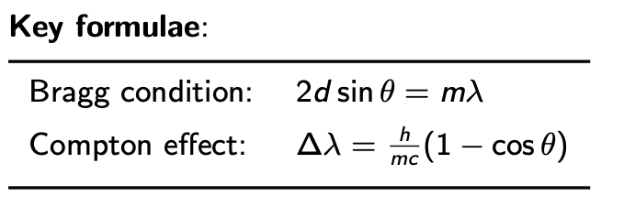

Recap: x-rays and the Compton effect

Slide 4
Recap: x-rays and the Compton effect

Slide 5
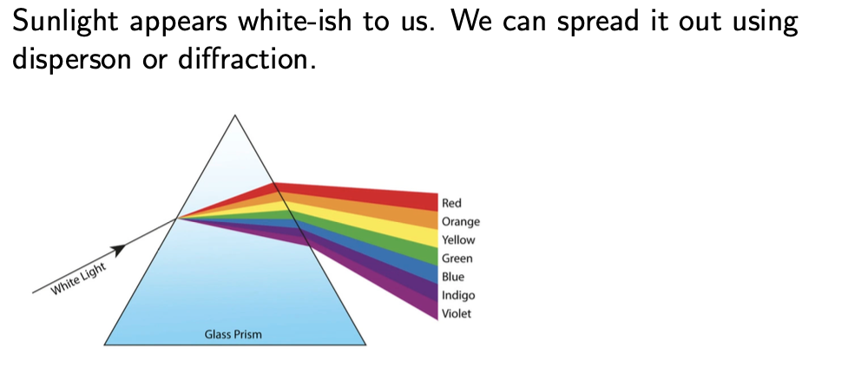
The continuous EM spectrum

Slide 6
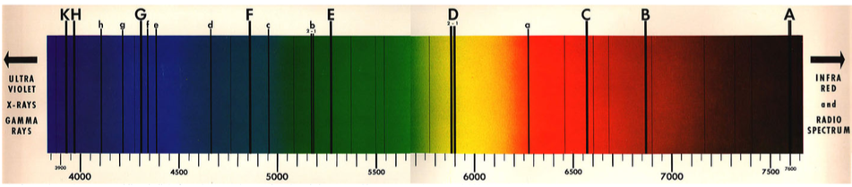
Early Spectroscopy
What are the dark bands?

Slide 7
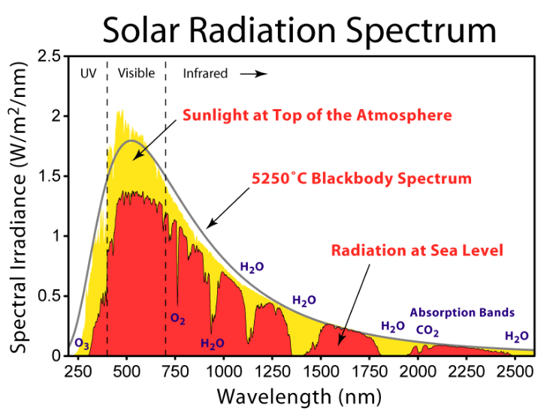
The Solar Spectrum

Slide 8
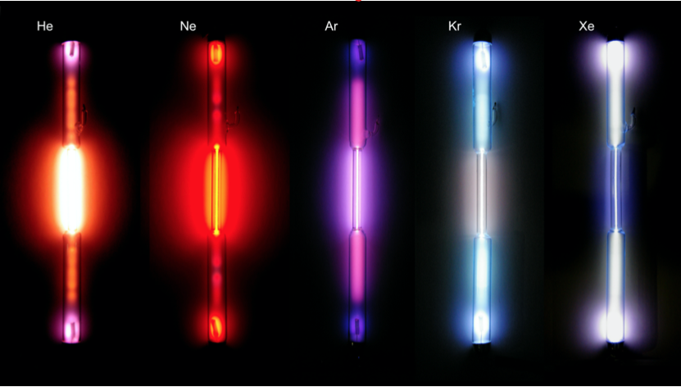
Different gases = different colours

Slide 9
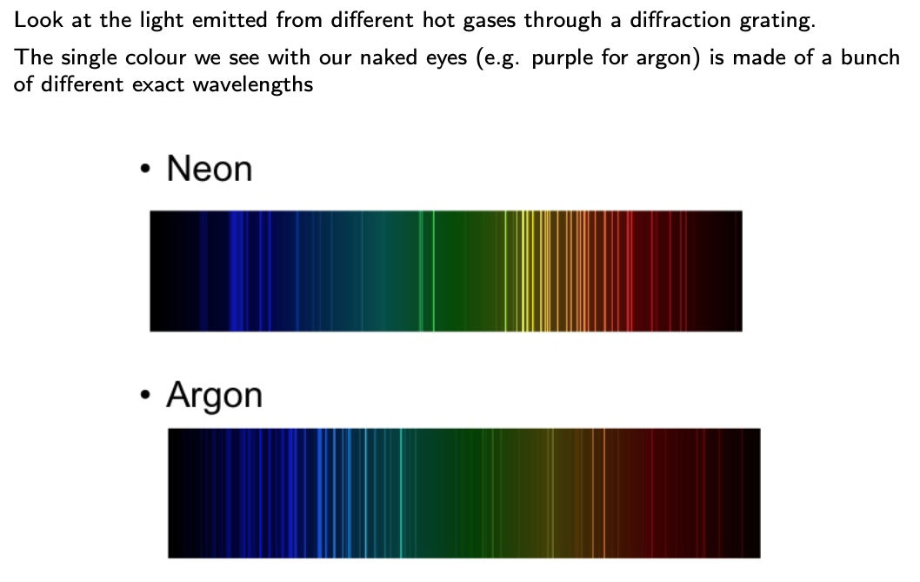
Emission spectra

Slide 10
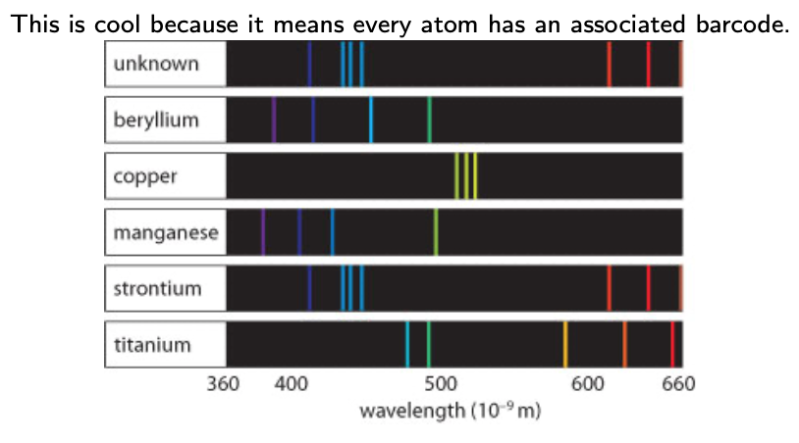
Emission spectra

Slide 11
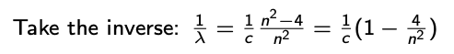


Hydrogen : the Balmer series (1885)
656 nm
486 nm
434 nm
410 nm

Slide 12
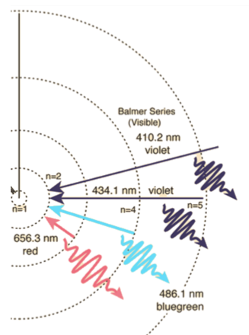
Rydberg formula (1890)

Slide 13
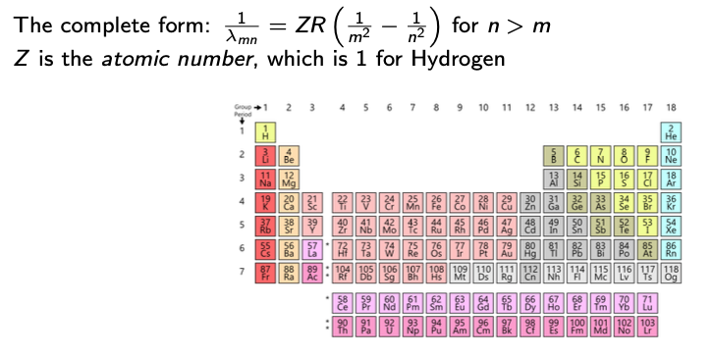

What is special about Hydrogen?

Slide 14
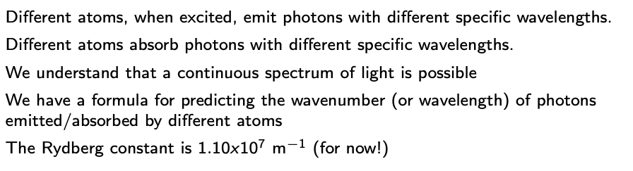
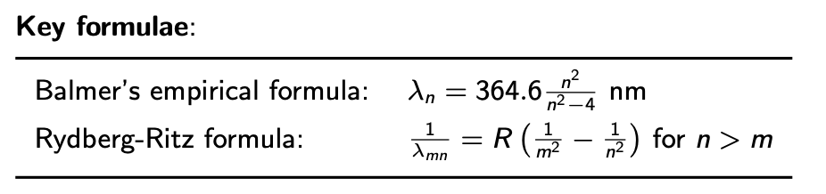
Summary

