Slide 1
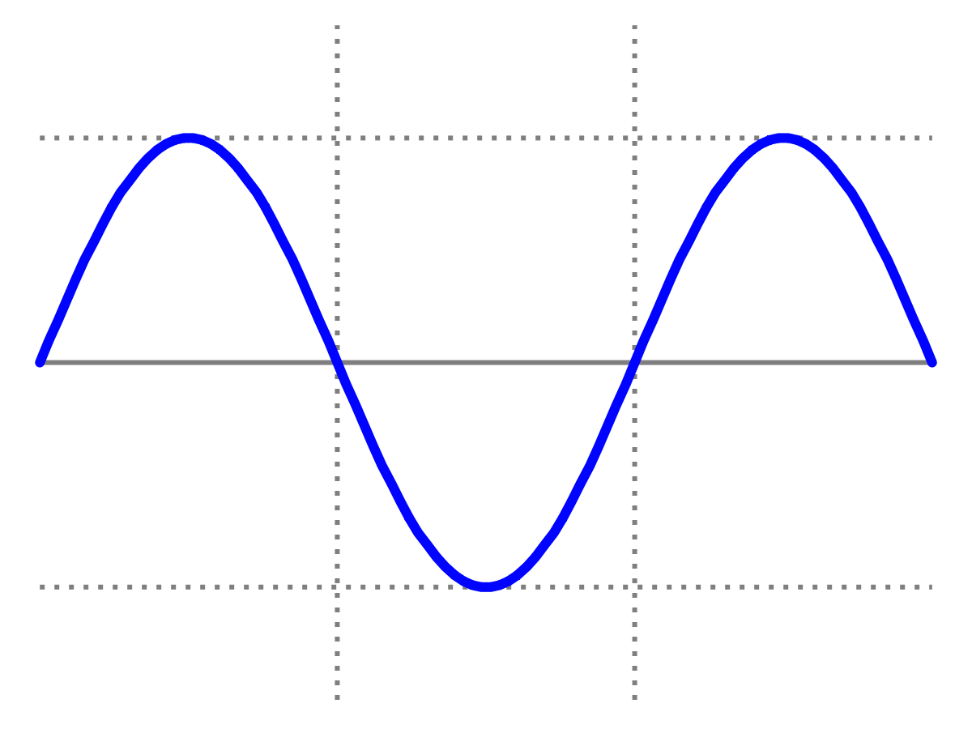
Introduction to Quantum Physics
(F3241)
Dr Lily Asquith
Week 8

Slide 2
This week & Next week
Today The Bohr model
Tomorrow 3pm Matthias Keller: atoms and molecules
Next Monday we will have my lecture on De Broglie
Next Tuesday Problem class
Your first assignment is on canvas. It is very gentle and shouldn’t take much time or effort. Due by 19 November.
https://canvas.sussex.ac.uk/courses/11124/assignments/50963
The next one, due 10 Dec, will be harder (to assist revision).
Attendance: can you sign in with “the app”?

Slide 3
Recap Coulomb potential

Slide 4
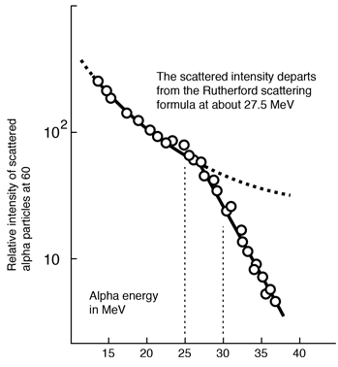
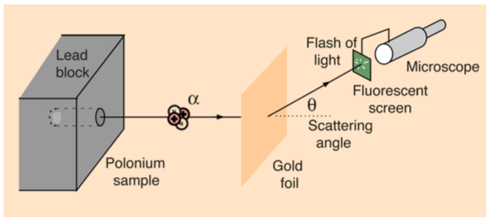

Recap Rutherford Scattering

Slide 5
A conundrum
An electron “in orbit” within an atom is changing direction, therefore has a
centripetal acceleration due to the Coulomb force.
Charged particles in an EM field radiate photons (proof to come in
another module).
We don’t observe this radiation.
If it were radiating, the electron would fall into the nucleus.

Slide 6
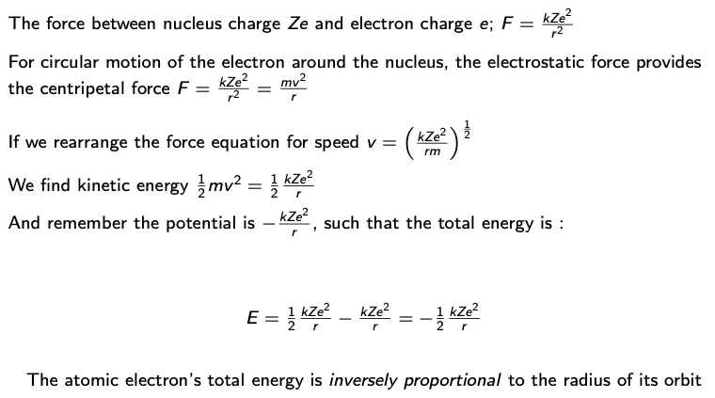
Classical Model

Slide 7
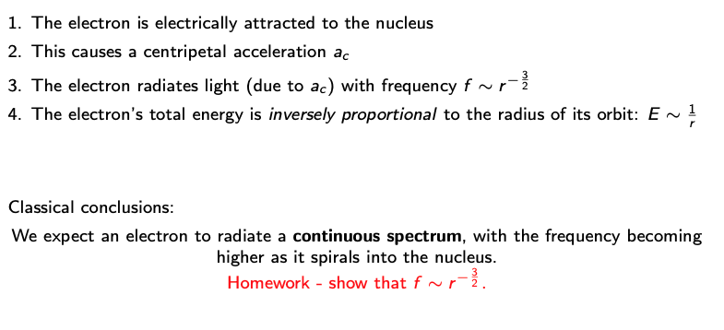
The fate of a classical atom

Slide 8
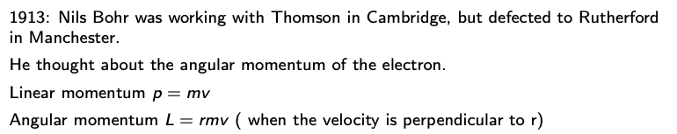
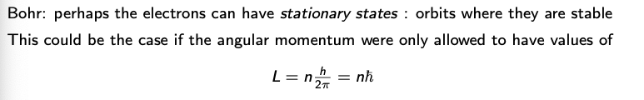
The Bohr model

Slide 9
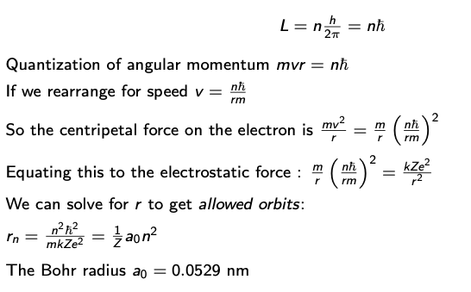
Bohr’s postulate on angular momentum

Slide 10
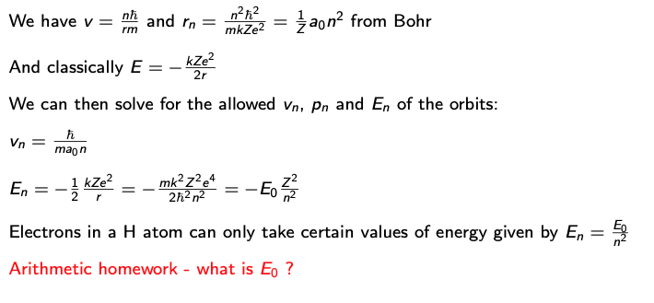
Stationary orbits

Slide 11
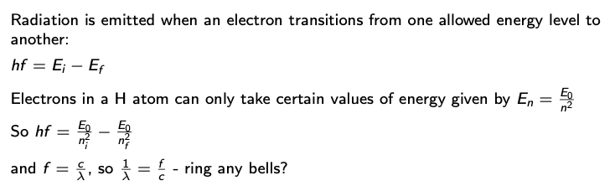
Bohr’s postulate on frequency

Slide 12
Experimental verification of Bohr’s postulates
We can produce electrons with a controlled kinetic energy using a potential
difference.
We can then scatter these free electrons from atomic electrons (gas).
If the free electrons have enough kinetic energy, they can impart this to the atomic electron allowing it to jump to another allowed energy level. It will then return to ground state and emit a photon equivalent to that energy. The free electron is now less energetic.
If the free electrons do not have enough energy, they can elastically scatter from the atomic electron and retain all of their KE.

Slide 13
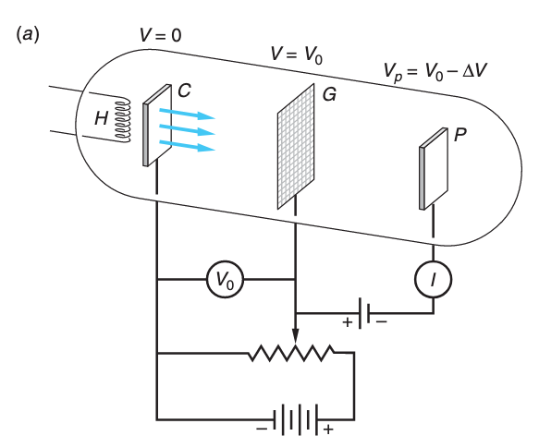
The Franck Hertz experiment 1914

Slide 14
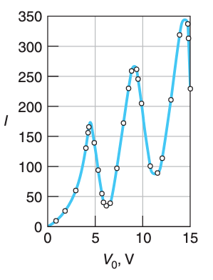

The Franck Hertz experiment 1914

Slide 15

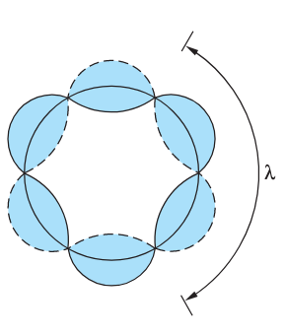
De Broglie

