Slide 1
^{Quantum Physics Colouring Book}

Slide 2
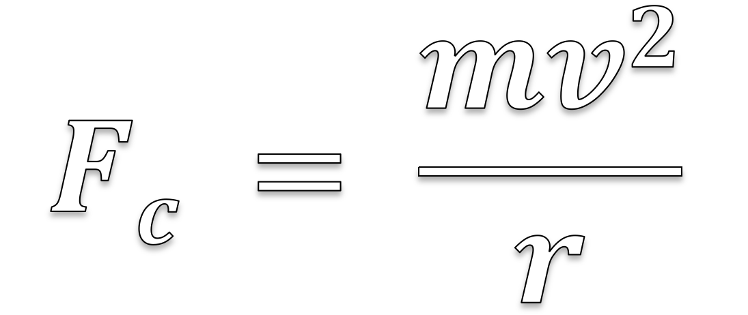
$$Fc = \frac{mv2}{r}$$

Slide 3

$$Fq= qE+q vB$$

Slide 4

$$E =\frac{V}{d}$$

Slide 5

$$λbb∝\frac{1}{T}$$

Slide 6

$Pbb∝T4$

Slide 7

$$En=nhf$$

Slide 8

$$hf=KEmax+Φ$$

Slide 9

$$2d sin⁡θ = nλ$$

Slide 10
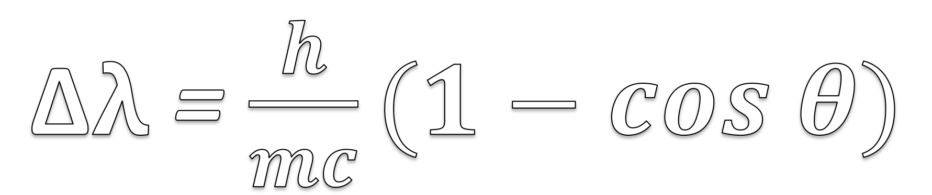
Δ$λ$ = $\frac{h}{mc}(1−cos θ)$

Slide 11
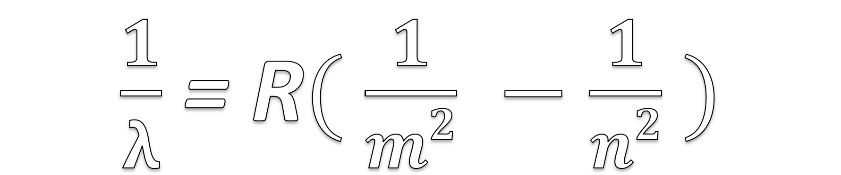
$\frac{1}{λ}$ = R$($ $\frac{1}{m2} −\frac{1}{n2}$ $)$

Slide 12
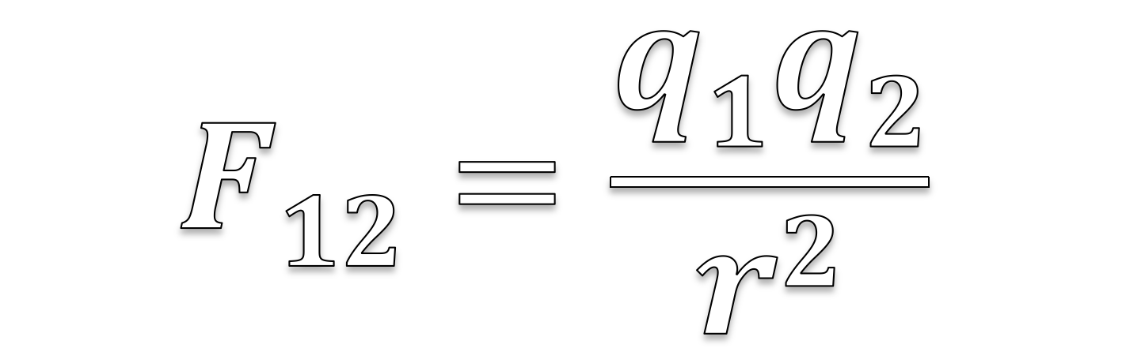
$$F12=\frac{q1q2}{r2}$$

Slide 13
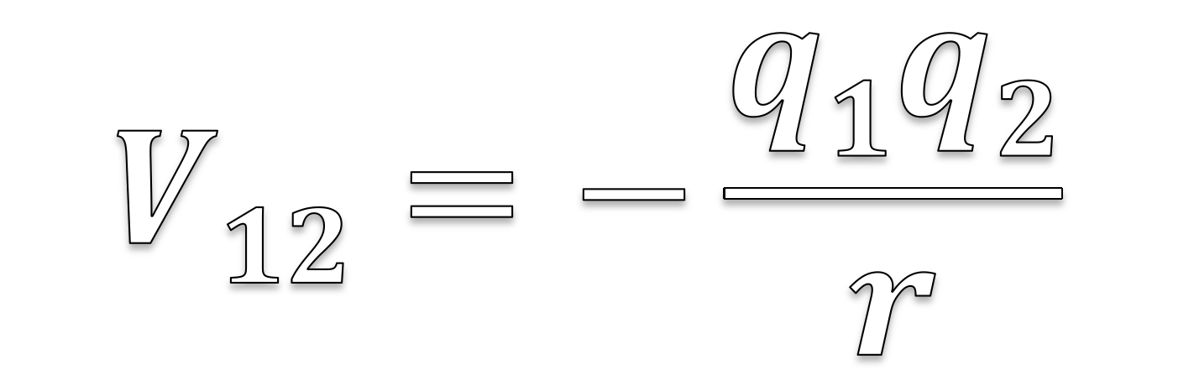
$$V12=−\frac{q1q2}{r}$$

Slide 14
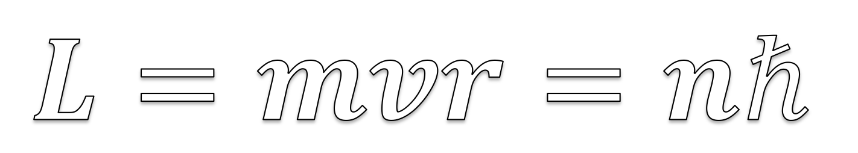
$$L=mvr=nℏ$$

Slide 15

$$λ=\frac{h}{p}$$

Slide 16

$P\left(x\right)=|ψ|$²

Slide 17
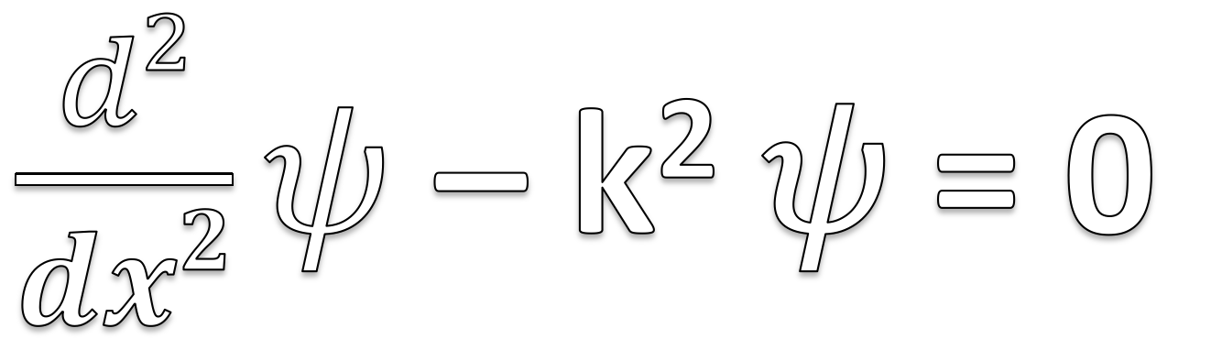
$\frac{d2}{dx2}ψ$ – k² 𝜓 = 0

