Slide 1
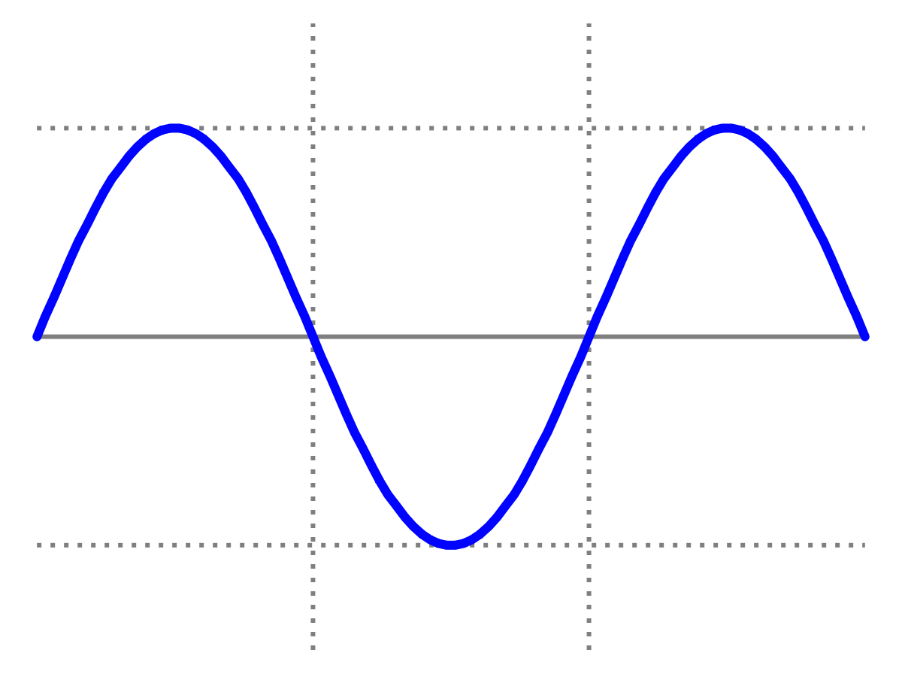
Week 7
Exam-style
problems
Introduction to Quantum Physics
(F3241)
Dr Lily Asquith

Slide 2
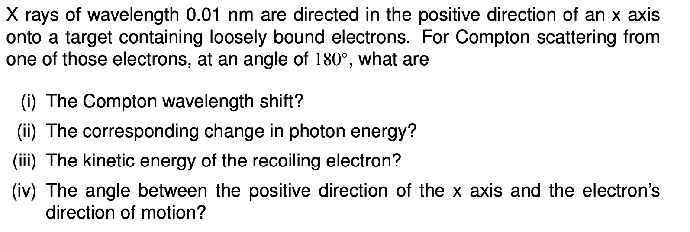

Slide 3
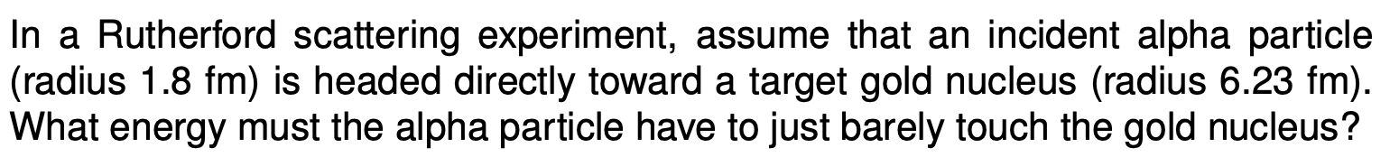

Slide 4
