Slide 1
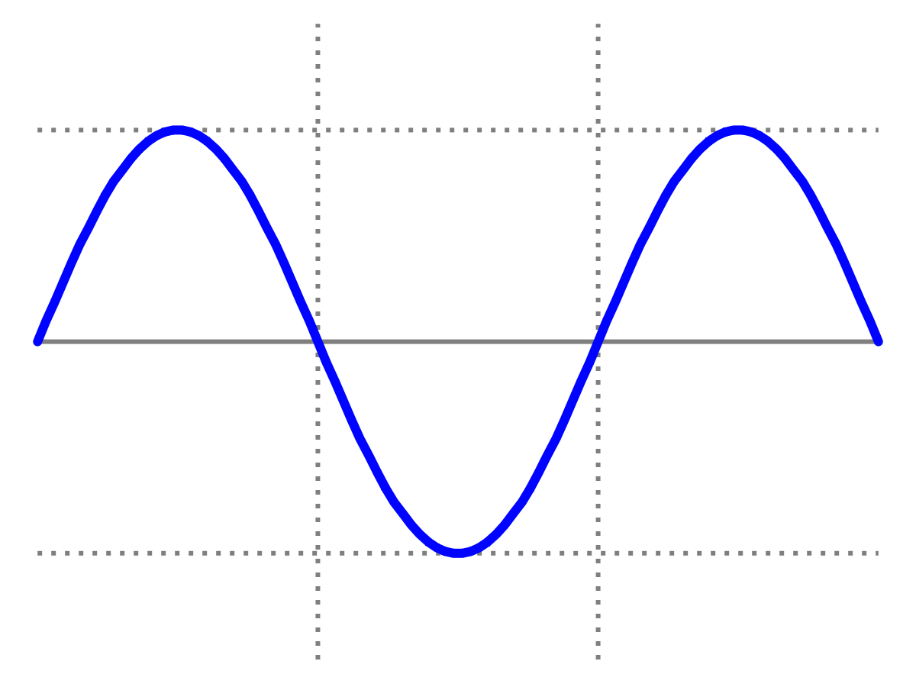
Introduction to Quantum Physics
(F3241)
Dr Lily Asquith
Week 1

Slide 2
I2Q : About this module
Live classes:
Monday at 3pm : Zoom lecture with Lily – change this to 4pm from next week?
Tuesday at 3pm : Zoom seminar with Lily & special guests
Canvas:
Pre-recorded mini-lectures and quizzes will be available from today.
Grading:
One unseen examination (80%) and two assignments (10% each)
Reading:
Modern Physics, Tipler & Llewellyn [link to pdf]

Slide 3
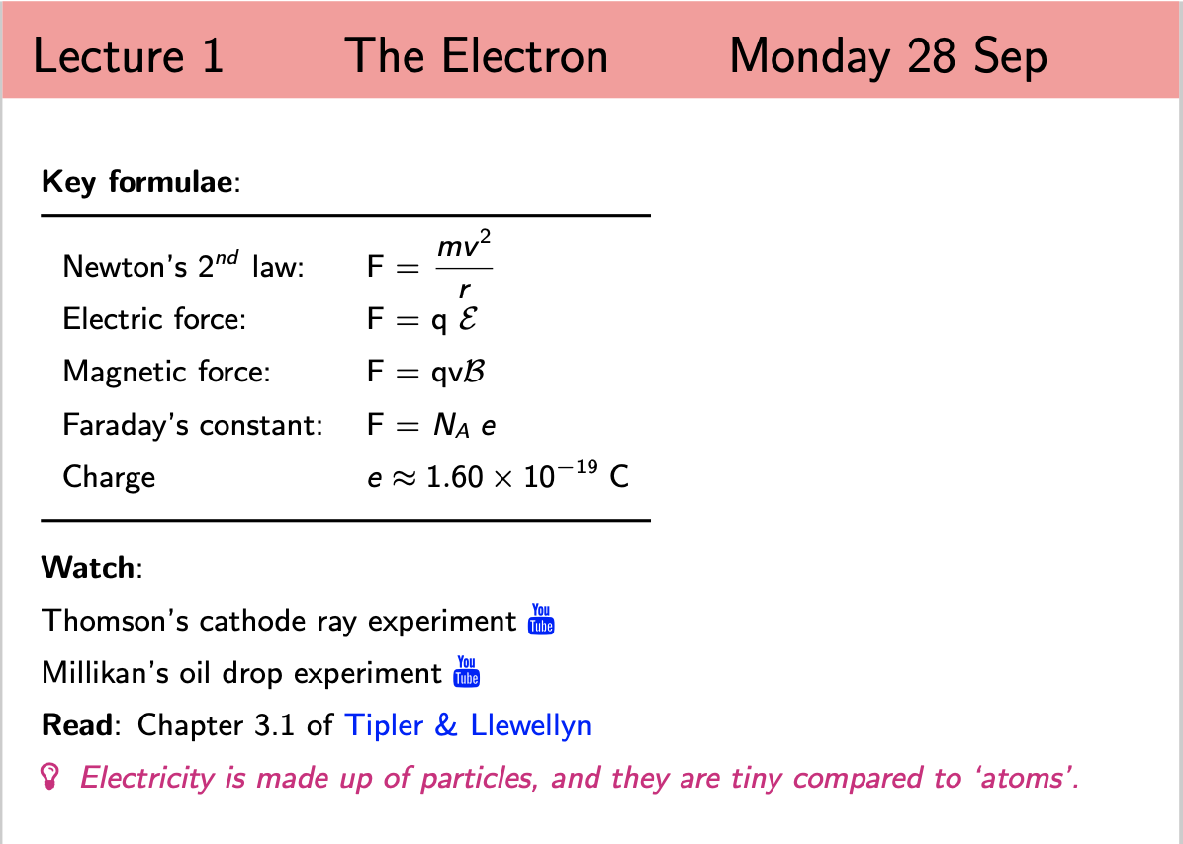
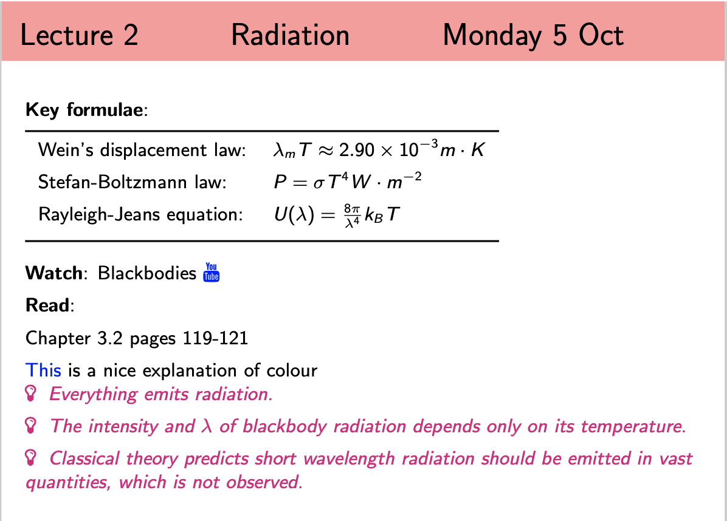
Syllabus
Canvas page has full syllabus:

Slide 4
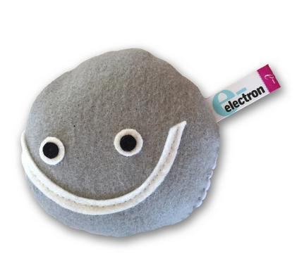
This week
For this week (week 1) only, we are going to use both the
Monday and Tuesday synchronous slots for talking about
the electron.

Slide 5
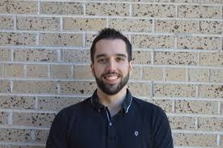
This week & Next week
During this week I will upload a few pre-recorded mini-lecture videos on radiation. I will email you all when they are up.
Next Monday we will have our radiation lecture.
Next Tuesday we have a zoom seminar
with Dr Steven Calvez, a neutrino physicist,
who works at Fermilab National Laboratory
on the NOvA experiment.

Slide 6
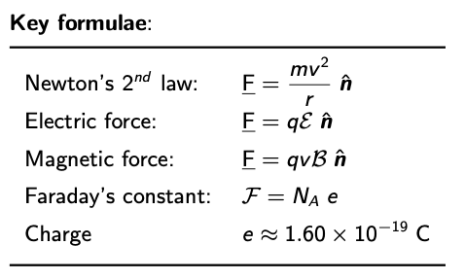
Lecture 1 The Electron

Slide 7
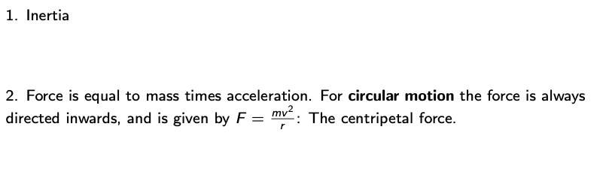
1.1 Newton’s Laws

Slide 8
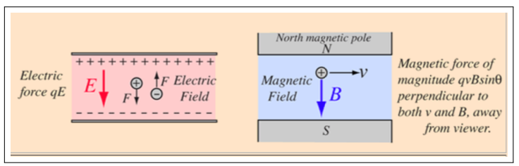
1.2 Lorentz Force

Slide 9
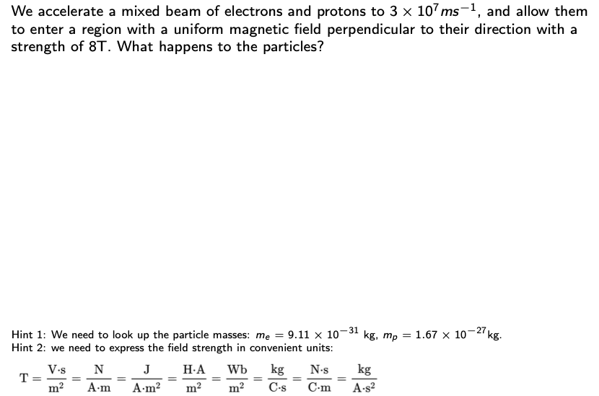
An example of equating forces

Slide 10
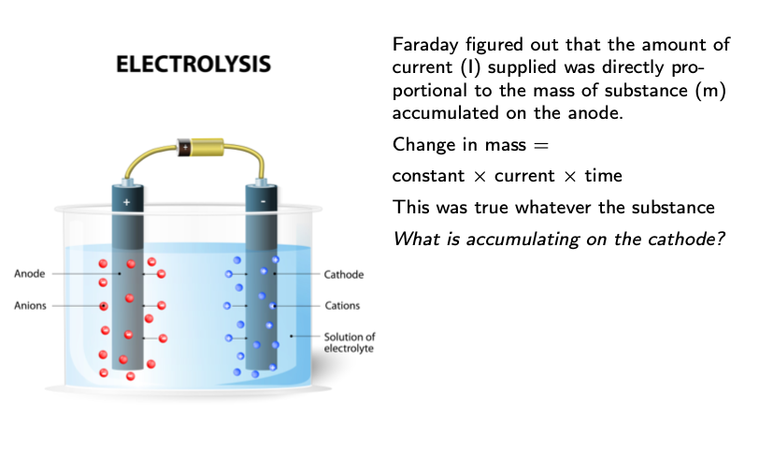
1.3 Faraday & Electrolysis (1834)

Slide 11
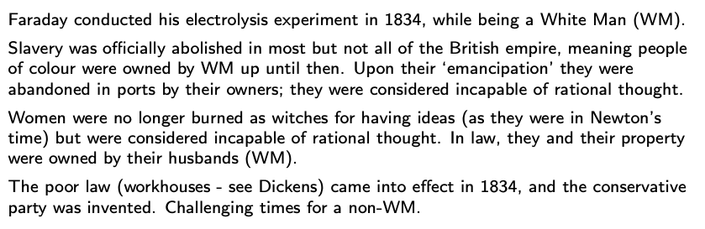
An aside on relating to Faraday and others

Slide 12
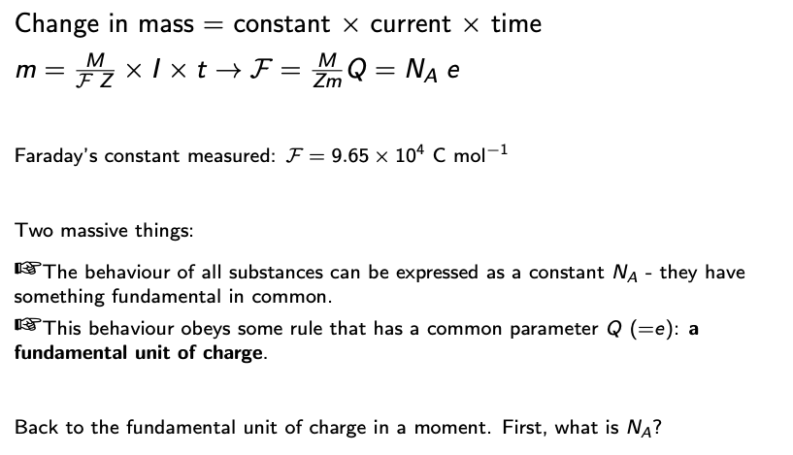
1.3 Faraday & Electrolysis - continued

Slide 13
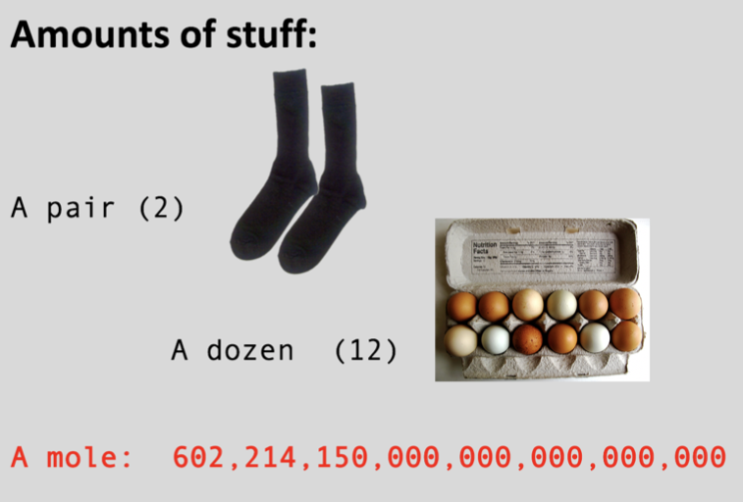
1.4 Avagadro’s Number (1811)

Slide 14
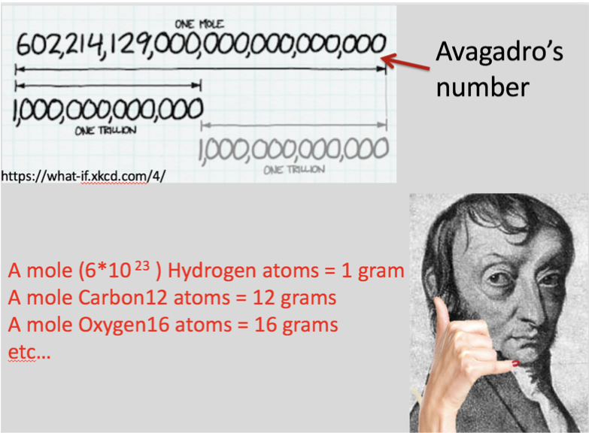
1.4 Avagadro’s Number (1811)

Slide 15
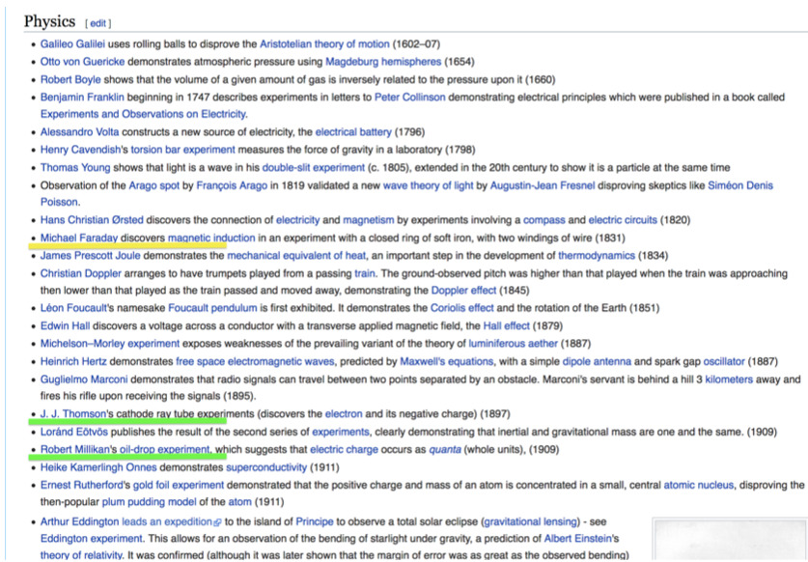
Experiments

Slide 16
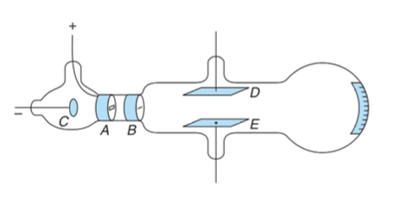
1.5 Cathode Rays

Slide 17
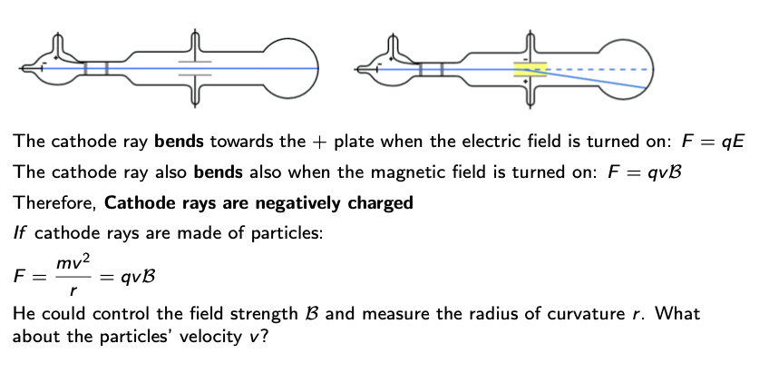
1.5 Thomson’s experiment: bendy rays

Slide 18
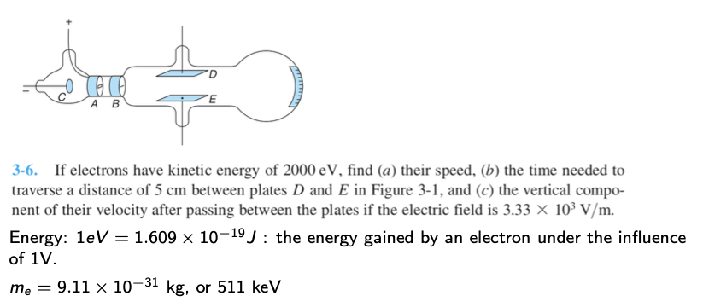
Example problem from Tipler

Slide 19
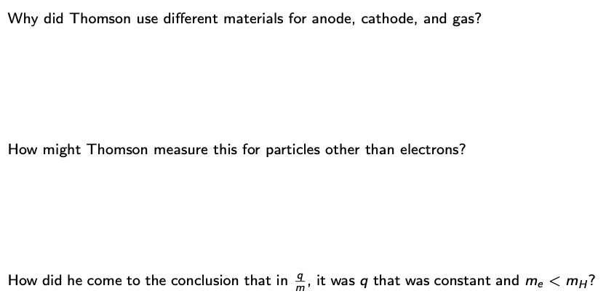
Think

Slide 20
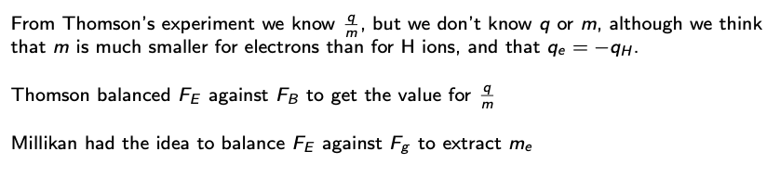
1.6 Millikan’s experiment: a balancing act

Slide 21
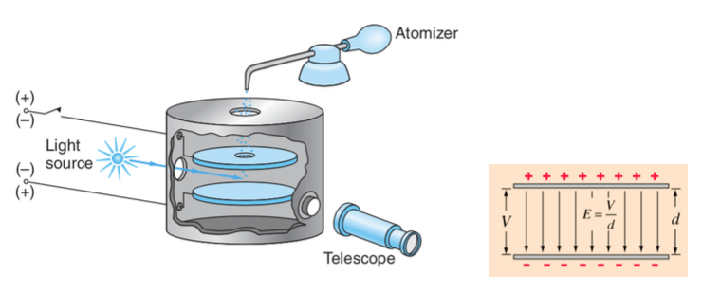
1.6 Millikan’s experiment: a balancing act

Slide 22
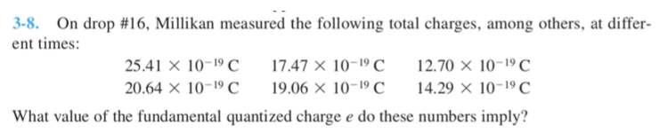
Example problem

Slide 23

Think

Slide 24
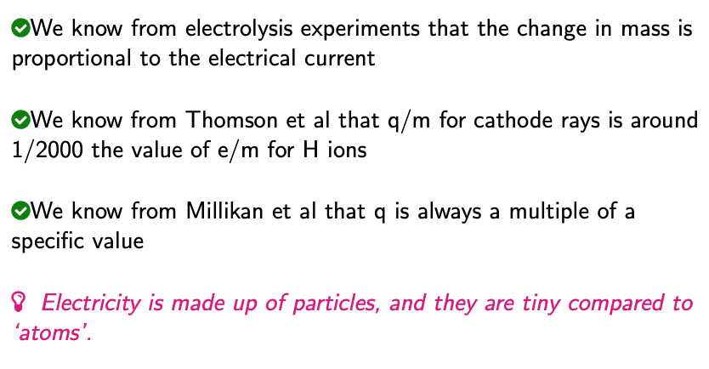
Where we are

